Slide 1
Financial Reporting Overview
CSU East Bay
June 2014

Slide 2
CSU Data Warehouse
All campuses have access to the CSU Data Warehouse
CSU is using the ORACLE OBIEE reporting tool
Summarized reports by all ChartFields with drill down
Open PO’s with drill down
Transactions by “posted date”
Department Hierarchy
Report by Division, by College, by Department
Can select by one and report at lower level
Data is one day old

Slide 3
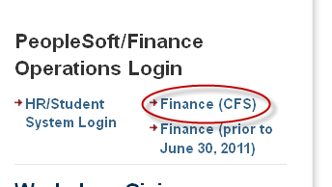
How do you Login to the CSU Data Warehouse?

Slide 4
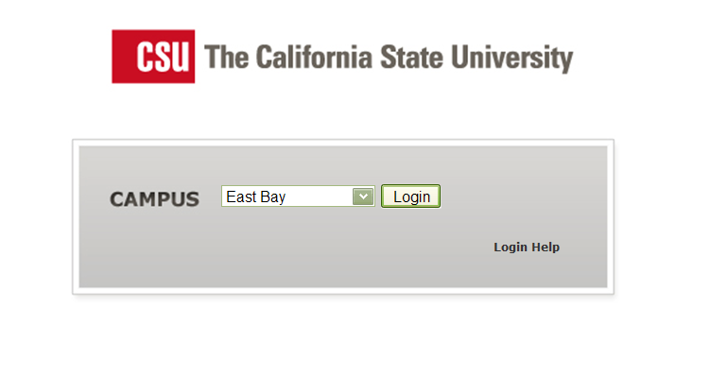
Select East Bay from the CSU Portal

Slide 5
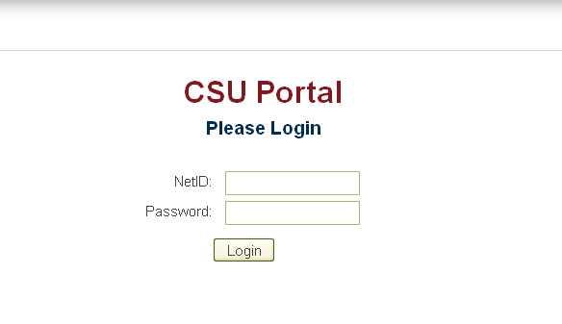
Enter your CSU East Bay Net ID and Password

Slide 6
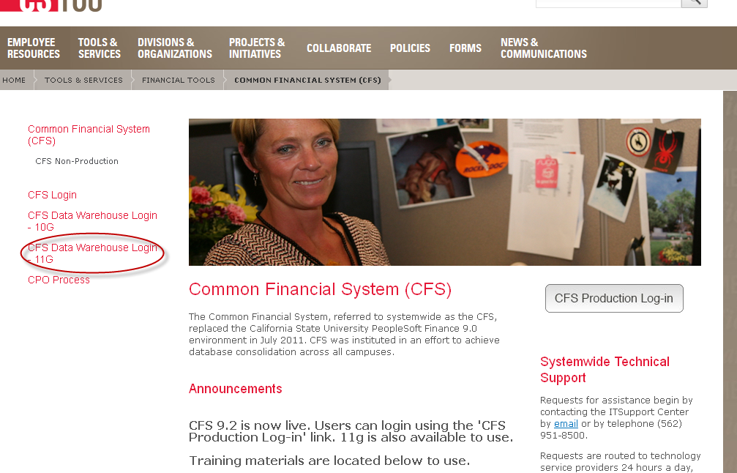
Select “CFS Data Warehouse Login – 11G”

Slide 7
Login Demo

Slide 8
Some OBIEE Basics:
Dashboards
Pages
Report Filters = Selection Criteria
Prompt
Multi-select
Column Selectors
Page Options
Download & Print

Slide 9
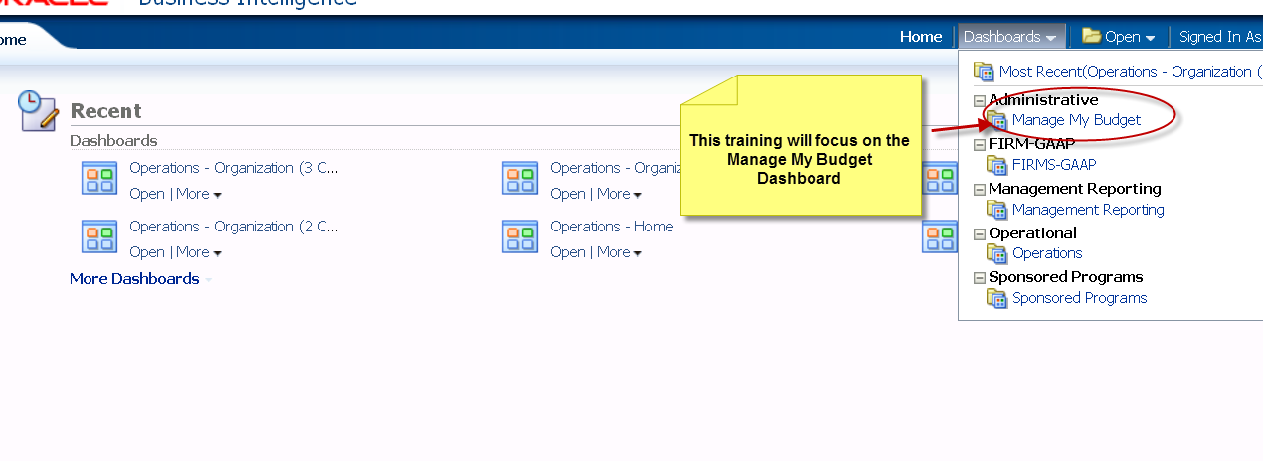
Select the Dashboard You’d Like to Use
Notes:
For this presentation, we’ll focus on the Manage my Budget Dashboard

Slide 10
Manage My Budget “Dashboard” has 10 Tabs (Reports) You Can Choose From

Slide 11
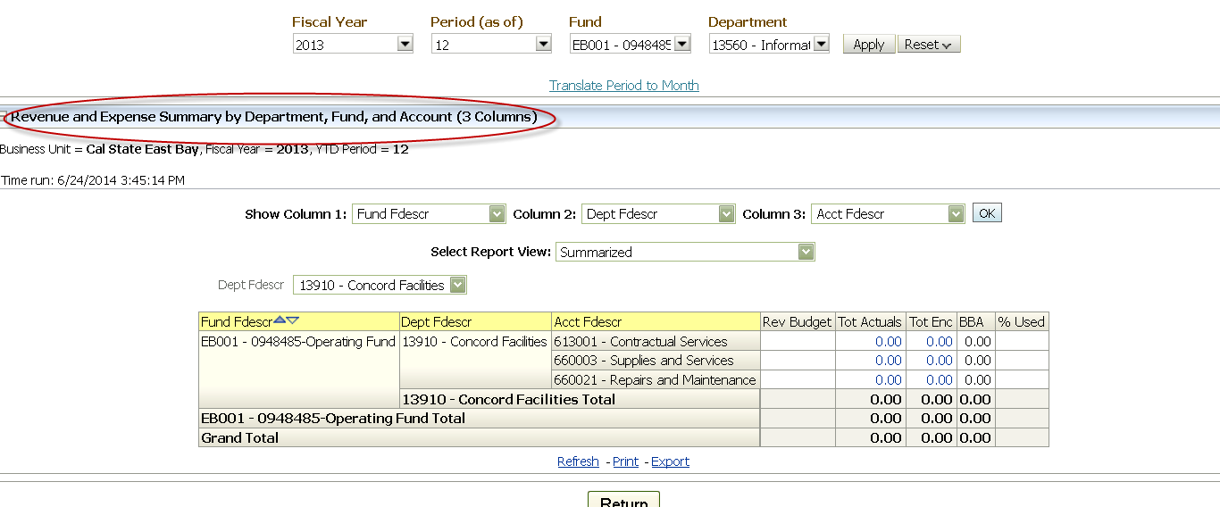
Department Report
Notes:
Take a look at the Department Report for this example.. 3 column

Slide 12
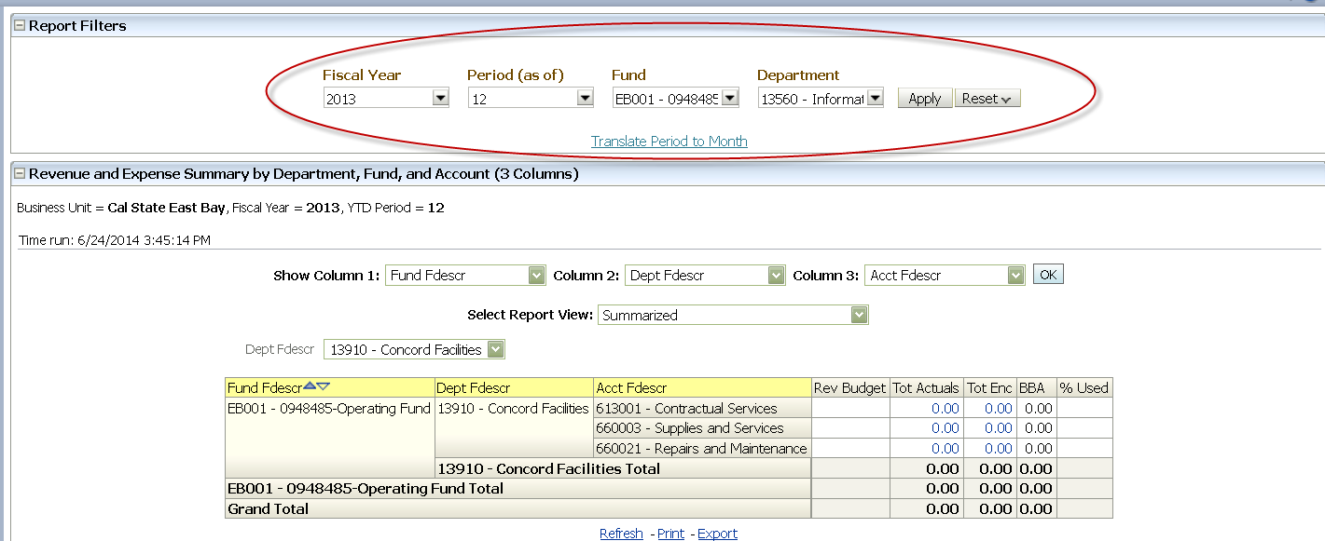
Department Report – Filters

Slide 13
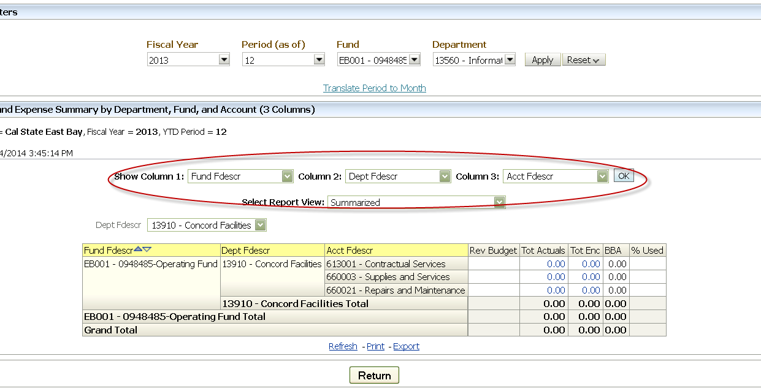
Department Report – 3 Column - Column Selectors

Slide 14
Department Report – Saving Reports
Notes:
Mention saving as defaults, and also how to access saved reports

Slide 15
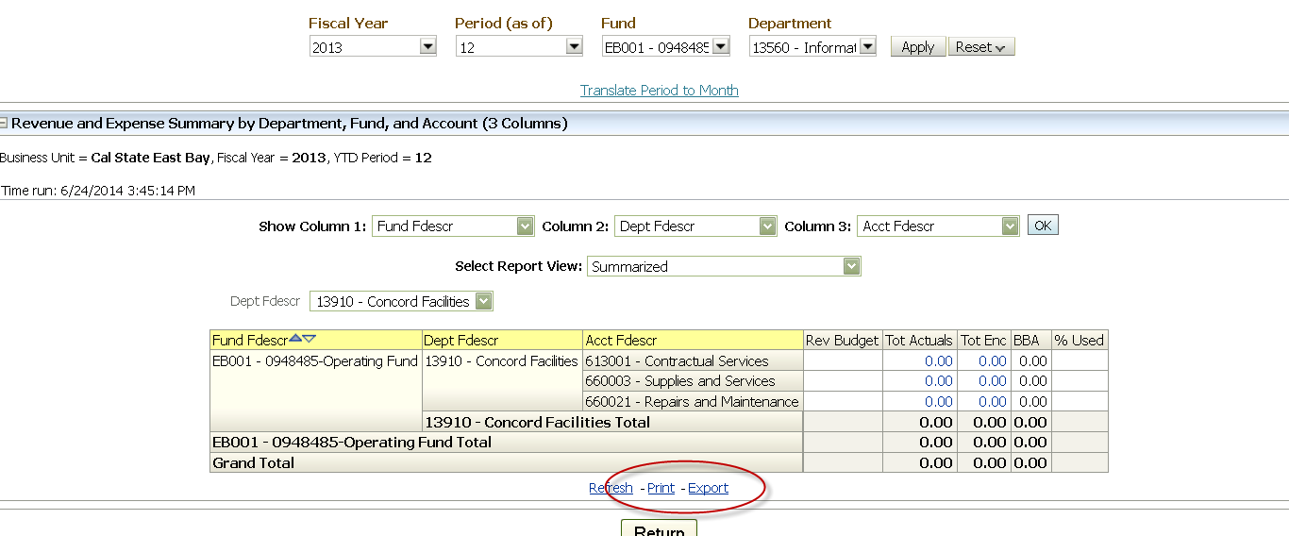
Department Report – Download
Notes:
Explain exporting to Excel as well as printing to PDF, etc

Slide 16
Demo Basic Locations

Slide 17
Set Your Home Page
To
EBCMP
(EBFDN or EBEDF)
and choose “Standard Budget”

Slide 18
Report Filters

Slide 19
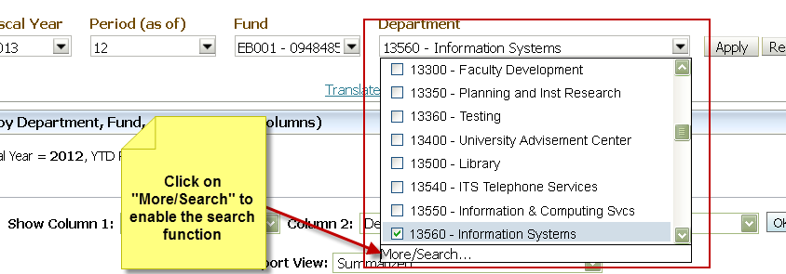
Multi Select Report Criteria

Slide 20
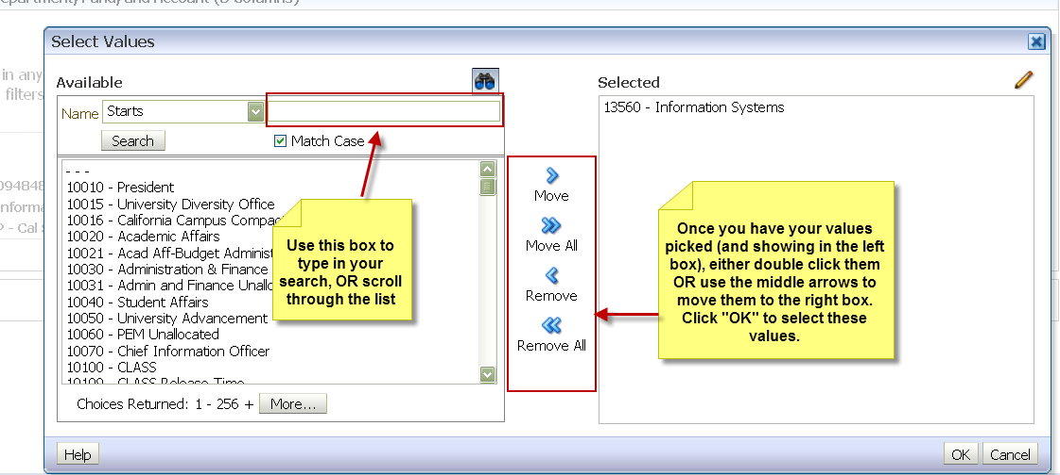
Multi Select Report Criteria
Notes:
Mention that the “X” needs to be removed when searching for values.

Slide 21
Demo Multi-Select vs. Prompt select

Slide 22
Column Selectors
Dashboards are interactive
Users can choose the information they want to see by using the column selectors
The number of column selectors in any given report is identified in its name

Slide 23
The “Department” Page on the “Manage My Budget” Dashboard Column Selectors
Account
Account Category
Fund
Class
Program
Project
DeptID
Account Type
CSU Fund
FIRMS Object Code

Slide 24
Sample: 2 Column Report
Dept by Fund
Fund by Account
Account by Program
Dept by Account
Project by Program
Fund by Dept
Dept by Project
The user can also choose a 3 or 4 column report
Report possibilities are endless

Slide 25
Set Your Home Page
To
EBCMP
(EBFDN or EBEDF)
and choose “Standard Budget

Slide 26
Demo Column Selectors

Slide 27
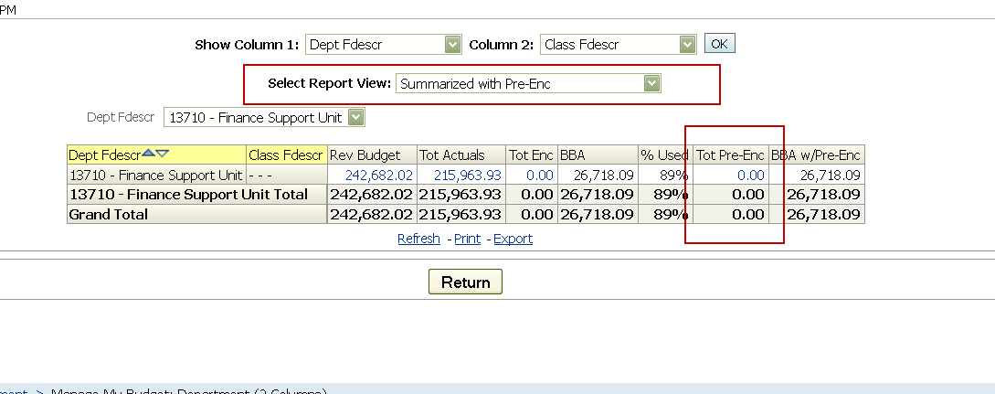
Pre-Encumbrance Reports
To view pre-encumbrances in your reports, select “Summarized with Pre-Enc”
For example - requisitions

Slide 28
Review/Any Questions?

Slide 29
Resources
CSU Training Materials
https://csyou.calstate.edu/Divisions-Orgs/bus-fin/it/BI-DW/CFSDW/Pages/BI-DW-User-Documentation.aspx
Refer to the 11G Guides

Slide 30
Overall Demonstration and hands-on

