Slide 1
Agenda
Welcome – Maureen Pasag, Associate Vice President, Financial Services
Topics
  Learning Aligned Employment Program (LAEP) and the Federal Work Study Process – Sonia Jethani, Director, Financial Aid
  Payroll Processes (Student Hiring & Cross Campus Faculty/Staff Payments) and California Employee Connect – Tony Tijero, Director, Payroll Services
  Fiscal Year-End Information/Reminders
  Procurement
  General Accounting
  Accounts Payable
  Student Dynamic Bill – Aaron Ledesma, Associate Director, Student Finance
Closing – Vareece Lincoln

Slide 2


Federal Work Study & Learning Aligned Employment Program
Office of Financial Aid and Scholarships
April 2023

Slide 3



Federal Work Study

Slide 4
Federal Work-Study (FWS)
Federal Work Study (FWS) is a form of financial aid largely provided by federal funding. A student must apply for financial aid each year to become eligible for the award, or to keep working in their current Work-Study job. Eligible FWS students earn money by working a limited number of hours per week at a pre-approved FWS site location. Employment may be found on or off-campus with employers that have arranged in advance to offer FWS positions to CSUEB students. Students must be enrolled at least half-time (6 units or more), actively attending in said classes and maintain Satisfactory Academic Progress (SAP) to retain eligibility for their FWS job.

Slide 5


FWS Involves Many Departments and is Closely Monitored and Strictly Regulated by the Department of Education

Slide 6
FWS FAQs
Will FWS pay the entire salary? No. Departments are responsible for 25% of the student’s total salary.
How do I know if an applicant is eligible for FWS?
Please confirm so with the student - they have access to view whether they were awarded FWS by logging in to https://www.csueastbay.edu/mycsueb/
Can I ask the Financial Aid office for a list of FWS eligible students?
Due to Federal Student Aid (FSA) guidelines, we are not allowed to share this information. We recommend you reach out to the student directly to confirm if they have been awarded the fund.
How much can a student earn in FWS during an academic year?
The maximum FWS award is for $3,000, however the amount awarded varies by student. Please work closely with the student to ensure they do not exceed the allotted amount, as this may result in a reduction of their financial aid.

Slide 7
FWS FAQs
How many hours can a student work?
The maximum allowed is 20 hours per week, 8 hours per day (this includes all on-campus jobs)
Can FWS be used to pay the student sick leave or holidays?
A school is not permitted to use either the federal funds to provide fringe benefits such as sick leave, vacation pay, or holiday pay, or employer’s contributions to Social Security, workers’ compensation, retirement, or any other welfare or insurance program.

Slide 8
FWS FAQs
Does FWS affect a student’s eligibility for other awarded scholarships?
FWS does not affect the student's eligibility to receive their other awarded scholarships unless the student is awarded up to their Cost of Attendance (COA) or ‘need,’ as determined by their FAFSA. In that instance, Financial Aid would adjust other aid awarded to make room for the scholarship.
Who can I contact if I have specific questions about the FWS program?
Lucretia Whitener is the FWS Coordinator and can be reached at lucretia.whitener@csueastbay.edu (for staff) or finaid@cuseastbay.edu (for students)

Slide 9
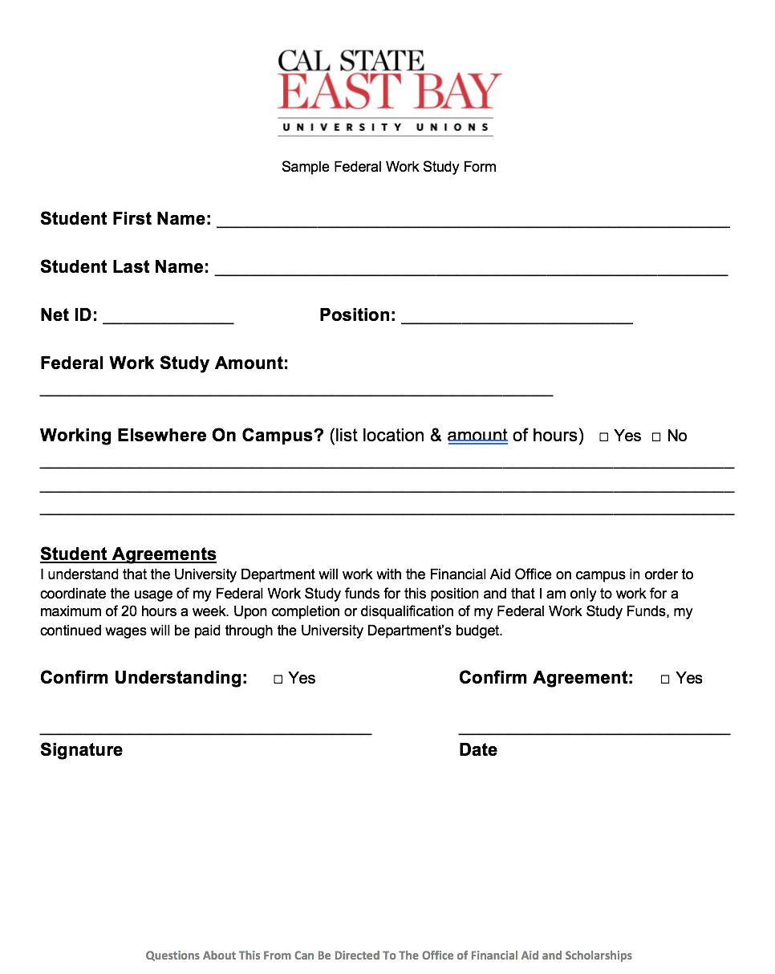
Sample
FWS Form

Slide 10
Example of Award
Amount | Source
$5,775 | Pell Grant
$5,472 | Cal Grant (CG) B
$1,656 | Cal Grant B Access
$2,400 | Federal Work Study (FWS)
$5,500 | Subsidized Loan
$2,197 | Unsubsidized Loan
$23,000 TOTAL AID
Johnny lives on campus with a $23,000 budget. Below are his amounts and sources of aid.
If Johnny were to receive an outside scholarship of $1,000, his Federal Work Study would be reduced to $1,400. Johnny would be required by law to repay the $1,000 back to the university in order for his outside scholarship to be accommodated. His other option is to request to reduce his loans early in the year (i.e. fall or winter) to avoid having to repay any funds.

Slide 11
Employer Tips
Review the employer guidance on our Federal Work Study Website
Reach out to you Division Budget Director to determine the amount that your department has been allotted: Each year, divisions are provided with Federal Work Study Allocations based on average 5 year expenditure on Student Assistants. It is the responsibility of each employer to monitor their FWS spending. Any overages will be charged to your department budget.

Slide 12
Learning Aligned Employment Program

Slide 13
The Learning Aligned Employment Program (LAEP) is funded by the California Student Aid Commission to support students with financial needs. LAEP provides funds to participating public postsecondary educational institutions to offer eligible students opportunities to earn money to help pay their educational costs while gaining career-related experience in their fields of study. LAEP allows a participating student to conduct research that relates to the student’s area of study, career objective, or the exploration of career objectives.

Slide 14
Yearly funding allowance based on the number of Pell-Eligible Students:
For the 2022-2023 Academic Year, approx. $700,000 -Unused funds will carry over year after year
-Public Educational Institution, Nonprofit Corporation: 90%
-UC/CSU: 100%
-For Profit: 50% LAEP

Slide 15
Underrepresented student *
Eligible to work in the United States
California resident
Meet financial aid Satisfactory Academic Progress requirements
Demonstrate financial need
Be in good academic standing with your school and major
Enrolled at least half-time at CSU East Bay as an undergraduate student
*“Underrepresented” students include first-generation college students, low-income students, students who are current or former foster youth, homeless students or those at risk of becoming homeless, students with disabilities, displaced workers, students with dependent children, formerly incarcerated students, undocumented students, students meeting the requirements of AB 540, and veterans.
Eligibility Criteria

Slide 16
- Award amount: up to $6,000 for the academic year, based on financial need and eligibility.
- Semester: Fall and Spring
Staff/Faculty/Supervisor Required: Staff/Faculty/Supervisor will sign and approve LAEP student contract.
- Hourly rate: At least minimum wage (hourly rate is set by the department & HR).
- Weekly Hours: set by each hiring department, a maximum of 20 hrs. a week.
- Not available during Summer
Note: Scheduled hours of work are set by the department, but will not exceed 20 hrs. per week.
Eligibility Criteria

Slide 17
Hired Compliance Specialist from Work-study Position providing experience in Enrollment Management
Secured Experience in Financial Aid & Scholarship Administration, Registrar and Admissions Administration, Student Financial Services Administration and campuswide student services administration.
Work-study → Temporary Hire (for experience to meet bargaining unit agreement)→ SSPIA Position → SSPIB Position
Hired 2 more LAEP Interns for Spring 2023 for possible position as Affinity Center Events Coordinator, or Enrollment Management Administration Position (depending on preference)
Pilot Program Started Spring 2023

Slide 18

Student Hire Process
Payments for Employees Working in Multiple Assignments
Cal Employee Connect
Notes:
4/20/2023
18

Slide 19
Student Hire Process
SEAF – Student Employment Action Form
Job Classifications: Student Assistant, Federal Work Study, Instructional Student Asst, Nonresident Alien Tax Status, Bridge Student Asst and Learning Aligned Employment Program (LAEP).
Position Numbers
Class Enrollment Schedule w/unit load
Student FICA Tax Exemption
Notes:
4/20/2023
19
Unit 1 - UAPD - California Federation of the Union of American Physicians and Dentists
Unit 2 - CSUEU - California State Employees’ Association (Registered Nurse, Pharmacist, Nutritionist)
Unit 3 - CFA - California Faculty Association
Unit 4 - APC - Academic Professionals of California (Student Services Professional, Evaluator, Credential Analyst)
Unit 5 - CSUEU - California State Employees’ Association (Food Service Worker, Groundsworker, Custodian)

Slide 20
Student Hire Process
Effective Dates and End Dates
Onboarding with Payroll
Monitoring work hours (20 per week)
Provide breaks and meal periods
Reviewing and clearing timesheet exceptions
Approving work hours and deadlines
Student Employment Guide
Notes:
4/20/2023
20

Slide 21
Payments for employees working in multiple campuses/assignments
Honorarium
Special Consultant
Hire on a temporary basis
Notes:
4/20/2023
21

Slide 22
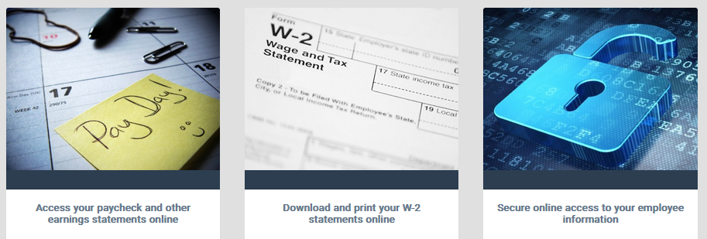
Cal Employee Connect
Cal Employee Connect is a secure web-based employee self-service portal available to California State Employees
Access earnings statements
W-2
Enroll in Direct Deposit and make account changes
Notes:
4/20/2023
22

Slide 23
Questions?

Slide 24


Y
U
FINANCE
INCLUDED
Financial Services Year-End Deadlines
April 20, 2023
Sai Vang and Rabi Joseph

Slide 25
Year Round Activities
Review Open Purchase Orders
  Performed at least monthly
  More frequently as year-end approaches
  Close Open Purchase Orders
Why?
  Accurately reflect budget balances
  Releases PO encumbrances (committed funds) for new purchases
Notes:
Sai

Slide 26
Year Round Activities
Open Purchase Orders Closure
Email PO numbers in numerical order to Chris Lam-Vasquez
A Purchase Order closure is FINAL--cannot be reverse
Pending Invoices
Identify pending invoices that need submission to Accounts Payable
Follow-up with vendors, if needed
Notes:
Sai

Slide 27

Year-End Deadline
Deadline: Monday June 5, 2023
Last date to submit requisitions for FY22/23.
Requisition processing time vary depending on its complexity and scope.
Requisitions received after deadline may be coded to next fiscal year.
Limited emergency exceptions may be granted on a case-by-case basis.
Notes:
Sai

Slide 28

TRIVIA TIME
Question: What is a benefit of closing a purchase order?
Notes:
Sai

Slide 29
Answer: Release funds for new purchasing needs
Notes:
Sai

Slide 30
Question: In what fiscal year may Purchasing recognize requisitions received after June 5, 2023?
Notes:
Sai

Slide 31

Answer: FY 23/24
Notes:
Sai

Slide 32

Effective/Successful Year-End Indicators
Slide title
One Touch Approach
Reviews and reconciliations occur throughout the year
Check balances/transactions at least monthly
More frequently as year-end approaches

Slide 33

Effective/Successful Year-End Indicators
Year Round Transaction/Balance Reviews include:
  Requisitions
  Encumbrances and POs
  Accounts Payable
  Fund and DeptID Balances
  Accounts Receivable Billing Requests
  Transfers (Budget, Expense, Payroll)
  Other allocations (i.e., Federal Work Study)

Slide 34

Year Round Reviews
Fund-DeptID-Program-Class-Project codes:
Make sure all chartfield values are correct at the transaction level.
Chartfield values include:
  Account
  Fund
  Dept ID
  Program (if applicable)
  Class (if applicable)
  Project (if applicable)

Slide 35
Year Round Reviews

Slide 36

Year End Reminders
Procurement Card (P –Card) transactions posted to USBank statement by May 18th
  Will be included in the current fiscal year
  Last ones to record for this fiscal year
  Consist mostly of May transactions

Slide 37
Year End Reminders
CERTIFY – Travel and Employee Reimbursement System
University-prepaid expenses (i.e., air travel, Enterprise Car Rental) should be processed timely:
        Check your Certify wallet for unprocessed expenses
        Be sure to clear your credit card icon (Prepaid) transactions by submitting your reimbursement claim
        within 30 days of completion of travel
        AP will process all submitted claims that are received by May 29th in CERTIFY in the current fiscal year as time permits

Slide 38

Year End Reminders continued
For guaranteed processing, submit final non-payroll expenditure transfers, budget transfers, and payroll adjustment requests by the cut-off dates.
Allow for normal processing times and inclusion within the current fiscal year
Items received after the due dates will be processed as time permits

Slide 39

Year End Reminders continued
Friday June 30, 2023:
  The Cashier’s Office will close at 1:00 P.M.
The month of July:
  The year-end close work continues “behind-the-scenes”
  Ensure department resources are available for inquiries
Please contact Accounting or Procurement for any questions.

Slide 40
Question: By what process will Accounting recognize unclaimed expenses for the current fiscal year?

Slide 41
Answer: Accrual

Slide 42
True or False
Procurement Card statement dated 6/23/2023 will be included in current fiscal year 22/23.

Slide 43
Answer: False

Slide 44

TRIVIA TIME
Question: When is the deadline to submit Budget, Payroll and Expense transfers?

Slide 45
Answer: The deadline to submit Budget, Payroll and Expense transfers is:
June 5th, 2023

Slide 46
TRIVIA TIME
Question: At what time on June 30, 2023 will the Cashier’s Office close?

Slide 47
Answer: 1:00pm

Slide 48

Questions

Slide 49
Year End Reminders continued
Please contact Procurement or Accounting offices for any questions.
Procurement Office:
Sai Vang, Procurement Director sai.vang@csueastnay.edu
Chris Lam Vazquez – Contract Administrator chris.lam-Vazquez@csueastbay.edu
Accounts Payable/Financial Accounting & Reporting:
Rabi Joseph – University Controller rabi.joseph@csueastbay.edu
Lana Lewis, Accounts Payable Manager lana.lewis@csueastbay.edu
Josephine Capiral, General Accounting Manager Josephine.capiral@csueastbay.edu

Slide 50
Thank You

Slide 51
Y
U
FINANCE
INCLUDED
Student Dynamic Bill

Slide 52
Below are a few features this new online service offers students.
After logging into the CSUEB Web Payment Portal, students are now able to:
See a summary view of their outstanding balance by term
See a detailed view of their outstanding balance by charge type (i.e., Tuition, Housing, Payment Plan, Misc, etc.)
See the due dates of their outstanding charges
See if they have any anticipated financial aid for a current or future term

Slide 53
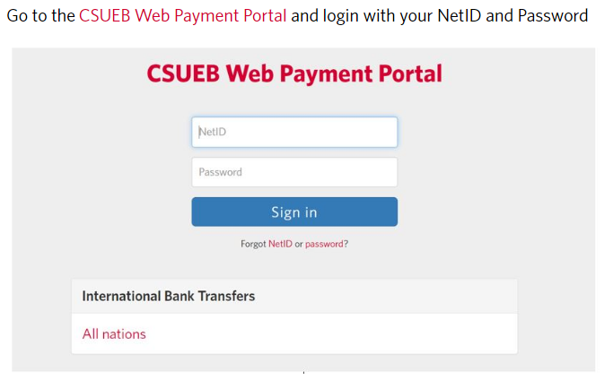

Slide 54
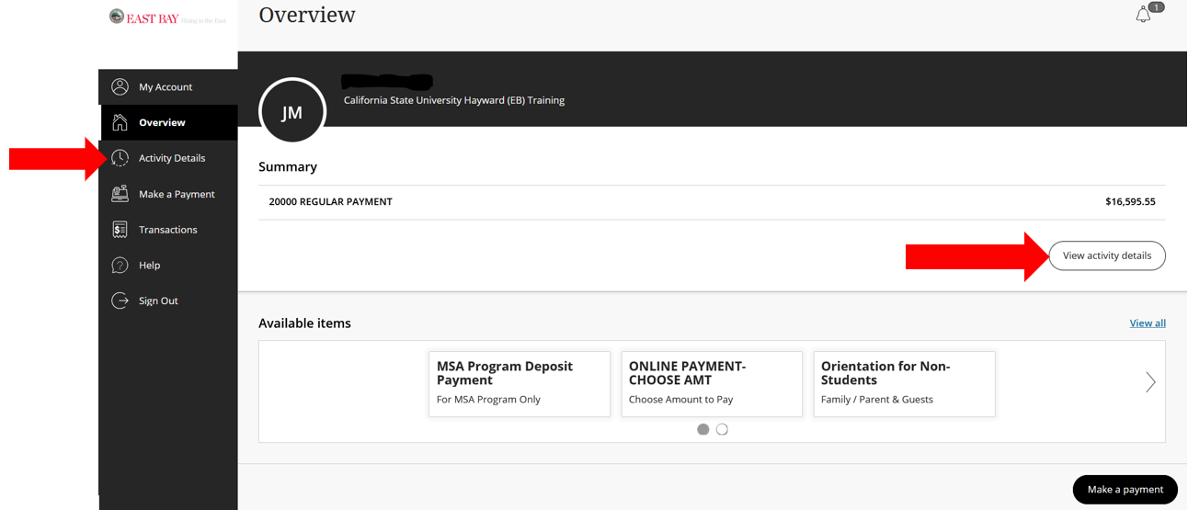

Slide 55
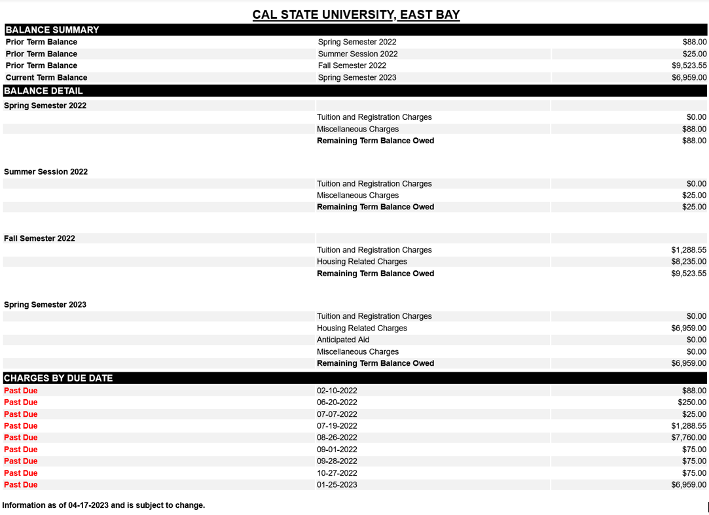

Slide 56
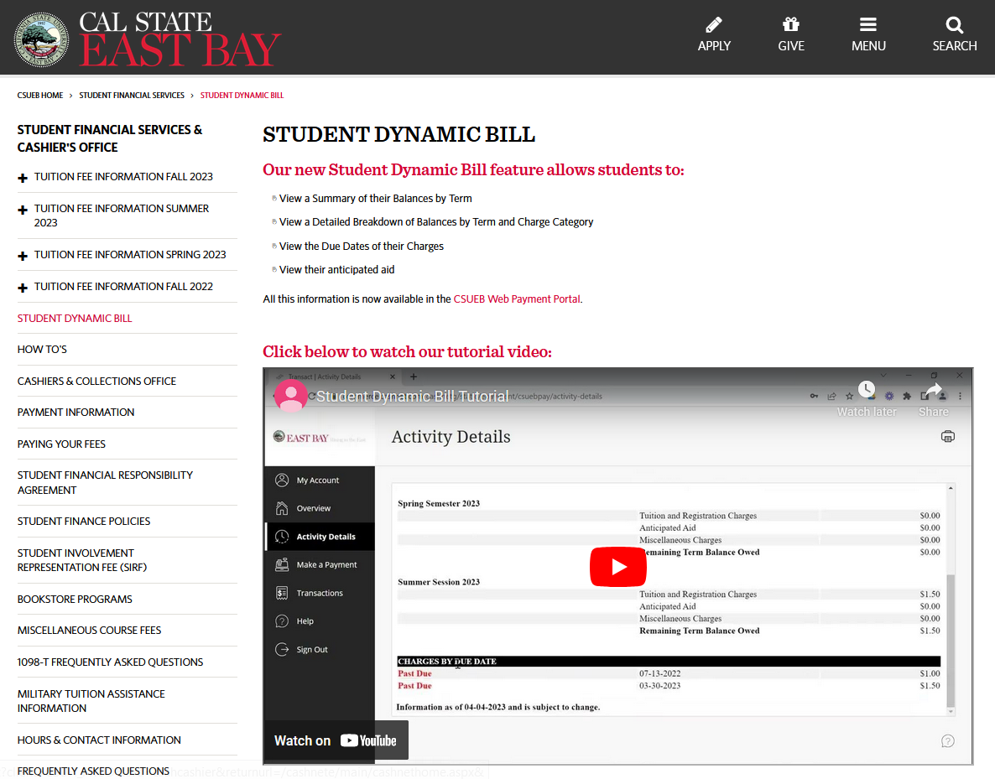

Slide 57
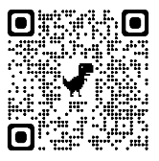
For More Information or Help…
STUDENT FINANCIAL SERVICES
studentfinance@csueastbay.edu
(510) 885-3767
SA 1200 – Cashier’s Office

