Slide 1




Slide 2










Slide 3

Welcome – Maureen Pasag, Associate VP, Financial Services
Topics
  Adobe Workflow - Adobe Sign Tips and Tricks - Veronica Salvador, Director, Administrative Processes & Tammy Heard, Accounts Payable Technician, Lead
  Information and Communication Technology (ICT) Review – Gene Lim, Deputy Chief Information Officer
  Transfers (Budget/Actuals)
Budget - Vareece Lincoln, Budget Analyst
Actuals - Jomelie Nelson, Accountant
  Interagency Financial Transaction (IFT) - Donna Arredondo, Accountant
  Cash Management – Aaron Ledesma, Associate Director, Student Financial Services
Announcements:
  Payroll Pick-up
  Invoicing
  Procurement event - Vendor Show
Closing - Maureen

Slide 4




Slide 5










Slide 6








Slide 7










Slide 8












Slide 9

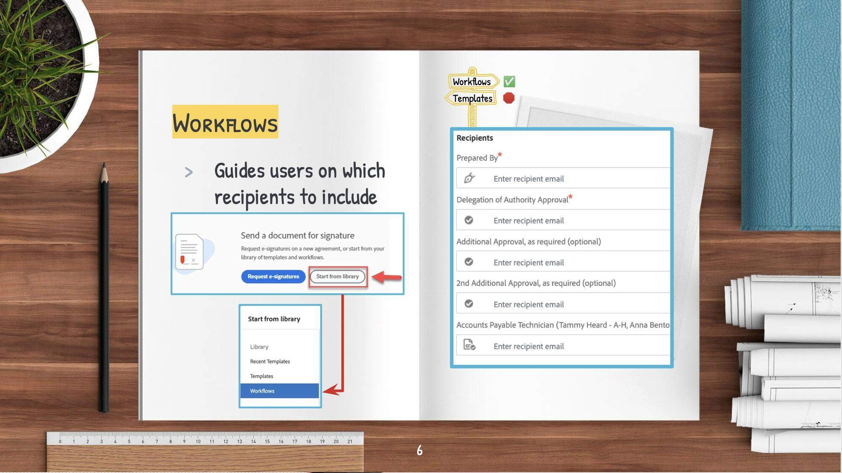

Slide 10


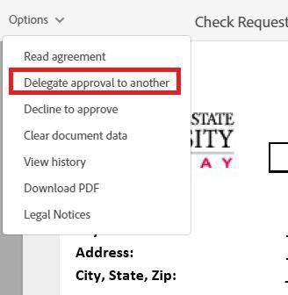















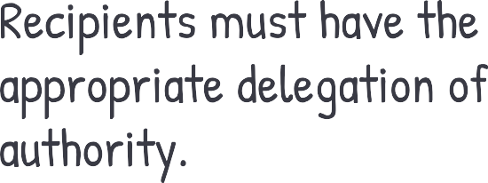

Slide 11
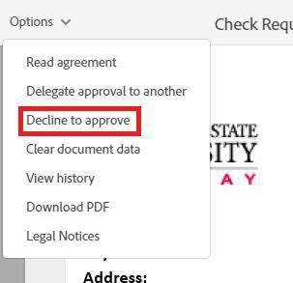






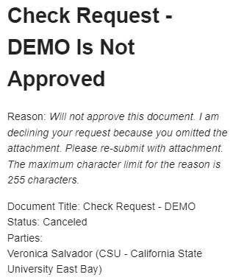


Slide 12
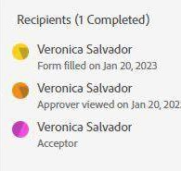

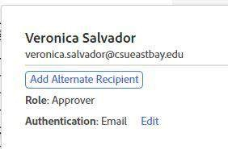






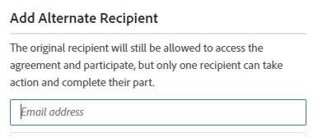
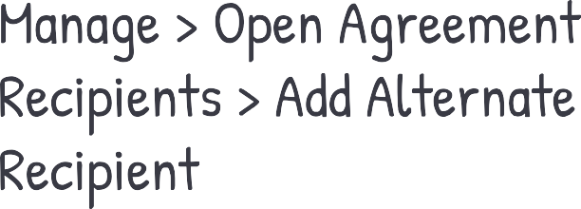

Slide 13






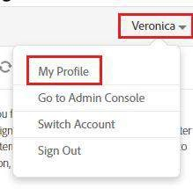
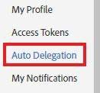
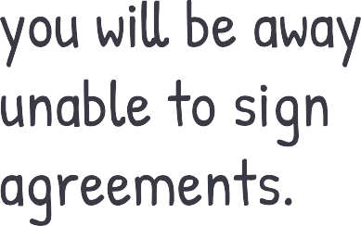
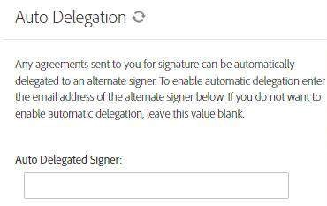
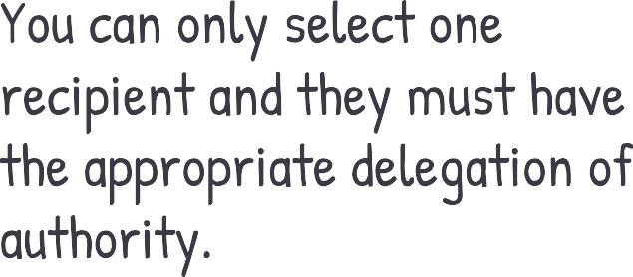

Slide 14





Slide 15



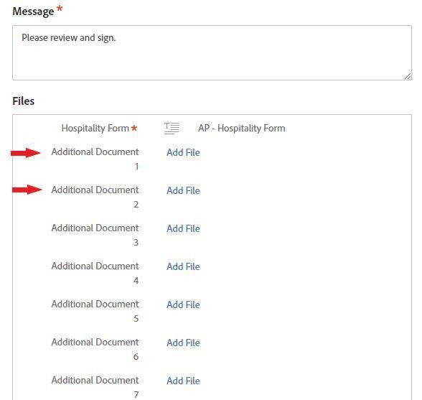

Slide 16




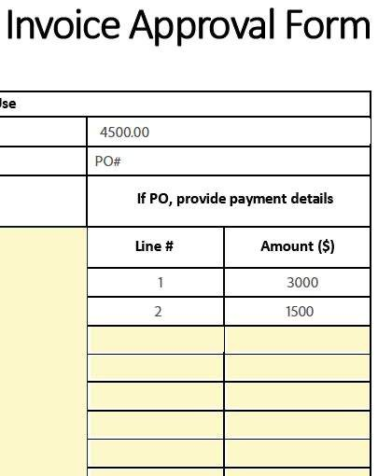

Slide 17




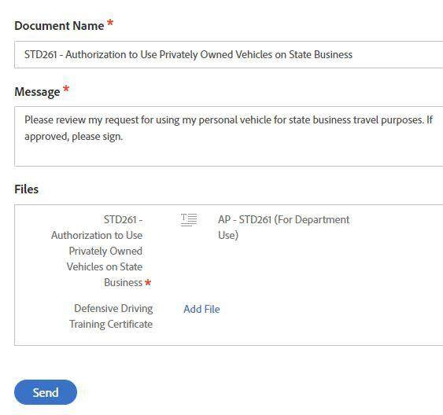

Slide 18






Slide 19






Slide 20













Slide 21












Slide 22



Thanks!
What would you like to learn more about?
Please post responses in chat.

Slide 23

ICT Review Process Overview
www.csueastbay.edu/ict

Slide 24
Why Must The CSU Comply With Section 508 ?
∗ In 1973, Congress amended the Rehabilitation Act to include Section 508
∗ CSU policy - make information technology resources and services accessible to all CSU students, faculty, staff, and the general public regardless of disability
∗ A shared responsibility for the campus per CSUEB
President’s January 4, 2017 Communique
∗ Federal law > CA State law > CSU

Slide 25
Why Must The CSU Comply With Section 508 ?
∗ Access
∗ Inclusion
∗ Bottom Line: Critical for Student Success

Slide 26
Roles & Responsibilities
∗ Purchasing Department
∗ Information Technology Solutions
∗ Asset / Accessible Media
∗ Information Security
∗ Accessibility Services

Slide 27
Roles & Responsibilities Cont.
Requestor = Subject Matter Expert
SME
∗ Each requesting dept will be required to identify a Subject Matter Expert (SME)
∗ SME completes Pre Acquisition Questionnaire

Slide 28
ICT categories of products and services identified under Section 508:
Electronic & Web
∗ Websites and web-based content
∗ Multimedia
∗ Subscription services
Software
∗ Web, desktop, server, mobile client
applications
∗ Authoring tools
∗ Operating Systems
∗ Systems/network administration, and remote access software
∗ Virtual meeting tools (e.g., VOIP, screen
shares, remote meetings)
Support Documentation & Services
∗ Training Services
∗ Help Desk or call center
∗ Automated self-service & technical support
∗ Product documentation
Hardware
∗ Desktop & portable computers (including mobile devices)
∗ Servers
∗ Printers/copiers and Document scanners
(including Multifunction office machines)
∗ Information kiosks and transaction machines

Slide 29
Examples of Products that do not Require a Review
∗ Computer mice
∗ Computer keyboard (when purchased alone)
∗ Flash drives
∗ Hard drives
∗ Power supplies and batteries
∗ Installation equipment (e.g., wall mounts, mounting
brackets, cables)

Slide 30
Compliance
∗ No product can claim 100% compliance.
∗ The degree of compliance must be evaluated.
∗ The Federal Government mandates that Agencies must “procure the product that best meets the standards.”

Slide 31
Compliance
Products must provide access to:
∗ Visual
∗ Blindness, low vision, color-blindness
∗ Hearing
∗ Motor /Mobility
∗ Neurological

Slide 32
What if a Vendor is Non-Compliant?
∗ Vendor generates an Accessibility roadmap
and/or
∗ Requestor (SME) generates Equally Effective Alternate Access Plan (EEAAP) submit if there is not Accessibility Roadmap.
∗ Collaboration with IT, Procurement, AS and requesting Department.

Slide 33
Information Security
What purchases are subject to IS review?
∗ Any purchase or contract that utilizes or collects University data.
∗ These are generally IT related.
∗ An IS review is also required for any non-IT contract that shares University data with an outside entity.
Examples: fundraising partners, healthcare providers
or survey facilitators.

Slide 34
IS Reviews are not required for...
∗ Purchasing commodity goods such as computer hardware or software licenses.
∗ Except...when used as part of a process or project that will utilize or collect University data.

Slide 35
Requirement for IS reviews
The CSU procurement requirements have three general provisions related to IS for Service or Information Technology Acquisitions:
∗ Use of Data
∗ Confidentiality of Data
∗ Information Security Requirements

Slide 36
General Steps of an IS review
∗ Perform verification that vendor meets IS requirements.
∗ Inform requestor of any risks to the University.
∗ Suggest possible mitigations for any unresolved risks.

Slide 37
Resources
∗ ICT Website
https://www.csueastbay.edu/ict/index.html
∗ CSU Product Accessibility Documentation Guidelines:
http://www.calstate.edu/Accessibility/EIT_Procurement/CSUProductAcce ssibilityDocumentationGuidelines.doc
∗ CSU East Bay’s Information Technology Services has
several policy and guideline documents:
http://www.csueastbay.edu/its

Slide 38
Thank you

Slide 39


Budget Transfers
Y U

Slide 40

Types of Transfers
Budget Transfers
Expense Transfers
Submitted to the Budget Office
Posted to the Budget Ledger
Reflects changes in the Budget column
Submitted to the Accounting Department
Posted to the Actuals Ledger
Reflects changes in the Actuals column

Slide 41



Budget Transfers
Budget transfers are requests from Departments to move budget from one
chart field to another chart field
Allocate available funds
according to a set plan
Reallocate funds to reflect changes to the plan
Method for allocating new funds
received during the fiscal year

Slide 42



Common Uses
Commonly Used for:
Transfer between Departments in the same Division
Transfer between Departments in the same College
Transfer between accounts within the same Department
Transfer between Departments in different Divisions

Slide 43
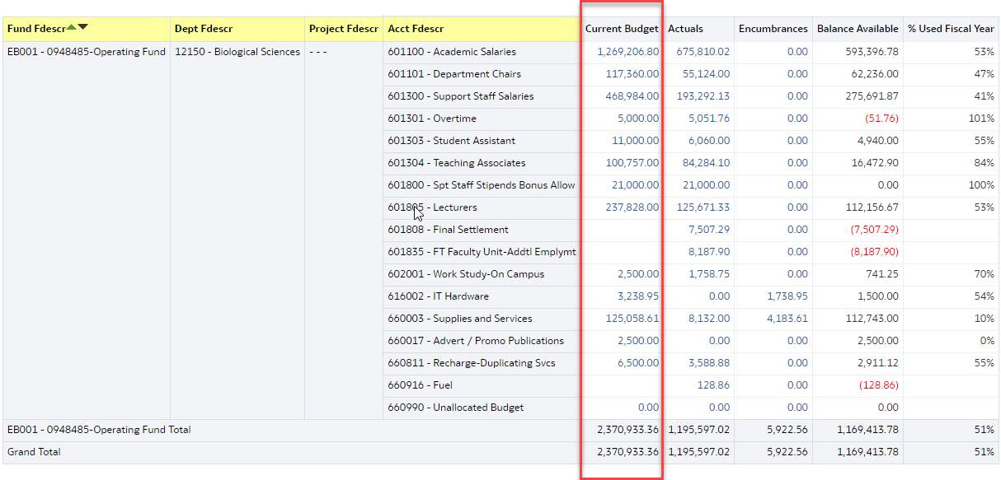
Preparing to Transfer Budget
Notes
Only for funding in the Budget Column
Always run report before transferring budget to double- check that there is enough budget within the chart field that you are pulling budget from

Slide 44
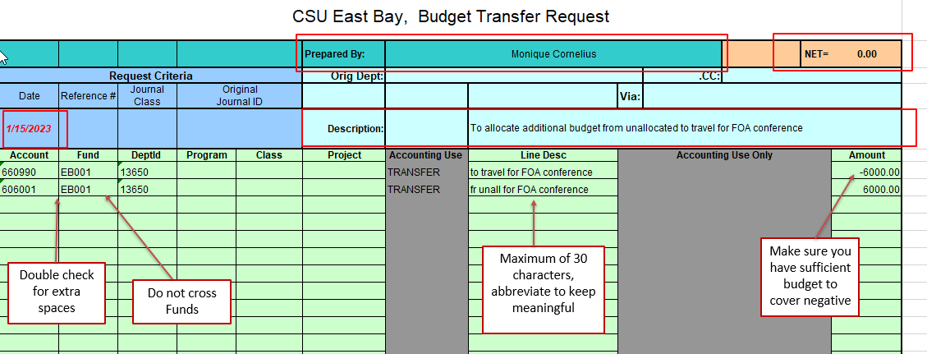
Sample Budget Transfer Request
Mandatory fields to complete
Prepared by (your name), Date, Department, Description
Required chart fields: Account, Fund, DeptID
Use Program, Project and Class as needed
Line Description (30 characters max)
Must transfer within same fund
Form Requirements
Submit in Excel format
Debits and Credits must equal to a net “0”
No commas in any field
Line description is 30 characters max

Slide 45
Submission Process
Complete the “Budget Transfer Form”
https://www.csueastbay.edu/budget/index.html
1
Make sure that you have Delegated Authority for the transaction or be sure to get approval
2
Email request form to: budget@csueastbay.edu
3

Slide 46
Tips and Reminders
Always run a report to double-check that there is enough budget
within the chart field that you’re pulling the budget from
Do not use this form to zero out BBA (Budget Balance Available) for a chart field…..this eliminates the ability to evaluate actual spending against your budgeted plan
Budget does not have to be perfect!!
Being over or under budget by line helps you see where adjustments
are needed for next year’s plan

Slide 47

Test Your Knowledge
What is the difference between Budget and Actuals?
No difference! Budget and Actuals are always the same.
Actuals are flexible and Budgets are rigid.
Budgets are for planning purposes and Actuals reflect what actually happened.
C. Budgets are for planning purposes and Actuals reflect what actually happened.

Slide 48
Test Your Knowledge
Can you transfer budget across different funds?
Never!
Sometimes.
Yes.
A. Never

Slide 49
Test Your Knowledge
Who approves budget transfers for a Department?
Administrative Assistants
Delegated Authority
Anyone in the Department
B. Delegated Authority

Slide 50

Please contact the Budget Office for additional information.
budget@csueastbay.edu

Slide 51

Expense Transfers
Y U

Slide 52

Common Types
Expense
Reclassification
Campus Cost
Allocation
Transfers (e.g.,
CERF)
Cost Recovery

Slide 53
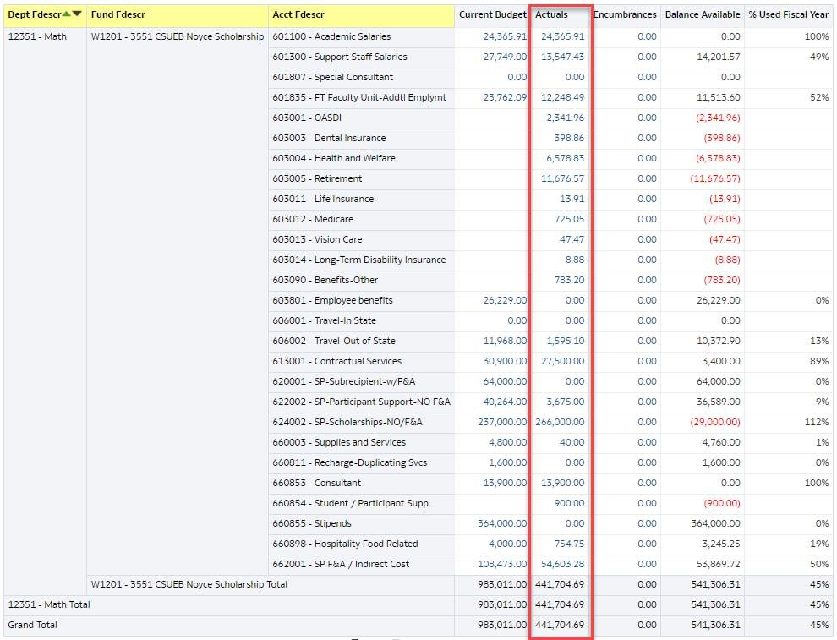
Expense Reclassification
Used to adjust or change expenses to a new chartfield (e.g. account, fund, dept ID, class, program, project)
Only for expenses in the Actuals ledger

Slide 54
Requirements
Transactions in the current fiscal year
Must meet fund’s intended purpose
Be an allowable expense according to fund guidelines
Follow CSU and campus spending policies

Slide 55
Submission Process
1
2 3
4
Complete the “Non-Payroll Expenditure Transfer Request” which can be found under Forms in this link: https://www.csueastbay.ed u/accounting- fiscal/general- accounting.html
Provide supporting documentation and explanation/reason for the reclass
Provide needed approvals
Email request form with backup, explanation and any needed approvals to: general.accounting@csueas tbay.edu

Slide 56
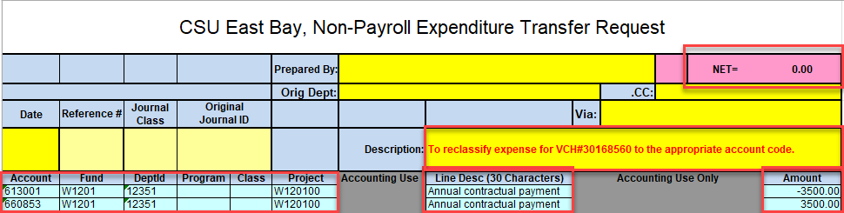
Non-Payroll Expenditure Transfer Request
Submit in excel format
Credit (-) must contain the complete chartfield string based on the original transaction
No commas in any field
Line description is limited to 30 characters max
Clear long description
Total debits (+) must equal the total credits (-)
Must net to zero

Slide 57
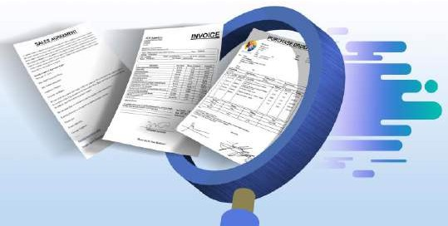
Supporting documentation examples
Screenshot of the original transaction from the Data Warehouse
Explanation/reason for the reclass
Computation
Contract/Invoice
Email
Approvals
Meeting minutes

Slide 58

Tips and Tricks
Ensure chartfield string accuracy and completeness for all payment requests before submitting to Accounts Payable to avoid adjustments
Move actual identified expense; not balances
Review financial activity monthly

Slide 59
Tips and Tricks Cont’d
Financial review must be an ongoing process throughout the year and not a year-end process
Backup documentation should clearly support request form
  Circle key amounts, create subtotals, etc.
  Clear description
  Auditor friendly
Make it easy for your approver!

Slide 60

True or False
Expense reclassifications can be processed for Budget ledger transactions.

Slide 61


Expense reclassifications can ONLY be processed for transactions in the ACTUALS ledger.

Slide 62
What should you check for when completing the Non-Payroll Expenditure Transfer Request Form?
A. No commas in any field
B. Nets to zero
C. Total credits equal total debits
D. Line description is 30 characters max
E. All of the above

Slide 63

No commas in any field
Nets to zero
Total credit equal total debits
Line description is characters 30 max

Slide 64

Email questions to: GENERAL.ACCOUNTING@CSUEASTBAY.EDU

Slide 65
Interagency Financial Transaction (IFT)
Y U

Slide 66

Understanding IFTs
Today, we are going to review:
  Definition of IFT
  Common types of IFTs
  Key things to remember when requesting for IFTs
  Requesting an IFT
  Approval workflow of IFTs

Slide 67

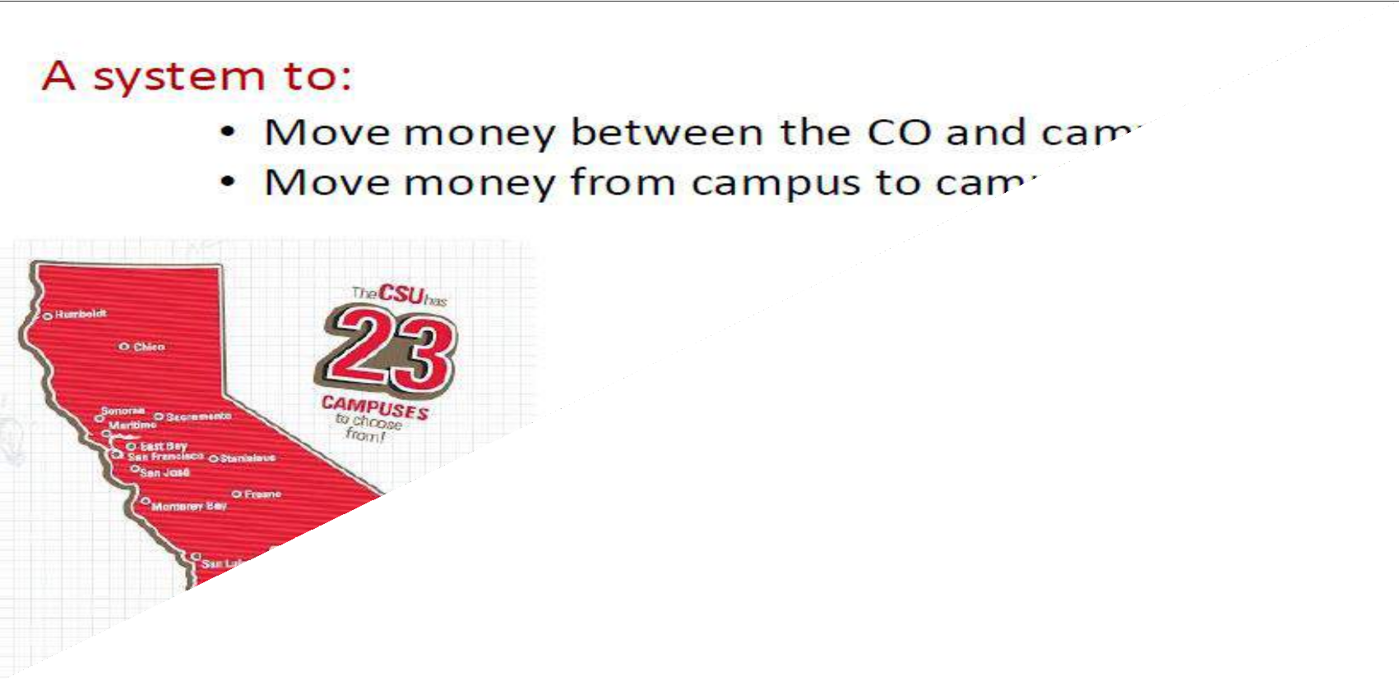
What is an IFT?

Slide 68

Common of Types of IFTs
Cost recovery/reimbursement of an expense incurred by the
CO or another campus on another campus’ behalf
Registration fees
Monthly payroll funding
Debt Service
Campuses share of systemwide expenses
Special funding from CO to the campuses
  Examples include lottery, emergency funding, awards, etc.

Slide 69

Key Things to Remember
Campus owed money initiates request
Need payment approval (MOU,emails, etc.)
For auxiliaries, only Associated Students Inc. and Foundation grants can use IFTs
Need appropriate approval from both/all campuses
All CSUEB IFTs requests must be initiated by the General Accounting department

Slide 70


Requesting an IFT
Send an email request to general.accounting@csueastbay.edu and include the following:
  Reason for IFT (include any dates and locations if applicable)
  Amount of IFT
  CSUEB chartfield string where IFT should be recorded in the general ledger
  MOU, email or similar backup indicating the other campus agreed to the
charges
  Campus where you want the IFT sent
o Campus contact name, phone # and email address

Slide 71
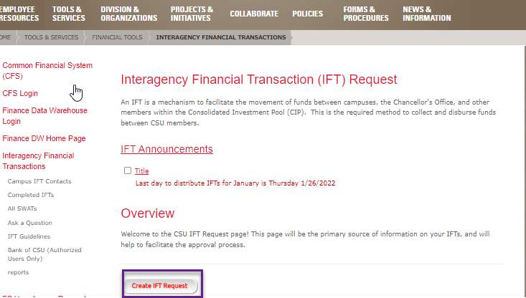
Requesting an IFT (cont’)
o Once all of the information has been received, General Accounting will submit an IFT request to the Chancellors Office

Slide 72

IFT Approval Workflow
General Accounting sends request to Chancellors Office (CO)
CO reviews the request and creates a PDF for the IFT and sends to General Accounting for review/approval
General Accounting reviews IFT pdf and either approves or disapproves
Upon approval from General Accounting, CO sends approval request to the campus delegated approver
Upon approval, the CO does one final review. If there are no problems, the CO sends out the IFT to the respective campuses to record in their general ledgers

Slide 73

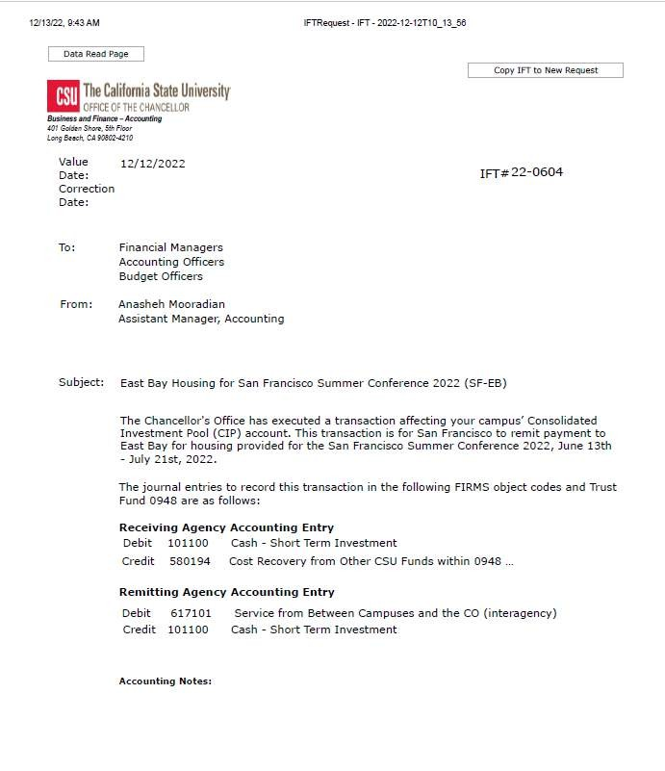
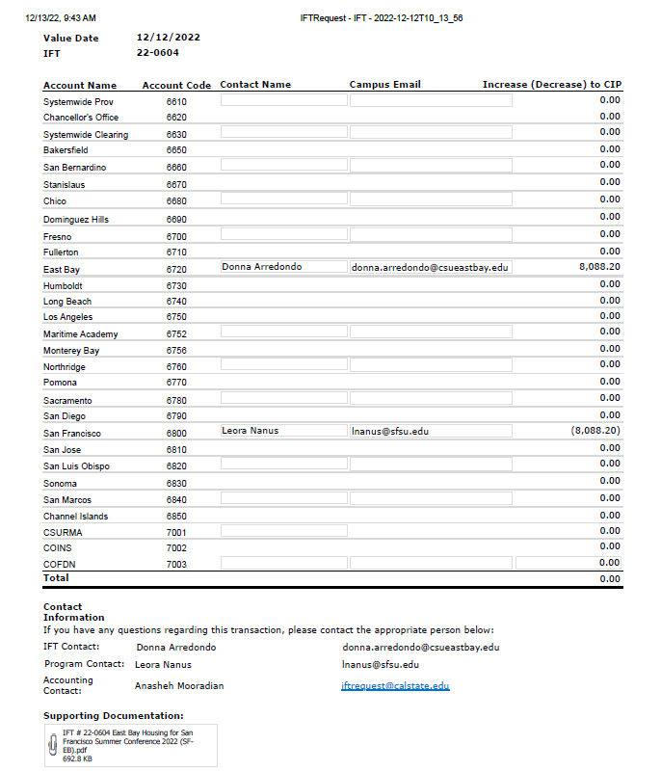
Sample IFT

Slide 74


Trivia Question #1
What does IFT stand for?
  International Financial Transfer
  Internal Finance Transaction
  Interagency Financial Transaction
  Interagency Financial Transfer

Slide 75

Trivia Question Answer #1
The correct answer is:
c) Interagency Financial Transaction.

Slide 76

Trivia Question #2
Who at CSUEB should initiate all IFTs?
  CSUEB General Accounting Department
  CSUEB Accounts Payable Department
  The individual CSUEB Departments
  The CSUEB Budget Office

Slide 77
Trivia Question Answer #2
The correct answer is:
  The CSUEB General Accounting Department.

Slide 78


Questions?

Slide 79
Cash Management
Y U

Slide 80
Try to Avoid Receiving $$
There are strict and detailed guidelines on how Cash and Cash
Equivalents are handled
Use this address when providing information to your payer: CSU East Bay
Attn: Cashier’s Office 25800 Carlos Bee Blvd Hayward, CA 94542
Reach out to the Cashier’s Office at
CASHIERS@CSUEASTBAY.EDU
Aaron.Ledesma@csueastbay.edu

Slide 81
Satellite Cashier
Number of individuals to be authorized should be kept to a minimum
Send a request to be an Authorized Satellite Cashier to CASHIERS@CSUEASTBAY.EDU
  Receiving Cash Only; Cash & Checks; Checks Only
    Average Amount of Collection
MPP/Director/Authorized Manager’s Name
Requests Will be Evaluated – FINAL APPROVAL Lies with
the Assoc or Director of Student Finance

Slide 82
Who to Contact
Feel free to reach to the Cashier’s Office at
(510) 885-3865 | CASHIERS@CSUEASTBAY.EDU
Or myself at:
(510) 885-2573 | AARON.LEDESMA@CSUEASTBAY.EDU

Slide 83
QUESTION #1
MULTIPLE CHOICE
Who should you reach out to if you’re expecting
a check payment from an outside entity?
Facilities Management
I.T.
Cashier’s Office
Accounts Payable

Slide 84
ANSWER
C. Cashier’s Office
Payments being made to your department via check should be mailed to the Cashier’s Office. To help the Cashier’s Office identify whose funds have been received you should always give them a “heads up” to keep a lookout for your money.
Checks can possibly be returned back to the payer if we cannot identify whose money it is!

Slide 85
QUESTION #2
TRUE OR FALSE
In order to “legally” handle cash and cash equivalents
you need to be authorized as a Satellite Cashier.

Slide 86
ANSWER
TRUE
If you are handling cash or cash equivalents you must be designated and authorized as a Satellite Cashier.

Slide 87
Y U
Announcements
Pay Warrant Pick-Up
  AR Invoicing

Slide 88
Pay Warrant Pick-Up
Department Reporting Unit #
Department Picking Up All Warrants?

Slide 89
AR Invoicing
All Accounts Receivable invoicing should be processed by Student Financial Services.
Invoice request form can be found online or can reach out to Aaron Ledesma for further
assistance

Slide 90

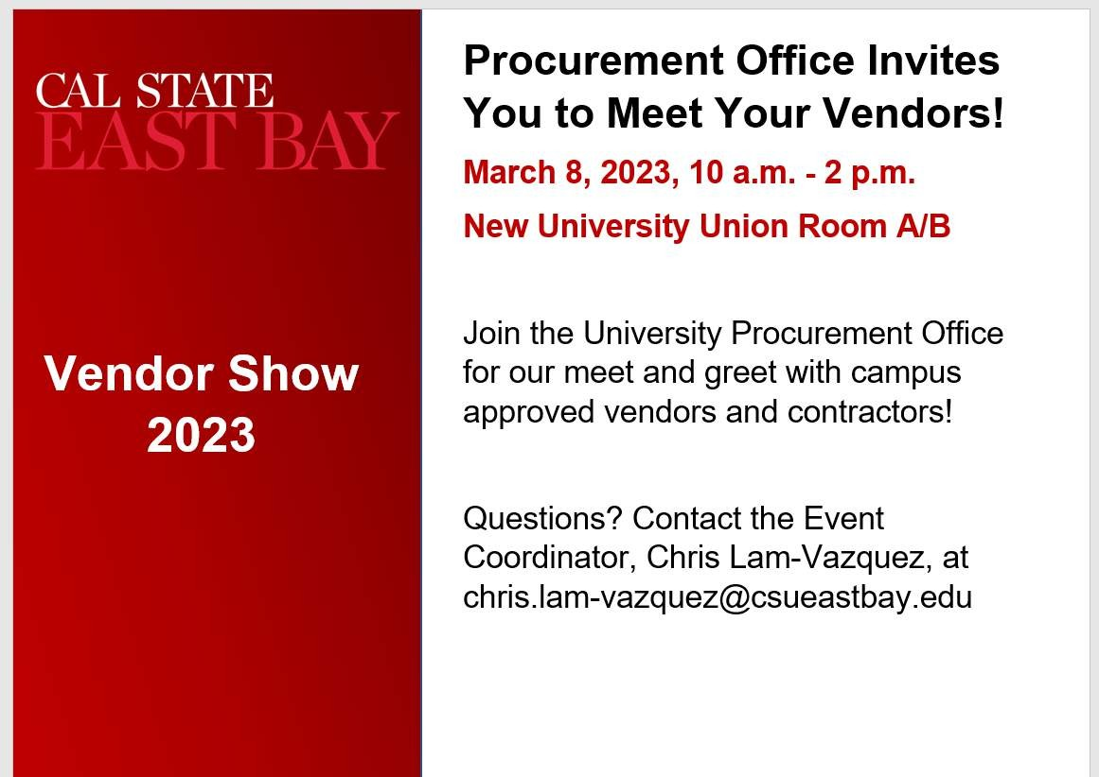
Announcement

Slide 91




