Slide 1
Pioneers for hope learning framework
Strategy Session
November 7, 2017

Slide 2
Agenda
Introductions
Welcome and Project Purpose
Maureen Scharberg, Dean of Academic Programs and Services
Patrick Lee, Consultant for the Stupski Foundation
Sarah Taylor, Project Co-Investigator and Associate Prof in Social Work
Small group activity – pathways to student success
Building a logical framework
Suggestions and resources

Slide 3
Pathways to student success
Form groups of 2-4 people. Try to partner with people you don’t know.
Using any of the materials available, draw/design/create a model that illustrates as many of these elements as you can:
The “destination” – student success
Things that clear the way or help students make progress
Things that stand in the way
Think about things you might want to include at the individual (student), organizational, community, and policy levels. As our project has an emphasis on food insecurity and housing instability, think about where and how to capture these issues.
Your model can take any form you wish. It can be two-dimension or three-dimensional. It can include words, pictures, symbols, etc. The entire model can take the form of a metaphor such as a garden, machine, or road map.

Slide 4
Gallery walk of models
Take a few minutes to review one another’s models. Use post-it notes to add comments. Use stars to indicate model elements that resonate with you.

Slide 5
Logical frameworks (aka logic models)
Illustrate the change we want to see and how we expect to get there
Provide a common language and point of reference
Used in program planning, program implementation, staff and stakeholder orientation, evaluation, and advocacy
Informed by research literature, expert feedback, practice experience, and lived experience
Subject to change
Adapted from: http://ctb.ku.edu/en/table-of-contents/overview/models-for-community-health-and-development/logic-model-development/main

Slide 6
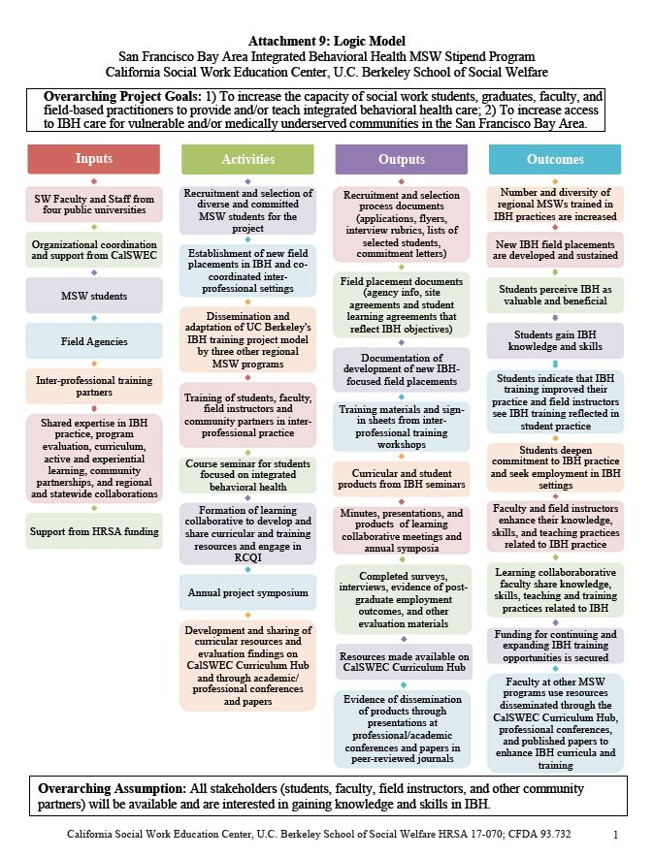

Slide 7
Building a logic model
Think about the “destination” ideas from the last activity.
What activities, outputs, and outcomes will help us reach our destination? Use the post-it notes to add ideas to the easel papers in each of these areas.
Review what others wrote. Add stars to ideas that resonate with you.

Slide 8
Next steps
Email sarah.taylor@csueastbay.edu or use post-it notes to share ideas about people you want us to talk to, books or articles you want us to read, and other suggestions.
Let us know if you want to be involved in future meetings like this one and/or join the project team as a collaborator.

