Slide 1
How to Plan an Essay

Slide 2
Why Plan?
“The German philosopher and writer Arnold Schopenhaur once advised: ‘Write the way an architect builds, who first drafts his plan and designs every detail.’ In building a house, a carpenter never goes into the project blind. He or she has a plan to consult; all of the parts -- the foundation, the walls, the supporting beams, the ceiling -- will work together because of this plan. Without a plan, ceilings might fall in and doorways might collapse.”
–Cheryl Sloan Wray www.writing-world.com

Slide 3
Benefits of Outlines
Keep you organized
Encourage a consistent theme & connection to your thesis
Professors can always tell if you planned before writing
Allow you to easily move paragraphs and ideas around with intention.

Slide 4
Step 1: Analyze the assignment
Look at the prompt with a critical eye
What is the prompt asking you to do?
Are there multiple questions?
Are there other requirements (page length? Details in syllabus?)
Do you need to do reading before hand?
Recommend marking it up.
Circle each question
At the end of your outline, go back and double check to make sure you covered all the components

Slide 5
Practice!
What is your career goal? Why are you drawn to this particular career? Make sure you address the qualities you possess which make you a good candidate for this field.

Slide 6
Step 2: Brainstorm
If you have to do related reading, keep the question next to you while you read. Flag pages related to the question(s).
Is this an opinion- based essay? Start with your ideas. List these out.
Is this an essay based on a clear and straight-forward answer in your reading? Look for the “short answer” to the question first. You may need to summarize this in your own words.
Jot down the smaller or supporting ideas too!

Slide 7
Step 2: Brainstorm
Is this essay a combination of your opinion and a clear-cut answer found in reading?
Start by jotting down your opinion first. List all your ideas out.
Then, go back and look for the “short answer” to the question in your reading. List out all the smaller of supporting evidence from the reading too.

Slide 8
Fighting Writers Block
“Writers block” comes up frequently in essays where we have to form our own opinions.
You can fight writers block through a practice of asking yourself lots of “analytical questions.”
Pretend you are a detective or investigator and you need to look at the assignment from every possible angle.

Slide 9
Practice!
What is your career goal? Why are you drawn to this particular career? Make sure you address the qualities you possess which make you a good candidate for this field.
What are some questions we can ask ourselves to help us answer this? Think about looking at this from every angle!

Slide 10
Practice!
What is your career goal? Why are you drawn to this particular career? Make sure you address the qualities you possess which make you a good candidate for this field.
Let’s brainstorm!

Slide 11
Thesis Statements
It can be valuable to at this stage draft a working thesis statement
Your thesis statement is the main idea of your paper, is usually an “argumentative” statement, and answers the main question of the prompt.
You will revise your thesis statement after you finish your outline.

Slide 12
Example of outline
https://youtu.be/sp0MWYbLUFU

Slide 13
Step 3: Plan- Your Outline
Look at your brainstorm and ask yourself:
Do some of your ideas naturally cluster together?
How many clusters are there?
Which ideas are more important or general?
Which ones are more like supporting details?
What order should the ideas be in?
Let’s put it in a structure format.

Slide 14
Practice!
Let’s practice planning our outline

Slide 15
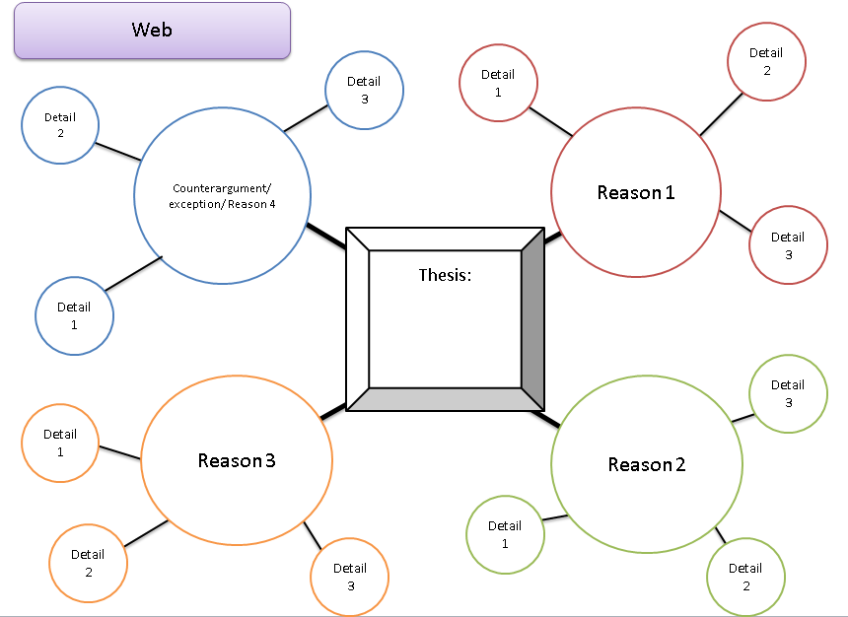
Step 3: Plan- Alternatives to Outlines

Slide 16
Step 4: Using Quotes
Quotes should support YOUR points in your paragraphs.
Review Critical analysis Essay Template for example.
Avoid dangling quotations!

Slide 17
Citations 101
When you use quotes, you must do TWO citations
In-text citation
And a citation on a Works Cited or Reference page
You should cite whether you use a direct quote, paraphrase, or just use someone’s idea.
Every type of source is cited differently- both in the essay and at the end. It’s impossible to memorize all the rules, so follow a trusted website like PURDUE OWL.

Slide 18
MLA
https://owl.english.purdue.edu/owl/resource/747/01/
In-text citation example of a single author of a book
Wordsworth stated that Romantic poetry was marked by a "spontaneous overflow of powerful feelings" (263).
Romantic poetry is characterized by the "spontaneous overflow of powerful feelings" (Wordsworth 263).
Wordsworth extensively explored the role of emotion in the creative process (263).
Works Cited Example

Slide 19
APA
https://owl.english.purdue.edu/owl/resource/560/01/
In-text citation example
According to Jones (1998), "Students often had difficulty using APA style, especially when it was their first time" (p. 199).
Jones (1998) found "students often had difficulty using APA style" (p. 199); what implications does this have for teachers?
Reference List example

Slide 20
Wrap Up
Benefits of planning
Step 1: Analyze the Assignment
Step 2: Brainstorm
Step 3: Plan (your outline)
Step 4: Using quotes
Citations

