Slide 1

Information on the
University Writing Skills Requirement
Project IMPACT
Workshop Series
Program Coordinator: Elizabeth Chueka

Slide 2
Overview
What is the UWSR?
What is the WST and do I HAVE to take it?
How do I sign-up? When should I sign-up?
What about accommodations?
What’s the course option?
General tips for success
Understanding the weird scoring rubric…

Slide 3

What is the UWSR?
(and why do I have a warning on MYCSUEB?!)

Slide 4
What is the U.W.S.R?
In order to graduate from any CSU, you need to meet the GWAR (Graduation Writing Aptitude Requirement)
At CSUEB, this is the University Writing Skills Requirement
Everyone must meet this requirement in order to graduate
You have two options: the WST (writing skills test) or the course option
Notes:
The WST stands for the Writing Skills Test. This is a 90 minute exam in which you must write an argumentative essay
The WST satisfies the University Writing Skills Requirement which is our Graduation Writing Assessment Requirement, something that all CSU’s have.
The WST requires that you demonstrate your ability to think and write critically by writing an analytic essay
You have two options to take the test: either by pencil/pen (25$) or computer (which is limited to 10 slots per exam and is more expensive.) T
It is available on the Hayward and Concord Campus

Slide 5
What is the WST?

Slide 6
What is the W.S.T?
Writing Skills Test: 90 min exam (2 hours total)
Satisfies University Writing Skills Requirement (UWSR) which is our GWAR
Demonstrate ability to think and write critically by writing an analytic essay
Paper and pencil/pen (25$)or computer (limited to 10 slots and 50$)
Hayward and Concord Campus
You can take it a total of 2 times (if you do not pass first time around.)
Notes:
The WST stands for the Writing Skills Test. This is a 90 minute exam in which you must write an argumentative essay
The WST satisfies the University Writing Skills Requirement which is our Graduation Writing Assessment Requirement, something that all CSU’s have.
The WST requires that you demonstrate your ability to think and write critically by writing an analytic essay
You have two options to take the test: either by pencil/pen (25$) or computer (which is limited to 10 slots per exam and is more expensive.) T
It is available on the Hayward and Concord Campus

Slide 7

What is the WST? After the exam
Receive your results in your horizon email about four weeks after test
No re-scoring of exams
Analytic evaluation 25$
  broad comments indicating weaknesses in the areas of development, structure, usage and mechanics
  Not line by line
Notes:
You will receive your results in your horizon email, approximately 4 weeks after the test
There is no re-scoring of exams. Your exam is evaluated by two people who must agree on the score. If they do not, your exam goes to a third person.
You can request an analytic evaluation for 25$
This evaluation will give you broad, general comments about the weakness in your essay, specifically about development, structure, usage, and mechanics.
They will not, however, comment on your essay line-by-line

Slide 8
Signing Up for the Test
Register on MyCSUEB
No refund.
You can only reschedule once! Must be done 2 weeks before exam.
Fee waivers
  Limited amount for students who meet low-income requirements provided by Financial Aid Office
  Go to testing office for form
Notes:
There are 2 ways you can register for the test: either on the Testing Office Website, or at the actual Testing Office.
There are no refunds for the exam, so be sure you are ready to take it.
You can reschedule the exam once for free, but this must be done 2 weeks before the exam.
There are a limited amount of fee waivers for students who meet the low-income requirements provided by the Financial Aid Office
To apply, go to the testing office for the form.

Slide 9
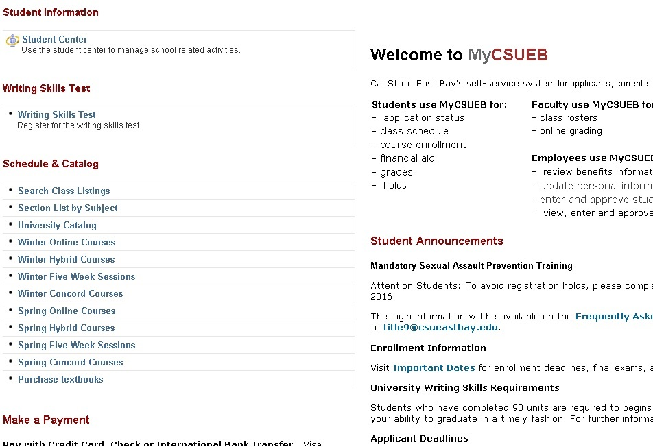
Registering for the Test

Slide 10

Reasons not to put it off…
Process to meet the UWSR can be time consuming
When you complete 90 units- you receive notice on MCSUEB- It is time to register! A future hold will be scheduled on your account.
When you complete 120 units- an Enrollment Hold is placed on your account.
  This means you cannot register for classes
  Only lifted if you register or sign up for a first tier course
  The “lift” may not be automatic. So plan ahead.
Notes:
There are a couple very strong reasons why you should NOT put the UWSR off.
In some cases, the process to meet the UWSR can be quite lengthy. We’ll go into this process a little later.
When you complete 90 units, you should prepare to meet the UWSR. You will receive a notice on your MYCSU that it is time to complete this requirement.
If you complete 120 units without meeting the UWSR, an enrollment hold is placed on your account.
This means you can not register for classes.
The hold will ONLY be lifted if you register for the WST or sign up for what’s called a “first tier course.”
This happened to me when I was a student. In my experience, the “lift” of the hold was not automatic. As you all know, some classes fill up very quickly, so plan ahead if you will face a hold.

Slide 11
Signing Up: Accommodations
Register for the test and pay fees
Make an appointment with AS Counselor
  Fill out Accommodations form
  This MUST be done at least two weeks before the test
The Testing Office will contact you the Friday before test to confirm (at the latest)
Private space in Testing Office, is not sound proof→ bring ear plugs. Space is limited.
  Generally the Wed, Thurs, or Fri before test date
Computer in Testing Office Space
What are some other accommodations you could discuss?
Notes:
Many of you are eligible for testing accommodations. Maybe you have these for your finals, midterms or quizzes and you might be interested in receiving accommodations for the WST as well.
In order to do this…
First register for the test and pay your fees.
Then, make an appointment with your AS Counselor.
They will discuss your accommodations and have your fill out a testing accommodations form
This MUST be done at least two weeks before the test.
The Testing Office will contact you one week to one and a half weeks before your test to confirm you’re accommodations.
Some important information… the private space in the testing office is not sound proof, so you may consider bringing ear plugs. Space is also limited
If you require private space, your test will generally take place the Wednesday, Thursday, or Friday before the test date.
There is a computer available in the testing office as well if you need this.
What are some other testing accommodations you could discuss with your AS counselor besides a private space?

Slide 12

Do I have to take the WST?
No… but you have to meet the UWSR in order to graduate.
Alternative: Pass the course option
Notes:
You do not have to take the WST, but you must meet the UWSR in order to graduate. You can do this either by passing the WST or passing the course option.

Slide 13


Course Option
First Tier Course’s Portfolio
Pass First Tier Course: ENGL 3000/3001
Limited Competence
Clear Competence
Developing Competence
Second Tier Course
C-
D+
Notes:
The course option is by no means an “easy way out” and is in fact more time consuming.
The course option begins with you taking what is called a “first tier course.” This is either ENGL 3000 (for native English speakers) or ENGL 3001 (for non-native English speakers.) You must pass this class AND pass a portfolio evaluation in this class.
This portfolio is graded by two evaluators who must agree on the score. If you receive Clear Competence, congratulations- you are done and your UWSR is met. If you receive Limited Competence, you must repeat the course.
If you receive Developing Competence, you must register for a Second Tier Course. This course is either ENGL 3003 or a specific course offered by your major department.
If you receive a C- or better in this course, your UWSR is met. If you receive a D+ or lower, you must repeat the course.
Understand that these courses are designed to give you an intensive experience in college-level writing and involve a lot of writing!

Slide 14
Course Option: NOT the Easy Way Out
First Tier Course
Second Tier Course
ENGL 3000/ ENGL 3001
  Weekly writing assignments
  Final exam
  Pass class and receive at least DC or CC on portfolio
Portfolio judged by two evaluators (or three): $25
  Cover page and table of contents
  Introduction essay
  3 drafts of 3 essays
ENGL 3003 or Option within Major
Pass class (C- or better)
  8000 words in total
  Minimum of 2 pgs/ week
  Weekly writing assignments
  3 multiple draft assignments
Notes:
Let’s talk about these courses a little more.
For the first tier course
Either ENGL 3000 or 3001
You have weekly writing assignments
It does have a final exam
And remember you must receive either a DC or CC on your portfolio
You work on compiling a portfolio in this class as well which is judged by evaluators (not your professor)
This portfolio includes a cover page and a table of contents
An introduction essay
And 3 drafts of 3 essays
For the Second Tier Course
Which is either ENGL 3003 or another course available in your major
You must pass this class with a C- or better
No matter what class you take, you will write at least 8000 words in total,
Write a minimum of 2 pages per week
Have weekly writing assignments
And 3 multiple-draft essays

Slide 15
So do I have to keep taking the courses over and over until I pass?
No, you can appeal the UWSR under two circumstances.
  Taken the first-tier & received LC 3 consecutive times, & your most recent teacher gives you a letter saying you did everything possible that you could.
    → BWS Appeals Committee
  You receive a D or D+ in a second tier course.
  → Request Administrative Appeal
You can take second tier CR/NC if it is NOT in your major.
  But a “D” will count as NC
Notes:
So a lot of students wonder, what if I get an LC on the first tier course, or a D on the second tier course over and over? Do I have to keep taking the courses over and over forever? The answer is no, you can appeal the requirement under two circumstances.
1. If you have taken the first-tier course and received LC 3 consecutive times, and your most recent teacher writes a letter on your behalf, saying that you did everything possible that you could to pass the portfolio…. Your appeal will go to the Basic Writing Skills Appeals Committee.
2. If you receive a D or a D+ in a second tier course, you can request an administrative appeal which may increase your grade and therefore allow you to meet the UWSR.
3. Note that you can take a second tier course Credit or No Credit, with Credit counting as a passing grade. This is only an option if you take a course not in your major. But, keep in mind that a D will count as no credit.

Slide 16

General Tips for Success on the WST
Notes:
So now let’s talk about some general tips for success.

Slide 17

How Can I Prepare?
Pay attention in ENGL 1000 and ENGL 1002
Project IMPACT Workshops
  Time Management
  Test Taking
  WST
SCAA Workshops on WST
Quick Guide to Passing the WST in Campus Bookstore
Practice Writing Sample Essays
Start Reading Daily
Work on developing skills you will use for the exam
Notes:
How can you prepare?
Well, first pay attention in ENGL 1000 and ENGL 1002. These courses will teach you techniques to help you pass the UWSR
Second, attend Project IMPACT Workshops that help you develop skills useful to the UWSR such as Time Management, Test Taking, and the WST
Third, you can attend SCAA workshops on the WST. These are rumored to be very, very good. They have been doing them for a long time. We will gladly help you sign-up or show you where SCAA is located.
Fourth, there is a fantastic book located in the campus bookstore called Quick Guide to Passing the WST. It is located downstairs with reference books and is written by an English professor who teaches the ENGL 3000 course. It is about 20$ and has numerous exercises. She uses it in her class.
Practice Writing Sample Essays. If you are receiving tutoring for ENGL 1000, 1002 or any of the remedial classes and have a couple weeks where you have nothing to work on, I will approve for you to bring these in for revision.
Start reading daily- even if it is just for 20 minutes. Reading builds your vocabulary and understanding of college-level English. If you have trouble reading, try listening to audio-books. This similarly will help you develop your writing.
Work on developing skills you will use for the exam. We will do some exercises today to help you with this- and more on Friday in part II.

Slide 18
Day of the Exam
Bring
  Need Photo ID!
  Pencils (#2) and Pens
  Confirmation print out or ticket
Any other items might be confiscated
Must arrive no later than 30 min before exam for regular, 15 min for computer guaranteed
No breaks, no leaving the exam room
You will be given a choice between 2 topics
  15 minutes to plan, 75 minutes to write
Notes:
On the Day of the Exam
Make sure you bring your photo id, #2 pencils and pens, as well as a print-out of your confirmation or ticket. I have provided you with a check-list of things to bring and things to do before your WST.
Any other items you bring might be confiscated and no food or liquid is allowed.
You MUST arrive no later than 30 minutes before the original exam or no later than 15 minutes before the computer guaranteed version.
There are no breaks and no leaving the exam room.
You will be given a choice between 2 topics
You will be given 15 minutes to plan and 75 minutes to write.

Slide 19
More General Tips for Success
Easier to read
  Pen
  Write on one side of page
Crossing out is okay
Start preparing before you reach 90 units
Treat it like the SATs
DON’T WAIT UNTIL THE LAST MINUTE TO TAKE THE EXAM!!!
  The University will not let you graduate without the UWSR and it will require you to go through all the proper attempts at the exam and courses.
  Story of former P.I. student
Notes:
1. The Testing Office suggests writing in pen, and on one side of the page because it is easier to read. It is in your best interest to make their job easier.
2. Crossing out is okay, and the evaluators will follow directions like arrows or reading directions written in margins.
3. Start preparing before you reach 90 units. This is a tough exam, and is even more challenging for many people with disabilities. Since this is a standard exam, it favors traditional learners. While there are accommodations to help level playing field, if you have a processing disorder, learning disability, speech and language disability, or other disability that affects your test performance or writing, it can be especially difficult. However, with proper preparation, you will meet the UWSR. I have witnessed dozens of P.I. students meet it, and those who meet it easiest and quickest, prepare early.
4. Treat it like it’s the SAT’s. Go to bed early the night before, study for it and you will do well.
5. Don’t wait until the last minute to take the exam!
- the university will not let you graduate without the UWSR and it will make you go through all the proper attempts at exams and courses before granting you a waiver.
- I have tutored in English 3000 almost a dozen times. One time stand out in my memory. It was Spring quarter and there was a young woman who was all set to graduate- except she had not passed the UWSR. She took the exam twice and failed. Now the quarter before graduation, she was taking a first-tier course.

Slide 20
Coping with Test Anxiety
Before the Exam
In the Exam
Good preparation
Regular exercise
Meditation
Engaging in relaxing activities
Eating balanced breakfast
Good night sleep
Deep breathing
Stretching
Tensing and relaxing muscles
Positive self-talk
Talk to your AS counselor about accommodations
Notes:
Test anxiety is something that affects all of us to some extent or another, but for some students it can be a real barrier to success. So let’s discuss some techniques we can use to reduce test anxiety.
What are some things you can do on a regular basis, or before the exam to reduce test anxiety?
What are some things you can do inside the exam to reduce test anxiety?

Slide 21
Understanding the WST Scoring Rubric
Notes:
Understanding how you will be graded is essential to writing a successful essay. You need to know what they are looking for in order to make sure your essay contains it.
We will briefly be looking at what you will be graded on and what the scores mean. You were given a hand out that breaks it down in detail. Some of the language can be kind of technical though, so I want to give you a chance to ask questions if you have them.

Slide 22

What will I be graded on?
Thesis
Task
Organization
Development
Technical Command
Each of these will be addressed in the next 2 workshops.
Notes:
Your essay will be graded on Thesis, Task, Organization, Development, and Technical Command.
Each of these will be addressed in this workshop or the next.

Slide 23
Understanding your score
Clear Competence (CC): “Pass” 8
  Pat yourself on the back!
Developing Competence (DC): “No pass” 7
  Re-take one more time or
  Second tier course
Limited Competence (LC): “No pass” 6
  Re-take one more time or
  First tier ENGL course
Notes:
Your score determines what options are available to you.
If you receive an 8- you are done!
If you receive a 7- you can retake the exam one more time or take a second tier course
If you receive a 6- you can retake the exam one more time or take a first tier course

Slide 24

Understanding your Score:
Clear Competence
Have a thesis that is more developed than one that lists its supporting points inside
Be able to complete the task asked of you
Go beyond the “Five Paragraph form”
  Also, have topic sentences and transitions too!
Have at least four well-developed reasons
  Varied forms of supporting details (personal experience, facts, no logical fallacies)
Have academic language and few grammatical errors
Notes:
A Clear Competence Score means that….
The essay has a thesis that adequately addresses the topic.
The paragraphs are adequately organized and developed with some appropriate details and examples.
Responds to the writing task but may slight some aspects.
Overall the sentences demonstrate an adequate facility with language; sentence variety may be limited
Minor errors in grammar or punctuation should not interfere with meaning and should be of the type that could be easily remedied given time for proofreading.
For information on what developing competence or limited competence looks like, consult your handout.

Slide 25
Next Time…
6 Steps to a Great Essay
Adapted from 5 Steps in SCAA’s PowerPoint on UWSR
Notes:
Now that we have gone over the details of the WST and UWSR and discussed what they want your essay to look like, let’s get into how to create the type of essay the University is looking for. We will start this today and finish it in Part II.

Slide 26
NEXT TIME: 6 Steps to a Great Essay
Analyzing a Prompt
Pre-write
Creating a Strong Thesis
Notes:
On Friday, we will be finishing our discussion on the “6 steps” to a great essay. We will be going over:
-Creating a Strong Thesis
-Organizing
-Writing from an Outline
-Writing from a Web
-Tips for drafting an essay
-Tips for revising an essay
This will be in the PI Lab from 11:00-12:00. Remember, if you want to participate in the WST Guided-Practice Test next Wednesday, you need to attend both part 1 and part 2!

