Slide 1
Google Calendar Appointments
A guide to the intricacies of entering appointments
(There’s a lot to remember)

Slide 2
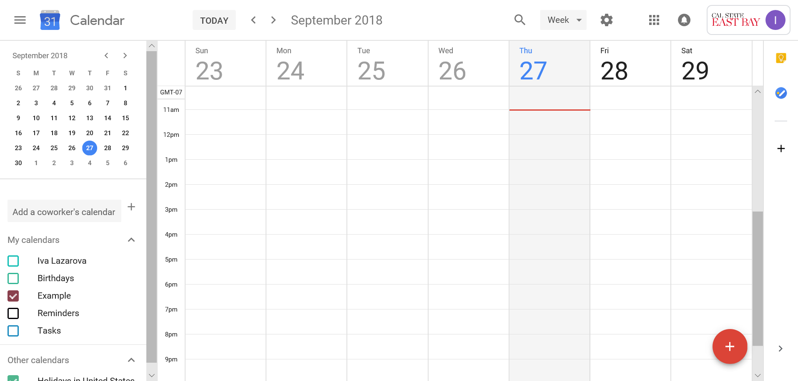
Open your Horizon Email Associated Google Calendar:
Notes:
Notice the gray box, and red line:
The gray indicates which day it is today- so does the calendar on the left
The red line indicates the time.
Green boxes around arrows let you navigate forward or backward in time.

Slide 3
Notes:
Click on the red plus to add appointments, bottom left.

Slide 4
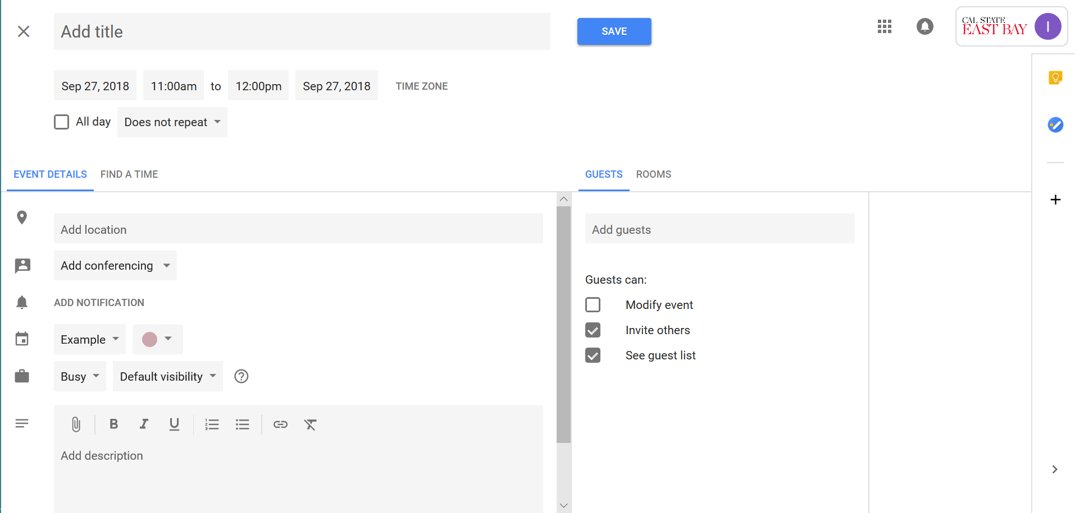
Notes:
This is the appointment scheduling window- it’s a lot to look at, with many options. What do they all mean?

Slide 5
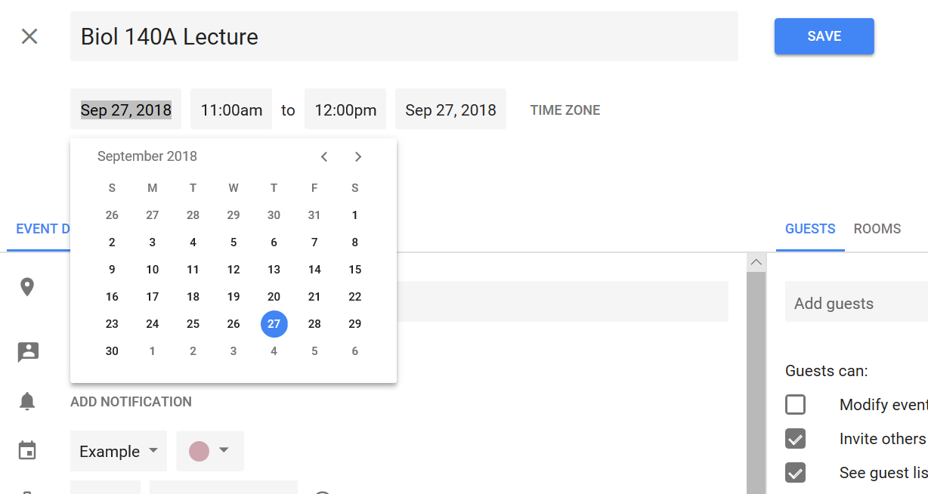
First things first: What is the event? When is this event?
Notes:
On the top, click the bar to type in the name
Directly under, click on the date. By default, Google Calendar will always set the event you are creating to today.
-Change it to the date of your event!
- 2 date boxes, one is stat date one is end date
They will both be the same date unless it is an overnight or multi-day event.

Slide 6
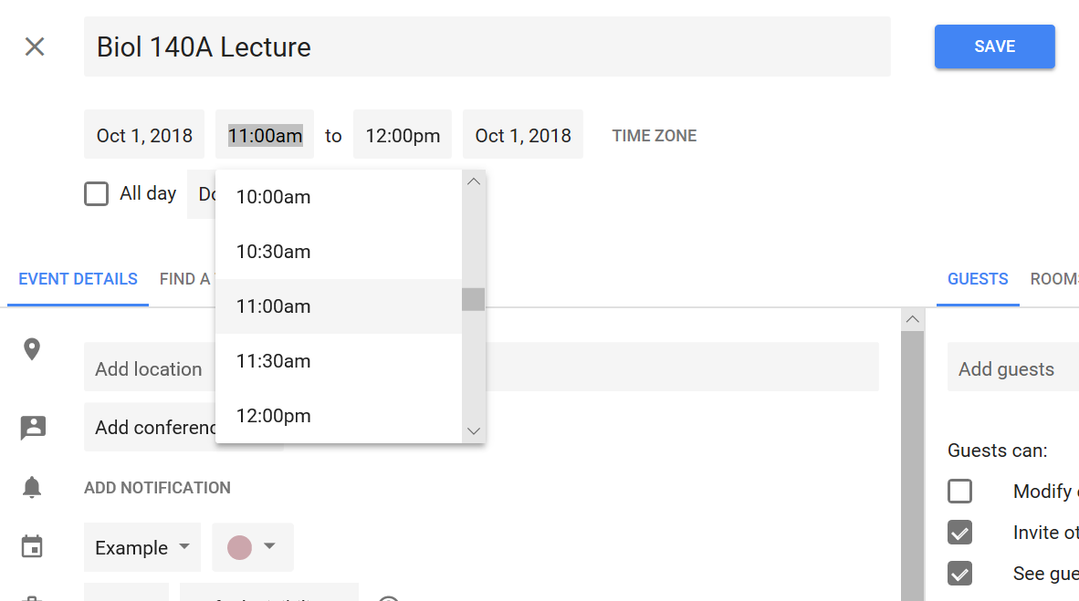
Notes:
Next to the new date, there’s 2 time boxes.
First box (on the left) is START time
Second box (on the right) is the end time.
Click the box to either type in a time, or select a time from the drop down menu.
Repeat for the other box to set the end time

Slide 7
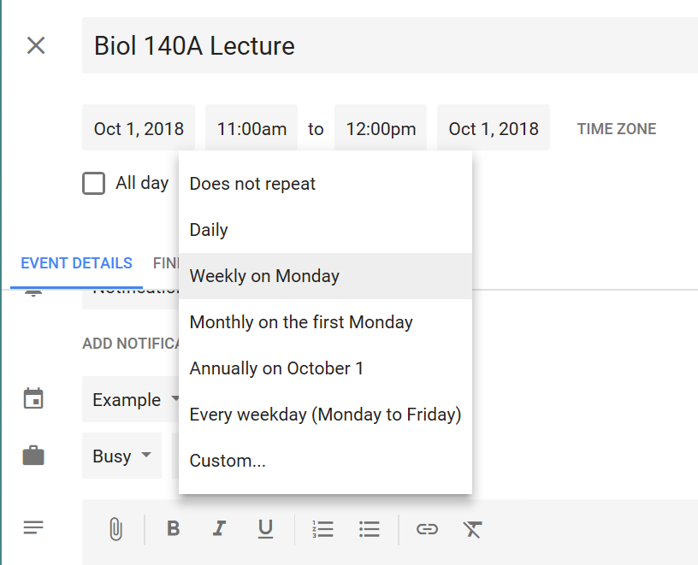
Things to Consider:
Is this event happening one time?
Does it happen once a week?
Does it happen on multiple days every week?
Notes:
You can choose whether or not the event repeats.
Can also choose HOW it repeats.

Slide 8
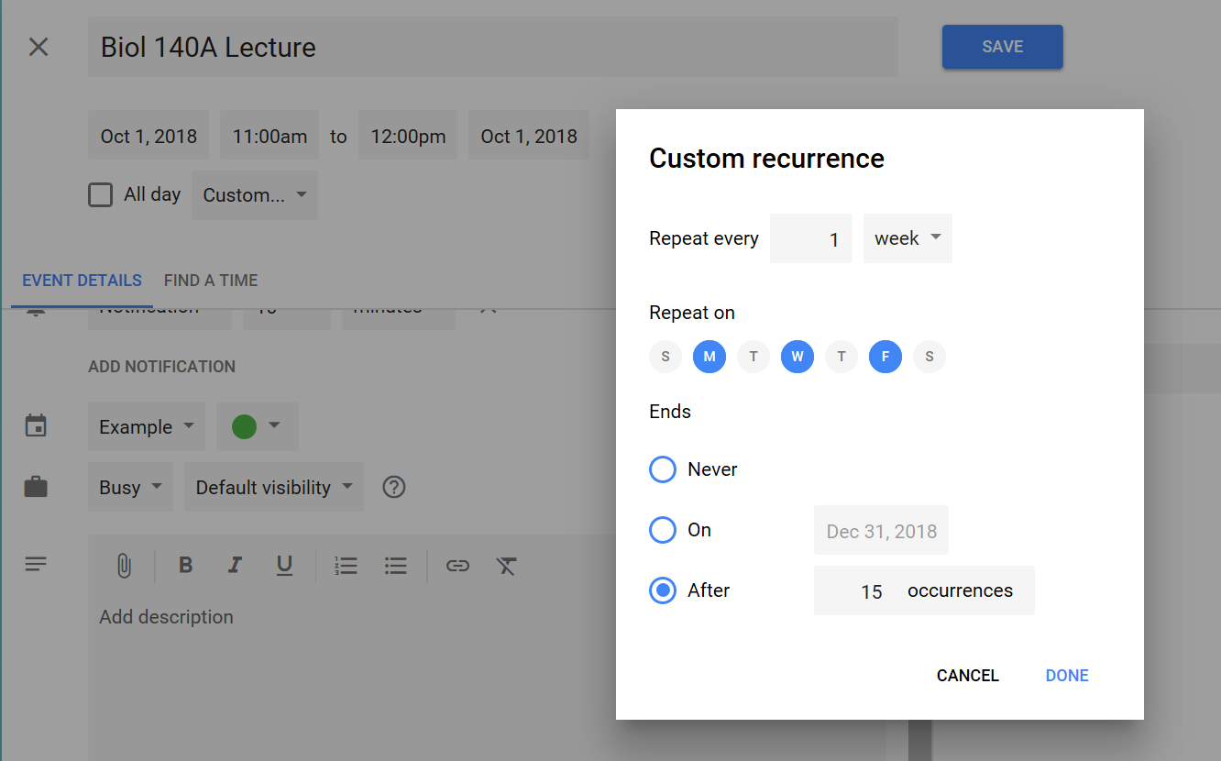
Notes:
Click on custom- a pop up appears
Select days it repeats on
Optional: select when it ends.
Default is never- may have to manually delete the event when it is done.

Slide 9
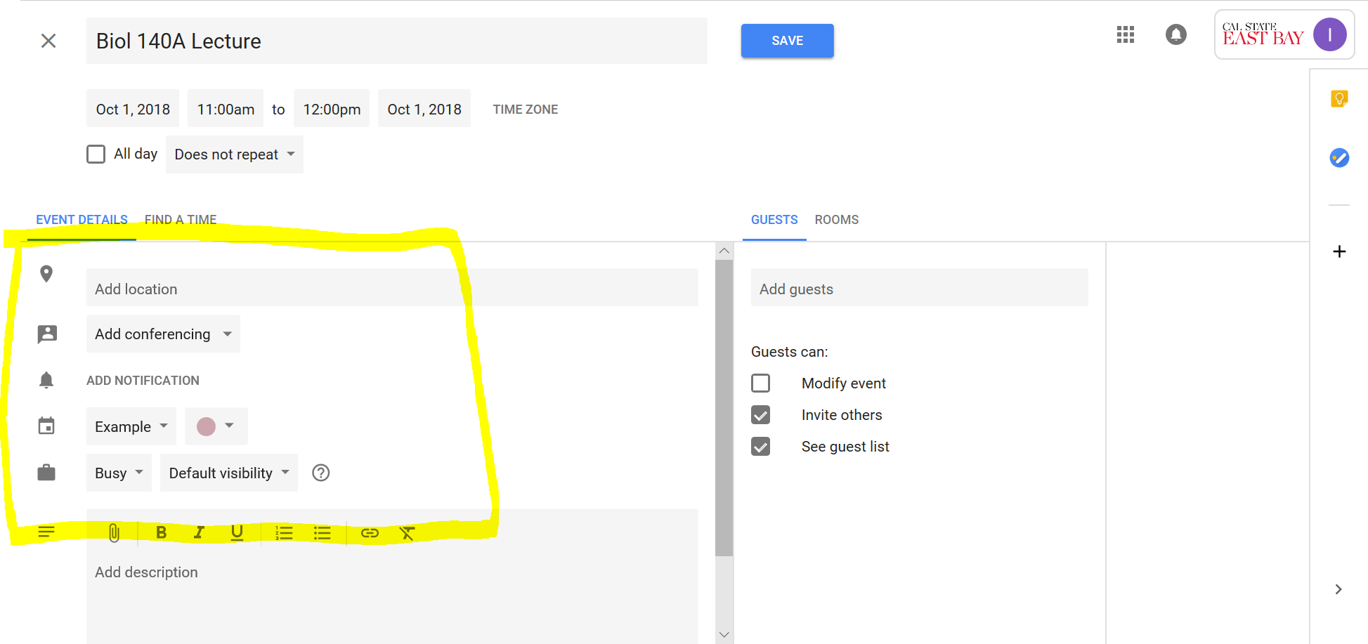
Notes:
Here are more options- fine details
Optional, but very useful for organization and time management.

Slide 10
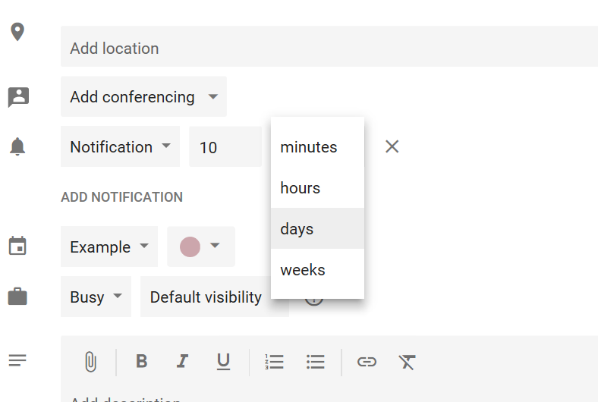
Notes:
NOTIFICATIONS!
You can set as many as you want, or delete them all.
Type in the numerals for how long before the appointment you want to be notified
Do you want to be notified days, weeks, hours, minutes before?
Click add notification to add as many more as you want- repeat the process above.
Click X to delete notifications you don’t want.
For events, I usually set 2.
-One so that I remember to get ready (for example, 1 Hour before)
-Another so that I leave on time to get to the appointment on time. (for example, 15 minutes before)

Slide 11
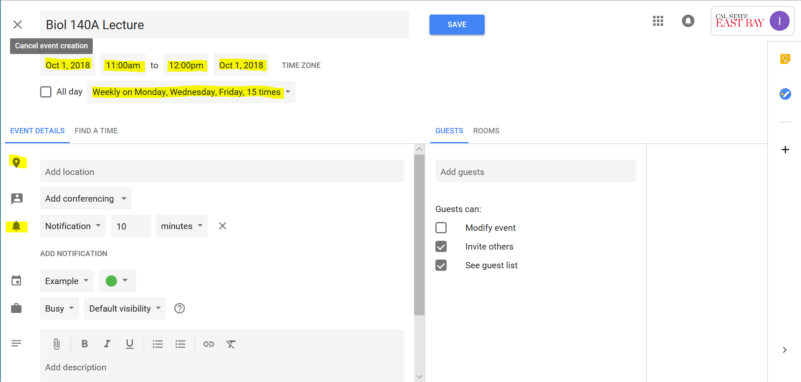
Notes:
Just checking to see I have everything filled out!

Slide 12
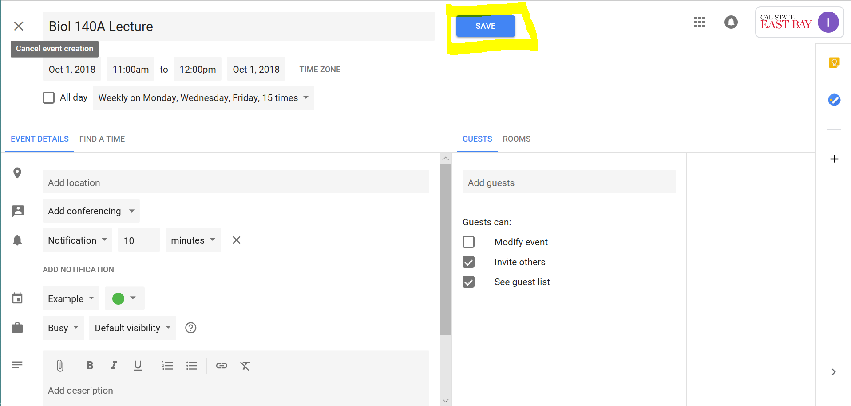
Now all that’s left is to save!
Notes:
Now all that’s left is to save!

Slide 13
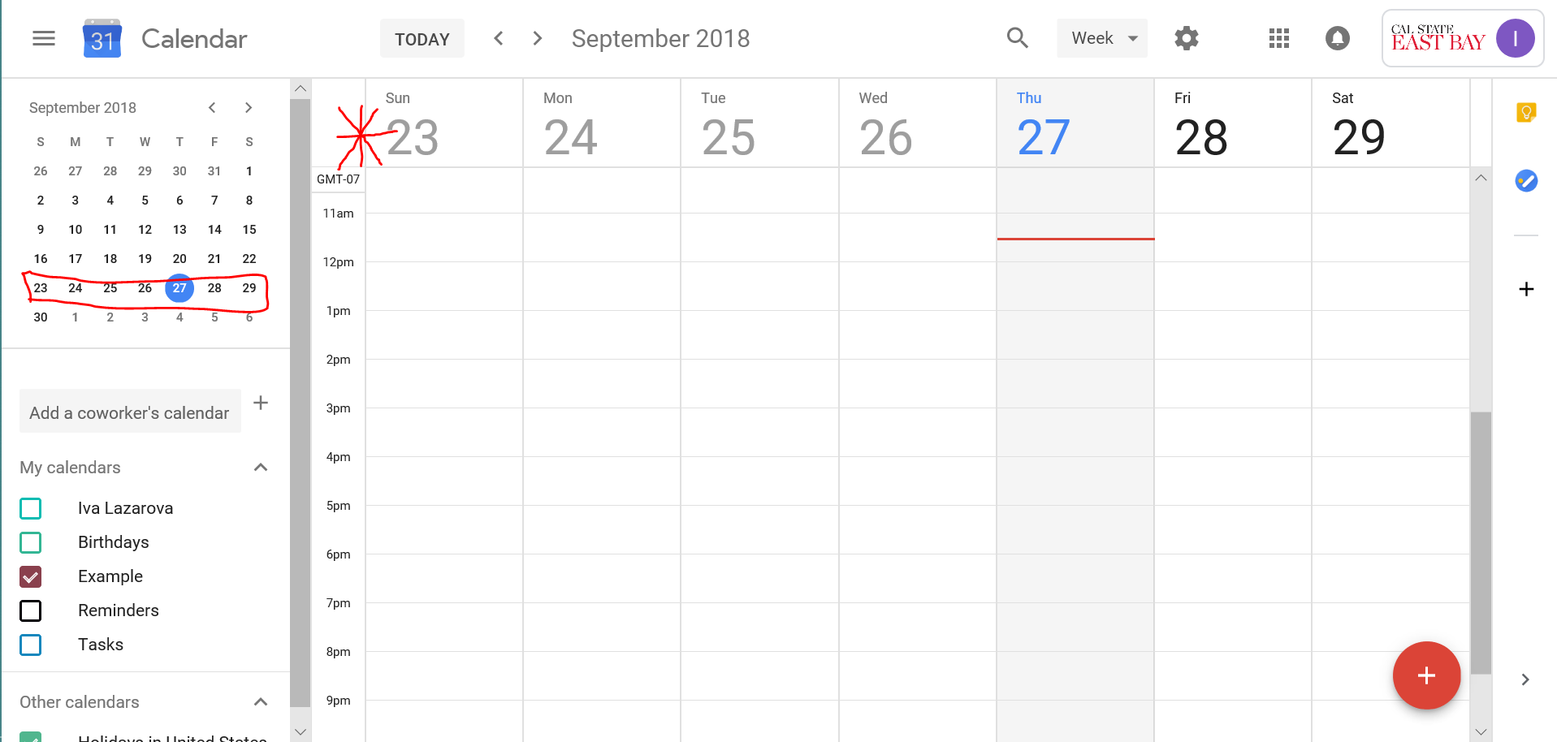
Wait, where did my appointment go?
Notes:
Remember- we set the appointment for Oct. 1, but we are not on the week that has Oct. 1.

Slide 14
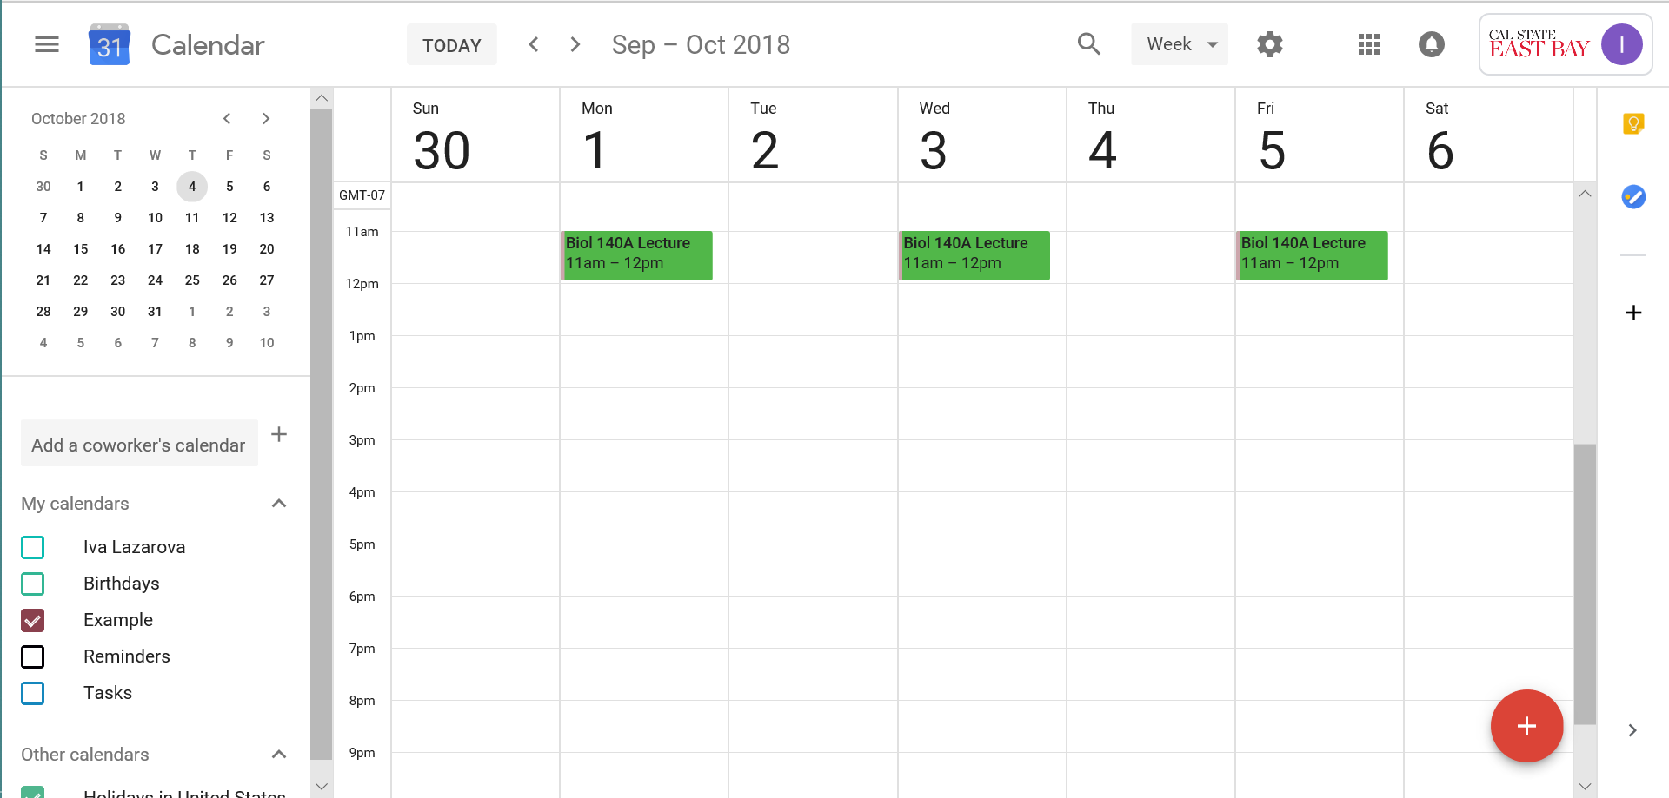
Oh, found it!

Slide 15
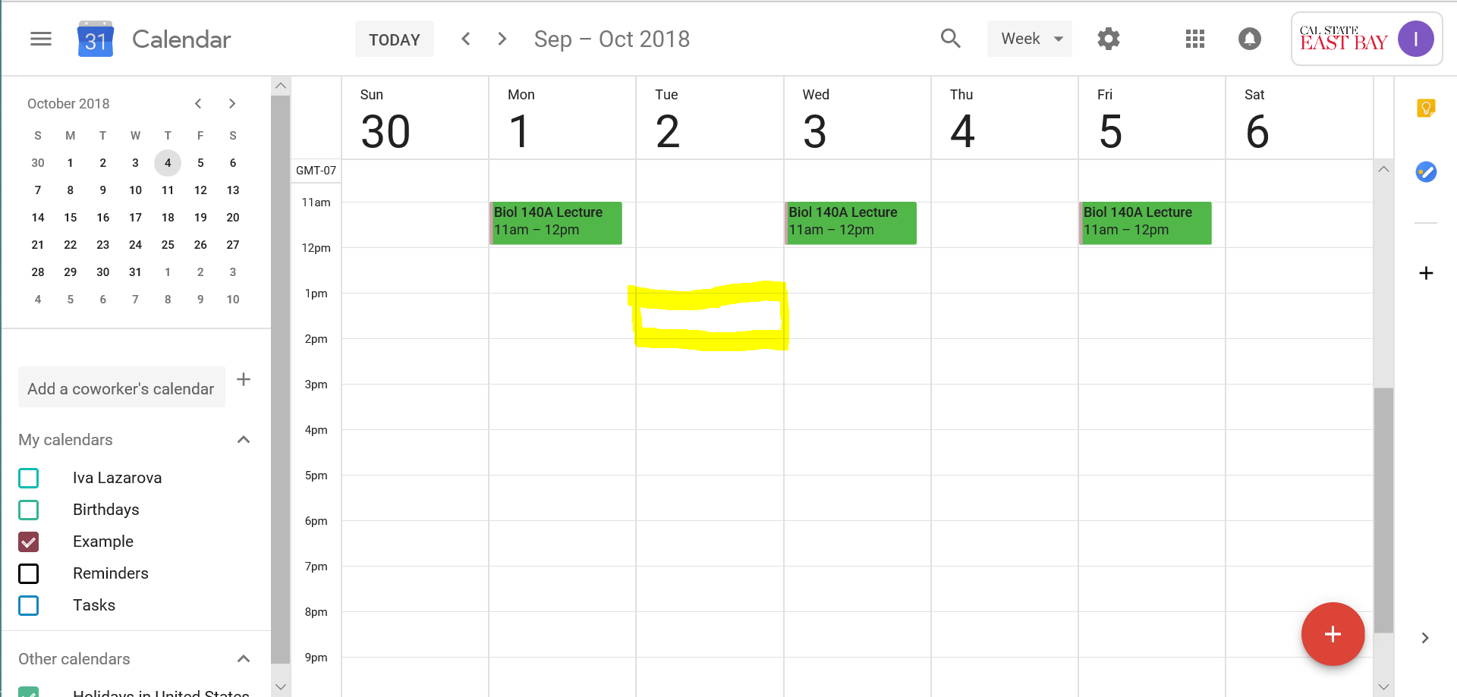
Notes:
A second way to add appointments!
Click at the time you want.
NOTE: Clicking in the middle of the box will start the appt at X:30 instead of X:00. Click as close to the line as possible if you want X:00
Pop up with more options!
Double check your times.

Slide 16
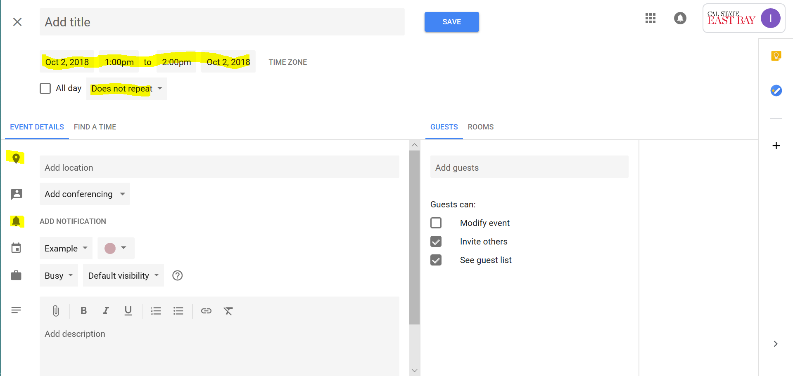
Notes:
Takes you to the same screen as before, just check to make sure the important things are entered!
Then Save

Slide 17
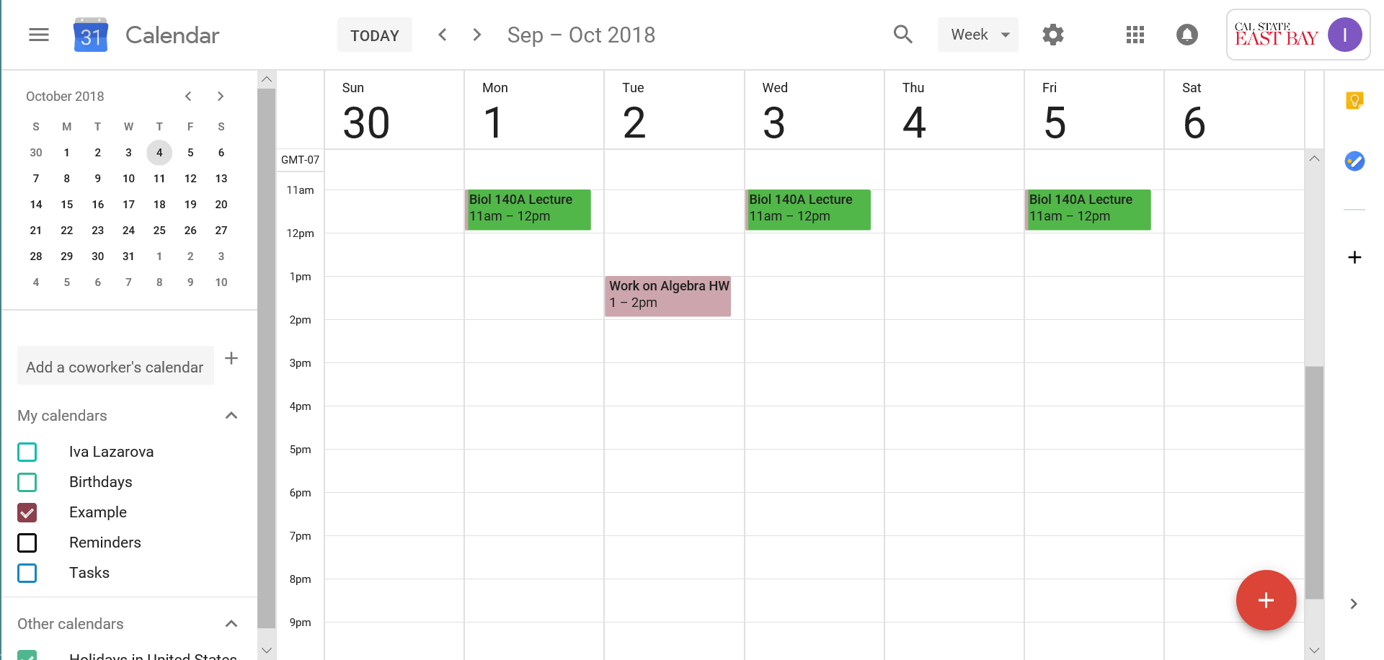
Notes:
Look, your new appointment is in too!
Continue repeating this process until all appointments are in there.

Slide 18
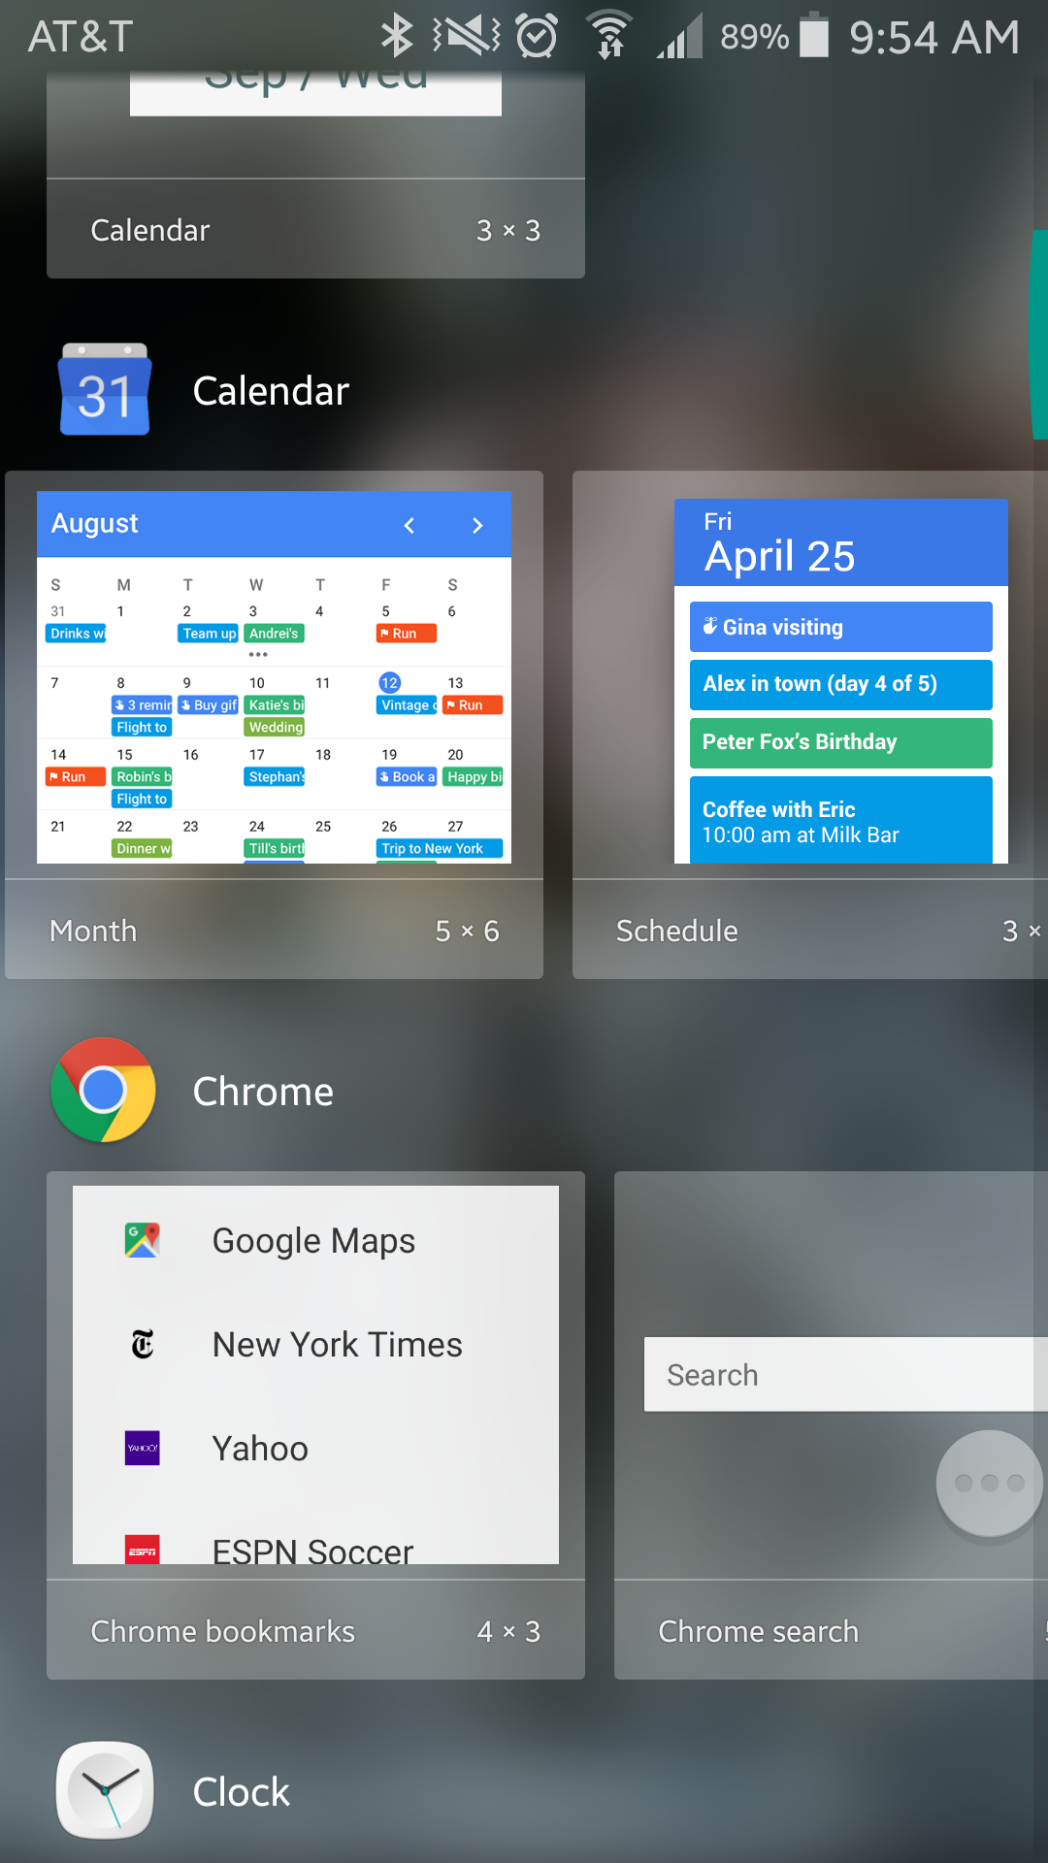
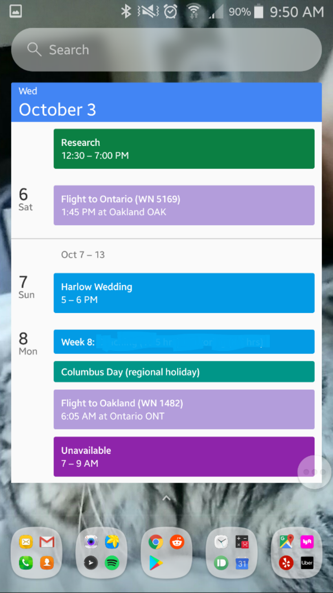
You can also add it to your phone’s home screen as a widget (resizable).
This allows you to quickly glance at appointments, and allows your notifications to pop up on your phone, so you never miss them!

