Slide 1
Cal State East Bay Campus Sustainability Committee
Fall Semester Meeting
November 2, 2018
Notes:
Attendance:
Rocio Camererra
Janay Hansen
Brooke Schuyler
Kim Baker Flowers
Sherman Lewis
Michael Schmeltz
Zachary Meade
Ryan Heryford
Winnie Kwofie
Sharon Chen-Bateman
Anna Alexander
Brian Cook
Martin Castillo
Julie Mielke
Debbie Chaw
Jillian Buckholz

Slide 2
Agenda
Sustainability Affiliates Report Out
ASI Sustainability Affairs Committee
SustainEastBay Club
Faculty Ad Hoc Senate Sustainability Group
Climate Research Group
CSU Sustainability Policy Update
CORE Building Overview
Sustainability Tracking, Assessment & Rating System (STARS) Update
Task Force Updates
Zero Waste
Procurement
CAP IT

Slide 3
Sustainability Affiliates Report Out
Notes:
Zachary
Committee is seated
Bringing together campus stakeholders
Goals: create an internal policy for clubs and orgs for sustainability
Brooke
Meet every other week
Campus Clean Up, 37lbs trash
Interest in starting a garden or garden club
Community engagement
Ryan
Comments on policy documents (CAP and CSU Sustainability Policy Draft)
Curriculum work
Sustainability minor, have charter and pathway developed
Space for student member in charter, have 9 faculty
Meeting date/time, 1st and 3rd Monday of month, 12pm - 1:30pm in SF 466
Michael
Climate change and public health background
Engage faculty in climate change research
Working group, CSUEB Climate Change working group
Was a strategic grant growth opportunity, but went in different direction so didn’t apply
Interdisciplinary research around climate change with public health/welfare is endgame of research
Env sc, physics, biostats, polysci, engineering, others
Developing a web presence on campus webpage
No students currently
Working on next meeting date/time
RFP for transportation development from CIty of Hayward next year, will include sustainability
*NEED RAW SUSTAINABILITY COMMITTEE NEXT MEETING

Slide 4
CSU Sustainability Policy Update
Current policy sunsets in 2020.
The current policy is sunsetting in 2020.
Significant State policy changes and evolving topic-areas from 2009 drafting and 2014 adoption of the current policy.
The Working Groups include:
Culture and Community,
Building and Utilities,
Education and Engagement,
Climate and Resilience,
Materials and Food,
Leadership, Planning and Governance
Transportation and Mobility
Working Groups Formed
Reviewed best practices, relevant policies and drafted recommendations.
Steering Committee Reviewed
Review Teams for each topic provided comment.
Draft Policy Developed
Steering Committee Review

Slide 5
CSU Sustainability Policy Update: Important Notes
The Draft Policy is high-level
Addresses broad goals and objectives.
Answers the “what” and “why”.
The complimentary ”Guide” contains specific actions that can be taken to reach the Board-Level goals.
It answers the “how”.
The update is utilizing a “sandwich” approach – meaning there are critical elements of advancing sustainability CSU-wide that will be incorporated beyond the the board-level policy.
These include: SUAM, Executive Orders, Contracts, RFPs as well as the guide referenced above. See the next slide for an illustrative description of this approach.
Critical elements of building and utilities still need to be properly addressed and incorporated.

Slide 7
CSU Sustainability Policy Update: Pre-Draft Policy Input Process
The Draft Policy can be accessed here.
The draft “Guide” referenced previously is linked to in the introduction of the Policy.
Please provide initial comments by November 5th.
You will have an opportunity to review this policy again.
Please submit comments using this form.

Slide 8
CORE Building Overview
Notes:
General Info/Layout:
Sharon is project manager
Central campus location
First floor collaborative/innovation space
Second floor quieter with library stacks
Natural light is key sustainability element
Third floor more quiet than second floor, a lot of collaborative space
SCAA on the third floor
Third floor bridge
First to second floor elevator
April 2019 ground break, done summer 2021
Sustainability features:
Net Zero Energy Ready
Rooftop solar, no funding to accommodate, but have infrastructure for solar
LEED Gold certification goal
Daylight features reduce electricity use
Recyclable content within interior
Water efficient fixtures
HVAC efficient system
Zero waste building, willing to work with students on this feature
Collaborative space is intentional
Color based on cultural themes
Art to demonstrate different cultures
All gender multi stall facilities on first floor
Drought tolerant landscaping
Irrigation controls
Bioswales around building to collect stormwater
Plan to keep current trees
First floor will have 24/7 space
San Marcos example about connecting basic needs with facilities in 24/5 space
No geothermal
Solar IV MEA is cost effective

Slide 9
STARS Update

Slide 10
STARS Update
Sustainability Tracking, Assessment & Rating System
A program of Association of the Advancement of Sustainability in Higher Education (AASHE)
Comprehensive look at sustainability in:
Academics
Engagement
Operations
Planning & Administration
Requires cross-campus collaboration:
All Divisions
At least 18 departments
Over 25 responsible parties
End of year internal deadline to submit to President’s Office
Goal: Earn rating by Earth Day, April 22, 2019

Slide 11
Task Force Updates: Zero Waste
Restructuring Zero Waste Subcommittee
Currently meeting monthly with Winnie Kwofie & Loralyn Perry (separately) to determine next steps
Goal: Zero Waste Campus
What are the crucial initiatives? First steps?
Notes:
Training of janitorial staff for zero waste
Bag color with correct color bin
Training by end of April
Streamline number of library bins
Strategic locations, work with ASI
Larger bins in the library
Education for students
Context of education, repurposed materials
Waste management doing education, like Recology
Update signs for items that are more particular to various areas of the campus
Walk with Grounds for location of bins outside
SA/SF contamination

Slide 12
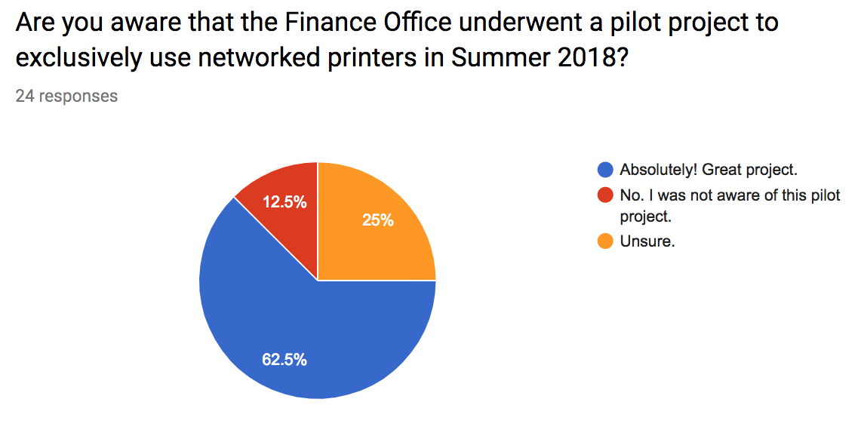
Task Force Updates: Procurement

Slide 13
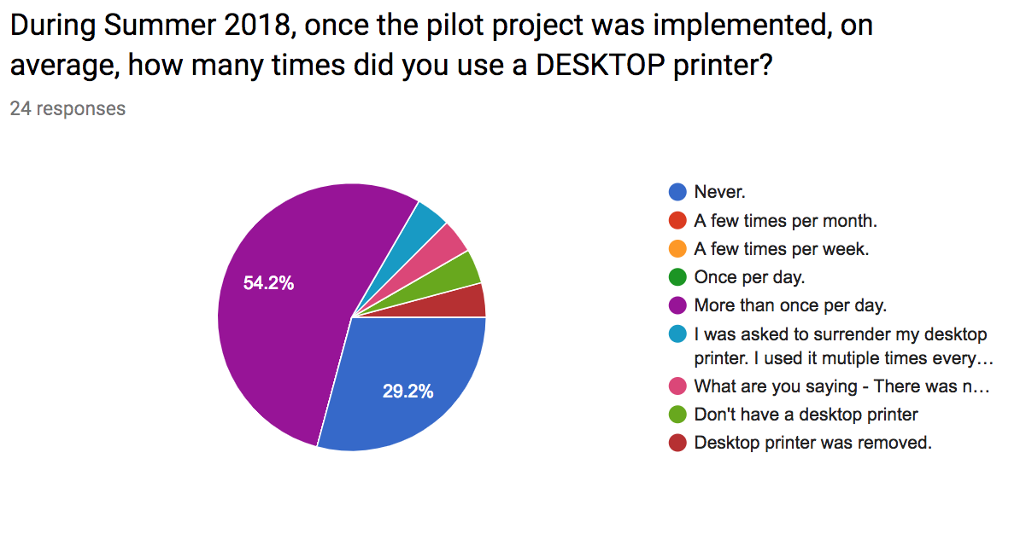

Slide 14
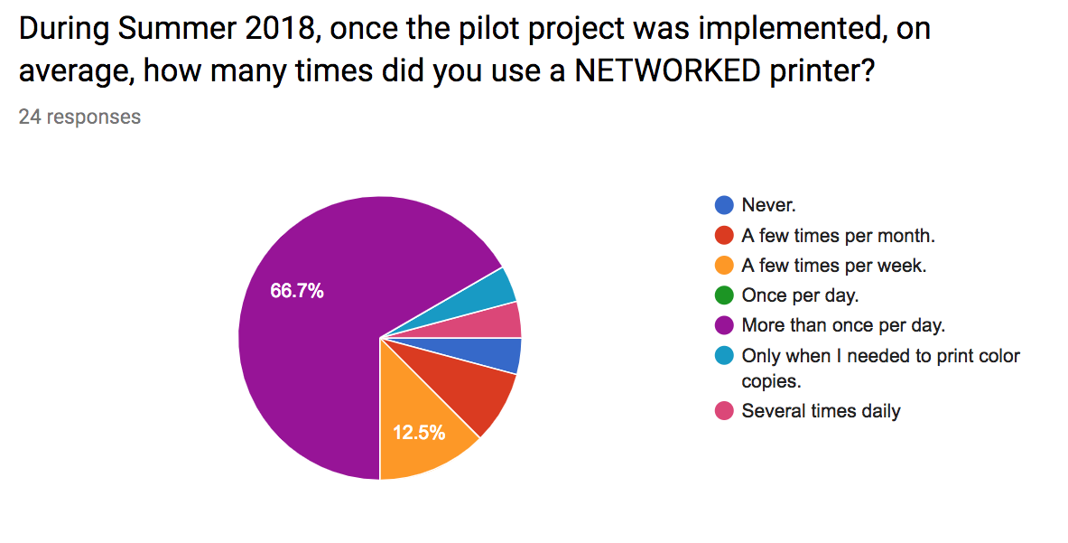

Slide 16
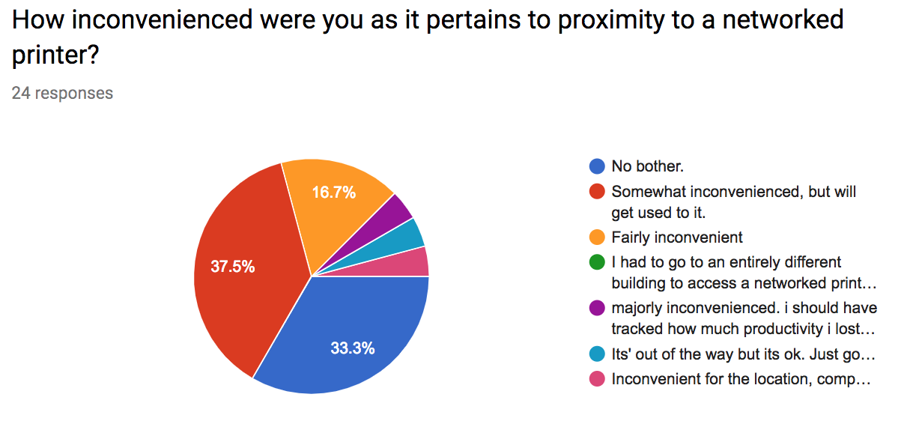

Slide 17
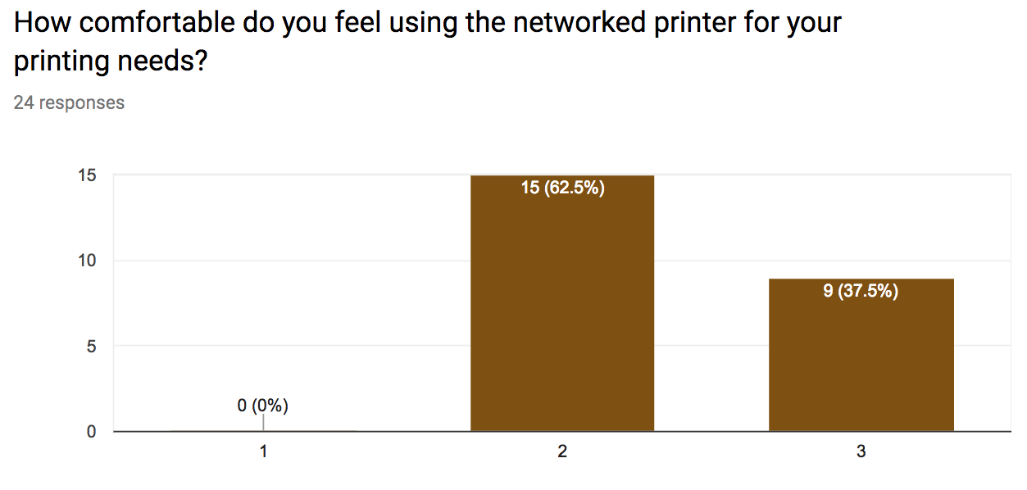

Slide 18
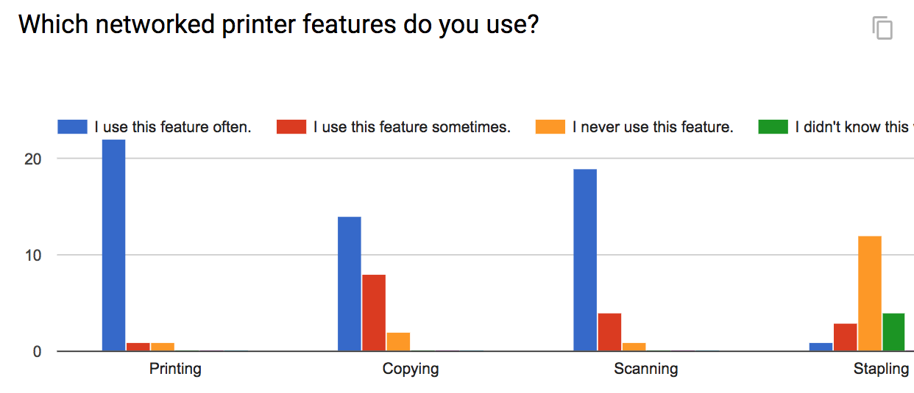

Slide 19
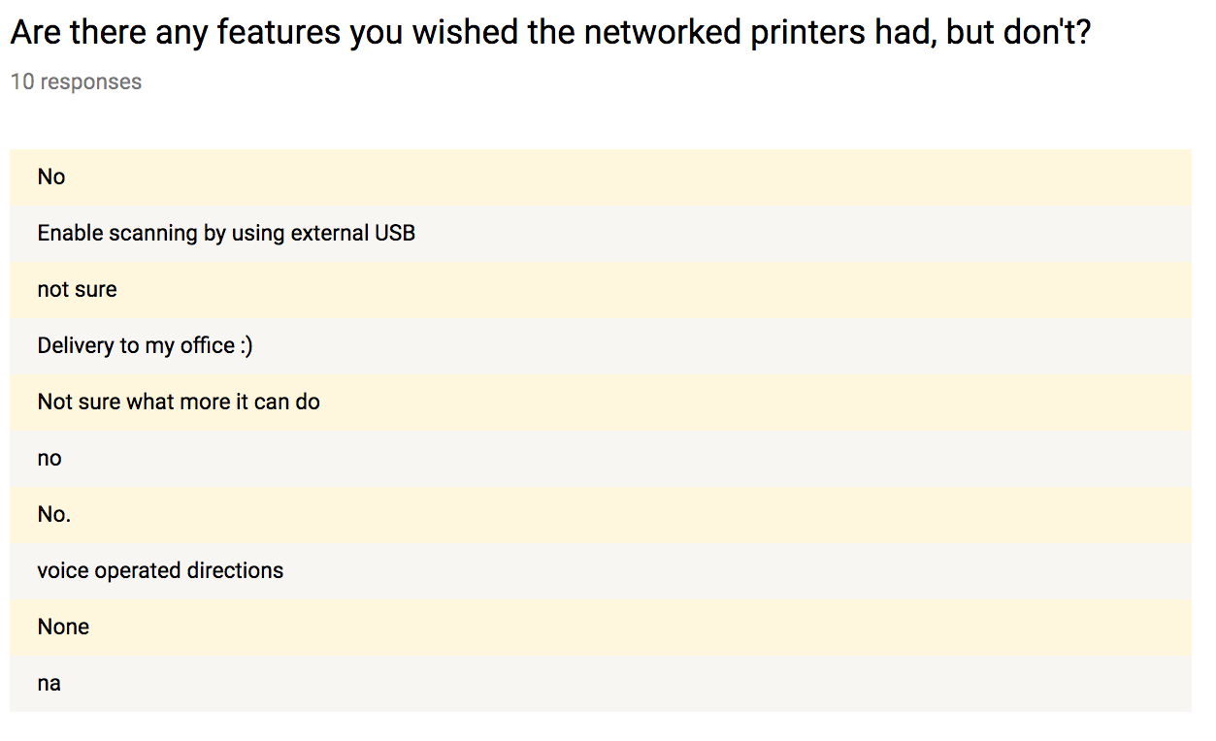

Slide 20
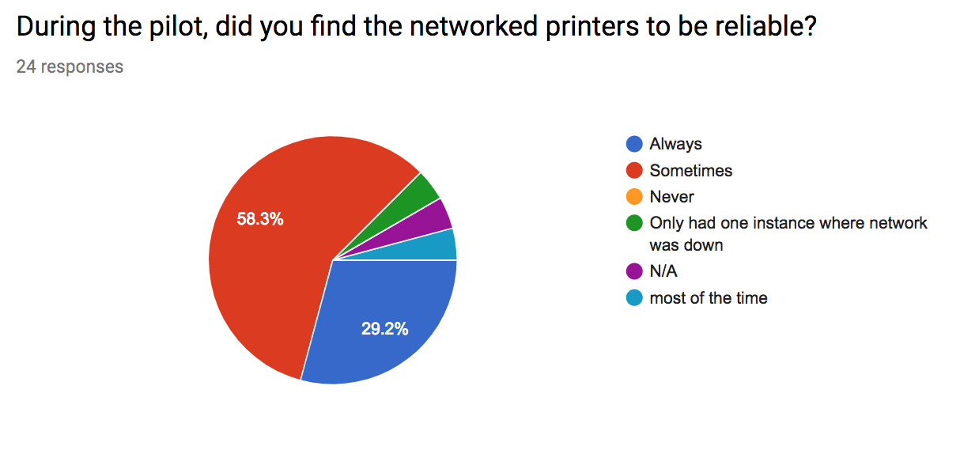

Slide 21
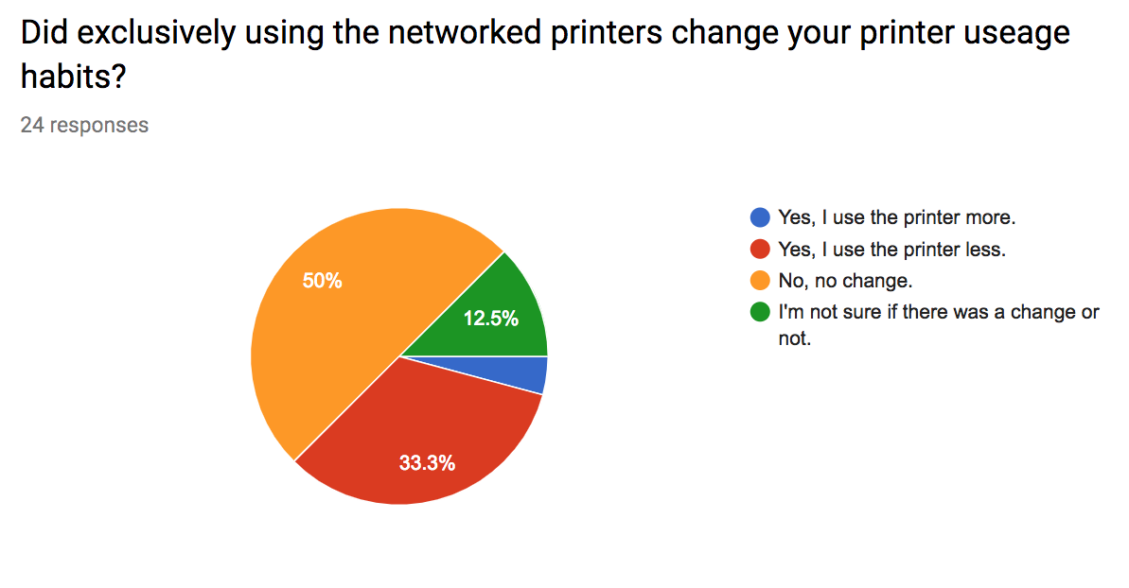

Slide 22
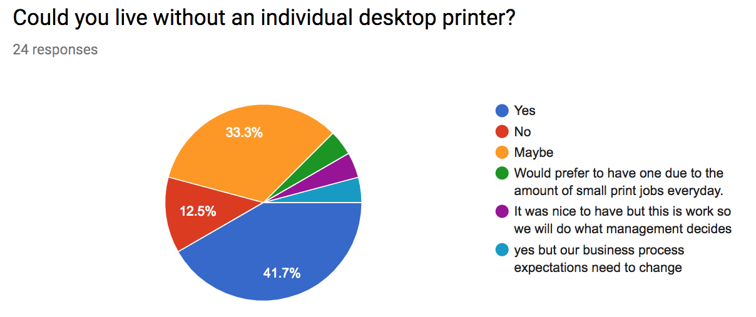

Slide 23
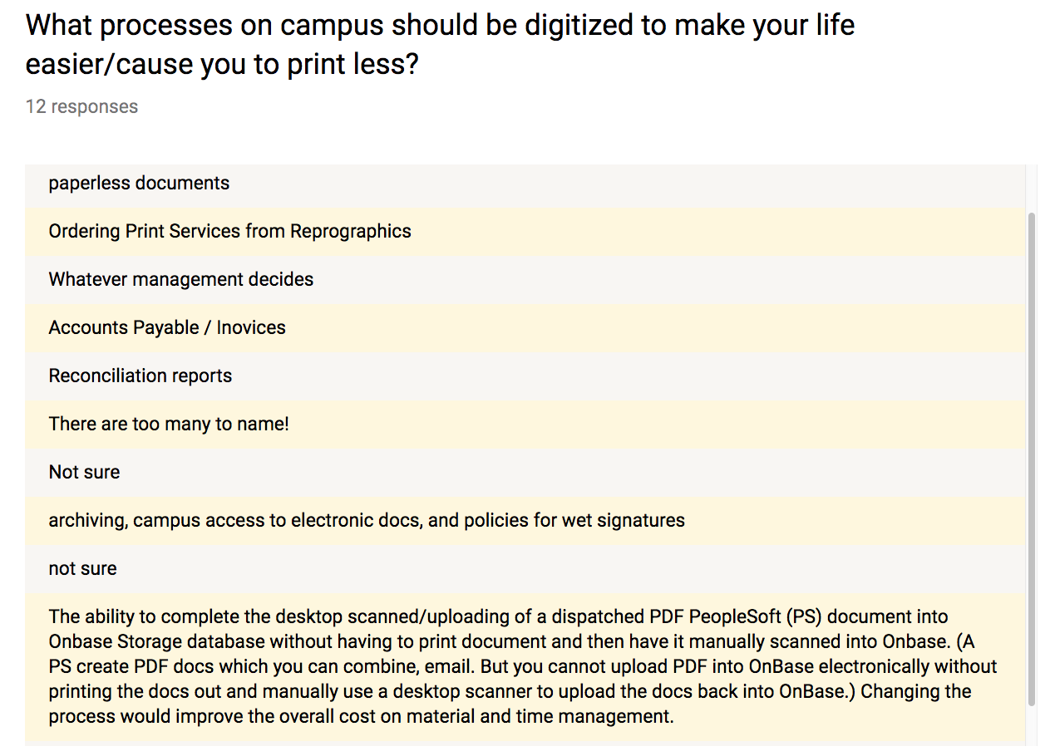

Slide 24
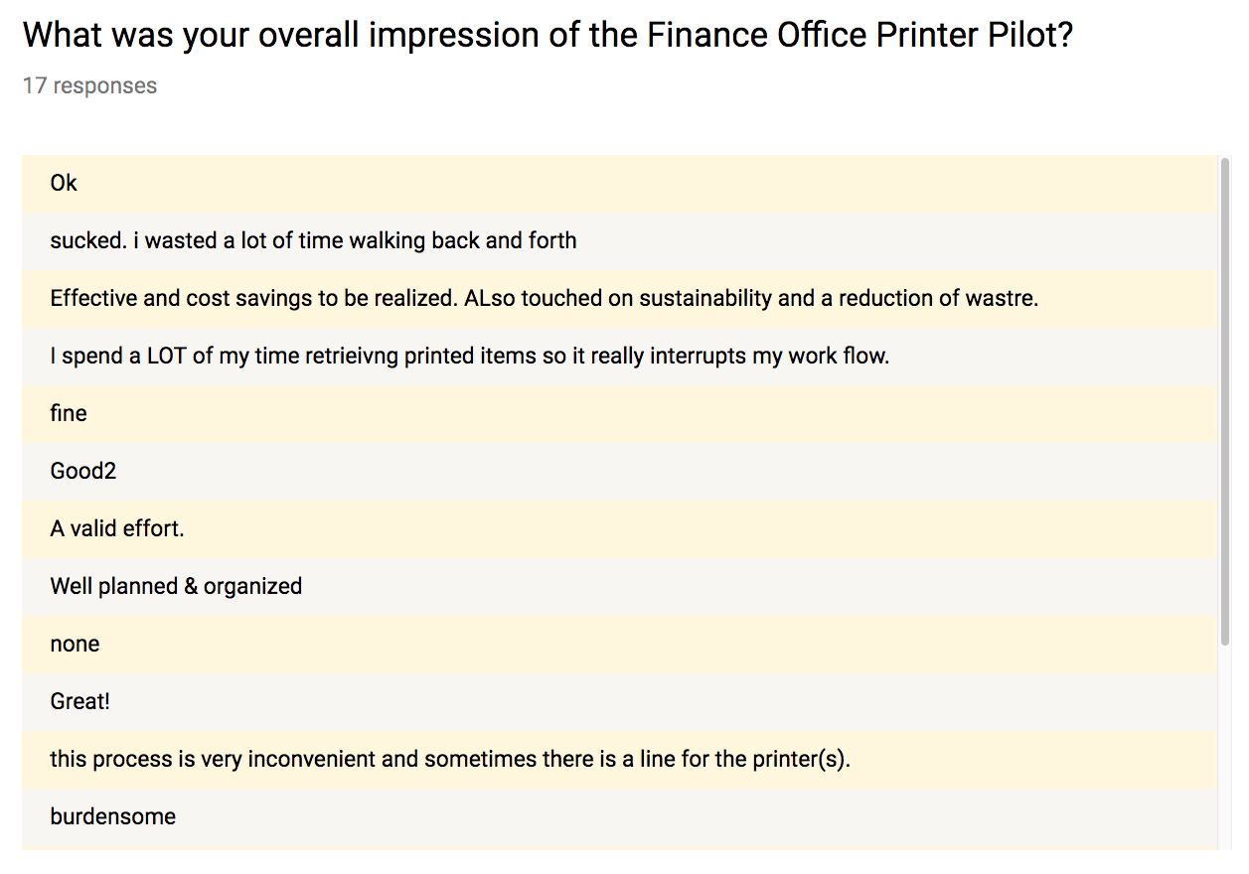

Slide 25
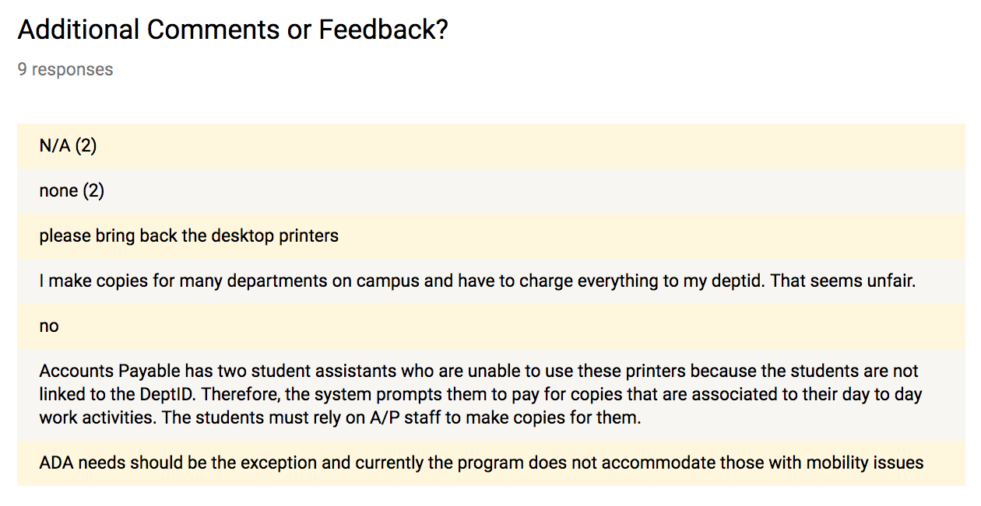

Slide 26
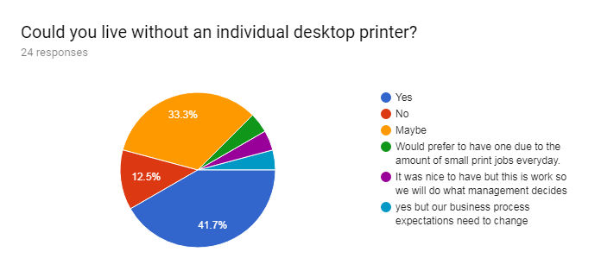
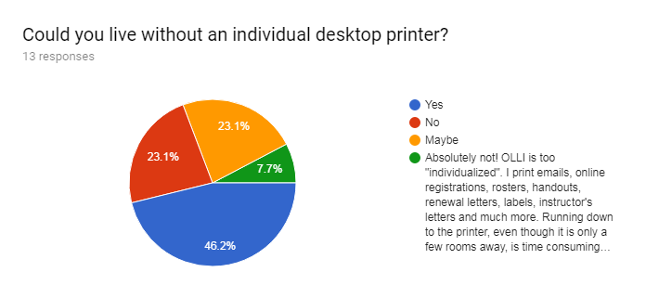
CSUEB Finance Office
CSUEB Concord
Notes:
20+9 = 29 out of 37 surveyed said they can live or maybe live without a desktop printer. That is almost 80% of survey takers.

Slide 27
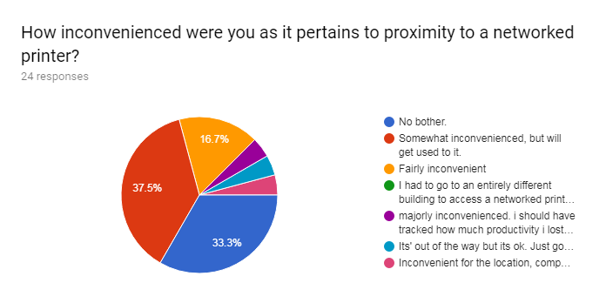
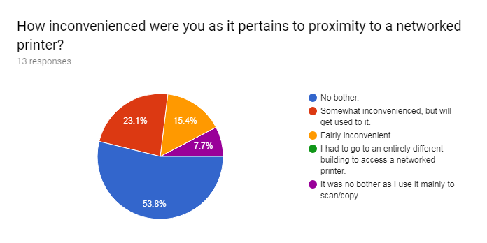
CSUEB Finance Office
CSUEB Concord
Notes:
27 of 37 responders said that they were not bothered by the location of the networked printers or that they will get used to it. In order to increase satisfaction, it may be beneficial to revisit placements in the future.
--
Next steps: Academic programs
Jillian/Debbie talk to Provost about next steps
Code machines correctly so that Dept IDs are listed in machines - setup in advance for Academic units
We’d get more support if we have a better understanding of what requires a wet signature and what doesn’t
Have adobe sign for digital signatures
Veronica may have list of wet signatures required on forms

Slide 28
Task Force Updates: CAP IT
CAP IT kick-off with President Morishita
CAP IT Monthly Meetings
One meeting held
Review of Action Steps by CAP IT Members
Convene with teams and report back
Challenges
Quick wins
Resources needed
Support needed
Signing contract (for supervisor/VP, too)
Designing data tracking system
Annual reporting to President and Second Nature

Slide 29
Spring Semester Meeting
Friday, April 12th
2pm - 3:30pm
Old UU 102

