Slide 1
Travel Expense Claim

Slide 2
Do I need to file a Travel Expense Claim?
Yes, All travelers are required to file the travel expense claim regardless of whether or not they are seeking reimbursement.
Upon return you will have 30 days in which to file your Travel Expense Claim. After which time you will no longer be eligible for reimbursement.
If you are not seeking reimbursement, you will still need to file a Travel Expense Claim to account for all prepaid expenses the College/Department has incurred for this event.
Work with your Faculty Advisor in charge of the event for any documents you may need copies of.
Notes:
Don’t forget to include information about mileage

Slide 3
You will need all the following documents
Pre-Travel Documents
Travel Authorization form (signed)
Academic Field Trip Waiver form (signed)
Event Agenda
Event registration confirmation (showing total cost and payment)
If you drove your personal car
Driving Safely, Driving Smarter certificate
STD 261 -Authorization to use Privately Owned Vehicles
INF 1101 - Authorization of Release of Driver Record Information
Receipts
Hotel/Lodging
Flight Itinerary
All meal receipts (must be itemized)
Any additional receipts for which you are seeking reimbursement.
Chartfield String
Faculty advisor should provide this to you.

Slide 4
Are my receipts correct?
All receipts must be itemized.
All receipts must have date of purchase.
All receipts must show proof of payment.
All receipts must be in PDF format.
Hotel/Lodging & Flight receipts must show travelers name.

Slide 5
Receipt Examples

Slide 6
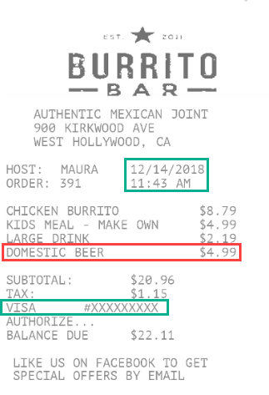
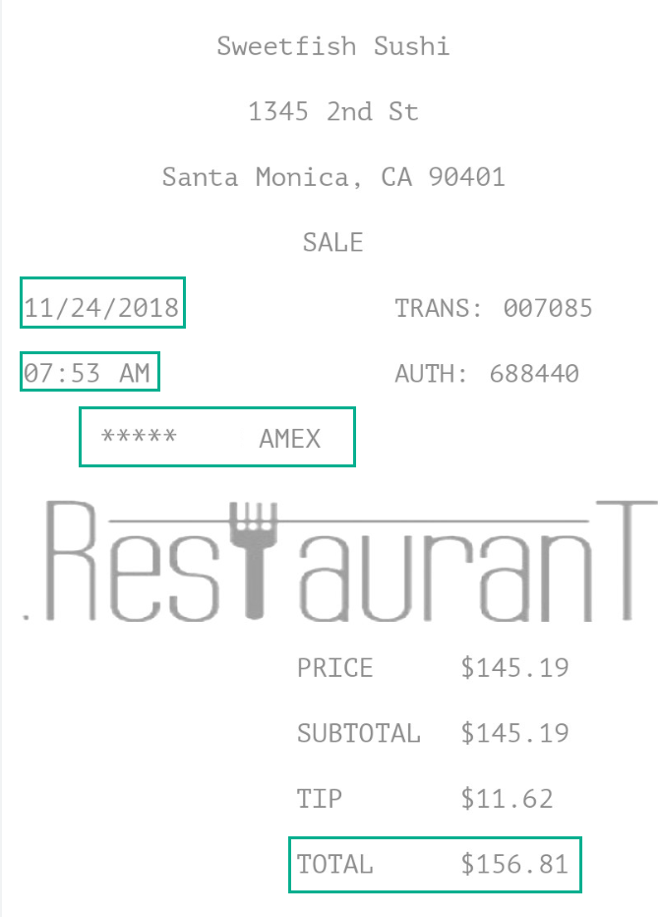
Meal receipts
Correct type of receipt (Approved)
Unacceptable receipt (Not Approved)
Not itemized
Not Approved
Even for approved receipts, if there are unauthorized purchases such as Alcohol the expense of the item will be deducted from the receipt total.
Notes:
Remind them alcohol is prohibited and mention the travel website

Slide 7
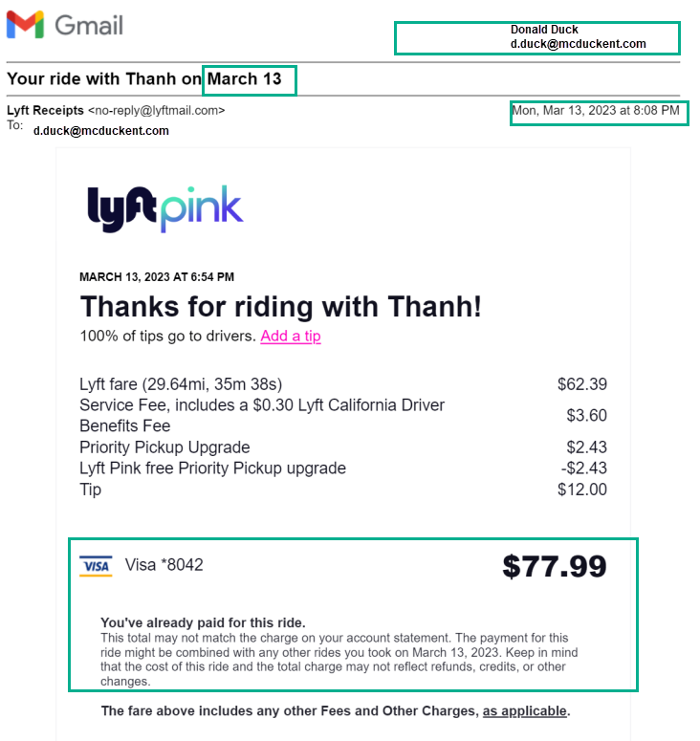
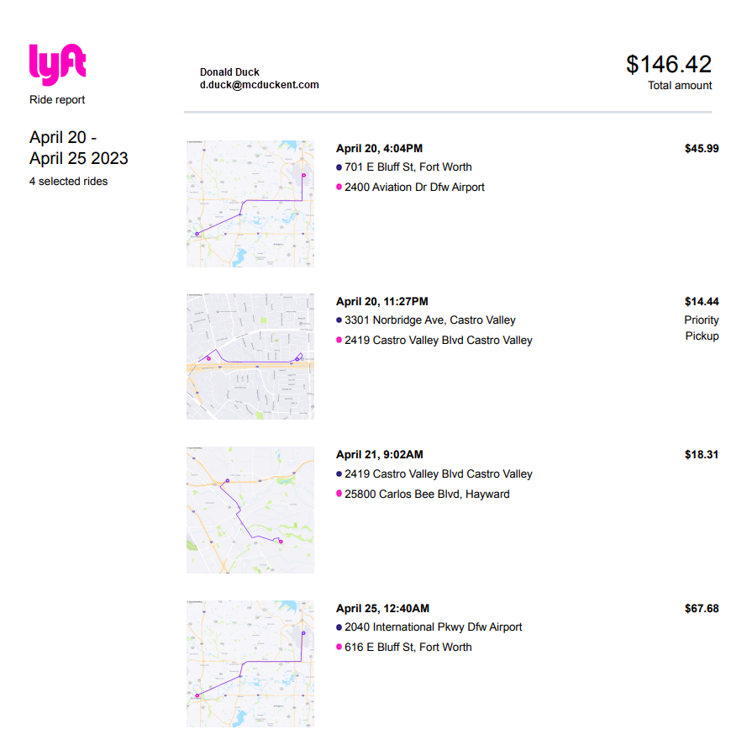
Transportation Expenses
Uber, Lyft and Taxi Cabs
Correct type of receipt (Approved)
Unacceptable receipt (Not Approved)
All receipts require minimum of the following data.
Traveler Name Dates of expense
Total Amount
Proof of payment

Slide 8
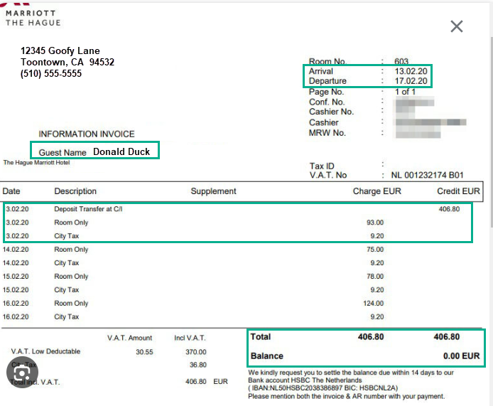
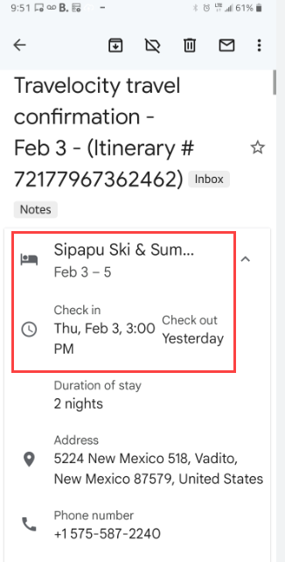
Hotels and Lodging
Travelers Name must be on the room invoice
Correct type of receipt (Approved)
Unacceptable receipt (Not Approved)
Must have travelers name
Must show check in check out
Missing itemized per night pricing.
Missing name over traveler
Missing verification of payment and total
Must show per day rate
Must show total balance and total paid

Slide 9
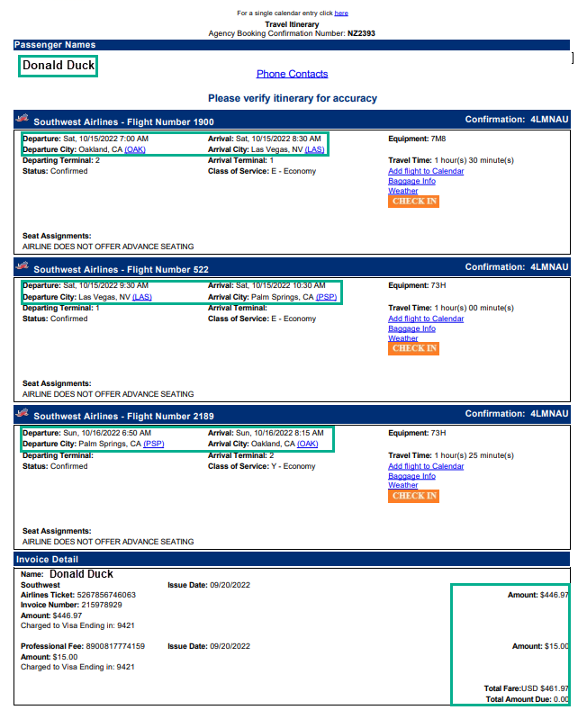
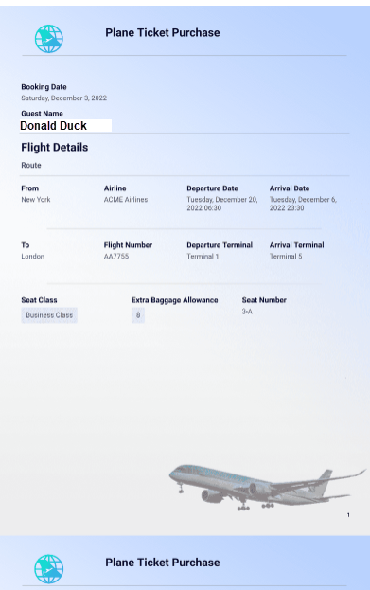
Airfare
Airfare must have specific itinerary
Correct type of receipt (Approved)
Unacceptable receipt (Not Approved)
Name of Traveler
Full flight itinerary
Full cost of flight and no balance due.
Notes:
Airfare in lieu of mileage

Slide 10
Airfare in lieu of mileage policy
If an employee/student/contractor elects to drive vs flying, they may be reimbursed for the lesser amount “Airfare in lieu of mileage”. The employee needs to obtain a price quote from the airlines, minimum 21 day advance quote and attach it to their claim. If someone within the department is also traveling to the business conference by airlines, you may also use their ticket as a price comparison.
Policy information is located on the University Travel website.

Slide 11
Travel Expense Web Form

Slide 12
Authorized Approvers for your claim
Who needs to sign your claim in order for it to be reviewed by Accounts Payable for payment. Ask your Faculty Advisor or Administrator for the appropriate name and email addresses 1. Delegation of Authority Approval (Delegation of Fiscal Authority Approval) 2. Additional Approver 1
3. Additional Approver 2 (optional typically used if your grant funded)
Notes:
If information is not correct the document need to be resubmitted. As they will not route appropriately. Make sure they check in with Faculty Advisor

Slide 13
Step One: Travel Expense Claim Web Form
Navigate: csueastbay.edu > Right hand corner click search > Type Accounts Payable > Click first option, scroll down “Forms” > Under “Travel Expense Form - To be used by students and non-employees > Click on (Web form)
Fill out the web form using the appropriate Authorized Approvers. Make sure to use your CSU Horizon email account. University Accounting will only communicate to student via the Horizon email account as a security measure. It is important you use only the Horizon email address.
BEFORE you click submit, just above the email for accounts payable click on the link to Download a copy of the Travel Expense Form. This is a Google Sheets form and you will be prompted to save a copy. Save the copy of the form to Excel via the file > download > Microsoft Excel Rename your Excel file with the following naming convention; First Last Name-Name of event-Term and Year
Notes:
Make sure to indicate students must use Horizion account

Slide 14
Step Two: Adobe sign email
After you have submitted the Web Form you will receive an email from “Cal State East Bay” with the subject of Signature requested on “your name_Travel Expense Form”
Save this email, you will need it at the end of the process. Just flag it or leave it as unread in your inbox. Make certain you can find it easily. This is the portal you need in order to submit your claim.
See Example Below

Slide 15
Filling out the Travel Expense Claim form

Slide 16
Step Three: Travel Expense Form
This is the most important form in the process. This is the document Accounts Payable will use to review your claim to issue a reimbursement check.
Have all your documents ready.
Put them in chronological order.
Make sure all documents are PDFs except the Travel Expense Excel form.
When you complete the Travel Expense Excel form be sure to save it.
Keep copies of everything you submit for your records.

Slide 17
Section 1 Your Contact Information
Enter your legal name to ensure you have no trouble cashing the check.
Enter full mailing address. Missing data will delay your check.
Enter a phone number in which you are able to be reached.
Net ID
Notes:
Use full mailing address as this is where the check will be sent. Use appropriate name.

Slide 18
Section 2 Purchased by University
This is normally only the registration for the event. However, depending on budget it could mean additional expenses. You will need all receipts pertaining to these expenses.
Notes:
The dates in this field are in reference to the dates of the trip

Slide 19
Section 3 Advance/Pre-paid/Purchase by Traveler (your expenses)
Example 1 Transportation Type - Flight
Place all expenses for a single day within a single row.
You must have receipts for all items listed on this section.
For lodging you will need to list each day and daily rate.

Slide 20
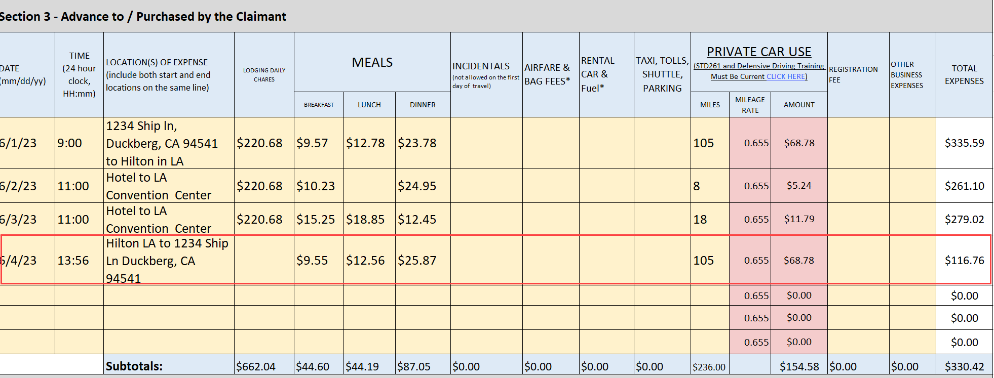
Section 3 Advance to /Purchase by Traveler (your expenses)
Example 2 Drove your own car to the event
Place all expenses for a single day within a single row.
You must have receipts for all items listed on this section.
For hotel you will need to list each day and daily rate.
You will need pdfs of Google Maps to verify the mileage and add to your claim.

Slide 21
Section 4 Purpose/Remarks
Here is where you entered the purpose of your travel and details of the event. Please provide your program name and if you were presenting at the event.
Your claim total will also be calculated in this section. Check that everything is correct.
Attend 14th Annual Anger management Conference 6/1/2023 - 6/5/2023
Students in the MS Counseling program
Notes:
Note the conference dates

Slide 22
Section 5 Cost Distribution
Enter the Chartfield String that your Faculty Advisor or Administrator provided to you.
Charfield Strings must have (Fund and Department) all other fields may not be part of your specific trip. If a (Program, Class, Project) code is provided make certain to add them to the proper field.
Student Travel only has two account categories 1) 606001 - In State Travel 2) 606002 - Out of state travel
Do not use any other accounts in this field. If the drop down is not working manually type them in.
Notes:
Make sure to verify with Faculty Advisor one more time the chartfiled string in case and funding sources may have changed.

Slide 23
Send your claim to Accounts Payable

Slide 24
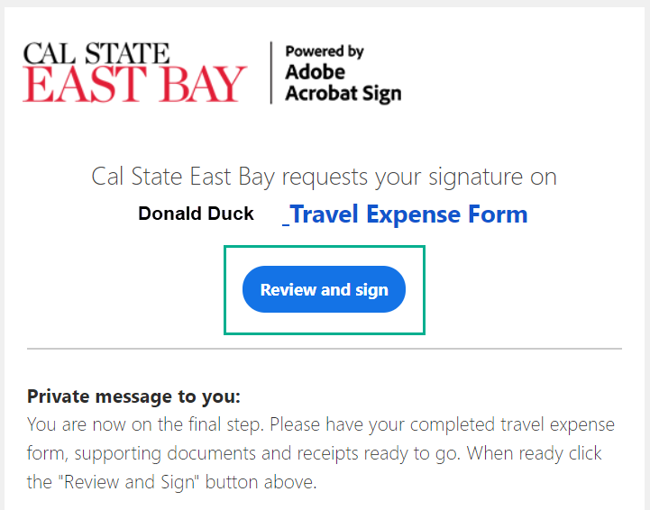
Step 4 Submitting your Travel Claim to Accounts Payable
Go back to your email and locate the email you were sent when you submitted your Web form. It should be from “Cal State East Bay” with the subject line Signature requested on “your name_Travel Expense Form”
Click on the large blue Review and sign button, Adobe Sign will automatically open

Slide 25
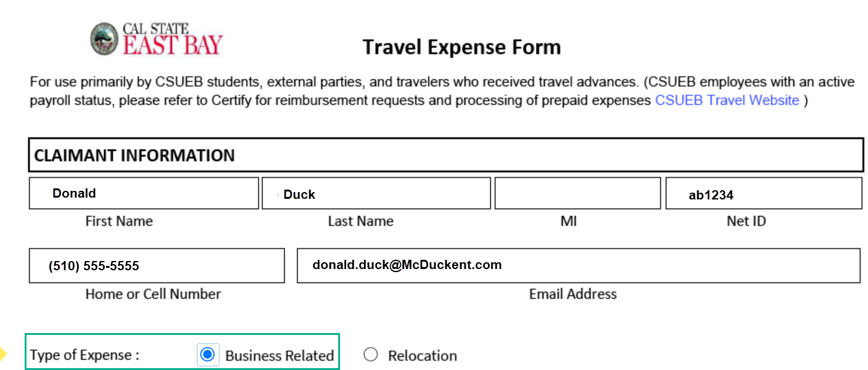
Review your contact information
Once you clicked the blue button to review you should automatically be redirected to the adobe form.
Review the Claimant Information to ensure everything is listed correctly.
Click the button under Type of Expense = Business Related

Slide 26
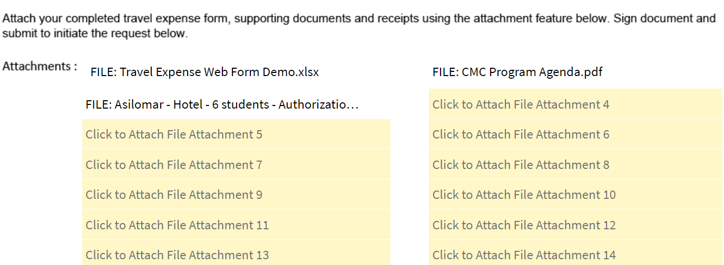
Attached your excel Travel Claim and Supporting Documents
Please attach your receipts and documents in the following order.
Excel Travel Expense Claim
Agenda
Travel Authorization
Travel Waiver
If you drove your own car all your Defensive Driving Forms Or Flight Itinerary
Event Registration
Expense Receipts
Notes:
Mention you have 20 slots for documents

Slide 27
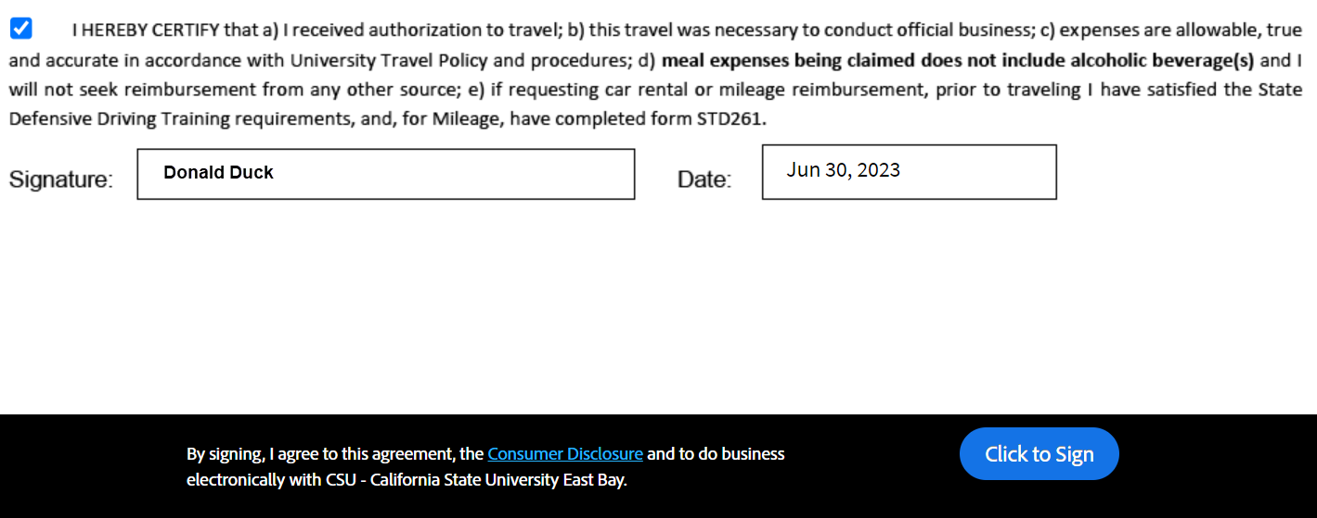
Sign and Submit your Travel Expense Claim
Check the certification button and type you name in the signature field
Click the “click to sign” button to submit your claim

Slide 28
Once you submit your claim
It will take 2-3 weeks to process.
Check your email for any correspondence from accounts payable.
Your primary contact is your Faculty Advisor.
You may also contact us at accounts.payable@csueastbay.edu Please provide your full name and Net ID.
Notify your Faculty Advisor or Department Administrator via email that you have filed your claim. They will also need to submit documentation for expenses paid for by the University.

Slide 29
Thank you for watching!
Please check out our other videos regarding student travel
Student Travel - Before you Travel
Student Travel - Driving on University Business

