Slide 1


Office of Admission
gradadmission@csueastbay.edu
510-885-3500 option 3
Jasmin Magallanes
Assistant Director-Office of Admission
Notes:
Going to answer 6 questions: Who, What, When, Where, Why and How.
First, we’re going to take a minute to watch a short video letting you know who we are.

Slide 2
What We Are Recognized For
Diversity – Consistently named one of the top 10 colleges in the west for diversity: #1 by U.S. News and World Report, #3 by Chronicle of Higher Education among others
Online Program – #1 Best online college in 2017-2018 awarded by AffordableCollegesOnline.org and #19 by OnlineColleges.net
Best Business Schools - #23 in 2018 awarded by Princeton Review
Best Schools for Computer Science Majors by Salary - #56 out of 466 awarded by Payscale.com
Best Online Hospitality Management Programs - #13 awarded by BestColleges.com
Social Mobility Index - #9 in the United States awarded by CollegeNet, #14 by Money Magazine
Notes:
Cal State East Bay is recognized by many independent outlets for outstanding achievements in many areas. Here are just a few of the accolades that we’re proud of.

Slide 3
Why Graduate School?
Career Advancement
  Provide you with skills and knowledge to better position you for better opportunities for advancement in your career
  Great tool to negotiate pay raise
Career Change
  Can prepare you for a bigger career transition, such as switching sectors, industries, or professions by gaining advanced skills and in-depth knowledge of an area outside your specialty
Job opportunities
  Some jobs require graduate degrees or credentials
  Distinguish yourself from the applicant pool & become more competitive

Slide 4
What we offer
Small class sizes
More one-on-one time with professors
Hybrid and online instruction
Late afternoon, evening, and weekend classes

Slide 5
University Admission Requirements
Have completed a four-year college course of study and hold an acceptable baccalaureate degree from an institution accredited by a regional accrediting association or shall have completed equivalent academic preparation as determined by appropriate campus authorities.
Be in good academic standing at the last college or university attended.
Have attained a cumulative grade point average of at least 2.5 in an acceptable earned baccalaureate degree, or a grade point average of at least 2.5 in the last 60 semester units (90 quarter units) attempted, or hold an acceptable post-baccalaureate degree earned at a regionally accredited institution.
Applicants must also meet the graduate program admission requirements.
Individual graduate departments may have additional admission standards for their programs. Contact your academic department for more information.
https://www.csueastbay.edu/aps/graduate-studies/graduate-program-directory.html

Slide 6
When to Apply
Spring Admission
August 1 – November 1
Fall Admission
October 1 – June 1
Summer Admission
February 1 – April 15
Some programs will have earlier application cycles and departmental deadlines. Please reach out to the individual academic department for details.

Slide 7
How to Apply to East Bay
What You Need On Hand:
  A list of all the institutions attended prior to and after your B.A. or B.S. degree with dates of attendance
  Social Security number, if you have one.
  Your citizenship status
  A method of payment You can pay the application fee by credit card.
  Annual income Your parents’ if you are a dependent; your income if you are independent

Slide 8

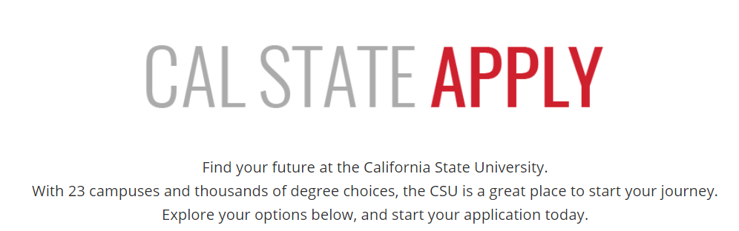

Slide 9
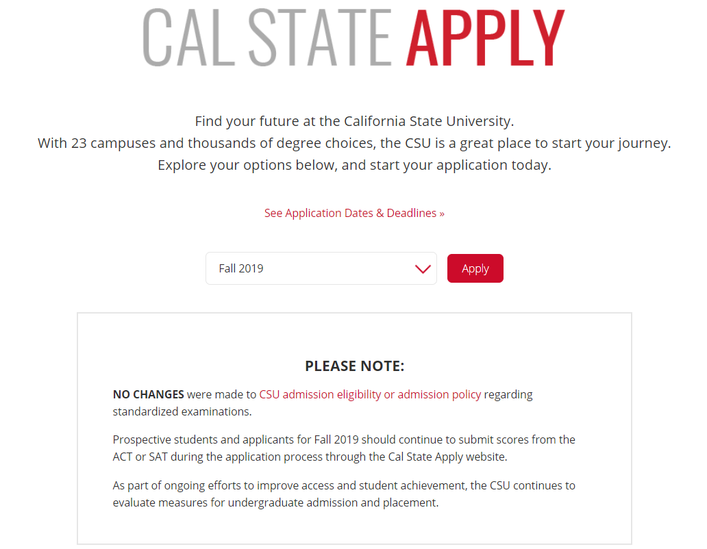
WWW.calstate.edu/apply
Select term

Slide 10
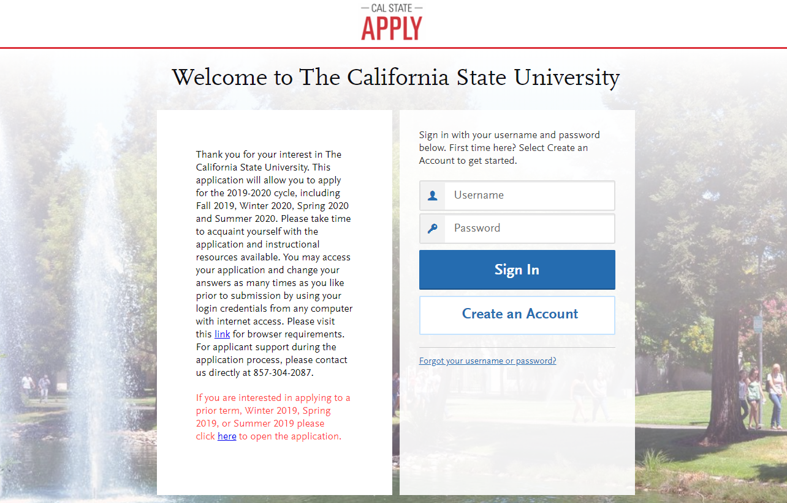

Slide 11
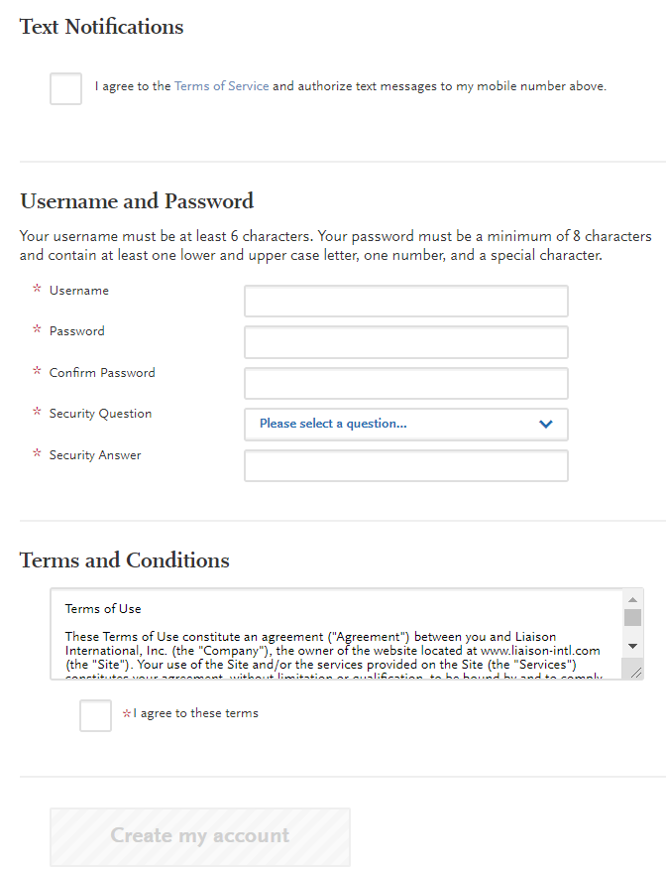
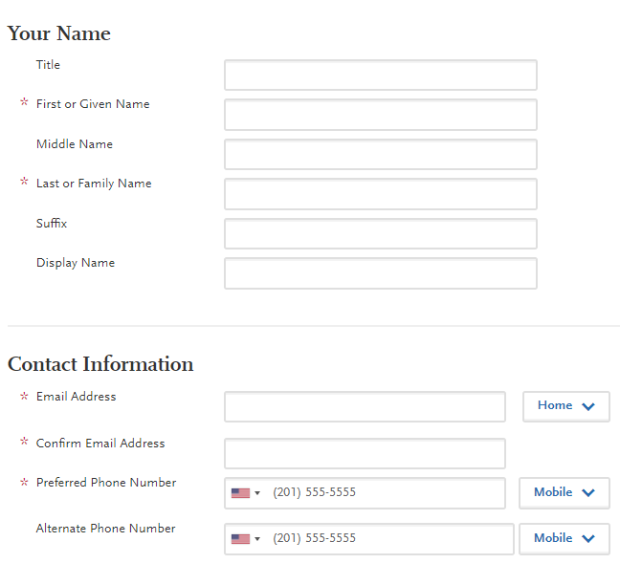
Create an Account

Slide 12
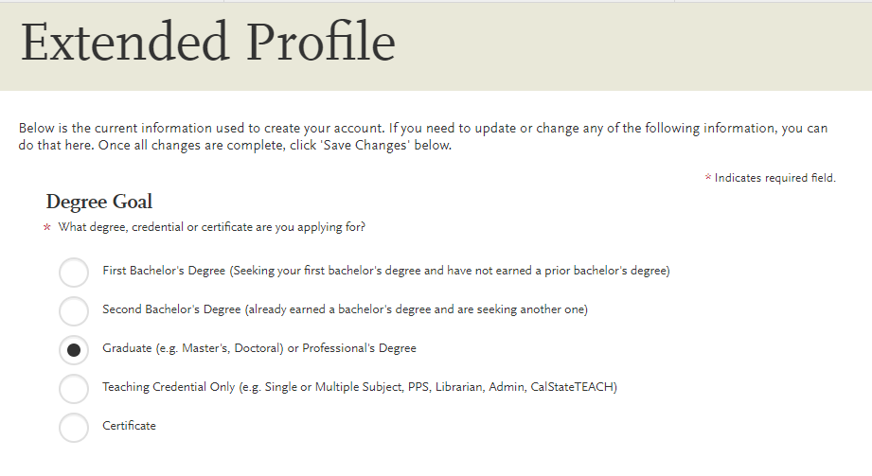
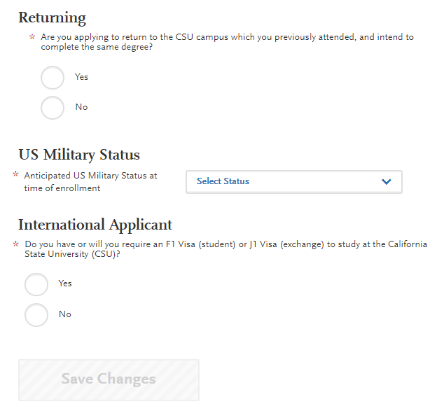
Complete you Profile
Select degree goal

Slide 13
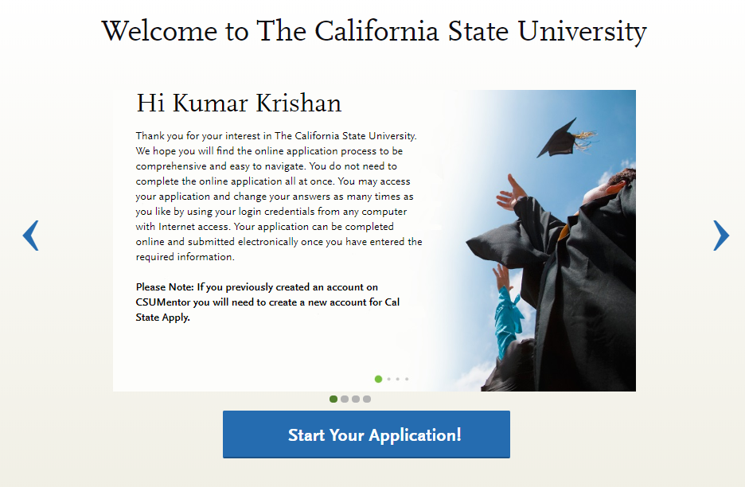

Slide 14
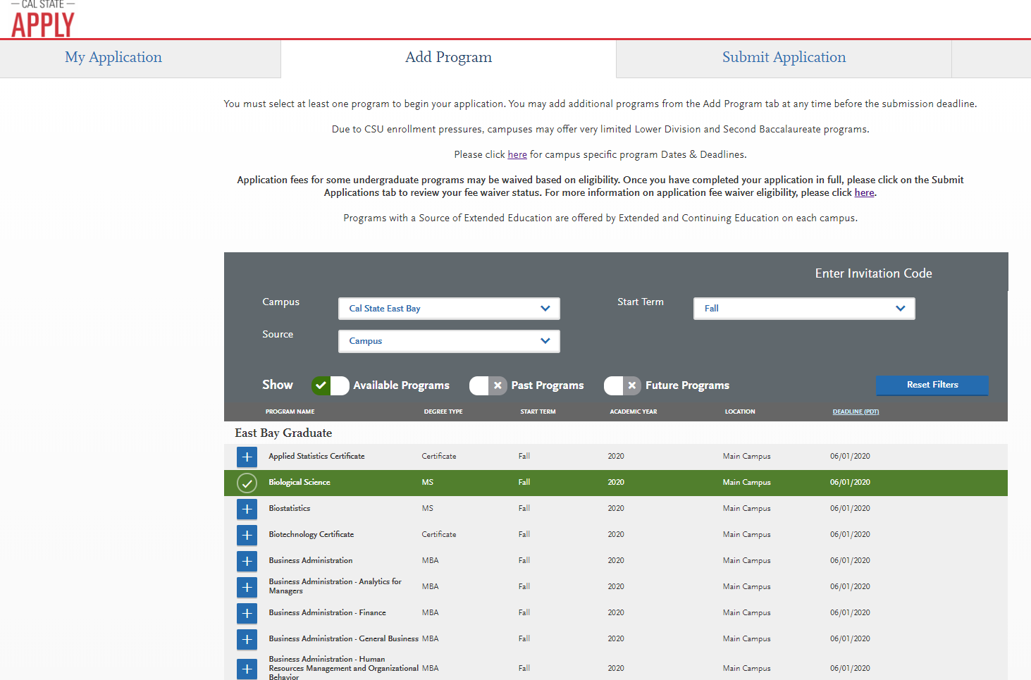
Select the Programs

Slide 15
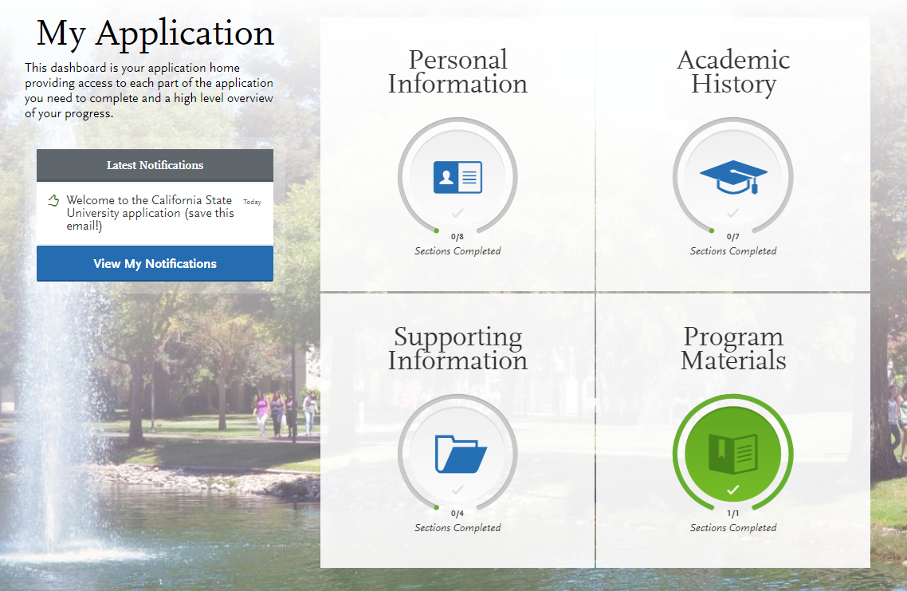
Application Dashboard

Slide 16
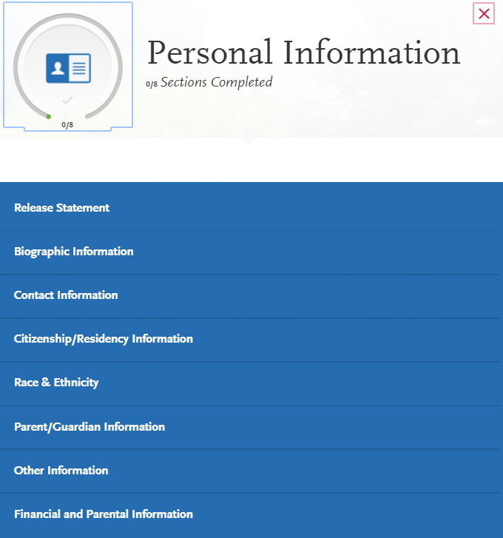
Personal Information

Slide 17
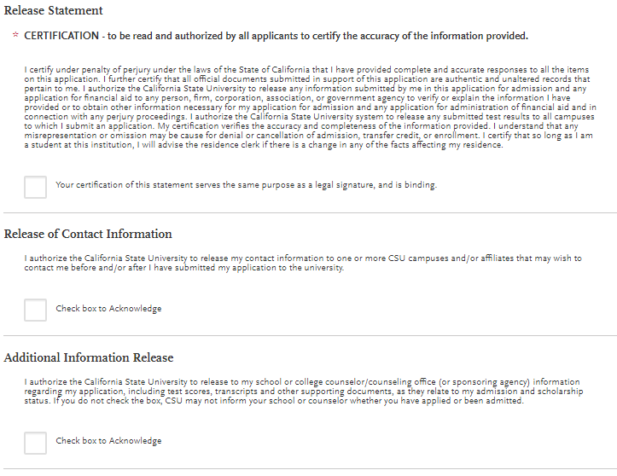
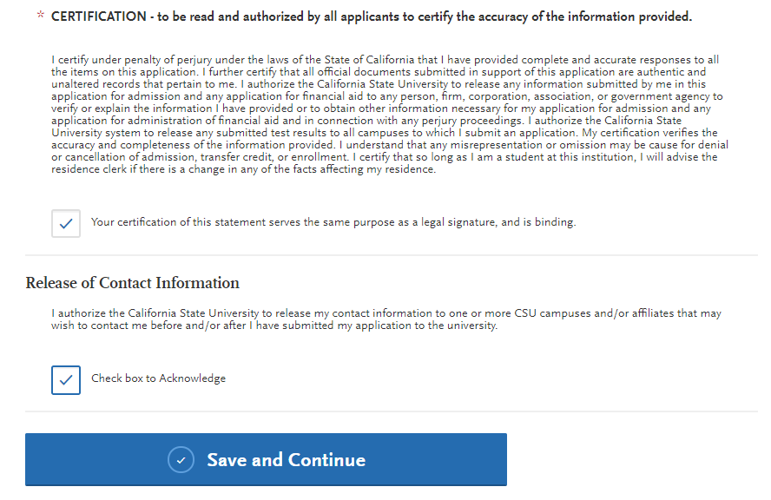
Release Statement

Slide 18
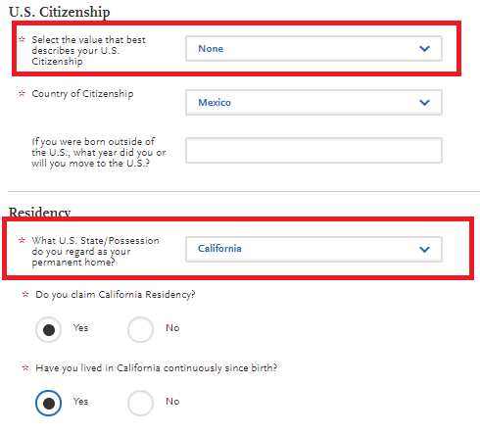
Citizenship/Residency Information
AB540 Applicants should select None
Applicants that reside in CA should select CA regardless of US Citizenship status

Slide 19
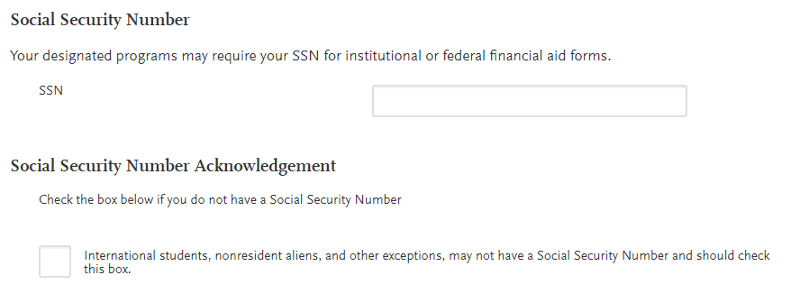
Other Information
Social Security
Recommend entering a SSN

Slide 20
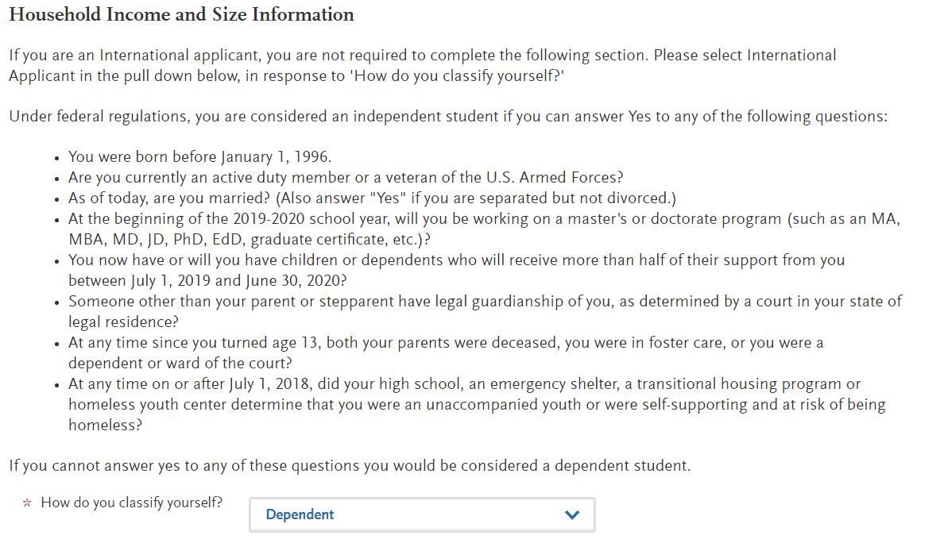
Financial and Parental Information

Slide 21
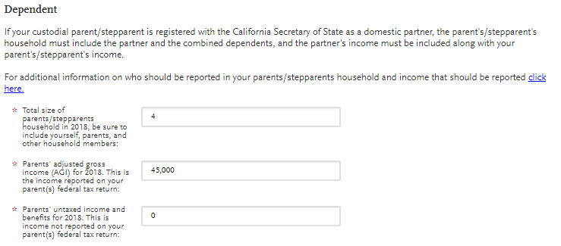
Financial and Parental Information

Slide 22
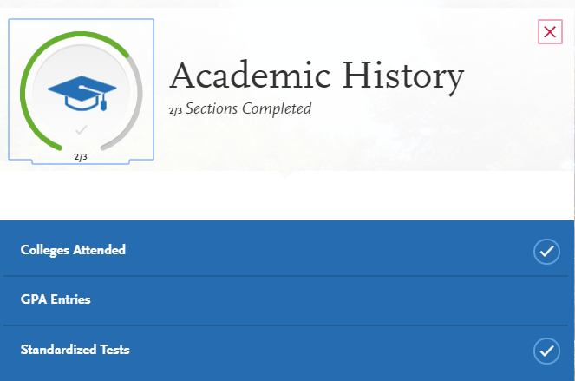
Academic History

Slide 23
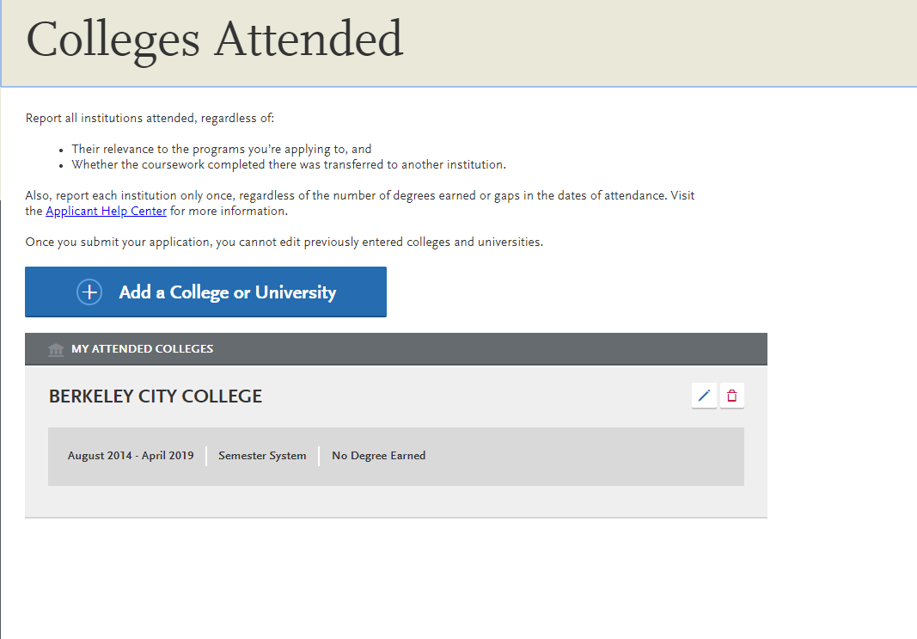
Colleges Schools Attended

Slide 24
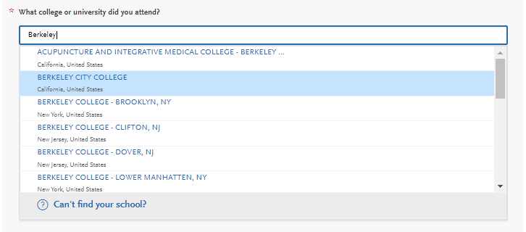
Colleges Attended
Enter school name and Select from drop down

Slide 25
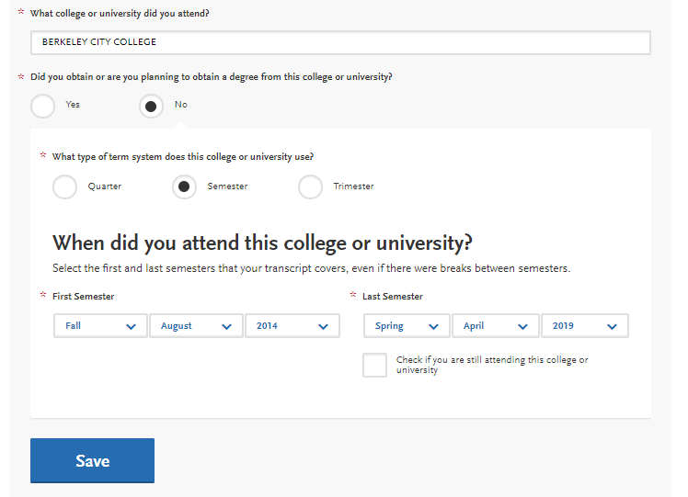
Colleges Attended

Slide 26
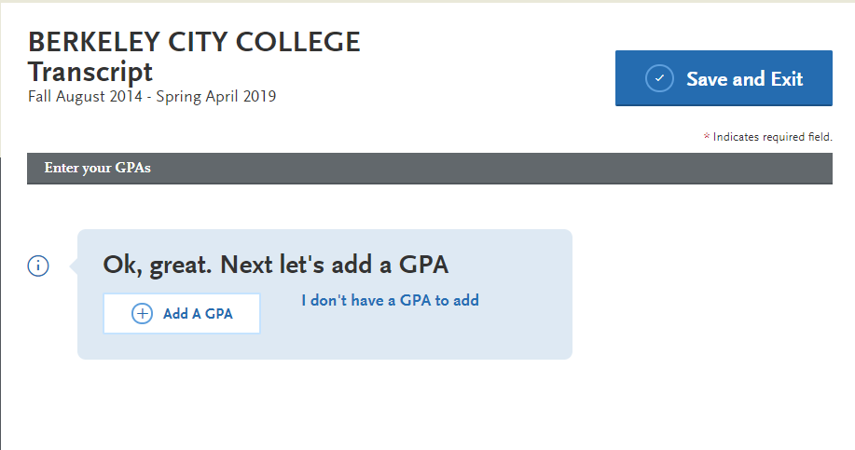
GPA Entry

Slide 27
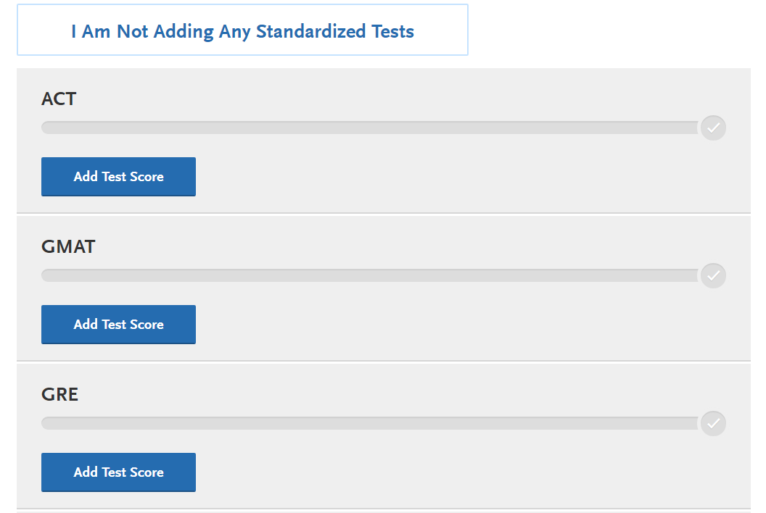
Standardized Tests

Slide 28
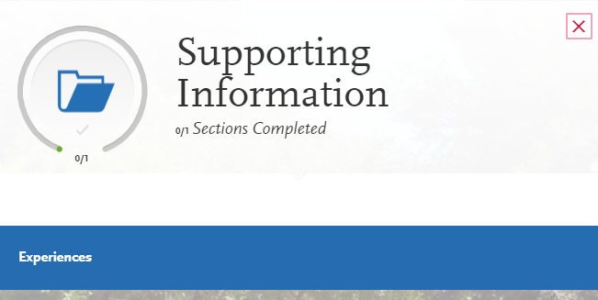
Supporting Information

Slide 29
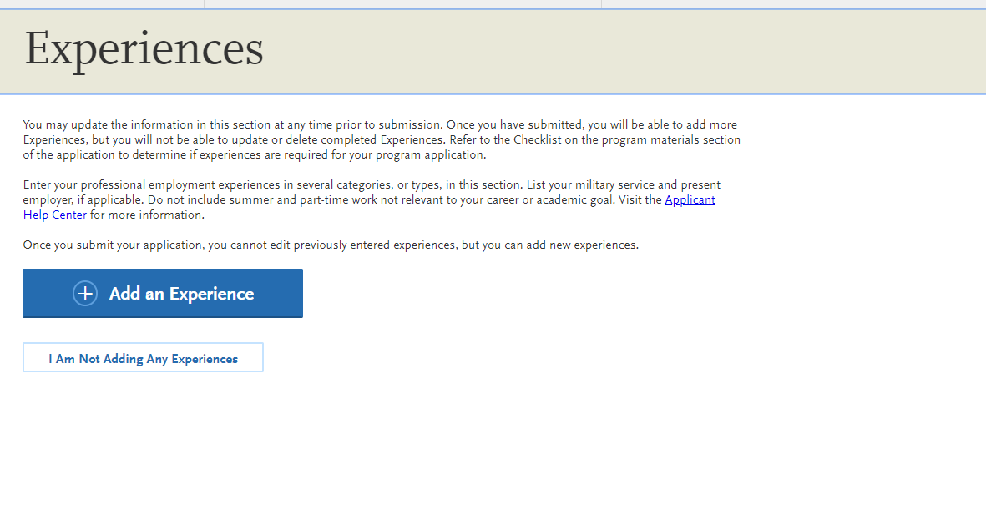
Supporting Information

Slide 30
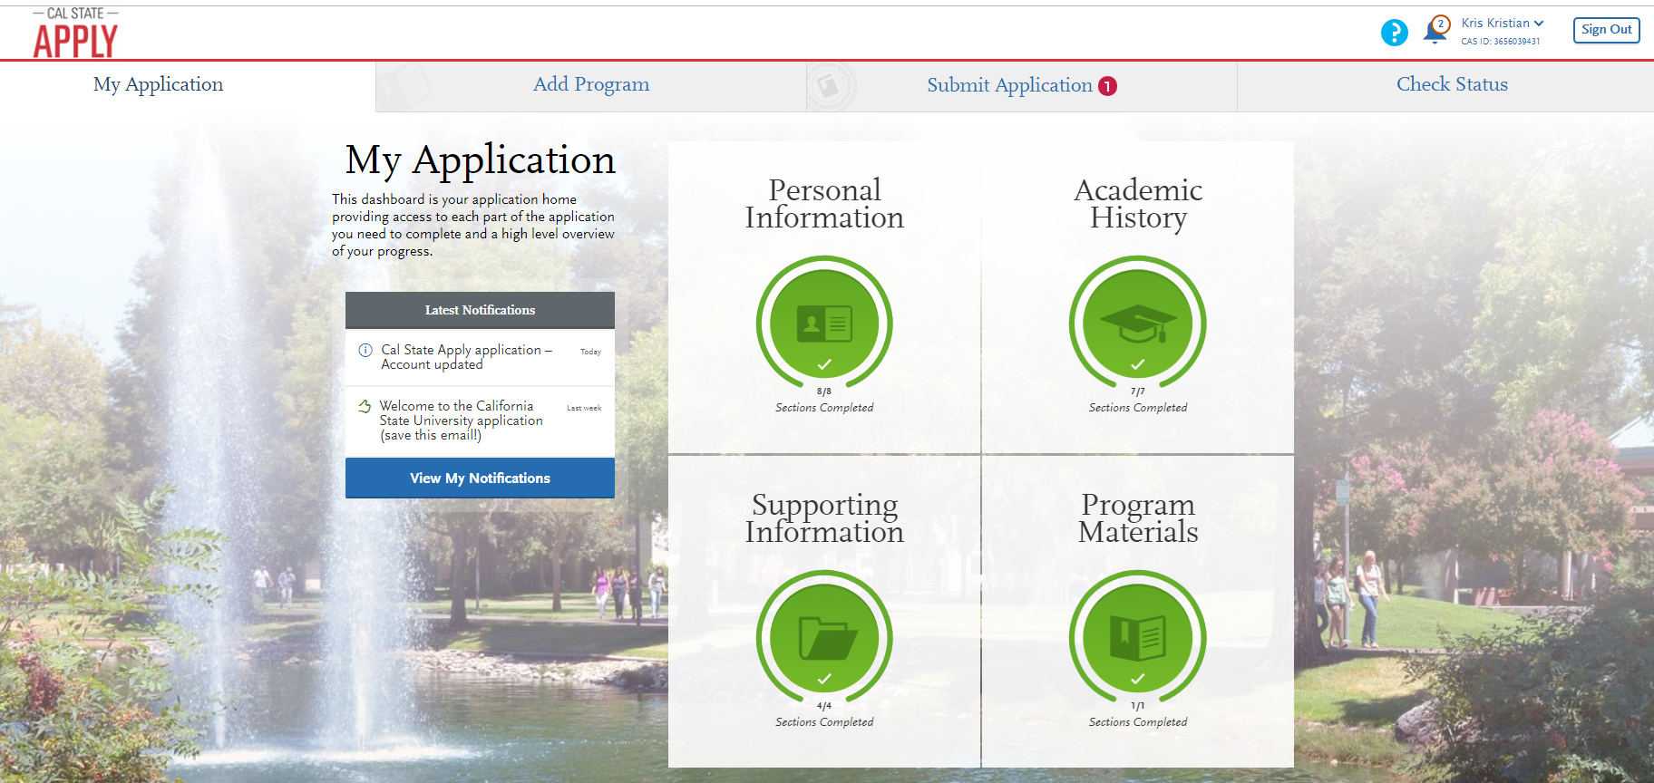
Submit Application

Slide 31
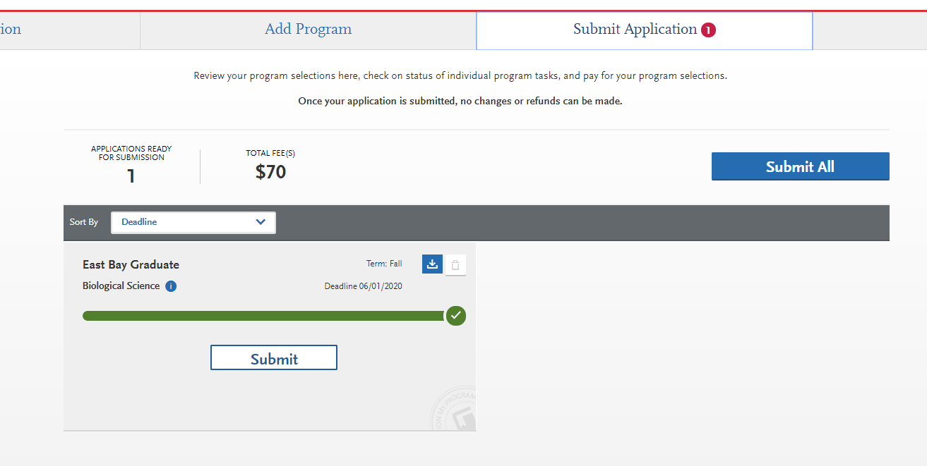
Submit Application
Submit App

Slide 32
Next Steps
Set up your NetID password
Check Your Horizon Email for Communication
Follow up with your academic program for deadlines and additional requirements
Check Your Admission Status and To Do List on your Student Portal
Pay Attention to Document Deadlines
Accept Admission
Enroll in classes
Pay your tuition fees

Slide 33

Contact the Office of Admissions by phone at (510) 885-3500 (option #3), Monday through Thursday 8 a.m. – 4 p.m. and Friday: 10 a.m. - 4 p.m. or
gradadmission@csueastbay.edu
https://www.csueastbay.edu/online/degree-programs/online-programs.html
https://www.csueastbay.edu/aps/graduate-studies/graduate-program-directory.html

