Slide 1
Graduate Education: Finding Your Program
Philip Cole-Regis

Slide 2
Researching /preparing
Clarify your career plans and goals
Research the career path
Maintain a good GPA
Participate in co-curricular activities

Slide 3
What’s the degree?
Master’s Degree
Professional Degree
Doctoral Degree

Slide 4
Things to consider:
Housing
Family
Organizations
Recreation and wellness

Slide 5
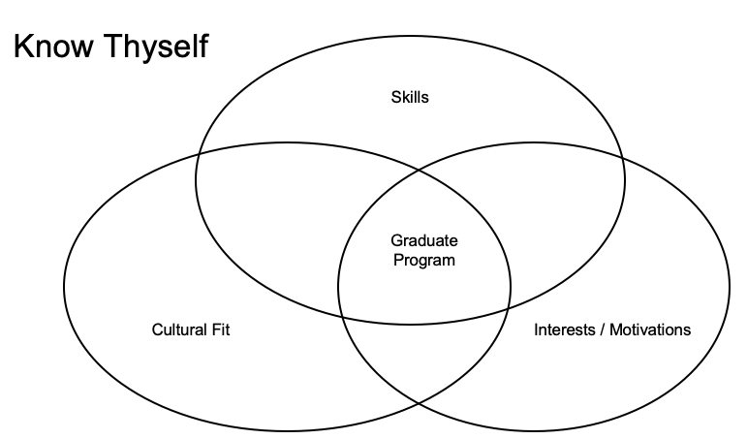

Slide 6
Statement of Purpose:
Why are you pursuing graduate school?
What inspires you to be in this program?
What experiences prepare you for your graduate endeavors?
How do you plan to use your graduate education?
What makes you a good fit for this specific graduate program?

Slide 7
Personal Statement:
Do you have accomplishments or achievements (can be non-academic) that show your ability to succeed in graduate studies?
What challenges have you had to face and overcome in order to obtain your education?
What unique and varied life experiences do you bring to the diversity of the program/university?
Why is this program important to you?

Slide 8
Things you can do to prepare:
Prepare your resume, list your positions of employment or volunteer work/community service since high school, either FT or PT.
Ask others that know you about your qualities to inform your draft statement/s.
Brainstorm, outline draft, edit, revise, proofread, finalize - get feedback!
Avoid: generalizations, false flattery, vague statements
Be honest! You don’t need to be perfect, if you think there is a shortcoming in your record simply address it concisely and honestly.

Slide 9
Research program requirements:
Research program materials required
Tests (i.e. GRE, GMAT, etc.)
Obtain letters of recommendation
Collect writing samples
Request transcript/s
Review the application timeline

Slide 10
Becoming a Graduate Student at Cal State East Bay
Aaron Ramirez

Slide 11
Application Process
Step One: Admission to the University
•Bachelor’s degree from accredited college or university
•Good Academic Standing & 2.5 GPA
•Apply online by the application deadline: Cal State Apply
•Pay $55 application fee
•Submit official copies of all universities attended by the documents deadline

Slide 12
Application Process
Step Two: Admission to the Program
•Meet Specific Program Requirements
•Contact program for application information, including departmental application (if required) and application deadlines

Slide 13
Resources to Support You
•Graduate Admission, Records, and Financial Aid
•College and Department (Graduate Coordinators)
•Office of Graduate Studies
•Library
•Academic Advising and Career Education (AACE)

