Slide 1
THE ROAD TO BUSINESS SCHOOL: GMAT ® VS. GRE ®

Slide 2
OUR TEAM
Your Name
Your Title
Email
Phone
Teacher Name
Teacher Certifications
Email (if teacher wants to give out info)

Slide 3
AGENDA
GMAT vs. GRE
Sample GRE and GMAT Questions
How The Princeton Review Can Help
Notes:
Enter current national promo or partnership discount

Slide 4
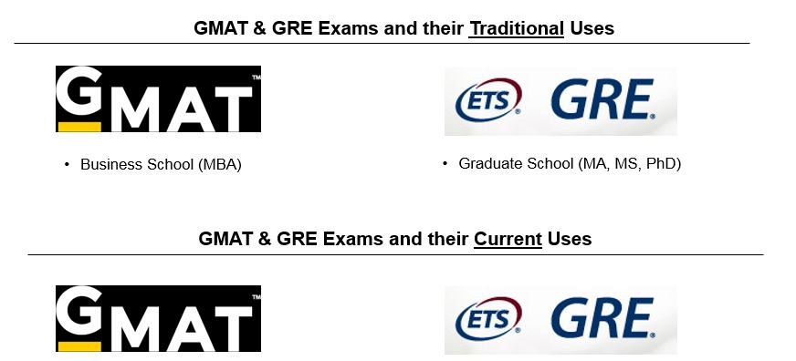
TRADITIONAL AND CURRENT USES
Business School (MBA)
Business-related Graduate School (MA,MS)
Graduate School (MA, MS, PhD)
Most Business Schools (MBA)
Business-related Graduate School (MA,MS)
Some Law Schools (JD)
Notes:
Traditionally – the GMAT exam was used for business school and the GRE was used for most other grad programs (aside from law and medicine)
Today – the GMAT exam can be applied to a slightly broader range of degrees, but the most important change is that essentially all business schools will accept the GRE exam. Some schools still have a have a preference however, and each student’s individual situation and competency can help dictate the best course of action. The GRE is now accepted by more than a dozen Law Schools!
Before walking through which test is best for you, let’s examine the high-level components of each test

Slide 5

GMAT, GRE, WHAT’S THE POINT?
Test scores help admissions officers compare applicants and sort through the piles and piles of applications.

Slide 6
GRE vs GMAT
 | GRE | GMAT
STRUCTURE | 3 hours, 45 minutes 60 min Analytical Writing Assessment (Two 30 min essays) Two 35 min Quantitative Reasoning sections Two 30 min Verbal Reasoning sections Experimental section (30 or 35 mins, can be Quant. or Verbal) | 3 hours, 30 minutes 30 min Analytical Writing Assessment (One 30 min essay) 30 min Integrated Reasoning section 62 min Quantitative section 65 min Verbal section
FORMAT | Computer adaptive by section (Quantitative and Verbal sections) Prometric™ Test Centers | Computer adaptive by question (Quantitative and Verbal sections) Pearson VUE™ Test Centers
SCORING | Quantitative & Verbal sections: 130-170 Essays: 0-6 | Overall score: 200-800 (Quantitative & Verbal raw scores: 0-60 each) Essay: 0-6 Integrated Reasoning: 1-8
COST | $205 | $250
Notes:
NOTE: The Paper & Pencil GRE is only offered in certain places and in certain circumstances such as to test-takers with accommodations.
The GMAT exam is slightly more expensive and adapts in difficulty each question, rather than by each section as is the case for the GRE.
ADDITIONAL KEY POINTS TO SPEAK TO:
GRE EXAM – can use an on-screen calculator, can skip questions and come back to them (within the same section)
GMAT EXAM – no calculator on math section (can use on-screen calculator for IR section) cannot skip questions
NOTE – explain the difference between adaptive by question (GMAT Exam) and adaptive by section (GRE exam)
The GRE has three sections: Math, Verbal, and Essay, or Analytical Writing Assessment.
First section is the Essay, where you’ll have to write 2 essays: one where you take a position and defend it and another where you critique someone else’s essay.
Then you’ll see two scored Math sections, two scored Verbal sections, and one Experimental section. The Experimental section could be either Math or Verbal and you won’t know where it is, but it’s not scored so it won’t affect your score.
Wait, what does an Experimental section mean? Well, you know how when Coke wants to try out its new artichoke soda, it brings in a bunch of college students, pays them $20 and has them try it? Well, ETS is doing the same with you, but YOU get to pay it for the privilege of doing its research for the company.
Since you won’t know which section is experimental, don’t worry about it. If it seems really easy or really hard, don’t waste time second-guessing yourself, just say “hey it was probably the experimental section!” In other words, don’t let the way you perform on one section affect the rest of your test.
Any of the five could be experimental.
Score Percentiles: Updated 7/25/17
Mean Verbal Score = 149.97 Mean AWA = 3.48
Mean Math Score = 152.57
GMAT Structure and Format
Section Type # of Sections # of Questions Time
AWA 1 essay 1 30 min.
Integrated Reasoning 1 12 30 min
Quantitative 1 31 (includes experimental) 62 min
Verbal 1 36 (includes experimental) 65 min
We don't know how many experimental questions there are in the quantitative and verbal sections. Our best guess is that it's about 25% of the questions.

Slide 7

THE GRE IS
“ADAPTIVE BY SECTION”
Notes:
So, as you may have heard, the GRE is “adaptive by section.”

Slide 8
GRE ADAPTIVE BY SECTION
Section 2:
Mostly Hard
Do well
Section 1:
Medium Difficulty
Do fairly well
Section 2:
Mostly Medium
Do poorly
Section 2:
Mostly Easy
Notes:
This means that the first section you’ll see for either math or verbal will be pretty average. If you do really well, the second section for that subject will be pretty hard. If you do really poorly, the second section will be pretty easy. If you do so-so, the second section will be pretty medium.
The test is about 4 hours long. What happens when do anything for 4 hours? Think about driving for 4 hours. You drift off, you lose focus. Same thing happens on the test. This is a test that requires practice and stamina.

Slide 9
THE GMAT IS
“ADAPTIVE BY QUESTION”
Notes:
So, as you may have heard, the GRE is “adaptive by section.”

Slide 10
40%
  Computer Adaptive Test (CAT)
    Difficulty of the test adjusts to the test-taker
    Adaptive by question
    Cannot skip around within section
    Must answer question to move to next one
    Cannot go back and change answers
GMAT
COMPUTER
ADAPTIVE
TEST
Notes:
What the GMAT actually measures, more often than not, is how good a test-taker you are.
First, what’s adaptive?
Adaptive means that the difficulty of the test adjusts to the test taker. The computer uses your performance on the questions you have been given to determine what question you will be given next. When you answer a question correctly, the next question is more difficult. When you answer a question incorrectly, the next question is easier.
The reason that the computer operates in this way is that it is trying to “get to know you”. As you move through the test, the computer learns about you. It determines the type and difficulty of questions you tend to miss and get correct, and uses this information to home in on your final scores.
When you sit down in front of the monitor, the computer assumes that you’re an average test taker (around 540) and starts testing you with a medium difficulty question. If you get it right, it “rewards” you by increasing its estimate of your score (say 570), and it gives you a harder question. If you get the second one right as well, it increases your score again (maybe 590), and raises the difficulty again. Now, suppose you got the first one wrong. Your score would go down (around 510) and the next question would be easier. If you missed the second one as well, your score would decrease again (say 490), and the difficulty would decrease as well.
At the beginning of a section, the computer puts you in a wide score range because it has no data on you yet. Even though you start the section at a 540, the computer is actually placing you into a score range that stretches all the way from 200 (the lowest possible score) to 800 (the highest possible score). By the end of the section — because the computer is now familiar with you — the score range is very narrow. For example, if you have a score of 540, then your score range runs from about 530 to about 550.
Essentially, three factors generate a tester’s score on the GMAT: 1) the # of questions answered, 2) the # of questions answered correctly, and 3) the difficulty level of the questions served by the testing engine.
Strategy Points
Earlier questions are more important to your score than later questions, so spend more time at the beginning of the section and speed up toward the end.
You can’t skip questions. Since each one relies on your answer to the previous one, you have to answer each one in order to move on to the next.
You can’t go back and change answers. Once you’ve answered a question, that answer is used to choose the next question, so that answer is locked in.
Don’t worry if you are having trouble at the end of a section — the questions are supposed to be challenging all the way through.
Finish your sections. You will be penalized for leaving questions blank, so you should guess on any remaining questions when you have about a minute or two left.
Experimental questions
Experimental questions will be sprinkled throughout your regular section. They are not difficulty rated, so don’t flip out if you suddenly get a really easy or really hard question unexpectedly. These questions don’t count toward your score and won’t affect the difficulty of your questions to follow. However, don’t try to guess which questions are experimental; do your best on every question without spending more than about 3 minutes on any single question.

Slide 11
GRE vs GMAT: SECTION ORDER
GRE:
First section is always the Analytical Writing Assessment (2 essays).
The remaining sections (Quantitative/Verbal) are random, with a 10 minute break after section 3.
There is also an experimental section that does not count towards your score, but it is not identified.
GMAT:
Test takers will be provided with THREE options for section order:
  Analytical Writing Assessment, Integrated Reasoning, Quantitative, Verbal (original order)
  Verbal, Quantitative, Integrated Reasoning, Analytical Writing Assessment
  Quantitative, Verbal, Integrated Reasoning, Analytical Writing Assessment
Choose order based on your preferences
  Start with your strongest section to build confidence or get the “worst” section out of the way first
Notes:
GMAC has just announced that, starting July 11, students taking the GMAT “will be able to choose the order in which they complete the four sections of the GMAT exam.” Test takers will be provided with THREE options for section order, and you can read lots more on this topic here. If you talk to or work with GMAT students, please get familiar with this update, as they will surely have questions about how to decide their personal section order. The section options will be:
Analytical Writing Assessment, Integrated Reasoning, Quantitative, Verbal (original order)
Verbal, Quantitative, Integrated Reasoning, Analytical Writing Assessment
Quantitative, Verbal, Integrated Reasoning, Analytical Writing Assessment
WHY IS THIS GOOD FOR GMAT TEST-TAKERS?
It can help decrease anxiety: students now have the option to get their “worst” section out of the way first, or to start with a strength—whichever approach will help them feel more confident
It can help with test-taking fatigue: in the current order, students do an hour’s worth of testing time before they get to the sections that are most important to schools. Integrated Reasoning in particular can be an exhausting section—some students may prefer to prioritize the Quantitative and Verbal sections, which contribute to their overall score, while they are fresh.
While the decision about which order to choose will be up to the individual student, we expect most students will want to start with Quant or Verbal now that they have the option to do so. Those students who prefer to ease into a test and treat the writing/IR sections as a warm up may want to stay with the standard order.
Note that students who have an exam scheduled before July 11 and want to take advantage of this change CAN reschedule their exam with no reschedule or phone fee, as long as that request is received by June 22, 2017. Finally, you should remind students that pacing within sections will still be key to test success, no matter which section order they choose.
Thanks,
Shadna

Slide 12
THE SCORE THAT GETS YOU IN
40%
  Mean GMAT Score = 556.04
  Mean GRE Math Score = 152.57
  Mean GRE Verbal Score = 149.97
WHAT IS A GOOD SCORE?
Notes:
The current GMAT is scored on a 200-800 scale, with sub-scores for Math and Verbal (0-60).
The essay is scored by two graders on a scale of 0-6, and your score is the average of the two scores, rounded to the nearest half point.
Mean GMAT Score (2015-2017) is 556.04
Integrated Reasoning scores will range from 1-8, in single-digit intervals. The IR score will not be on the unofficial score report you receive immediately after the exam, but it will be on the Official Score Report delivered within 20 days.
For the Math and Verbal, the scoring software calculates your score based on: The number of questions you complete, the number of questions you answer correctly, and the difficulty of the questions you answer.
So, what’s a good GMAT score? (Teachers: Wait for audience response.) The score that gets you in is a good score. Different programs have different standards.
GRE:
Score Percentiles: Updated 7/25/17
Mean Verbal Score = 149.97 Mean AWA = 3.48
Mean Math Score = 152.57
http://www.ets.org/s/gre/pdf/gre_interpreting_scores.pdf

Slide 13
GRE vs GMAT: QUANTITATIVE
 | GRE | GMAT
CONTENT | Arithmetic Geometry Algebra Data Analysis | Arithmetic Geometry Algebra Data Analysis
QUESTION TYPES | Problem Solving Quantitative Comparison Numeric Entry Select All That Apply | Problem Solving Data Sufficiency
Notes:
Note: While the content is similar, the hardest GMAT Quantitative questions are harder than the hardest GRE Quantitative questions
GRE:
The content in these areas includes high school mathematics and statistics at a level that is generally no higher than a second course in algebra; it does not include trigonometry, calculus or other higher-level mathematics.
Quantitative Comparison
Questions of this type ask you to compare two quantities — Quantity A and Quantity B — and then determine which of the following statements describes the comparison:
-Quantity A is greater.
-Quantity B is greater.
-The two quantities are equal.
-The relationship cannot be determined from the information given.
GMAT:
The Integrated Reasoning section features four question types that can include sortable tables, graphs, and data or other information about a variety of situations. GMAC states that the section measures skills similar to those used in business school. A standard basic calculator is provided as an onscreen tool for use during the Integrated Reasoning section.
The Quantitative section measures your basic mathematical skills, understanding of elementary concepts, ability to reason quantitatively, aptitude to solve quantitative problems, and ability to interpret graphic data. No calculator is provided for the Quantitative section.
The Verbal section measures your ability to understand and evaluate what is read and to recognize basic conventions of standard written English.

Slide 14

PROBLEM SOLVING
Approximately half of each Quantitative section will be Problem Solving questions
GMAT has 5 answer choices (with only 1 correct answer)
GRE has some questions with 1 correct answer, select all that apply, or fill in the blank

Slide 15

GRE vs GMAT: QUANTITATIVE SECTION
DIFFERENCES

Slide 16
GRE QUANT SECTION:
QUANTITATIVE COMPARISON
x < 0 < y
Quantity A Quantity B
xy x + y
Quantity A is greater
Quantity B is greater
The two quantities are equal
The relationship cannot be determined from the information given
Notes:
Students may need to try several FROZEN numbers to find the set that makes Quantity B less than Quantity A. Be prepared to help!
You can show how to compare the fractions that result from the second plug in using the Bowtie. Or, discuss using the onscreen calculator.
ANSWER IS D – Relationship cannot be determined
Try plugging in values for x and y:
x=-2
y=2
A=-4
B=0
x=-1/2
y=1/100
A= -1/200
B=-49/100

Slide 17
GRE QUANT SECTION:
QUANTITATIVE COMPARISON
x < 0 < y
Quantity A Quantity B
xy x + y
Try plugging in values for x and y:
x = -2
y = 2
A = (-2)(2) = -4
B = -2 + 2 = 0
X
Quantity A is greater
Quantity B is greater
The two quantities are equal
The relationship cannot be determined from the information given
X
X
Try plugging in different values (FROZEN):
x = -1/2
y = 1/100
A = (-1/2)(1/100) = -1/200
B = -1/2 + 1/100 = -49/100 = -98/200
Notes:
ANSWER IS D – Relationship cannot be determined
Students may need to try several FROZEN numbers to find the set that makes Quantity B less than Quantity A. Be prepared to help!
You can show how to compare the fractions that result from the second plug in using the Bowtie. Or, discuss using the onscreen calculator.
ANSWER IS D – Relationship cannot be determined
Try plugging in values for x and y:
x=-2
y=2
A=-4
B=0
x=-1/2
y=1/100
A= -1/200
B=-49/100

Slide 18
GMAT QUANT SECTION:
DATA SUFFICIENCY
Directions: Each of the data sufficiency problems below consists of a question and two statements, labeled (1) and (2), in which certain data are given. You have to decide whether the data given in the statements are sufficient to answer the question.
Using the data given in the statements plus your knowledge of mathematics and everyday facts (such as the number of days in July or the meaning of counterclockwise), you are to fill in an oval
  (A) if statement (1) ALONE is sufficient, but statement (2) alone is not sufficient to answer the questions asked;
  (B) if statement (2) ALONE is sufficient, but statement (1) alone is not sufficient to answer the questions asked;
  (C) if BOTH statements (1) and (2) TOGETHER are sufficient to answer the question asked, but NEITHER statement ALONE is sufficient;
  (D) if EACH statement ALONE is sufficient to answer the question asked;
  (E) if statements (1) and (2) TOGETHER are NOT sufficient to answer the question asked, and additional data specific to the problem are needed.
AD or BCE: If Statement (1) is sufficient, the only options are A,D. If Statement (1) is not sufficient, the only options are B,C,E.
Notes:
Go over the Data Sufficiency directions.
Explain how you can quickly split the answer choice options, depending on Statement 1 (AD or BCE)

Slide 19
GMAT QUANT SECTION:
DATA SUFFICIENCY
If y = 75, what is the value of x ?
x + y + z = 180
x + y = 141
Notes:
Alone is not sufficient
Alone is sufficient to solve – ANSWER CHOCE B

Slide 20
GMAT QUANT SECTION:
DATA SUFFICIENCY
If y = 75, what is the value of x ?
x + y + z = 180
x + y = 141
A D B C E
Statement (1) is Not Sufficient – So we are left with answer choices B,C,E
Statement (2) alone is Sufficient
ANSWER CHOICE B
  (B) if statement (2) ALONE is sufficient, but statement (1) alone is not sufficient to answer the questions asked
X
X
Notes:
Alone is not sufficient
Alone is sufficient to solve – ANSWER CHOCE B

Slide 21
GRE vs GMAT: VERBAL
 | GRE | GMAT
CONTENT | Vocabulary Reading Comprehension | Grammar and Expression Argument Construction Reading Comprehension
QUESTION TYPES | Text Completion Sentence Equivalence Reading Comprehension | Sentence Correction Critical Reasoning Reading Comprehension
Notes:
GRE:
The content in these areas includes high school mathematics and statistics at a level that is generally no higher than a second course in algebra; it does not include trigonometry, calculus or other higher-level mathematics.
Quantitative Comparison
Questions of this type ask you to compare two quantities — Quantity A and Quantity B — and then determine which of the following statements describes the comparison:
-Quantity A is greater.
-Quantity B is greater.
-The two quantities are equal.
-The relationship cannot be determined from the information given.
GMAT:
The Integrated Reasoning section features four question types that can include sortable tables, graphs, and data or other information about a variety of situations. GMAC states that the section measures skills similar to those used in business school. A standard basic calculator is provided as an onscreen tool for use during the Integrated Reasoning section.
The Quantitative section measures your basic mathematical skills, understanding of elementary concepts, ability to reason quantitatively, aptitude to solve quantitative problems, and ability to interpret graphic data. No calculator is provided for the Quantitative section.
The Verbal section measures your ability to understand and evaluate what is read and to recognize basic conventions of standard written English.

Slide 22

READING COMPREHENSION
Approximately 50% of GRE Verbal section
Approximately 30% of GMAT Verbal section
Passage on left side of screen, the question (one at a time) on the right side of screen
Notes:
There are a variety of ways to analyze a passage. These include looking for key sentences in each paragraph and determining whether the passage discusses a problem or a change. No matter which way you choose, the important thing is to read the passage for the main idea, what the author wants you to believe, as opposed to the details of the passage.
Let the questions guide you for more details (if necessary)
5 multiple choice answers for GMAT.
GRE can be 5 multiple choice answers, All that Apply with 3 choices, or Select a Sentence.

Slide 23
READING COMPREHENSION
GMAT has 5 answer choices (with only 1 correct answer)
GRE has the following:
    5 answer choices (with 1 correct answer)
    Select All That Apply (with 3 choices)
    Select a Sentence (from the passage)
Notes:
5 multiple choice answers for GMAT.
GRE can be 5 multiple choice answers, All that Apply with 3 choices, or Select a Sentence (from the passage)

Slide 24
GRE vs GMAT: VERBAL SECTION
DIFFERENCES

Slide 25
GRE VERBAL SECTION:
TEXT COMPETION
The master blacksmith had to choose between his two apprentices, who were as (i) _______________ as two young men could be. The first lacked awareness of the basic principles of metallurgy, but was incredibly (ii)_______________ . The second possessed great academic knowledge, but was not very adept with the hammer.
Blank (i) Blank (ii)
polemical | amiable
disparate | proficient
facile | prodigious
Notes:
Answer: B and E
The sentences that describe the young apprentices make clear that the two are very different, so choice (B) is correct for the first blank. Polemical would imply the men were enemies or had strong differences of opinion so this is too strong. Facile means agreeable or easily influenced. The second blank should be a word that means "adept" since it describes a characteristic of the first young man that the second lacks. Choice (E) is a good synonym for "adept." Amiable means agreeable and prodigious means large or amazing.

Slide 26
GRE VERBAL SECTION:
TEXT COMPETION
The master blacksmith had to choose between his two apprentices, who were as (i) _______________ as two young men could be. The first lacked awareness of the basic principles of metallurgy, but was incredibly (ii)_______________ . The second possessed great academic knowledge, but was not very adept with the hammer.
Blank (i) Blank (ii)
polemical | amiable
disparate | proficient
facile | prodigious
Notes:
Answer: B and E
The sentences that describe the young apprentices make clear that the two are very different, so choice (B) is correct for the first blank. Polemical would imply the men were enemies or had strong differences of opinion so this is too strong. Facile means agreeable or easily influenced. The second blank should be a word that means "adept" since it describes a characteristic of the first young man that the second lacks. Choice (E) is a good synonym for "adept." Amiable means agreeable and prodigious means large or amazing.

Slide 27
GRE VERBAL SECTION:
TEXT COMPETION
The master blacksmith had to choose between his two apprentices, who were as (i) _______________ as two young men could be. The first lacked awareness of the basic principles of metallurgy, but was incredibly (ii)_______________ . The second possessed great academic knowledge, but was not very adept with the hammer.
Blank (i) Blank (ii)
polemical | amiable
disparate | proficient
facile | prodigious
Notes:
Answer: B and E
The sentences that describe the young apprentices make clear that the two are very different, so choice (B) is correct for the first blank. Polemical would imply the men were enemies or had strong differences of opinion so this is too strong. Facile means agreeable or easily influenced. The second blank should be a word that means "adept" since it describes a characteristic of the first young man that the second lacks. Choice (E) is a good synonym for "adept." Amiable means agreeable and prodigious means large or amazing.

Slide 28
GRE VERBAL SECTION:
SENTENCE EQUIVALENCE
The photographer _________ posed the bride for her portrait, carefully adjusting each fold of her dress and each curl of her hair before taking the picture.
 meticulously
 frantically
 subversively
 hectically
 fastidiously
 hysterically
Notes:
Who/What: photographer
What else: carefully adjusting each fold of her dress
Word: carefully
A ✓
B
C
D
E ✓
F

Slide 29
GRE VERBAL SECTION:
SENTENCE EQUIVALENCE
The photographer _________ posed the bride for her portrait, carefully adjusting each fold of her dress and each curl of her hair before taking the picture.
 meticulously
 frantically
 subversively
 hectically
 fastidiously
 hysterically
✓
X
X
X
✓
X
Notes:
Who/What: photographer
What else: carefully adjusting each fold of her dress
Word: carefully
A ✓
B
C
D
E ✓
F

Slide 30
GMAT VERBAL SECTION:
SENTENCE CORRECTION
While brokers, as a rule, are not permitted to know executive access codes, in many instances, they are widely known.
they are widely known
they are to be widely known
they are known by many
the codes are by many able to be widely known
the codes are widely known
X
X
X
X
✓

Slide 31
GMAT VERBAL SECTION:
CRITICAL REASONING
Many antiviral medications are effective at killing only some strains of the targeted virus. If only some strains of a targeted virus are killed by a given medication, there is danger that, through random mutation or the emergence of other strains from natural reservoirs, resistant strains will gradually dominate those vulnerable to medication. If the antiviral medications are continually administered, for example to humans or cattle, there is a significant risk that existing medications will grow ineffective, leaving doctors with no remedies for these diseases
The conclusion of the argument above depends on which of the following assumptions?
The same medicines are administered to both humans and cattle.
New medical developments will not effectively kill previously resistant strains.
Existing viruses will mutate to form resistant strains where none had existed before.
Viruses cause more diseases than other forms of infections, such as bacteria, prions, and molds
Biotechnology and drug companies will work to develop new medications that attack resistant viral strains.
X
✓
X
X
X
Notes:
The argument depends on the assumption that new medicines will not kill resistant viruses. While confusingly worded, answer choice B addresses that assumption. Work confusing passages like this carefully, figuring out what information is important and what is distracting. The correct answer is B.
Subject Area: Critical Reasoning
Categories: Assumption

Slide 32

ANALYTICAL WRITING ASSESSMENT
The GMAT and GRE both have an Argument Essay
The GRE also has an Issue Essay
30 mins for each essay
Notes:
The Analytical Writing Assessment (AWA) section of the test measures our ability to think critically and communicate complex ideas through writing.
The AWA uses a basic word processing program that allows you the ability to insert and delete portions of text (cut and paste) and undo the previous action.
The "Analyze an Argument" task assesses your ability to understand, analyze and evaluate arguments according to specific instructions and to convey your evaluation clearly in your writing. Each topic consists of a brief passage in which the author makes a case for some course of action or interpretation of events by presenting claims backed by reasons and evidence.
Your task is to discuss the logical soundness of the author's case by critically examining the line of reasoning and the use of evidence.
The "Analyze an Issue" task assesses your ability to think critically about a topic of general interest and to clearly express your thoughts about it in writing. Each Issue topic makes a claim that can be discussed from various perspectives and applied to many different situations or conditions. Your task is to present a compelling case for your own position on the issue.

Slide 33
4 STEP APPROACH
  Brainstorm
  Outline
  Write
  Edit
BASIC OUTLINE
  Introduction
  Body Paragraph 1
  Body Paragraph 2
  Body Paragraph 3 (optional)
  Conclusion
40%
ANALYTICAL
WRITING
ASSESSMENT
Notes:
4 Step Approach
Brainstorm
Outline
Write
Edit
Basic Outline
Introduction
Body Paragraph 1
Body Paragraph 2
Body Paragraph 3 (optional)
Conclusion

Slide 34

WHAT TO EXPECT AT TESTING CENTER
Notes:
BOTH PEARSON AND PROMETRIC TESTING CENTERS PROVIDE A SIMILAR TESTING EXPERIENCE – Both are very concerned with security, all of your items go into a locker and you can only bring your ID and key to the locker into the testing area.
THE BIG DIFFERENCE IS THAT PEARSON USES LAMINATED BOOKLETS AND A MARKER FOR SCRAP PAPER, AS OPPOSED TO PAPER & PENCILS AT A PROMETRIC CENTER
https://home.pearsonvue.com/Test-Owner/Deliver-your-exam/Pearson-VUE-test-center-network/Pearson-Authorized-Test-Center-Tour.aspx
Arrive at the test center no later than 30 minutes before assigned start time. Any late arrivals will not be permitted to sit for the exam, and it will count as a no show attempt.
Check in will include verification of government issued current photo ID, assignment of secure storage for personal items, admissions procedures, and receipt of your seat assignment.
Sites may have a fingerprint scan, palm scan, or even retina scan.
You will be asked to empty your pockets and may be wanded for security purposes.
You will be asked to sign or click off that you are taking test only to go to business school (not stealing secrets).
You will be provided four bound, double-sided wet erase sheets and a wet erase pen.
You have the option to use noise-cancelling headphones
Be prepared to possibly start late due to check-in delays. This means other students will be taking breaks at different times. Delayed starts will not impact your total test time.

Slide 35
GRE vs GMAT: TESTING CENTERS
GRE – PROMETRIC CENTERS
Check in will include verification of government issued current photo ID, storage for personal items in locker, admissions procedures, and receipt of your seat assignment
Sites may have a fingerprint scan, palm scan, or even retina scan
Asked to empty your pockets and may be wanded for security purposes
Asked to sign or click off that you are taking test only to go to Grad/Business School (not stealing secrets)
Provided pencils and scratch paper at your desk
Option to use noise-cancelling headphones
GMAT – PEARSON VUE CENTERS
Similar security features as listed above
Instead of paper/pencil scratch paper, you will be provided four bound, double-sided laminated sheets and a marker
Notes:
GRE:
https://www.prometric.com/en-us/for-test-takers/prepare-for-test-day/pages/what-to-expect.aspx
Arrive at the test center no later than 30 minutes before assigned start time. Any late arrivals will not be permitted to sit for the exam, and it will count as a no show attempt.
Check in will include verification of government issued current photo ID, assignment of secure storage for personal items, admissions procedures, and receipt of your seat assignment.
Sites may have a fingerprint scan, palm scan, or even retina scan.
You will be asked to empty your pockets and may be wanded for security purposes.
You will be asked to sign or click off that you are taking test only to go to med school (not stealing secrets).
You will be provided pencils and scratch paper at your desk. You can raise your hand for additional pieces.
You have the option to use noise-cancelling headphones
Be prepared to possibly start late due to check-in delays. This means other students will be taking breaks at different times. Delayed starts will not impact your total test time.
GMAT
https://home.pearsonvue.com/Test-Owner/Deliver-your-exam/Pearson-VUE-test-center-network/Pearson-Authorized-Test-Center-Tour.aspx
Arrive at the test center no later than 30 minutes before assigned start time. Any late arrivals will not be permitted to sit for the exam, and it will count as a no show attempt.
Check in will include verification of government issued current photo ID, assignment of secure storage for personal items, admissions procedures, and receipt of your seat assignment.
Sites may have a fingerprint scan, palm scan, or even retina scan.
You will be asked to empty your pockets and may be wanded for security purposes.
You will be asked to sign or click off that you are taking test only to go to business school (not stealing secrets).
You will be provided four bound, double-sided wet erase sheets and a wet erase pen.
You have the option to use noise-cancelling headphones
Be prepared to possibly start late due to check-in delays. This means other students will be taking breaks at different times. Delayed starts will not impact your total test time.

Slide 36

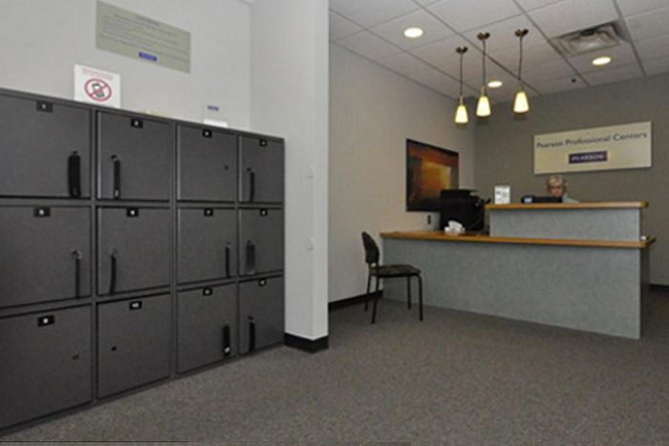

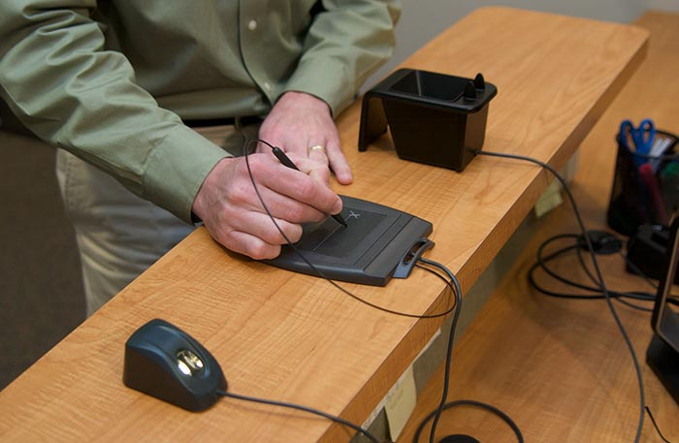

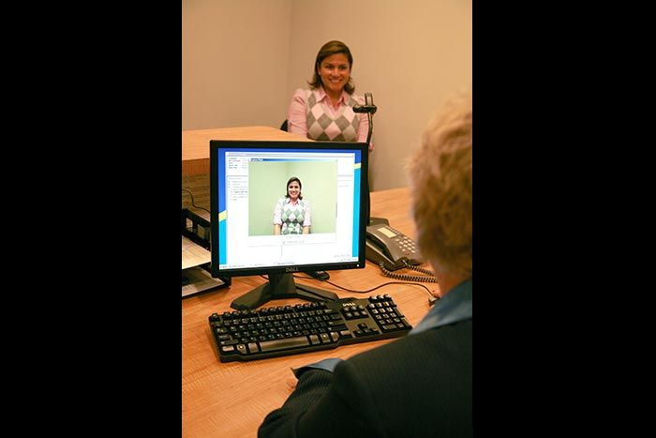

TESTING CENTERS
Source: https://home.pearsonvue.com/Test-Owner/Deliver-your-exam/Pearson-VUE-test-center-network/Pearson-Authorized-Test-Center-Tour.aspx
Notes:
https://home.pearsonvue.com/Test-Owner/Deliver-your-exam/Pearson-VUE-test-center-network/Pearson-Authorized-Test-Center-Tour.aspx
Arrive at the test center no later than 30 minutes before assigned start time. Any late arrivals will not be permitted to sit for the exam, and it will count as a no show attempt.
Check in will include verification of government issued current photo ID, assignment of secure storage for personal items, admissions procedures, and receipt of your seat assignment.
Sites may have a fingerprint scan, palm scan, or even retina scan.
You will be asked to empty your pockets and may be wanded for security purposes.
You will be asked to sign or click off that you are taking test only to go to business school (not stealing secrets).
You will be provided four bound, double-sided wet erase sheets and a wet erase pen.
You have the option to use noise-cancelling headphones
Be prepared to possibly start late due to check-in delays. This means other students will be taking breaks at different times. Delayed starts will not impact your total test time.

Slide 37

IMPROVE YOUR SCORE
  Content
  Strategy
  Technique
  Practice, Practice, Practice
  Confidence
Notes:
So, how do you improve your score? First of all, know the test writer. Who writes the GMAT? ACT. They also write the ACT, a college-entry exam.
Are they a government agency? A group of scholars and academics? Nope. They’re a private company in business to make money by developing standardized tests.
Why should you care? How will knowing about the test writers help you score higher on the GMAT?
Answer: The more you know about test writers’ tactics, the better you will be able to use those tactics against them.
Five Areas
Content – You must master the core Integrated Reasoning, Math, and Verbal content.
Strategy – Knowing how the test is written and scored help makes it predictable.
For GMAT, Early questions count more. The test-writers have a number of ways that they make questions hard, including using complicated wording, multiple steps and distractor answer choices. Knowing how to spot their distractor answer choices will put you in control.
For GRE, be sure to skip around within each section, handling the questions you know how to approach first, and guess on any remaining – NEVER LEAVE AN ANSWER BLANK!
Technique – The Princeton Review will give you specific techniques for each question type on the test.
Practice, Practice, Practice – After you learn the correct techniques, you must apply them over and over. And over. Practicing perfect makes perfect.
Confidence – If you prepare properly and thoroughly, you’ll be able to meet all the challenges that the GMAT presents.

Slide 38

OUR JOB IS TO HELP YOU
GET INTO YOUR DREAM SCHOOL

Slide 39

PrincetonReview.com
FREE PRACTICE TEST & ANALYSIS
FREE BUSINESS SCHOOL SEARCH ENGINE
PREPARATION FOR THE GRE & GMAT TRY US FOR FREE!
HOMEWORK HELP
GRE
RESOURCES
Notes:
Visit the Princeton Review website: www.PrincetonReview.com
Free Practice Test & Analysis – You can take a free full-length GRE practice test and receive a personalized score report pinpointing your strengths and weaknesses:
Free Grad School Search Engine – Explore our in-depth profiles of Graduate School programs. You can narrow your search using specific criteria and see all of the relevant stats to help find your best fit school: www.PrincetonReview.com/grad-school
Achieve Your Target Score – The Princeton Review offers a variety of prep options for different learning styles and budgets.
Homework Help – 24/7 Academic Tutoring – Live, On-Demand, over 40 subjects

Slide 40
HOMEWORK HELP
GPA Booster
Tutors available 24/7
On demand or scheduled sessions
Access on mobile, tablet or desktop
Expert help in over 80 subjects, including:
  Algebra • Geometry • Calculus • Statistics
  Essay Writing • Reading Comprehension • Accounting
  Psychology • Sociology • Physics • Biology • Chemistry
Notes:
$39.99/month for 1 hour
$79.99/month for 2 hours
$114.99/month for 3 hours
Or
$0.75/minute – pay as you go

Slide 41

TEST PREP WITH OPTIONS FOR EVERY SCHEDULE
AND BUDGET
Notes:
We’re with you all the way with our test preparation programs. The Princeton Review has been helping students improve standardized test scores for more than 30 years. Taking these tests require skill, and it’s something you can learn. We’ve got options for every budget and every schedule, from an online self-paced program to one-on-one private tutoring.
Prep for the “I want the soup-to-nuts experience” student
GMAT Self-Paced
Prep on your own with a customized online course. Let our adaptive practice and exclusive algorithm guide your way.
GMAT Connect
Comprehensive prep with an exclusive prep algorithm, online tools, a private tutor, and live interactive GMAT Explanations sessions
GMAT Connect Plus
With Connect Plus, you’ll get 3 sessions with a private tutor and the full bundle of official GMAT guides (ebook editions)
GMAT Private Tutoring
Looking for a personal GMAT coach? Private Tutoring is for you. Our GMAT-certified private tutors will work with you to create a personalized prep plan with instruction targeted to your needs to ensure you are gaining points fast.
Prep for the “I want the soup-to-nuts experience” student
GRE Ultimate
With our expert instruction and exclusive online tools, you’ll prep more efficiently and more effectively.
You’ll have access to 24 hours of live instruction, 8 computer-adaptive tests, and 180+ hours of online resources.
Available In-Person or LiveOnline
Prep for the “I’ll do what I want, when I want” student
GRE Self-Paced
Study at your own pace with our interactive guided program, leveraging the same comprehensive GRE strategies and tools available in our Ultimate course.
Available Online, On-Demand
Prep for the “I want a life coach, err…private tutor” student
GRE Private Tutoring
Our expert tutors work with you to make a plan, set goals, and exceed them.
Available In-Person or LiveOnline

Slide 42
Doing Well o the MCAT
TRY OUR GMAT/GRE PREP FOR FREE!
Get acquainted with the online tools that power our GMAT and GRE prep programs
This free 14-day trial unlocks the following content:
A full-length, computer practice test
A detailed, interactive score report that provides in-depth guidance
Access to some of our interactive video lessons and adaptive drills
Enroll today:
www.PrincetonReview.com/GMATFreeTrial
www.PrincetonReview.com/GREFreeTrial
Notes:
You’re serious about your GMAT prep—so are we. During this free 14-day trial, you’ll get acquainted with the online tools that power our GMAT prep programs.
Includes:
A full-length, computer-adaptive-by-question practice test that mimics the actual GMAT: You’ll come away with a realistic understanding of the test and how you might score.
A detailed, interactive score report that provides in-depth guidance about how you’re using your time and where you have opportunities for improvement.
Access to some of our interactive video lessons and adaptive drills on the following topics:
Plugging In— one of our iconic methods that helps you turn difficult algebra questions into easy arithmetic
Data Sufficiency— our Pieces of the Puzzle technique will help you evaluate statements for data-sufficiency questions, a major source of anxiety for GMAT takers
Sentence Correction: Subject-Verb Agreement— learn the rules and a basic approach for this commonly tested error
Assumption Questions— learn how to find the main parts of the argument and the characteristics of wrong answers for this important Critical Reasoning question type
Trial begins immediately after enrollment and lasts for 14 days.
www.PrincetonReview.com/GMATFreeTrial
Experience the extensive online materials that complement our GRE prep programs
This free 14-day trial unlocks the following content:
A full-length, computer-adaptive-by-section practice test that mimics the actual GRE
A detailed, interactive score report that provides in-depth analysis
Access some of our interactive, video-based lessons, including:
Global strategies that can be used throughout the test to maximize your score
Basic Properties of Integers—up to half of the questions in the Quant section use words like “prime,” “factors,” and “remainders.”
Plugging In, one of our iconic methods to help you to turn difficult algebra questions into easy arithmetic
Sentence Equivalence—learn how to find the clues and transition words in the sentences that the test writers use to justify the correct answers
DrillSmart—our exclusive drilling engine, which offers questions at your skill level so you can make the greatest improvements in the least amount of time
Enroll today: www.PrincetonReview.com/GREFreeTrial

Slide 43
PARTNERSHIP OPPORTUNITIES
Full-Length Practice Tests & Score Report Analysis
Test-Taking Strategy Sessions, Admissions Sessions, Guest Speakers
Prep Discounts
Joint Events and Promotions
Webinars
Customized Courses
Job Opportunities
Notes:
Resources for Student groups and advisors
PARTNERSHIP OPPORTUNITES!

Slide 44
QUESTIONS?
Your info here
(email and phone)
/ThePrincetonReview
@ThePrincetonRev
ThePrincetonReview
©2018 TPR Education IP Holdings, LLC. All Rights Reserved. All tests are registered trademarks of their respective owners. None of the trademark holders are affiliated with The Princeton Review or these products. The Princeton Review is not affiliated with Princeton University.

