Slide 1
Fall 2025 International Orientation
Notes:
NOTE: to change background photo, edit the master style slide.

Slide 2
Agenda
8:30 AM – 9:00 AM
Registration
9:00 AM – 9:10 AM
Staff Introductions
9:10 AM – 9:20 AM
ISO, Health Insurance, and Civil Rights Office
9:20 AM – 9:30 AM
New Student Check In Process
9:30 AM – 10:10 AM
F-1 Advising
10:10 AM – 10:55 AM
Intercultural Presentation
10:55 AM – 11:00 AM
Group Breakout
11:00 AM – 11:30 AM
Groups
J-1 Exchange & Global Academy
Undergraduate Advising
Graduate Q & A
11:30 AM – 12:00 PM
Guest Speakers
President Cathy Sandeen
AVP Balvinder Kumar
Director Thomas Torres-Gil
12:00 PM – 1:00 PM
Lunch

Slide 3
Staff Introductions
International Programs
Notes:
NOTE: to change background photo, edit the master style slide.

Slide 4
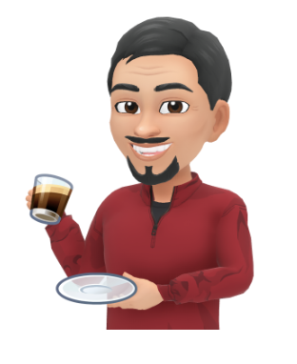




Thomas Torres-Gil, Director of International Programs
Karen Jackson, International Admissions Representative
Sara Hatter, International Admissions Counselor
Curie Kim, International Admissions Counselor
Brian Cheng, SEVIS Records Coordinator, DSO

Slide 5





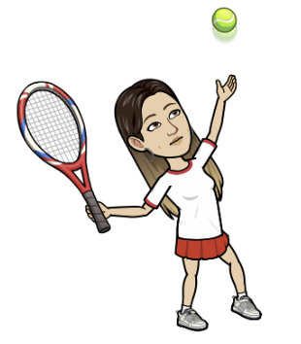
Lily ShuFen Hsiao, International Student Advisor, DSO
Jamie He, International Student Advisor, DSO
Yuri Nagasawa, Senior Program Coordinator, Global Academy, DSO
Kelly Moran, Senior Program Coordinator, Exchange, RO
Laura Perry, International Partnerships Coordinator
Kelly Pan, International Recruitment & Marketing Manager

Slide 6
International Student Organization
Student Life and Involvement Center (SLIC)

Slide 7
International Student Health Insurance
Alliant Insurance Services
Stephanie Crea

Slide 8
Civil Rights Office
JoLani Hironaka | Terri LaBeaux | Mike Chang

Slide 9
F-1 Student Check-In
Brian Cheng, SEVIS Records Coordinator
Notes:
NOTE: to change background photo, edit the master style slide.

Slide 10
Immigration Check-In
Why do I need to Check-In?
In order to maintain your F-1 status, students are required to check-in to the school to report your arrival and enrollment.
The Department of Homeland Security (DHS) uses the Student and Exchange Visitor Information System (SEVIS) to monitor and track students

Slide 11
Immigration Check-In
Who Needs to Check-In?
Initial Students
Transfer Students
Change of Educational Level
Change of Status

Slide 12
Immigration Check-In
How do I complete the Check-In process?
Submit the Check-In process documents
Enroll full time
  Undergraduate Students - undergraduate students are required to enroll in a minimum of 12 units per semester. This includes students who are pursuing a 2nd Bachelor's degree.
  Graduate Students and Post-Baccalaureate - graduate students are required to enroll in a minimum of 8 units per semester.

Slide 13
Immigration Check-In
Check-In Process Documents
For new international students who will be inside the USA for Fall 2025, you must complete the virtual "check-in" procedure after your arrival by submitting the following documents via an online form that was sent to your HORIZON email.
New Student Information Form - this must include a valid USA address and US phone number. Do NOT submit your check-in documents until you can fully complete this form.
Passport - copy of your bio page in your passport
F1 visa - copy of the official visa in your passport
I-94 (www.cbp.gov/i94)
  I-94 Record page

Slide 14
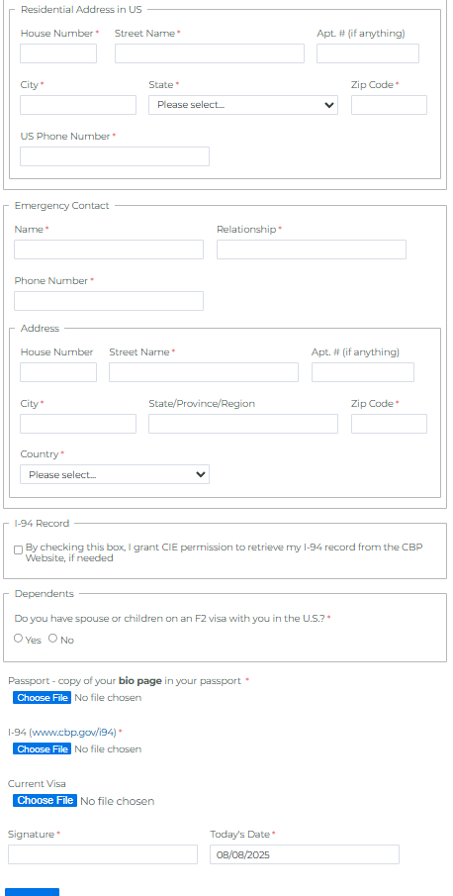
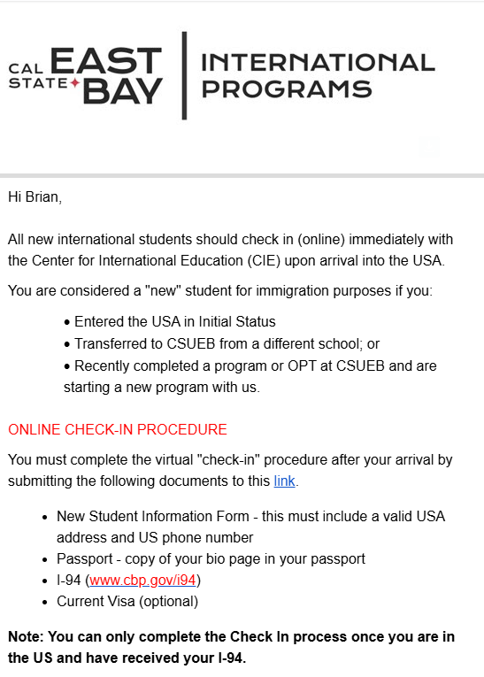
Immigration Check-In

Slide 15
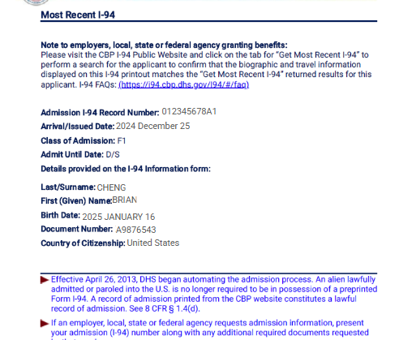
Immigration Check-In
https://i94.cbp.dhs.gov/home

Slide 16
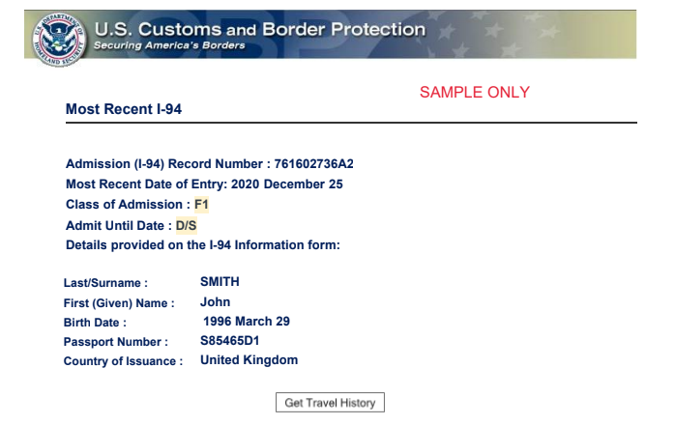
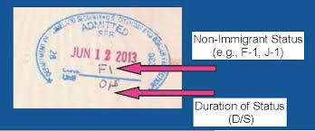
How do you know if you have a status?
You Gain Status by:
Upon legal entry to the U.S.
Upon approval by USCIS Service Center
Proof of Status
Listed on your I-94 (Departure/Arrival) Record
Entry Stamp
You may or may not receive an entry stamp in your Passport

Slide 17
Immigration Check-In
What happens if I don’t Check -In?
After completing Check –In?
I-20 won’t be registered
Lead to Termination of SEVIS Record and falling “Out of Status”
SEVIS record is Registered
Continued Attendance I-20 is issued

Slide 18
F-1 Immigration Do’s and Don’ts
Lily ShuFen Hsiao & Jamie He, International Student Advisors

Slide 19
What Will Be Covered Today?
Maintaining Your Academic & Immigration Status
    Why is it important?
How to maintain it?
Your Responsibilities
What to do and avoid
International Student Handbook

Slide 20
Why is “Maintaining Status” important?
Your Academic and Immigration statues are both important as they allow you to remain legally in the U.S. and make progress towards your degree

Slide 21
Why is “Maintaining Status” important?
Employment:
  On/Off Campus Employment: CPT/OPT
  STEM Extension for eligible degrees
Travel and Re-entry to the U.S.
Future Immigration Eligibility
Transfer
    Switching schools or attending classes concurrently at a SEVP Certified Institute

Slide 22
The “DO’s” of Maintaining Status
Maintain a full-time workload in the Fall and Spring semesters*
Summer is considered your annual vacation, unless it’s your last term
Maintain a Good GPA to avoid Academic
Probation & Academic Disqualification (DQ)
Attend your classes that require attendance and do your assignments
Obtain authorization from CIE if you wish to withdraw from a class

Slide 23
Staying in Status: Common Mistakes (Don’ts)
Avoid plagiarism or cheating
Limit online courses
Unauthorized Off Campus Employment
Exceeding allowed work hours

Slide 24
Consequences of Failing to Maintain F-1 Status
Termination of SEVIS Record
Your SEVIS record may be Terminated, making you ”Out of Status”

Slide 25
How to Maintain Your Academic Standing
Enrolling and maintaining a full-time courseload
Minimum ____ units per semester for Graduate students
Minimum ____ units per semester for Undergraduate students
Must be full-time in the fall and spring semesters
Maintain Good Academic Standing
____ or higher GPA for Graduate students
____ or higher GPA for Undergraduate Students

Slide 26
How to Maintain Your Academic Standing
Enrolling and maintaining a full-time courseload
Minimum 8 units per semester for Graduate students
Minimum 12 units per semester for Undergraduate students
Must be full-time in the fall and spring semesters
Maintain Good Academic Standing
3.0 or higher GPA for Graduate students
2.0 or higher GPA for Undergraduate Students

Slide 27
How to Maintain Your Academic Standing
Class Modalities:
In Person
Online
Hybrid
Enrollment Requirements
Online Course Limits:
One course or 3 units can count toward full-time enrollment per semester

Slide 28
Full Course of Study - Graduates
Graduate Students: at least 8 units/semester
Online Course Limits:
  Only 1 online class can be counted towards full time enrollment per semester
      3 classes at 3 units each (9 units) - 2 in person classes and 1 online class, this is considered full time
      3 classes at 3 units each (9 units) - 1 in person class and 2 online classes, this is NOT considered full time
      4 classes at 3 units each (12 units) - 2 in person classes and 2 online classes, this is considered full time
    Summer is considered your vacation unless your last term

Slide 29
Full Course of Study - Undergraduates
Undergraduate students: at least 12 units/semester
Online Course Limits:
Only 1 online class can be counted towards full time enrollment per semester
      4 classes at 3 units each (12 units) - 3 in person classes and 1 online class, this is considered full time
      4 classes at 3 units each (12 units) - 2 in person classes and 2 online classes, this is NOT considered full time
      5 classes at 3 units each (15 units) - 3 in person classes and 2 online classes- this is considered full time
    Summer is considered your vacation unless it is your last term

Slide 30
Pop Quiz!!!
F-1 Visa Benefits
1. ______________ 2. __________________
3. ______________ 4. ___________________

Slide 31
Pop Quiz!!!
F-1 Visa Benefits
1. Work 2. Travel and Re-entry
3. Transfer 4. Future Immigration Eligibility

Slide 32
How to Maintain Your Academic Standing
Maintain full-time Courseload: ______
Maintain Good GPA: _____
How many online courses can you take each semester: _____

Slide 33
Pop Quiz!!!
What are the Don’ts?
1. 2.
3. 4.

Slide 34
How to Maintain your F-1 Status
Maintain your Immigration Status/Documents:
Valid I-20: Program End Date Must Not Expire
Valid Passport
Valid I-94: Must State ”F-1” and ”D/S”
Valid Visa: Optional once you enter the U.S.

Slide 35
How to Maintain your F-1 Status
Valid I-20
Pay Attention to your I-20 Program End Date
                Carry a physical copy with you
                Electronic copies are ok, too, but you must physically sign your I-20

Slide 36
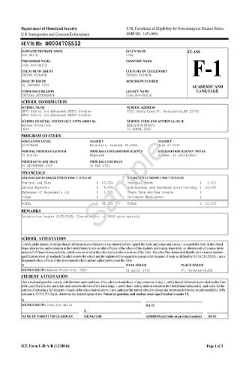
I-20 Document
I-20 is the Certificate of Eligibility for F-1 Students
Your I-20 expiration date is listed as the Program End Date
Check Personal, Program, and Financial Information for accuracy

Slide 37
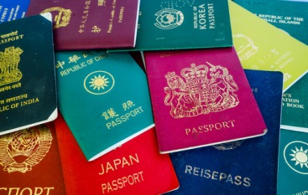
How to Maintain your F-1 Status
Valid Passport
Has an expiration date at least 6 months in the future
                Check with your Embassy/Consulate Office to renew your Passport while in the U.S.

Slide 38
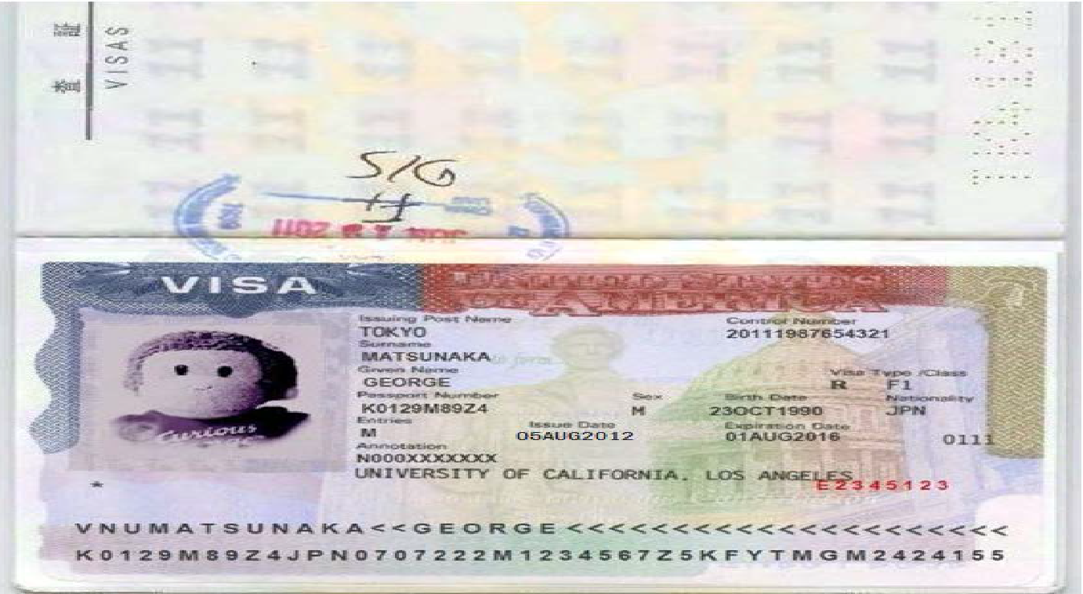
How to Maintain your F-1 Status
F-1, or other, Visa
Your F-1 visa can expire while you are in the U.S.
                Visas are only issued outside of the U.S.

Slide 39
How to Maintain your F-1 Status
Status Documents
Status: A valid I-94 must state “F-1”
D/S: Duration of Status means that you are allowed to stay in the U.S. as long as you are “maintaining status”
Obtain at: www.cbp.gov/i94

Slide 40
Pop Quiz!!!
Maintain a valid status of the following documents:
1. 2.
3. 4.

Slide 41
Pop Quiz!!!
Maintain a valid status of the following documents:
1. I-20, unexpired 2. Passport
3. F-1 Visa by Entry 4. I-94, D/S for F-1

Slide 42
How to Maintain your F-1 Status
Other than those 4 required documents, what else do you need to do in order to maintain your F-1 status?

Slide 43
How to Maintain your F-1 Status
Update your Contact Information
Rules state that this must be done within 10 days of the change
Update your information in MyCSUEB portal
What information?
U.S. Physical and Mailing Address
Foreign Address
Phone Number and Email Address
P.O. Box is not acceptable for living address (physical) but ok for mailing

Slide 44

Employment – On Campus
F-1 students maintaining status can begin working on campus up to 30 days before their program start date
Hours:
20 hours per week while school is in session
40 hours per week during breaks (spring/summer/winter)
On Campus Employment ends once you complete your degree program and no later than the Program End date on your I-20

Slide 45

Employment – Off Campus
Types of Off Campus Employment:
Curricular Practical Training (CPT) – internship based
Optional Practical Training (OPT/STEM) – pre and post
Economic Hardship – due to unforeseen circumstance
Off Campus Employment Guidance
Must receive approval before beginning employment
CPT/OPT must be related to field of study (major)

Slide 46

Employment – Curricular Practical Training (CPT)
Must have been in valid F-1 status for at least one academic year
Must be in good academic standing
Employment must be “an integral part of the established curriculum”
What you must do:
Receive approval from your academic department and internship office
Submit CIE forms and receive an I-20 with CPT endorsement
Begin employment after receiving CPT I-20
Contact CIE immediately if considering dropping course or changing employer

Slide 47

Employment – Optional Practical Training (OPT)
Must have been in valid F-1 status for at least one academic year
Must be in good academic standing
Eligible for 12 months of full-time employment
Pre Completion OPT: before your program ends (part-time)
Not very common since it takes away from your 12 month clock
Post-Completion OPT: after your program ends (full-time)
STEM eligible students can apply for the STEM Extension (24 months)

Slide 48
Grace Period
60 Day Grace Period
F-1 students have a 60 day grace period after after completion of a course of study
F-1 students can: apply for Post-Completion OPT, depart the country, or transfer to a different school in the U.S.
15 Day Grace Period
An F-1 student authorized by a DSO to withdraw from classes will be allowed 15 days to depart the U.S.
No Grace Period
Students who violate F-1 rules and regulations are not entitled to a grace period

Slide 49
Other Important Information
CIE Website - https://www.csueastbay.edu/cie/
Important Dates - https://www.csueastbay.edu/registrar/important-dates/index.html
Best source for deadlines and important dates.
7-week sessions schedule
Health Insurance - https://www.csueastbay.edu/cie/f-1-students/new-students/insurance.html
Best contact is csuebhealthinsurance@csueastbay.edu
The Bay Advisor - https://www.csueastbay.edu/aps/the-bay-advisor/
Horizon Email - https://horizon.csueastbay.edu/
Please include your Net ID

Slide 50
What Have We Covered?
How to maintain your academic status
How to maintain your immigration status
Your important legal documents
Types of Employment

Slide 51
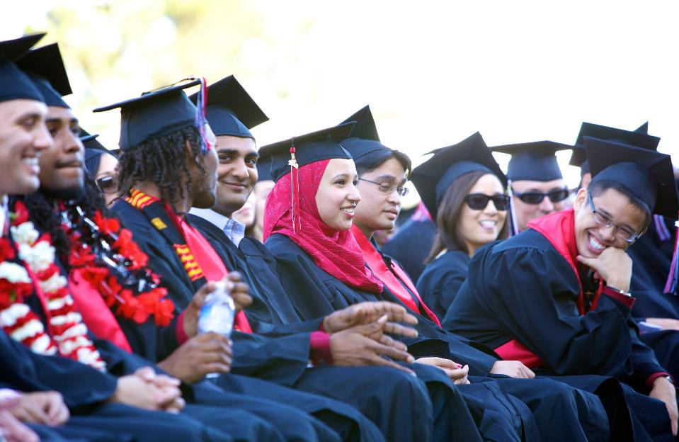
We Wish You a Great Semester Ahead!

Slide 52

Intercultural Presentation

Slide 53
Agenda
Culture
We’ll talk about visible and invisible culture
Optical Illusions
Do you see what I see?
Dialogue
Activity based dialogue that connect you with your peers
Culture Shock
We’ll wrap the presentation with some concluding thoughts.

Slide 54
Draw A Tree
Draw a Tree
By yourself
Any kind
First thing that comes to mind
1 minute

Slide 55

Tree = Culture?
Look at your tree. Share with a neighbor the details of your picture.
Do all the trees look different?
Did you include roots?
If you did not, how come? Was it because you usually don't see the roots?

Slide 56


Slide 57

Defining Culture
Examples
Visible | Invisible
Food | Religion
Clothes | Values
Language | Work Ethic
Symbols/Rituals | Relationships

Slide 58


Slide 59


Slide 60
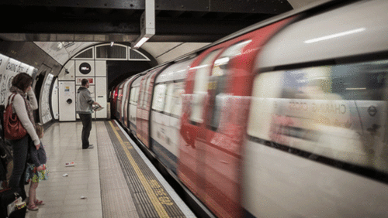

Slide 61


Slide 62

Dialogue - Activity
Form Groups of 3 or 4
Discuss these topics:
U.S.: Share something about U.S. culture that is different from your own. What do you think about that?
Global: Share something about your home country that you feel is unique.

Slide 63
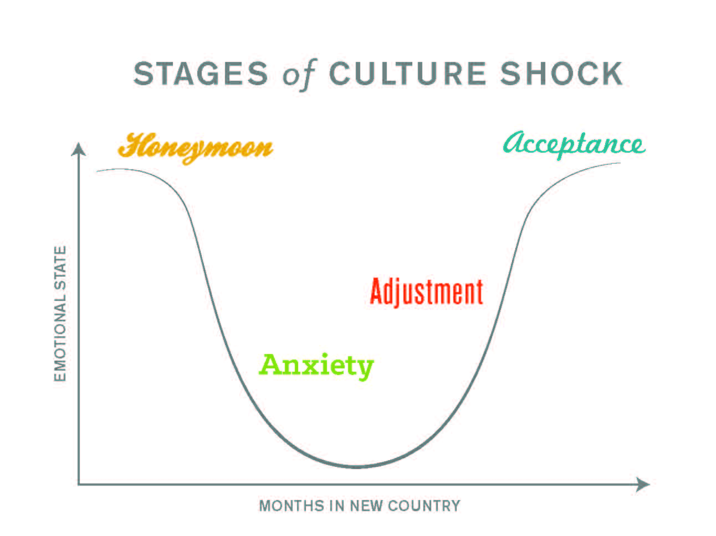
Culture & Culture Shock
Your brain develops highways or roads
Culture is:
Behavior
Problem solving
Socializing
Relationships
New Cultures can play tricks on you
Adjusting takes time
Your experience may vary

Slide 64
Group Breakouts
Global Academy & J-1 Exchange | Undergraduate | Graduate

Slide 65
Dr. Cathy Sandeen
President, Cal State East Bay

Slide 66
Balvinder Kumar
Interim Associate Vice President of Continuing Education

Slide 67
Center for International Education
https://www.csueastbay.edu/cie/

