Slide 1
WELCOME WEBINAR FOR NEWLY ADMITTED STUDENTS
JANUARY 30, 2025

Slide 2
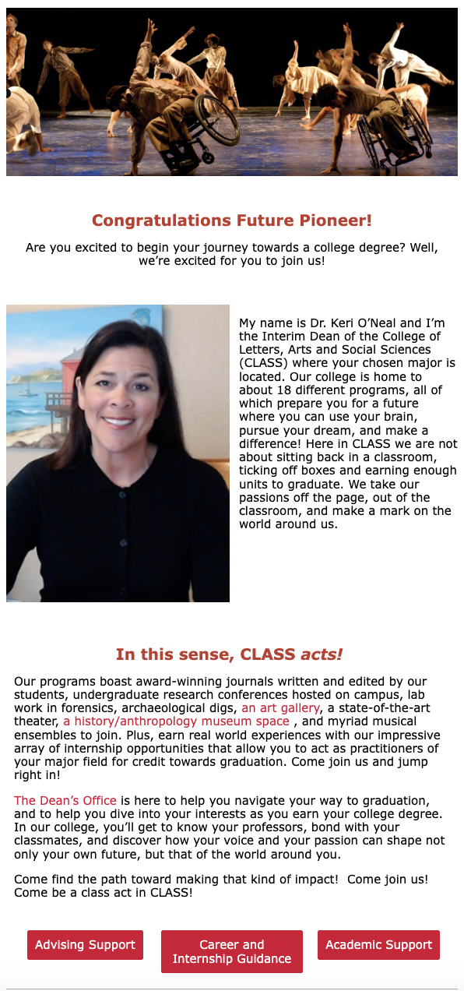

Slide 3
“… technology alone is not enough. It’s technology married with liberal arts, married with the humanities, that yields the results that make our hearts sing.”
– Steve Jobs, 2010
Other tech CEOs across the country agree that liberal arts education – with its emphasis on creativity and critical thinking –
is vital to the success of their business.

Slide 4
“In the dynamic environment of the technology sector, there is not typically one right answer when you make decisions. There are just different shades of how correct you might be.”
Steve Yi, CEO Media Alpha
Majored in Asian Studies
“I don’t believe there is one answer for anything. That makes me a very unusual member of the team.”
Danielle Sheer, Vice President at Carbonite
Majored in Existential Philosophy

Slide 6
MUSIC
MODERN LANGUAGES & LIT PHILOSOPHY POLITICAL SCIENCE PUBLIC ADMINISTRATION RELIGIOUS STUDIES SOCIAL WORK
SOCIOLOGY
SPEECH, LANGUAGE & HEARING SCIENCES THEATRE & DANCE WOMEN’S STUDIES
ART ANTHROPOLOGY COMMUNICATIONS CRIMINAL JUSTICE ENGLISH ETHNIC STUDIES
GLOBAL STUDIES
HISTORY/SOCIAL SCIENCE TEACHER PREP
HISTORY HUMAN DEVELOPMENT
LIBERAL STUDIES

Slide 7
So many opportunities to fly!
Come to Cal State East Bay and create:
publications * research conference presentations museum exhibits * musical performance real work experiences through internships newspapers * academic and creative journals theatrical productions * documentaries game designs* art gallery shows forensic investigations * archaeological digs direct paths to becoming teachers
and bonds with fellow falcons through student clubs, attending college events and working within your community.

Slide 8
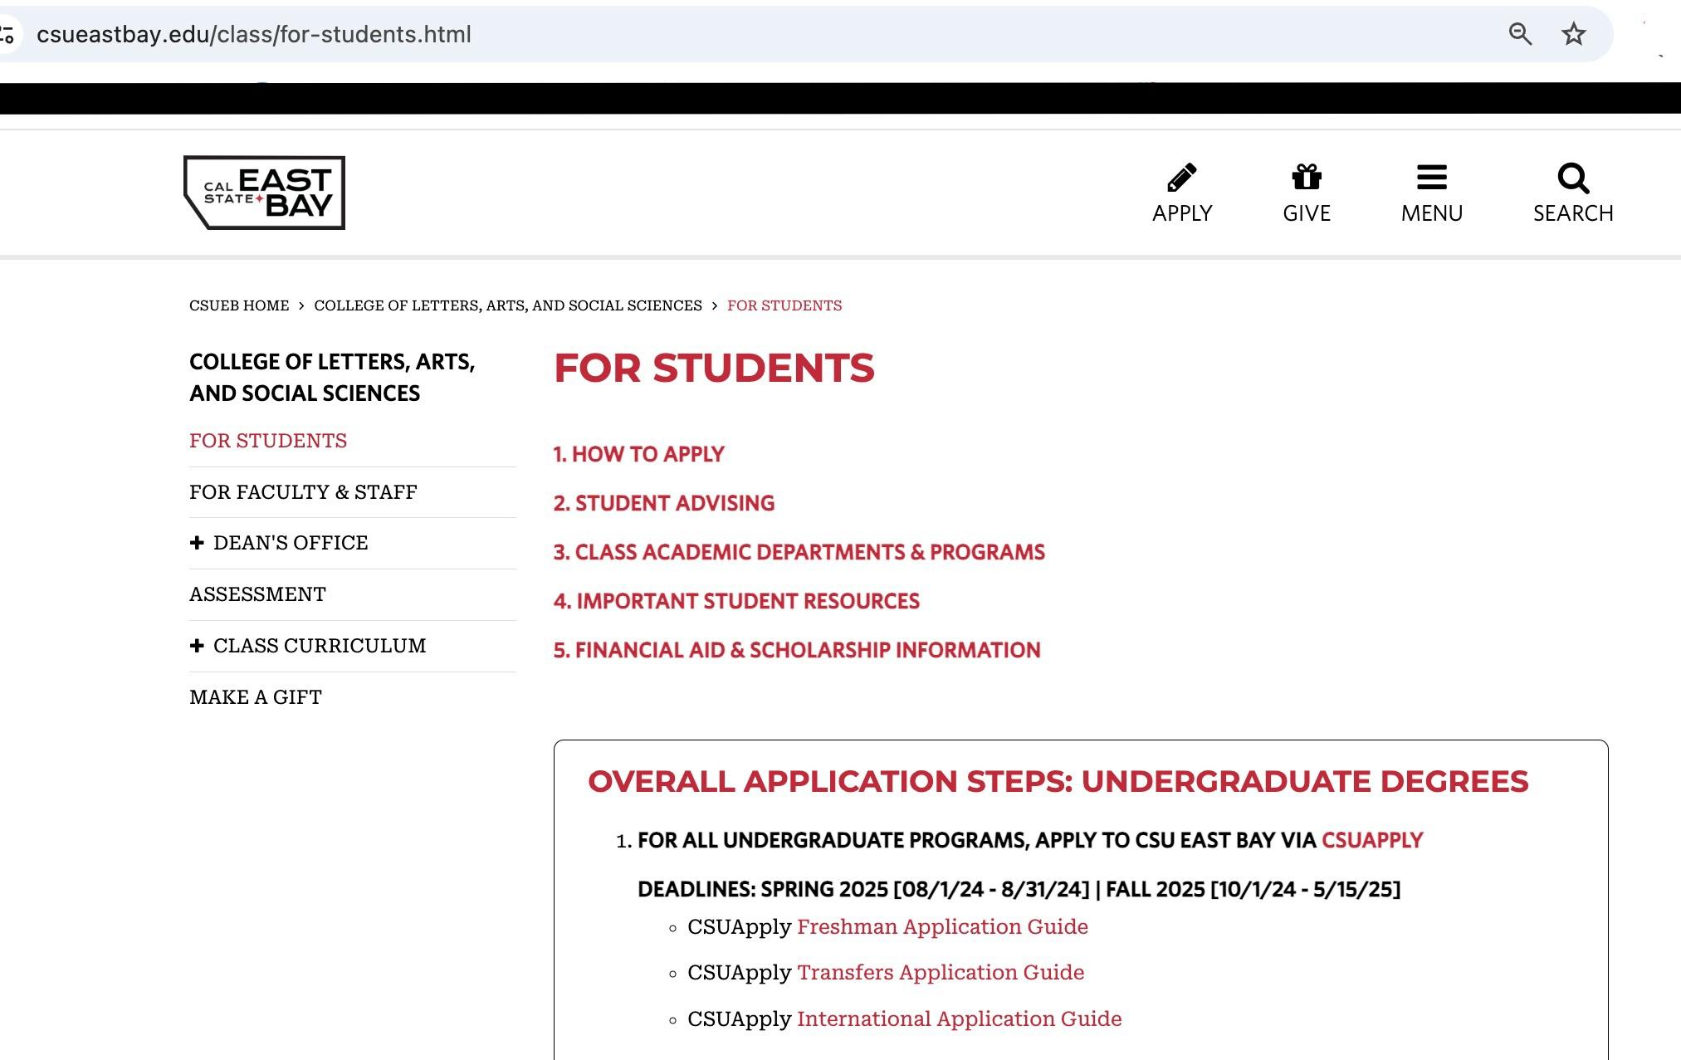
visit→ https://www.csueastbay.edu/class/

Slide 9
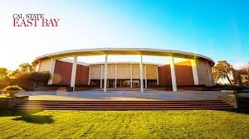
CLASS Dean’s Office
MB 1505 - enter first door on the left!
Keri O’Neal - Interim Dean
Ethel Nicdao - Associate Dean, Faculty Affairs & Administration
Linda Ivey - Interim Associate Dean, Student Affairs & Curriculum
Mary Kendall - Queen of all things

Slide 10
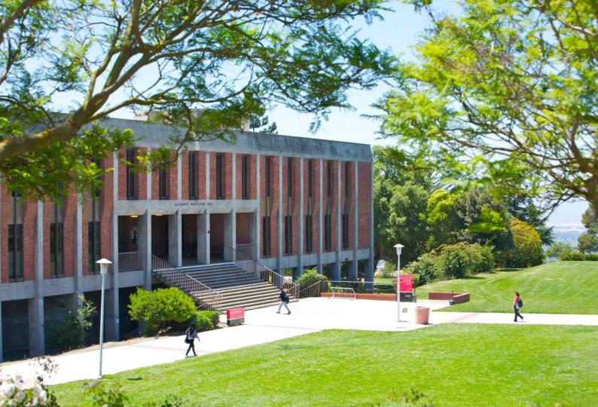
CLASS SSC
Student Services Center
MI Hall 4006 - 4th floor, then good luck!
Jerome Narvaez, Coordinator
Sharla Blank
Wendy Couttien
Terry Cunningham
Tristan Garcia
Mo Her
Natalie Nelson
Erin Quineri
Andrea Weiker
class_ssc@csueastbay.edu
(510) 885-3477
The Bay Advisor - “main advisor”
ADVISORS!

Slide 11
Next Steps:
Check in with your *main* advisor
Check out your major and the course you’ll need/want to take
Contact your “major advisor” if you have questions about the program
When in doubt, write me! linda.ivey@csueastbay.edu

