Slide 1
Exploring Conceptualizations of Diversity and Social Justice in a Diverse, Public, Urban University Ethnographic & Qualitative Research Conference February 10–11, 2014, Las Vegas, NV
Sarah Taylor, PhD, Rose Wong, PhD, Colleen Fong, PhD, & Julie Beck, PhD California State University, East Bay

Slide 2
Acknowledgments and Background
The study was funded by the Programmatic and Excellence in Innovation in Learning (PEIL) program through the CSU East Bay Office of the Provost.
The goal of the PEIL program is “To support innovation and excellence in education, and to promote teaching that prepares students to meet the demands of the 21st Century global environment…Programmatic Excellence & Innovation in Learning (PEIL) grants are intended to support faculty teams and departments committed to achieving widespread sustained improvement in undergraduate instruction using established best practices.”
These internal grants are awarded competitively. Our team received the grant in 2012-2013 and again in 2013-2014.
In addition to the co-authors, contributors to the study included: Isobel Marcus, MSW, Thahn Le, MSW, Philip Chang, MSW Candidate, and Derek Jackson Kimball, PhD.

Slide 3
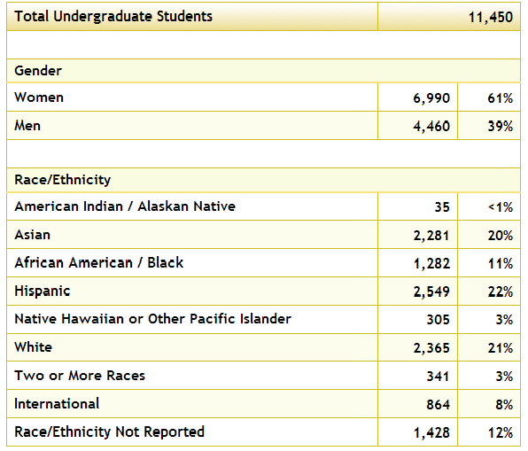
Demographics of CSU East Bay Students
From: http://www.collegeportraits.org/CA/CSUEB/characteristics

Slide 4
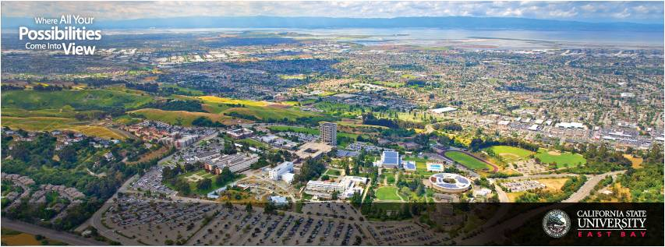
Other Campus Facts
13,851 students total (2401 grad students)
34% of undergrads are over age 25
44% of undergrads are classified as having a low-income
39.8% of first-time, first-year, full-time students graduate within 6 years.
Data from: http://www.collegeportraits.org/CA/CSUEB/characteristics & http://www.collegeportraits.org/CA/CSUEB/undergrad_success
Image from: http://www.linkedin.com/edu/california-state-university-east-bay-17825

Slide 5
Research Background and Questions
Our purpose was to explore next steps in advancing our Institutional Learning Objective (ILO), adopted in Spring 2012, that graduates should be able to Apply knowledge of diversity and multicultural competencies to promote equity and social justice in our communities?
How does this highly diverse student body influence the type of academic community we co-create?
How do students, faculty, and staff understand diversity?
How well are we teaching and learning about diversity?
How well are we creating an inclusive environment?

Slide 6
Methods
Part of a three-component planning study:
Focus groups with faculty staff, and students
Insights and strategies from visits and face-to-face interviews with our neighboring institutions engaging in exemplary practices
The DSJ-specific content in 85 course syllabi drawn from across the campus
All groups facilitated by a professional consultant with experience in diversity and social justice and in leading focus groups
The leadership team provided a semi-structured focus group protocol. Topics included:
Conceptualizations of diversity, social justice, and civic engagement
How curricular and co-curricular activities currently address diversity, social justice, and civic engagement, including the explicit and implicit curriculum
Suggestions for how curricular and co-curricular activities should address diversity, social justice, and civic engagement
Separate groups for staff (1 group), faculty (2 groups), graduate students, (2 groups), STEM undergraduate students (2 groups), and all other undergraduate students (4 groups).

Slide 7
Focus Group Opening
On the index card I’m giving to you, please take a few minutes to jot down the first 5 words that come into your head when I say “diversity and social justice.”
Great, thanks. Can we go around the room and share the words? I’m going to write all the words you said on the white board. You can skip your turn if you don’t feel comfortable.
Looking at our white board, and thinking about your classes and extra-curricular activities at CSU East Bay, please share any thoughts you have about what’s written there (a-f prompt only as needed).
Are there any words that seem especially important to you? Why?
Are there any words that seem to be missing?
Are there any words there that you have a question about?
How are these words reflected in the content of your classes?
How are these words reflected in the way your professors teach (e.g. how they manage the classroom, how they behave in office hours, etc.)
How are these words reflected in your extra-curricular activities?

Slide 8
Sample characteristics
11 focus groups with 46 faculty, staff, and students
27 students, 8 staff, 11 faculty
Age | Percent of total group participants (n=46)
18-22 | 22%
23-40 | 41%
41-60 | 28%
Over 60 | 7%
Missing | <1%
Race/ Ethnicity | Percent of total group participants (n=46)
African American | 22%
European American | 24%
Latino American | 17%
Asian/Pacific Islander American | 24%
Multiple Ethnicities | 13%

Slide 9
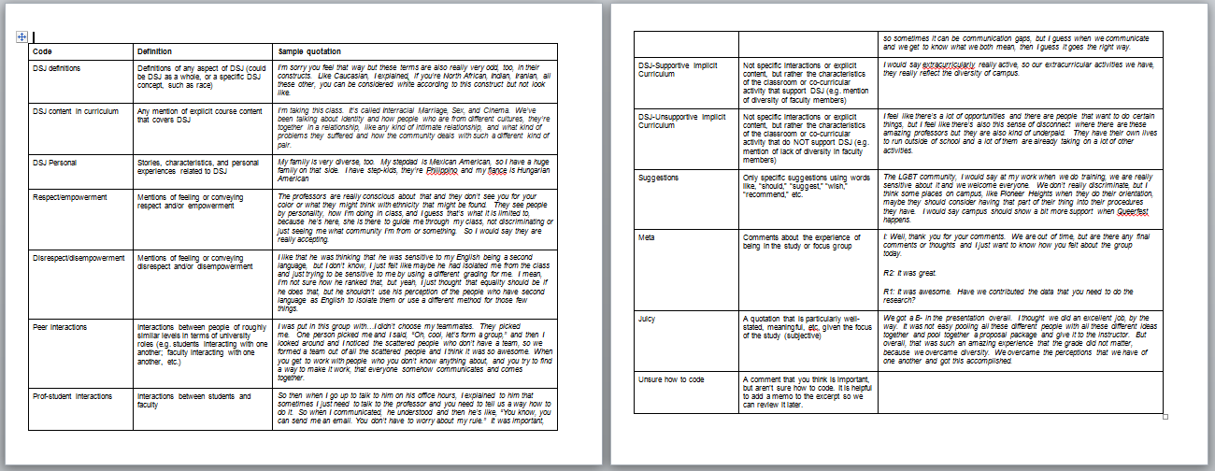
Analysis

Slide 10
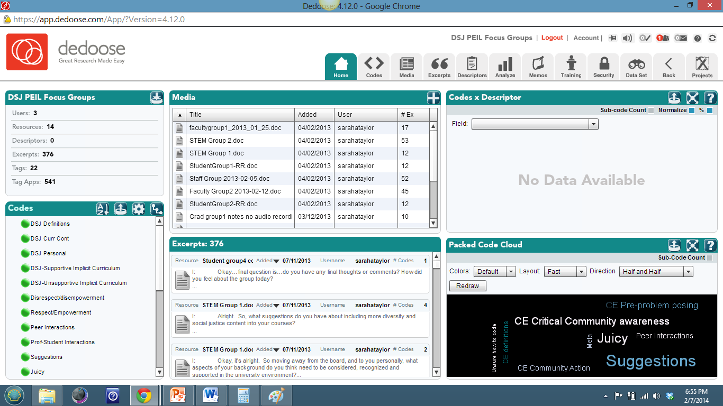
Analysis continued

Slide 11
Overview of Findings, Page 1 of 3
Research Question | Summary Finding | Example Quotation
How does this highly diverse student body influence the type of academic community we co-create? | Our diversity provides wonderful opportunities for learning, but we don’t always capitalize on it. Just “showing up” to school or work in a diverse setting isn’t enough. Team-based projects can facilitate learning among diverse students, if well-executed. | Group activities is number one in my opinion in getting to know other people of different diversity…I was put in this group with…I didn’t choose my teammates. .. that was such an amazing experience that the grade did not matter, because we overcame diversity. We overcame the perceptions that we have of one another and got this accomplished. - STEM Student I have a lot of classes that require …a lot of group projects. It’s been really difficult…Even though the instructor has this premise that putting us together, that it will achieve some form of diversity or add to this paper – we all end up being very separate. How it comes across, the work is still done; however, our critique on assignments usually is that we aren’t collaboratively together, still separate. - Undergrad Student

Slide 12
Overview of findings, Page 2 of 3
Research Question | Summary Finding | Example Quotation
How do students, faculty, and staff understand diversity? | Faculty, students, and staff see diversity as very broad. Some faculty and grad students worry about race being de-emphasized. | Racism has to be on the table. - Faculty Member Race is a big one actually, because some of us have experienced racial inequality or situations that have just not been…where you have been disenfranchised because of your race. - Grad Student
How well are we teaching and learning about diversity? | Mixed reviews. Everyone is too busy. Some faculty are exemplary. Others need support and training. | I think most professors try to be fair, so fairness, but there’s not a lot of…to me, professors are so scared. There’s not a lot of expression of anything else. We try to be fair, not offend anyone with what I have to say or anything that I’m teaching, but it doesn’t go past that…there’s not a lot of discussion about different things like gender or awareness or culture or education. - Undergrad student

Slide 13
Overview of Findings, Page 3 of 3
Research Question | Summary Finding | Example Quotation
How well are we creating an inclusive environment? | Mixed reviews. Everyone is too busy. Some individuals go the “extra mile.” There are disconnects between faculty, students, staff, and administration. | They want to engage this process as a downstream process, so moving downstream in this clearly hierarchal structure…How about it flows upstream and changes the management culture? - - - Staff Member It’s kind of like a rat race, kind of like a maze. They have an expectation that I’ll figure out the campus but in so many departments and processes, what is the general purpose? Why do you have a Dean of this or that? What is the connection? - Undergrad Student

Slide 14
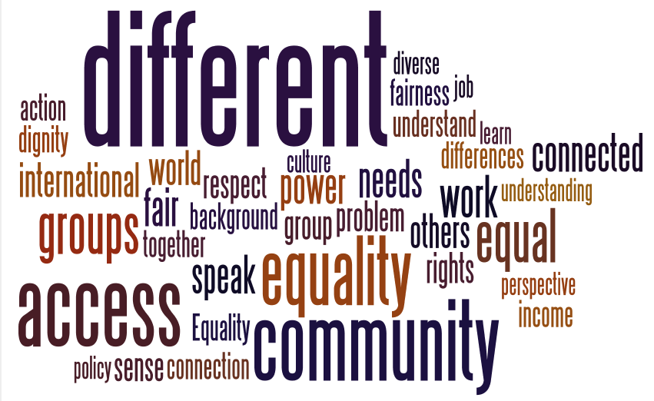
Concepts Associated with Diversity and Social Justice

Slide 15
Aspects of Diversity Mentioned
Ethnicity
Culture
Sexuality
Race
Religion
Socioeconomic status
Gender
Complex lives
Personal struggles
Language
First gen college student
Parental status
Immigration status
Geography
Age
Disability
Homelessness

Slide 16
Strengths and Limitations
Often when participants—especially students—shared, they generated an immense amount of passion. For example, when one student shared that she felt empowered when she graduated—her energy cannot be captured in the audio recording or transcript. In almost every focus group participants appeared to be comfortable with one another and thoughtful of one another and the conversations flowed smoothly.
- Focus Group Facilitator
Limitations
Selection bias
Small sample size
Likely oversample of social work students
Strengths
Passion
Depth
Rich detail

Slide 17
Need for Support to Make Changes
I feel like there’s a lot of opportunities and there are people that want to do certain things, but I feel like there’s also this sense of disconnect where there are these amazing professors but they are also kind of underpaid. They have their own lives to run outside of school and a lot of them are already taking on a lot of other activities.
Undergrad Student
I didn't come prepared for this job…I'm in quarter two, and I'm just a little ahead of the students mainly because it's content I haven't taught…But I think…in terms of the system issue and systemic change, and if we're about social justice as an institution, then it's going to really cause more work for us, the instructors, and collaborative work in my opinion is the best way to go at that.
- Faculty Member

Slide 18
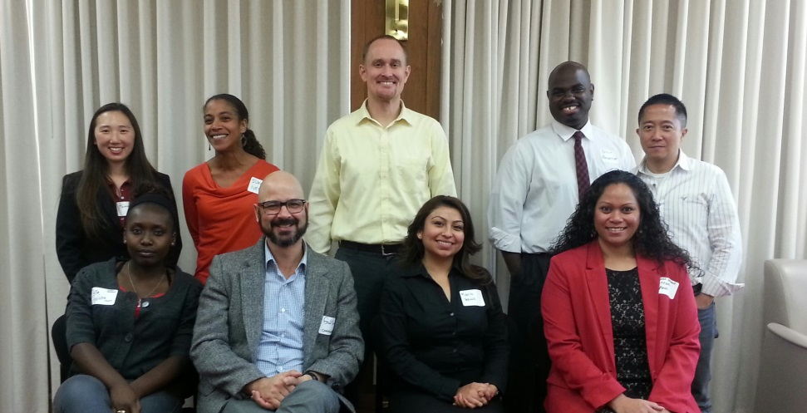
Next Steps
DSJ Faculty Fellows Pilot Program 2013-2014
DSJ Teaching Guide 2013-2014
Proposal submitted for a STEM Expansion of the Faculty Fellows Program
More analysis, presentations, and papers

Slide 19
Sunset in Hayward, CA, October 2, 2012, Photo by Sarah Taylor
Sarah Taylor, MSW, PhD
Assistant Professor, Department of Social Work
California State University, East Bay
sarah.taylor@csueastbay.edu
http://www20.csueastbay.edu/directory/profiles/sw/taylorsarah.html

