Slide 1
What Is Early Start?
The Early Start Program (ESP) was mandated by the CSU Board of Trustees in response to numbers of new students requiring remediation in mathematics and English.
Students complete mandatory ESP course(s) the summer before enrollment at a CSU.
Goals:
better preparation of new students in mathematics and English by starting in the summer
better assessment of academic preparation
improving the likelihood of a successful completion of a college degree
The ESP requirement began with the Fall 2012 entering class.

Slide 2
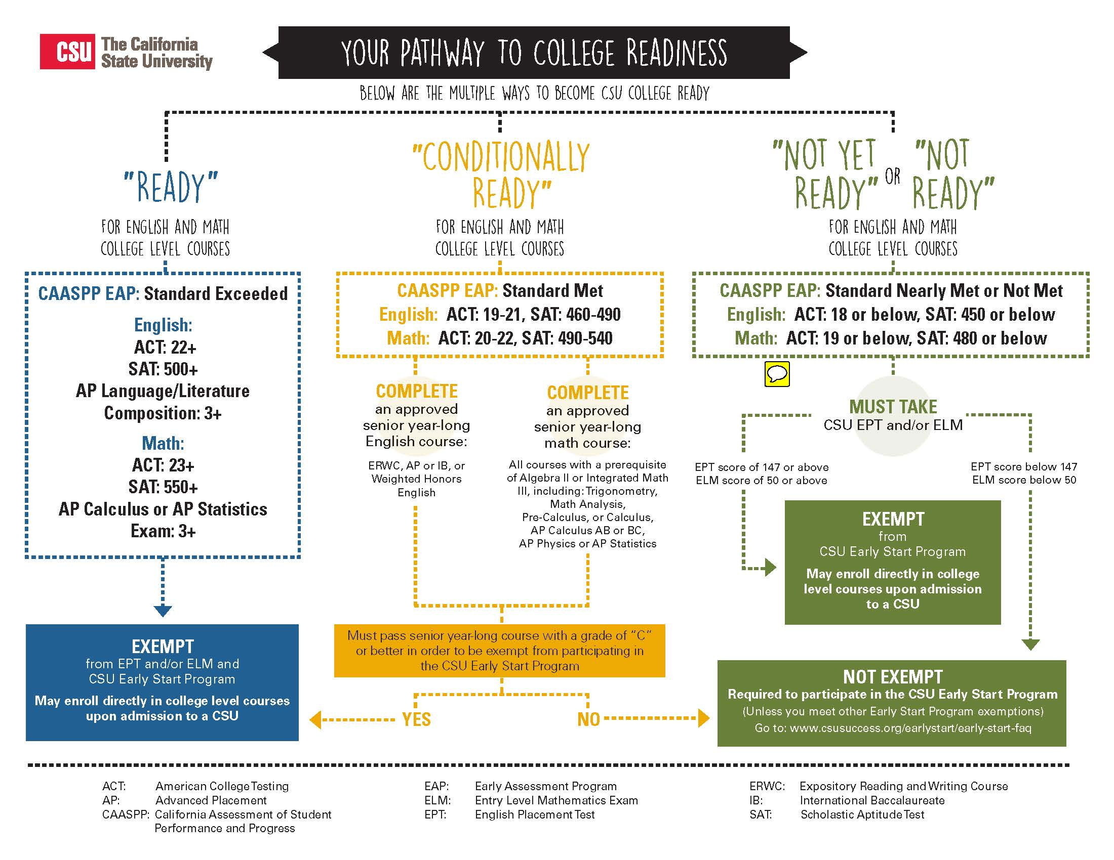
Who Must Complete Early Start?

Slide 3
When and where are the ESP classes?
ESP can be completed at any CSU
Dates and options vary by campus. Most are in June/July.
www.csusuccess.org/earlystart lists all courses by campus
Updated in January
On-ground and online courses
1 semester / 1.5 quarter unit ESP courses
Some campuses offer full remedial options
August courses available at CSUEB for incoming CSUEB students only

Slide 4
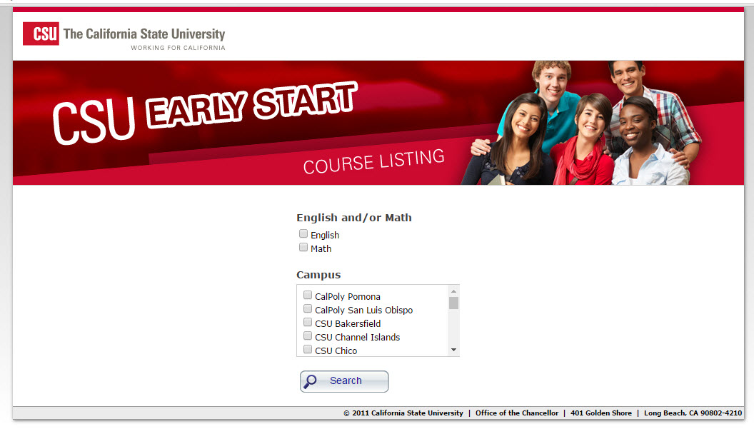
When and where are the Early Start classes?

Slide 5
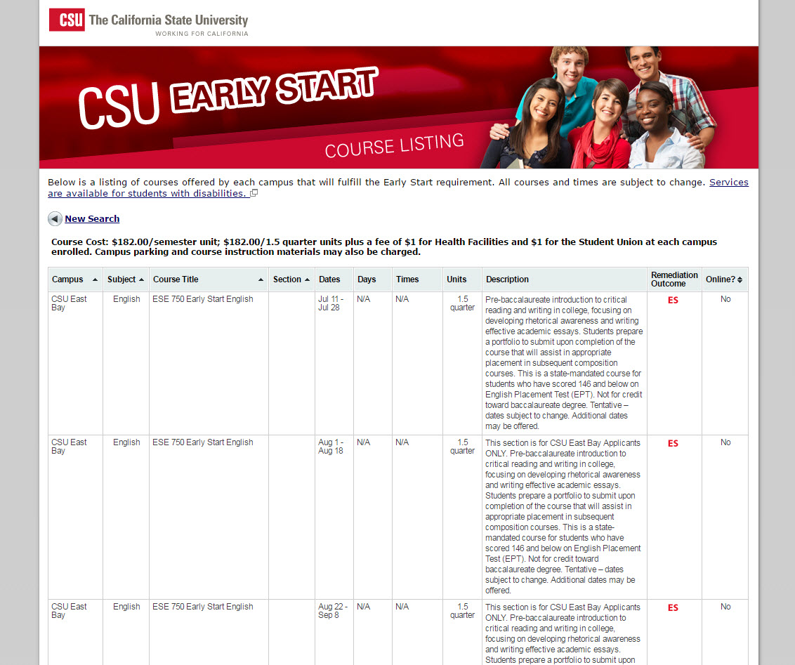
When and where are the ESP classes?

Slide 6
Costs and Fee Waivers
ESP courses = 1 semester unit / 1.5 quarter units
Cost is $182 per semester unit / $182 per 1.5 quarter units
CA residents with EFC of $5,000 or less receive waiver for ESP course fees.
Waiver is automatically applied to course fees at time of enrollment
Parking costs and course materials (textbooks, ALEKs access) are not covered by the fee waiver.

Slide 7
How do students enroll?
Registration process begins in May.
Completed in MyCSUEB
Step 1: (Smart Page) CSUEB will ask student to indicate where he/she will complete ESP – at CSUEB or a service campus
Step 2: Student registers for ESP class at CSUEB or service campus by the registration deadline. (If registering at service campus, student uses service campus portal – i.e. MySJSU)
Step 3: If required, student pays course fee by the fee payment deadline

Slide 8
Reminders for students…
Make sure to take the EPT/ELM no later than the May 7th test date.
If you are EAP Conditionally Ready you must pass your senior year experience course with a C or better in both semesters to become exempt from remediation and ESP. Your exemption will be applied when your final H.S. transcript is received.
The Early Start requirement is mandatory for those required to complete it. Do not delay registration as many courses (especially online courses) fill quickly.

Slide 9
Questions?
www.csueastbay.edu/csuearlystart
CSUEB Early Start Office
(510) 885-3910
earlystart@csueastbay.edu

