Slide 1
AI Infused Assignments – Spring 2025 Working Group
Notes:
NOTE: to change background photo, edit the master style slide.

Slide 2
AGENDA
AI Detection Tools
Example
Turnitin Discussion
Creating a Flyer using AI - Example

Slide 3
Goal - AI Detection Tools & Strategies
AI Text Detectors (~15 minutes to try multiple samples through both):
Try GPTZero, , DetectGPT or Phrasly or review this 2024 Zapier article. ,
You can explore more Grammarly, Copyleaks, DetectGPT, GPTZero, Originality.ai, Smodin, Quillbot
AI Image Detectors (~15 minutes to try all 3):
Try the Maybe AI Image Detector,, the Optic AI or Not Detector or Illuminarty's AI Image Detector
NYT's Interactive AI Image Detection Exercise
(~15 minutes): Follow along with this interactive tool designed to train you to become a human AI detector. This resource primarily focuses on "deepfakes," meaning images of people who do not actually exist. How do you think this might be used by your learners? What about more global applications? You can also get your free CSU East Bay account.
Roft.io Games: Practice Detecting Text Written by AI (~15 minutes): This project will allow you to practice detecting text written by AI. You will learn some of the hallmarks of AI-generated text and put those skills to work by detecting multiple types of AI-generated text content, from short stories to news articles.
If the link doesn't work, check out CNN's Interactive AI Writing Detection Exercise (Duffy & Uzquiano, 2023) instead.
Why Students Cheat on Exams & Assignments (~5 minutes): Carnegie Mellon University created a page to help you identify why students might cheat on assignments. This page also guides you to explore strategies for encouraging academic honesty.

Slide 4
Lets try
Download Literacy Reflection Assignment Sample 1 and Sample 2.
We will use GPT Zero to analyze both documents.
Let us compare the results now with DetectGPT
Note both require to have accounts set up and I am using the free versions.
What are your first observations and what limitations to we see.

Slide 5
DISCUSSION
What strategies can you think of for detecting AI-generated text and images
Notes:
NOTE: to change background photo, edit the master style slide.

Slide 6
Generating a Flyer
Today the department of Statistics is hosting a seminar open to everyone. Below are some details of the event. How can I create a flyer to promote this.
Host: Data Science Club Location: CORE 178 on Thurs. March 20 from 12-2
Speaker: CSUEB Alumnus and current Distinguished Engineer at Snowflake, Murray Stokely, will be joining us to talk about an upcoming paper about some of his recent work in using statistics to optimize cloud compute bills at Snowflake.

Slide 7
SHARE an Eaxmple or Concern
Notes:
NOTE: to change background photo, edit the master style slide.

Slide 8
Name (Make a copy of this slide and add in your details)
DEPARTMENT –
CLASS/ SUBJECT you tried
OUTCOME - Discuss the process & potential strategies

Slide 9
Name Lonny Avi Brooks
DEPARTMENT – COMM
CLASS/ SUBJECT Midjourney for Future Scenario images
OUTCOME - Discuss the process & potential strategies

Slide 10
Name: Lonny Avi Brooks, Chair Comm Dept.
DEPARTMENT – COMM
CLASS/ SUBJECT History essay
OUTCOME - Discuss the process & potential strategies
For this exercise, I used GPTZero and Optic AI or Not Detector to evaluate AI-generated content, including a fictional story, an essay, and an illustration. The results varied, raising key questions about the effectiveness of these detection tools.
https://gptzero.me/
Links to an external site.
I used this text detector to screen my daughter's research for her essay and then for her final essay for a college course she is taking just for fun…
I used Optic AI or Not Detector as an AI image detector for a comix artist I work with who absolutely detests AI for use in art because of the copy right infringement AI poses. His illustration for a graphic novel I am co-creating with him pass the Human test somewhat in terms of calling it "Likely human.
I tried it on a story I created with AI as well, not pictured here, and it did not do well on that test, noting that it was human generated so now I’m wondering how well it does with stories in general and if this detector is more sensitive to nonfiction than fiction if the text occurs specifically in a specific storytelling genre.

Slide 11
Andrew Yunker
DEPARTMENT – General Studies
CLASS/ SUBJECT GS 101A & GS 101B
OUTCOME -
AI example of a limitation
Prompt: You have 15 cows and 12 chickens, how many legs are there on your property if there are also 2 tables and six flying ravens at your neighbours place?
Test this out in an AI such as ChatGPT

Slide 12
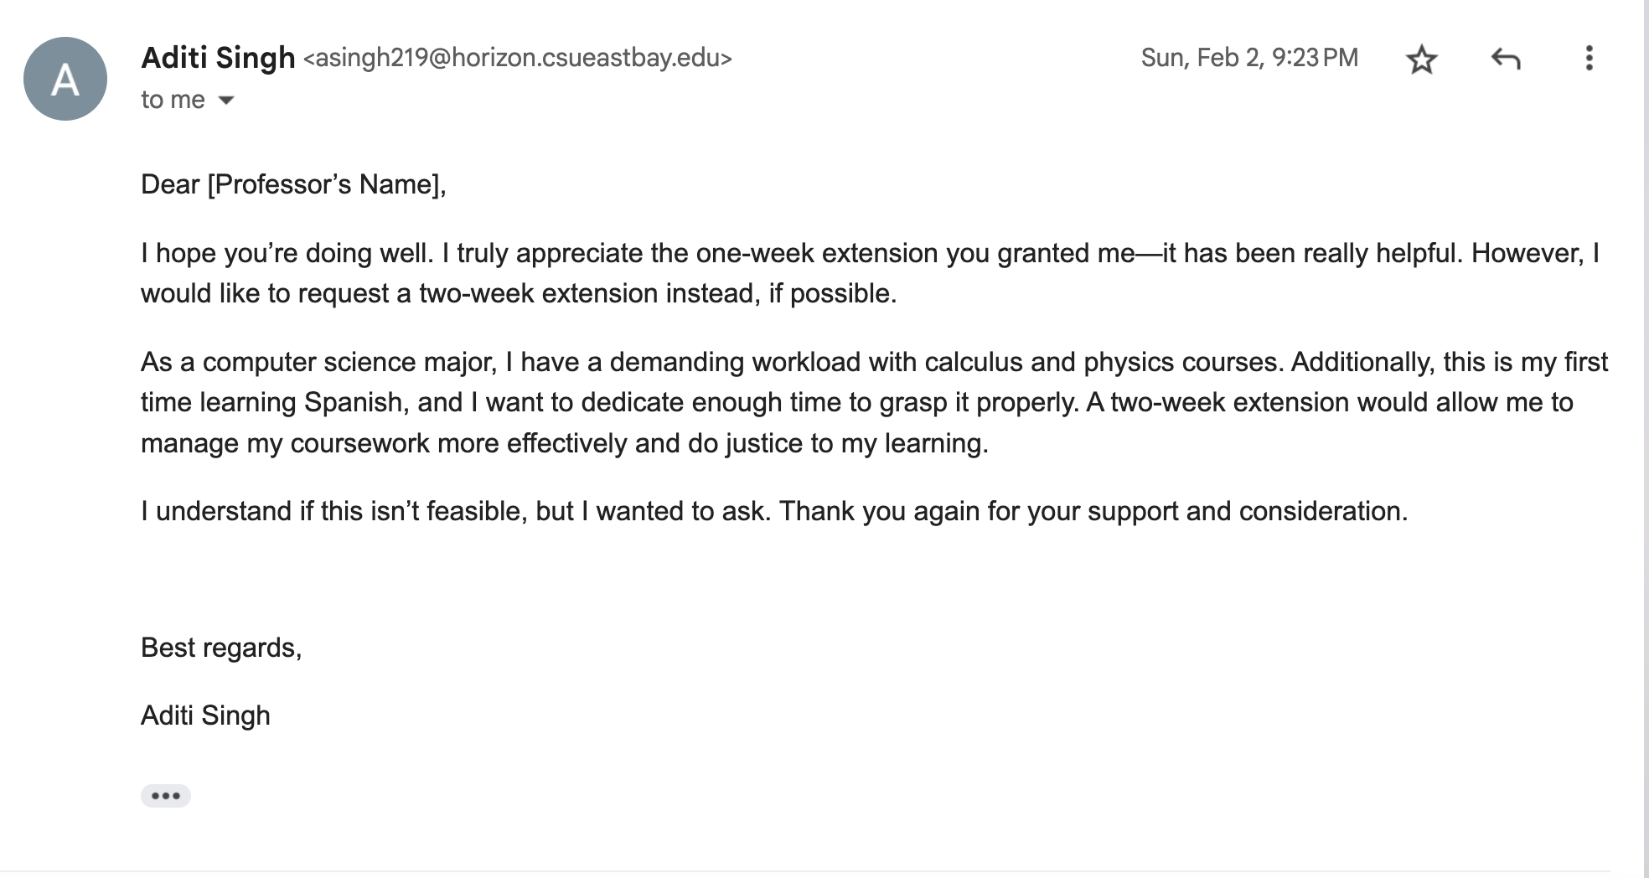
Name (Gabriela Díaz-Dávalos)
DEPARTMENT – Writing, Languages, and Literatures
CLASS/ SUBJECT - SPAN 141

Slide 13
MORE RESOURCES at
AI Writing Update on Turnitin's Detection Tool
Navigating AI Detection with Students
(Packback, 2024): In this article, you will review strategies for detecting AI text in student submissions as well as how to navigate these conversations with your students professionally and diplomatically.
-
https://marketing.ces.ncsu.edu/ai-guidance/
https://guides.library.ttu.edu/artificialintelligencetools/detection
Notes:
NOTE: a version of this slide is also provided without the quote marks for non-quotation feature slides.

