Slide 1
Grading and Feedback Strategies in Canvas
Shara Cheng and Cheryl Saelee

Slide 2
What makes feedback effective?
1
Notes:
Ask how much time folks spend on grading. What makes feedback effective for them? Effective for students?

Slide 3
Feedback should be:
Specific
Actionable
Timely

Slide 4
Strategies Continued
Clear Assignment Instructions
Define what the purpose is and what steps should be taken
Scaffolding Assignments
Helps break it up into smaller more manageable steps so that just in time feedback can be provided.
Include Self-Reflections
Have a student submit a short paragraph reflecting on their work and rubric criteria
Notes:
https://ctl.columbia.edu/resources-and-technology/resources/grading-strategies/

Slide 5
Strategies Continued
Determining which assignments need how much grading
Canvas discussion summaries

Slide 6
2
Tools in Canvas

Slide 7
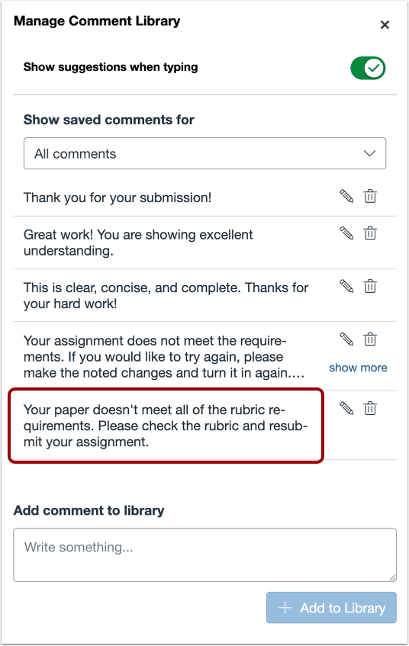
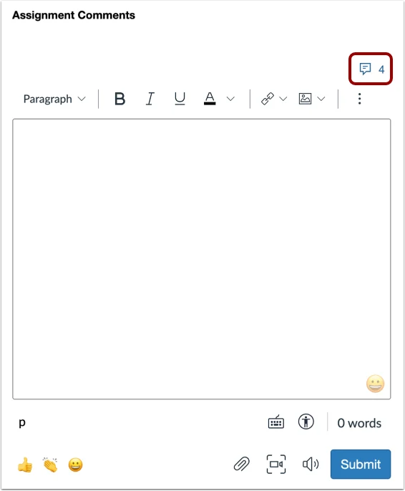
Comment Library
Notes:
https://community.instructure.com/en/kb/articles/664291-how-do-i-use-the-comment-library-in-speedgrader
https://teaching.pitt.edu/resources/speedgrader-comment-library/

Slide 8

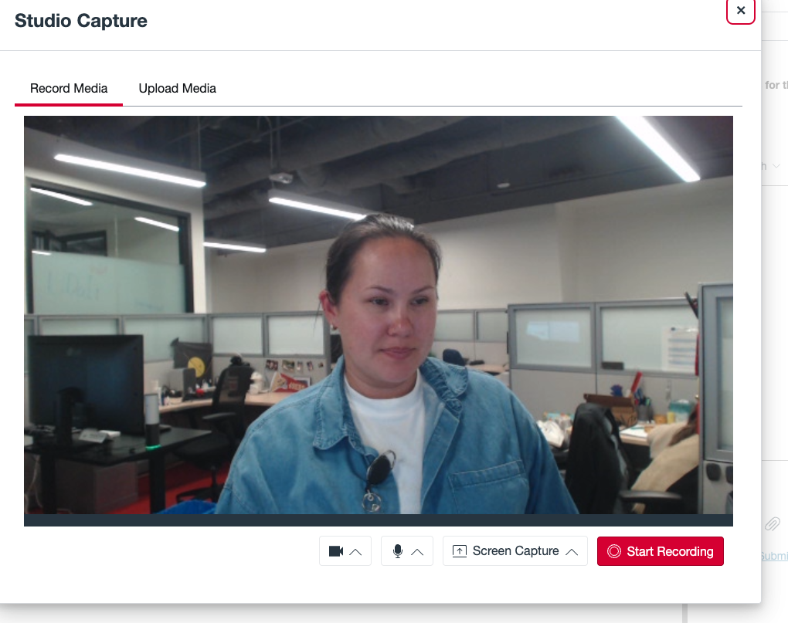
Media Feedback
Notes:
https://www.slu.edu/cttl/resources/resource-guides/canvas-media-for-feedback.pdf
https://mitsloanedtech.mit.edu/2025/02/26/new-in-canvas-screen-capture-feedback-feature-added-to-speedgrader/

Slide 9
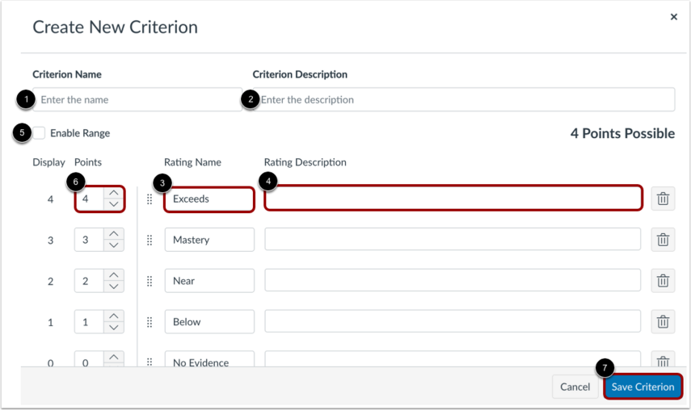
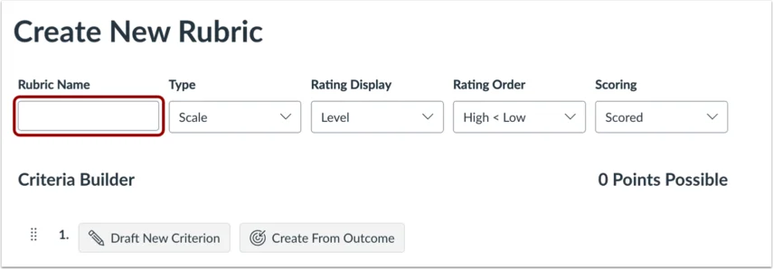
Rubrics
Notes:
https://community.instructure.com/en/kb/articles/661102-how-do-i-add-a-rubric-to-an-assignment
https://community.instructure.com/en/kb/articles/661107-how-do-i-add-a-rubric-in-a-course-using-enhanced-rubrics

Slide 10
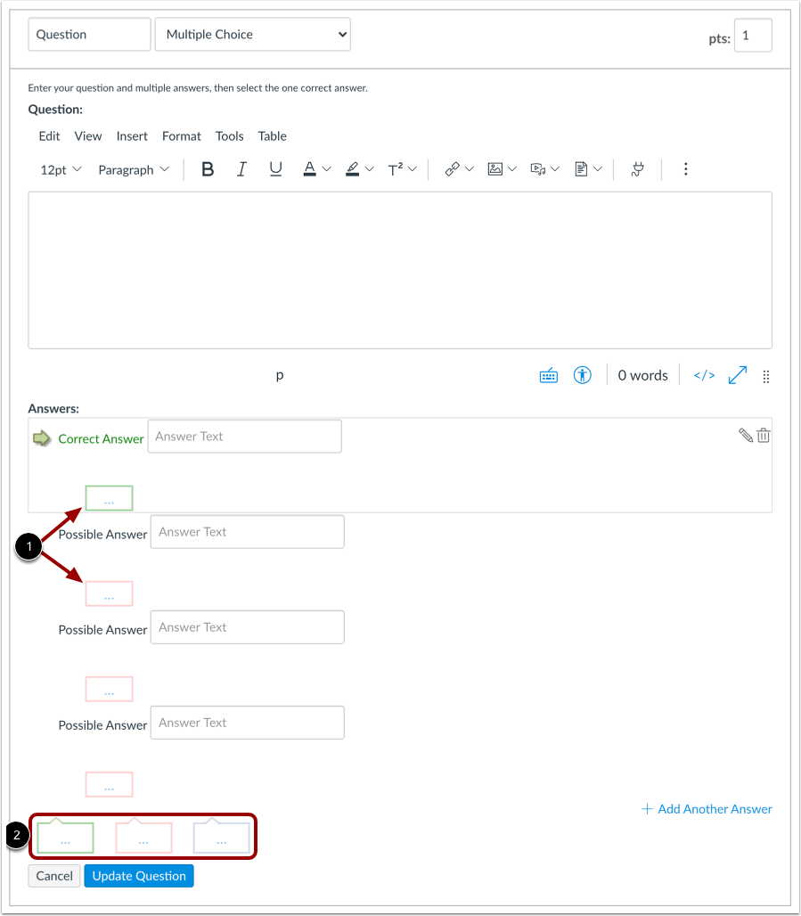
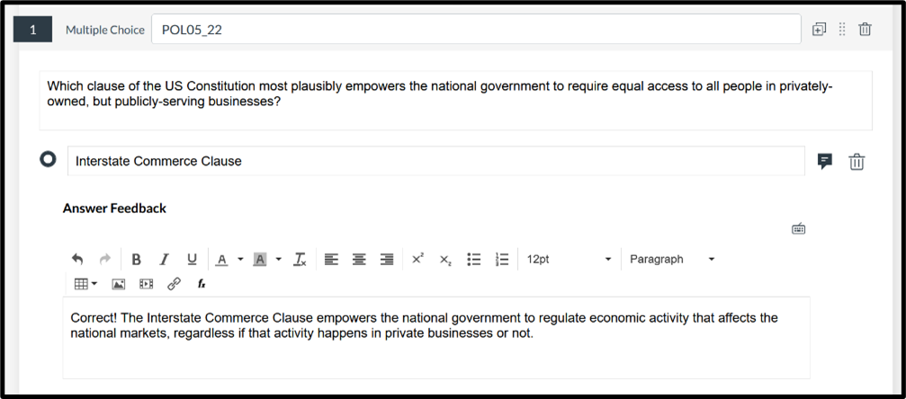
Quizzes Instant Feedback
Notes:
https://ready.msudenver.edu/self-help-tutorials/grading/add-feedback-in-new-quizzes/

Slide 11
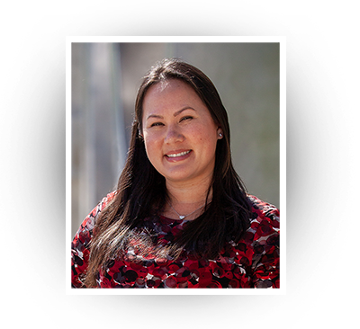
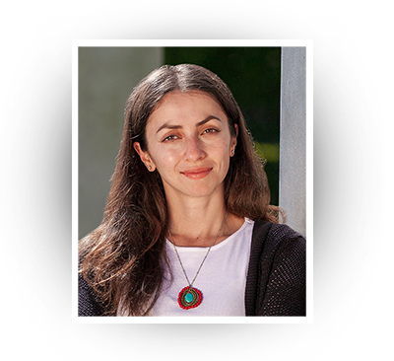
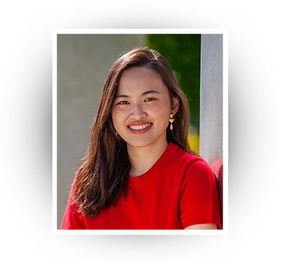
Contact Us!
Cheryl Saelee cheryl.saelee@csueastbay.edu Nursing, Paralegal, Criminal Justice, Computer Science, Physics, Writing, Languages & Literature, Music, General Education, Sociology, Public Affairs and Administration, History & Global Cultures, Management, Kinesiology, Educational Leadership
Serena Kohgadai
serena.kohgadai@csueastbay.edu
Ethnic Studies, Political Science, Theater and Dance, Philosophy and Religious Studies, Liberal Studies, Teacher Education, Mathematics, Art and Design, Chemistry and Biochemistry, Biological Sciences, Marketing, Hospitality, Recreation and Tourism, Earth, Environmental and Sustainability Sciences
Shara Cheng
shara.cheng@csueastbay.edu
Human Development and Women's Studies, Social Work, Educational Psychology, Psychology, Speech, Language and Hearing Sciences, Communication, Library, Statistics and Data Sciences, School of Engineering, Accounting and Finance, Economics, Public Health and additional University Extension programs.
Contact for help: canvas@csueastbay.edu

Slide 12
3
Questions?

