Slide 1
Tacit Signals/Hidden Signals
What messages are we sending to students and what are they sending us with implications on transfer student retention and reenrollment
August 13, 2026
Notes:
Thank you for having me today. I had the privilege of being an EAB Rising Leader in Higher Education Fellow earlier this year and was encouraged to share my findings and the actions the campus has taken in response to this work since then. I want to thank Anthony for nominating me and Carmen for supporting me. I hope that there is something new for all of you and that you indulge me with some fun. Seeking your expertise

Slide 2




Notes:
Motivations – let’s be real. We can look at students as a source of money – have enrollment targets for state funding, have tuition fees. We can also look at students as data – evaluated on metrics, report to federal agencies, grants, foundations, measured by success in terms of graduation – philanthropy, etc.. Nothing inherently wrong in this, it is just that this bleeds into important communications with our students and they simply don’t appreciate that.

Slide 3
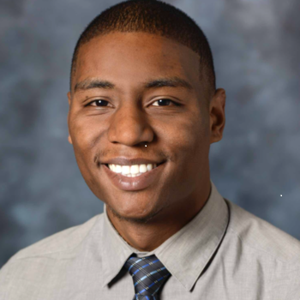
Student-centered
Life-long learning
Dr. Mark Wainwright, former CSUEB Gen Chem Student
Notes:
All our work should be guided by vision “to be a catalyst for student equity, life-long learning, innovation and educational success that amplifies upward mobility for all communities.” Without acknowledgement of both these truths, we will be frustrated in our efforts. Return to this later. Mark is now an emergency room doctor at Alta Bates – had some risk factors, came into office hours, stood out as someone who would succeed – and I got to see him and his son at the World Cup!

Slide 4

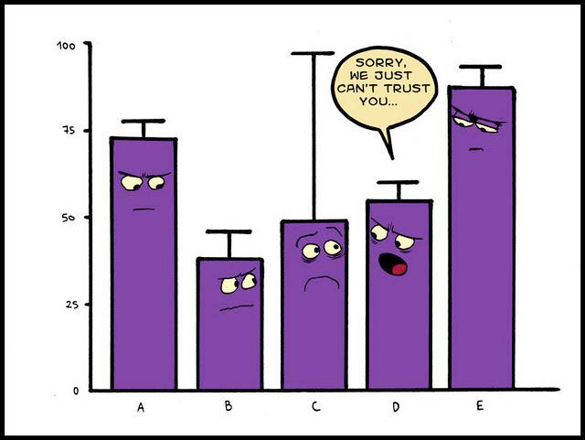

Data
Theory and Practice
Conversation
ACTION
Notes:
The goal of my project was to increase transfer retention. Today’s talk will be informed by the data that we have readily available to us, the data we don’t have readily available us, theory and practice from EAB and the literature, and conversations with colleagues on campus and the EAB staff and fellow community.

Slide 5
Transfer Retention Rates at CSUEB Are Underexamined
CSUEB’s Strategic Plan
Student Success: Priority #1
Enhance the overall student experience to increase engagement and retention, while promoting intellectual achievement and career readiness.
Impact of Poor Retention/Dropout
2024-2025 Retention Rates
Students | Institution
Overall income loss | Tuition
Reduced career opportunities | Planning complications
Financial aid implications | Statistics/reputation
First-years | New transfers
77% | 84%
176 left | 234 left
Fall-to-fall, transfer students retained at a higher rate, but greater pool means more transfer students leave.
Notes:
This project aligns strongly with CSUEB’s strategic plan, Future Directions, in which Student Success is Priority #1, an important part of which is student retention. Retention is critical for students because if they leave permanently they do not capitalize on the career opportunities and income loss that come from completing the degree, and starting/stopping can have financial aid implications. From the institution’s perspective, it needs the tuition and target enrollment to ensure funding, students leaving complicates planning, and poor retention rates can lead to a negative reputation affecting potential and current students, faculty, and staff. In 2018, we had two major changes at the University – a switch from a quarter to semester system and the removal of mandatory developmental courses in English and quantitative reasoning and a revamping of the curriculum to include needed support. Since then, fall-to-fall persistence has ranged from 74-80%. The University has a goal to raise that to 85%, and significant effort has been geared towards this from both Academic Affairs and Student Affairs. CSUEB is distinctive in that the vast majority of new students entering each Fall are transfer students, in Fall 25 the ratio was approximately 3 to 1. As such, even though fall-to-fall persistence on a percentage basis is much higher for new transfer students, the number of them leaving is greater. Since our 2- and 4-year degree completion rates for transfers are strong, their leaving has been underexamined and potential approaches underresourced. We are not alone in that nationwide and historically about half of students who leave higher ed do so in their second year or later, and students starting at community colleges have a lower chance of getting their degrees.

Slide 6
Who leaves?
Notes:
Indulge me for a moment and take a minute to write down people you know who left their college/university, following a “non-traditional” degree path.

Slide 7

“Education is not a tournament; once out, an individual does not necessarily stay out.”
Temple and Polk, Sociology of Education, 1986, Vol. 59 (April):79-84
Notes:
Change in mindset in these conversations… it might be the right thing for someone to leave for a while. That is the way my list looks.

Slide 8



Used Bay Advisor to examine notes/course history for 237 Fall 24 new transfers who weren’t enrolled in Fall 25
Academic problems
Transfer
Financial
Work/Family
Lack of clear plan
Some returned
Some went back to community college
Notes:
64 academic probation, 58 had institution gpa of 0, some hadn’t met traditional “transfer” standards, 22 came back, 60 with no history or obvious reasons!

Slide 9
Preliminary thoughts
Reasons are too varied for single approach.
Many with academic problems had no progress reports.
Many we simply don’t know and no clear follow up.
Financial reasons are not particularly actionable.
University retention is at least a 100-year old problem with lots of study; models even with 100+ variables not great at predicting
The 4 year continuous attendance narrative has never represented more than 40 - 50% of American higher education
My goal shifted:
  Identify opportunities where we could improve communication to address preventable withdrawals
  Smooth path for re-enrollment
  Improvements for all students
Notes:
Scroll through Excel sheet, maybe color code, Financial – socially acceptable reason that covers a complex decision making process. Not directly related to family income.

Slide 10
What is retention rate for native students between 60 – 70 units in Fall 24 to Fall 25?
Notes:
232 students in Fall 24 56 not in Fall 25 76%

Slide 11

Wouldn’t it be nice…
Notes:
So after all the effort of recruiting them, wouldn’t it be nice if they just stayed through graduation! But we are not Hotel California – they can leave…. and they do. Keeping our mission in mind, reframe our role as supporting students in their learning and development. For some, that might need some coaching and redirection, for some it might mean leaving for a while and returning, or not… Look at your list.

Slide 12

Can we predict leavers upon entry and take action?
Sort of… and I think that is why we have the numbers we do have
Not particularly well for individuals
University retention is at least a 100-year old problem with lots of study; models even with 100+ variables not great at predicting
The 4 year continuous attendance narrative has never represented more than 40 - 50% of American higher education
The decision to leave is complicated ….
Notes:
How do we target our actions to have the most impact with limited time and money? Great if we could watch the entering students and know who needs the most support and what that support looks like. Not there…. Many examples of students who would be predicted not to complete – undocumented, single parents, immigrants, low income and those who left who would be predicted to stay – white, more financially stable, etc..

Slide 13
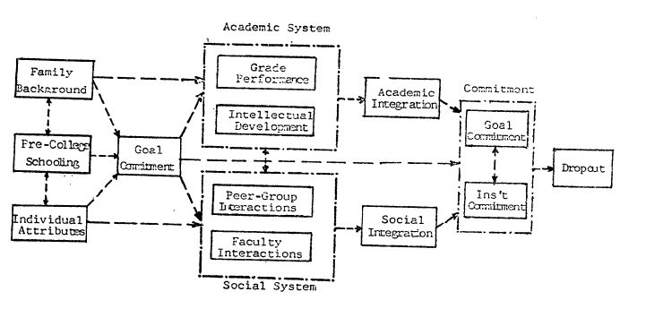
Tinto’s Theory of Departure
Tinto & Cullen, Dropout in Higher Education: a Review and Theoretical Synthesis of Recent Research, Columbia, 1973
Notes:
Tinto’s theories – first developed in the 70’s continues to be the underlying theory with updates and modification. Main idea is connection to the institution; academic and social integration are key – balance between goal/institutional commitment with competing forces

Slide 14
Tinto’s Theory of Departure
Key for adult learners
Tinto & Cullen, Dropout in Higher Education: a Review and Theoretical Synthesis of Recent Research, Columbia, 1973
Notes:
Connection to the institution; academic and social integration are key – balance between goal/institutional commitment with competing forces – what we have control over, tip the scales

Slide 15









Should I stay or should I go now?
Notes:
What often gets lumped under “financial” is the cost-benefit analysis of all time and money, perceived future gain vs current sacrifice, alignment between values and reality, goal orientation, etc.. Developing as a human (even the adult learners) and all these factors are dynamic… Survey “stayers” – they are often more dissatisfied with the items in the survey than the leavers. Rich internal mental processes that they likely can’t articulate – can’t read their minds, don’t want people to read mine!

Slide 16
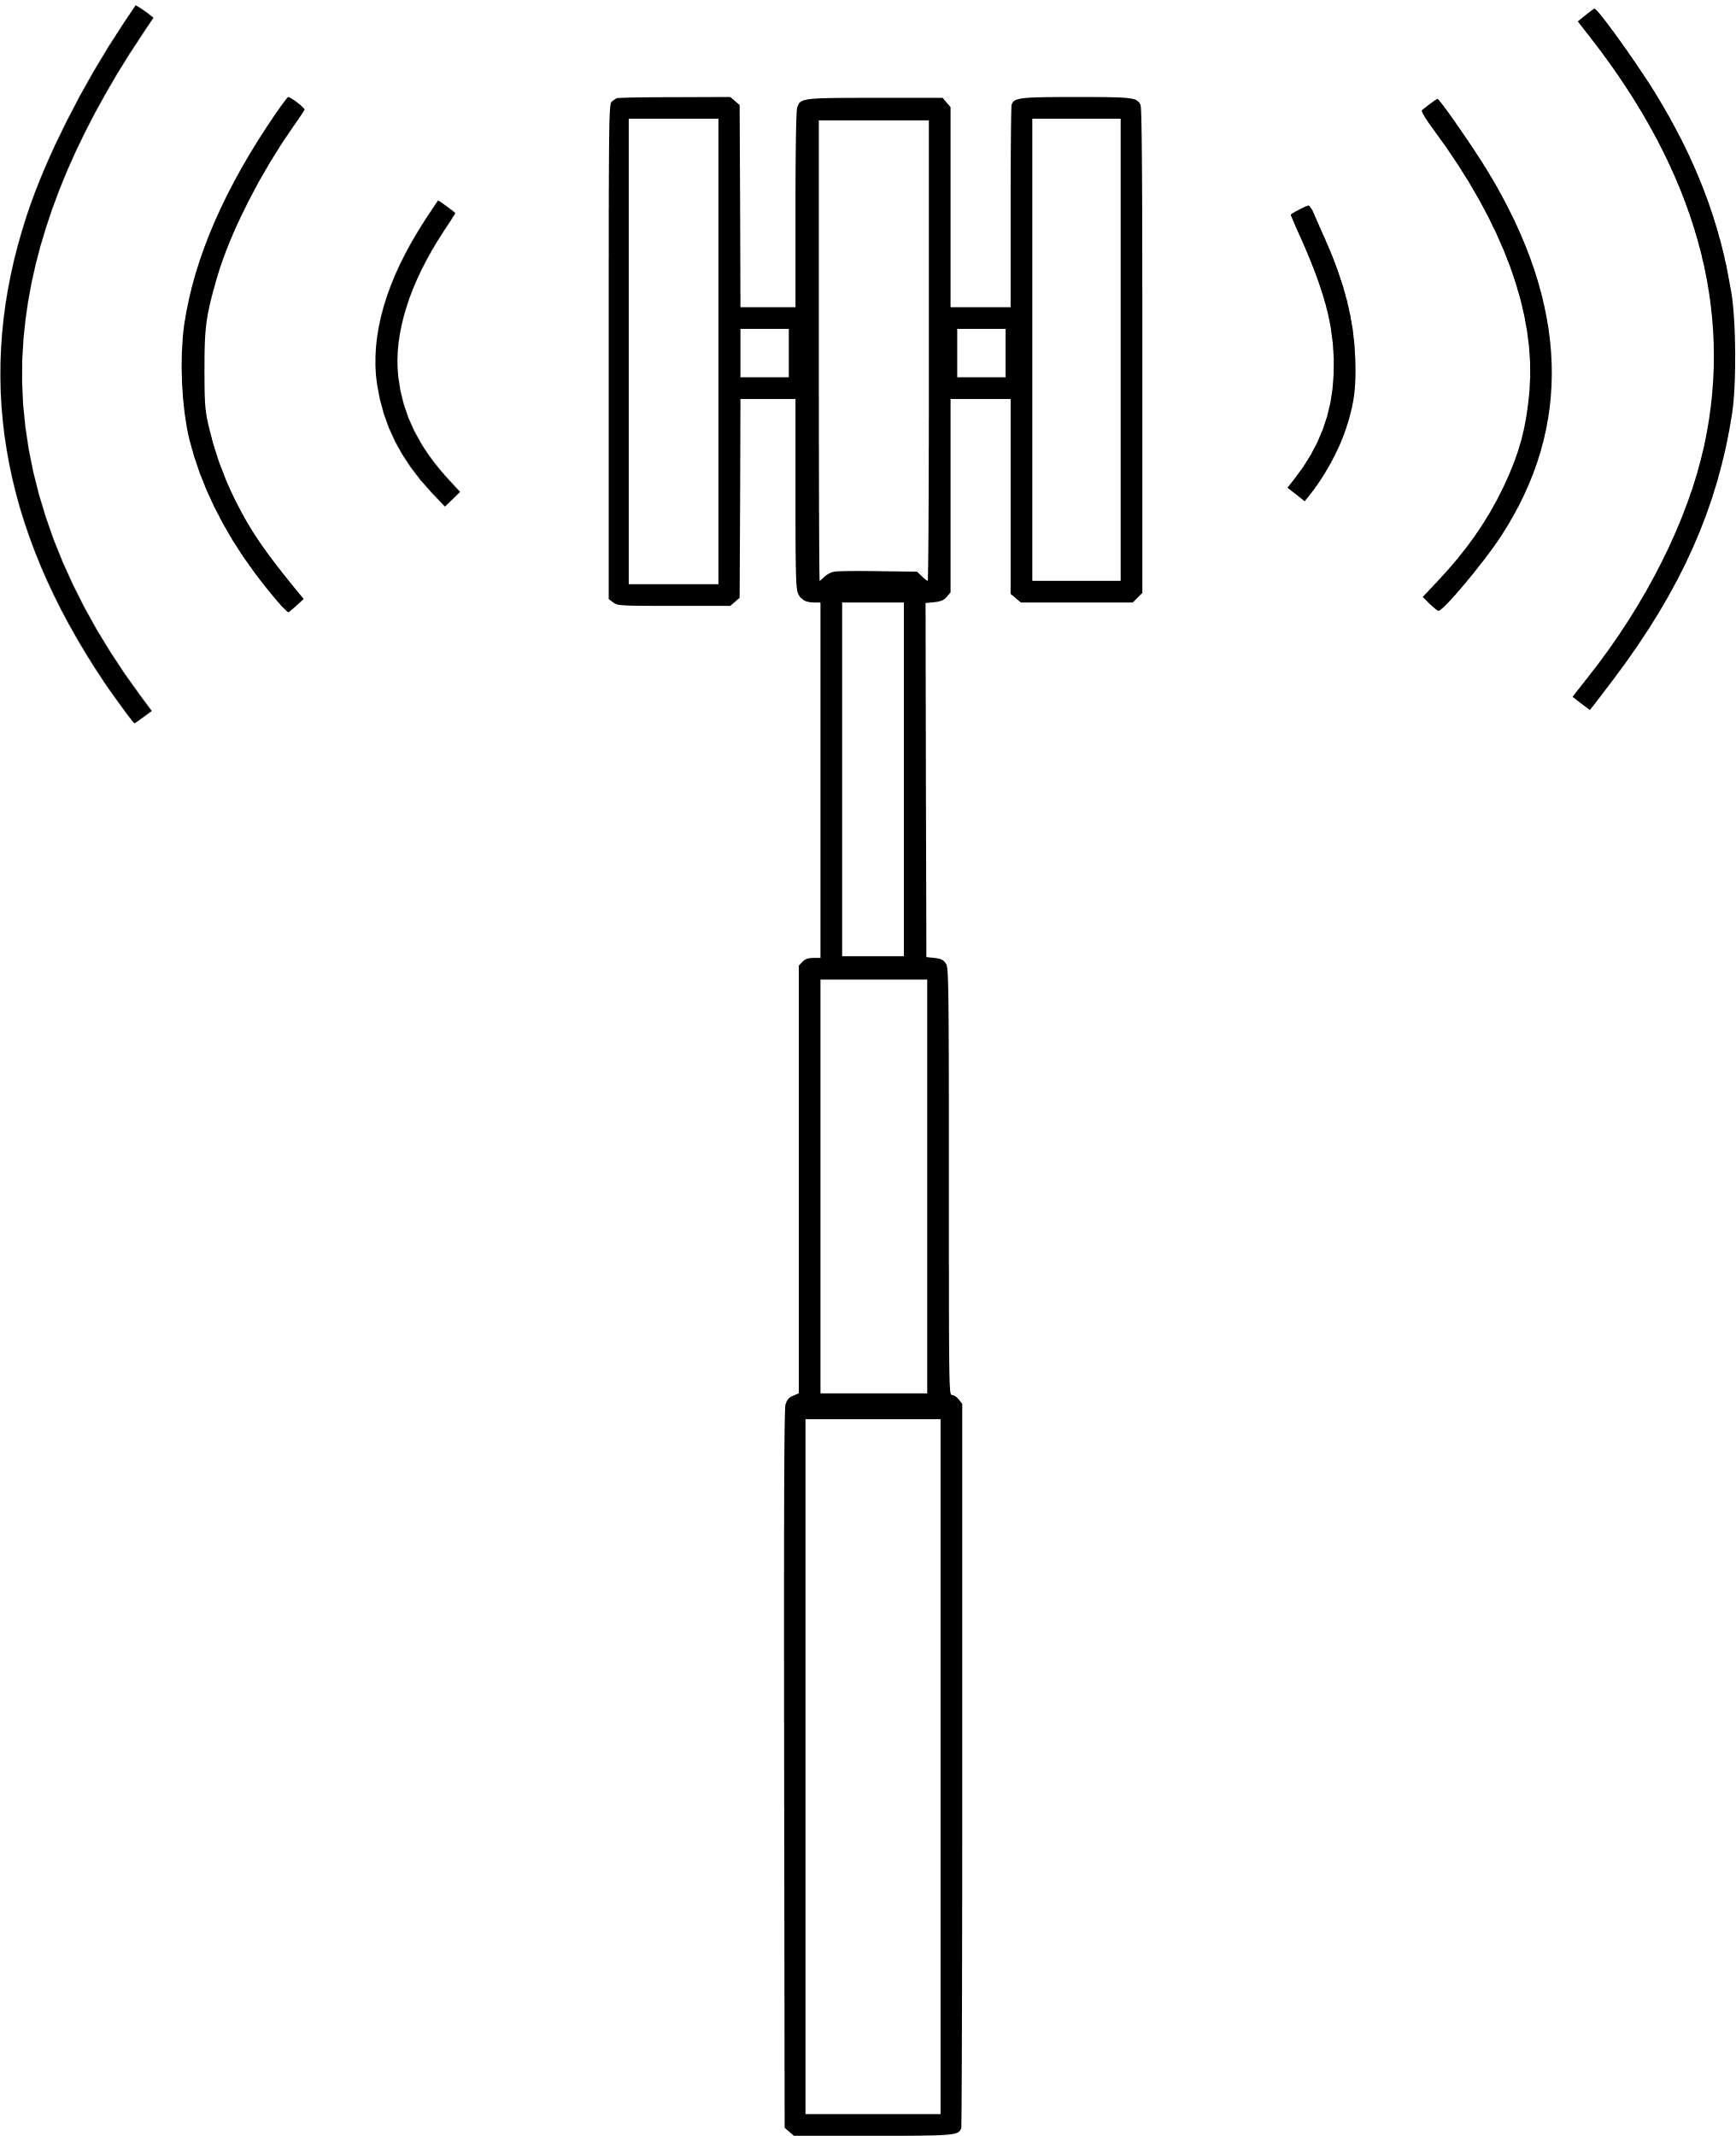
Student behaviors
Not enrolling in next semester classes
Not applying for FAFSA
Certain transcript requests
Steep slope in GPA trendline (“transfer shock”)
Course engagement
Conversations with advisors/faculty
Notes:
But, we can do a better job reading the signs that students are considering leaving or will have to leave.

Slide 17

Case Studies
Student earns only F’s and WU’s in Fall and has no progress reports, advising appointments, or communications in Bay Advisor.
Student stops out with plan to return, enrolls, and then all classes dropped.
Student doesn’t enroll for any major classes.
Who notices? Who responds? Who follows up?
Notes:
These are real students that I found in doing my review of transfer students.

Slide 18

By the absence of a response, are we giving the “green light?”
Notes:
Sometimes nothing happens – when it does what are we saying by not noticing?

Slide 19

Are there actions we can take to move to a “yellow light” to address preventable withdrawals?

Slide 20
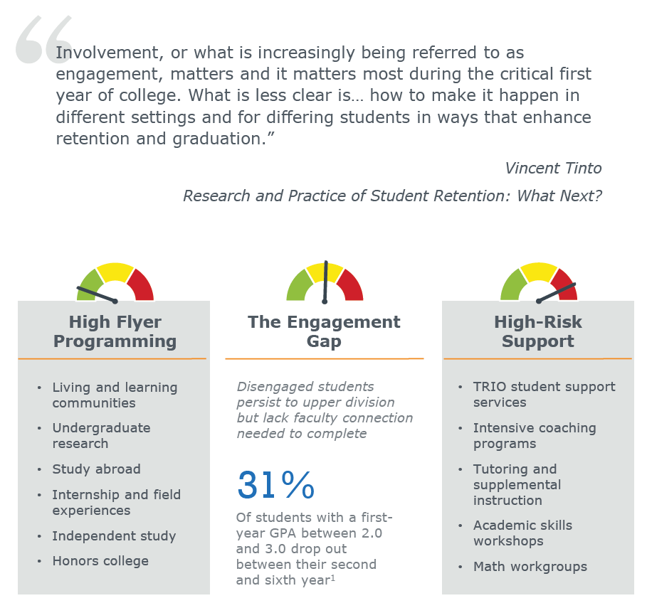
Classes are common experience; faculty are the connection.
Time spent in class with faculty and peers far outweighs time with advisors and other staff.
“My Data”
51% (123) of new Fall 24 transfers who didn’t enroll in Fall 25 within “murky middle”
14 were back as of Spring 26 (11% of those who left).
21% (14) of the 60 – 70 unit Fall 24 natives who didn’t enroll in Fall 25 within “murky middle”
Only one came back.
Undergraduate research
Study abroad
Independent Study
UHP
Internship and field experiences
TRIO student support
Peer academic assistance
Diversity centers
Workshops
32419-6-EAB-AAF-Study
Notes:
How do we establish academic integration and identity?

Slide 21
Better coordinating our strengths and resources
People Capital
Materials
Faculty Champions
Advisors
Associate Deans
Peer Supporters
Degree Audit Reports
Bay Advisor
Roadmaps (Sample Ed Plans)
Schedule
Can we better facilitate connections between people and improve the usefulness of tools?
Notes:
Yes. As I mentioned earlier, we

Slide 22

When there is friction between an institution and an individual, it is the individual who is worn down.
Notes:
What do I mean by friction? misalignment of values, culture, perceived hypocrisy, distrust, bureaucracy, tone, confusing language, mixed messages – individuals have to compromise

Slide 23

Response
Designing for Student Success Workshops
- Degree Audit Reports
- Success Markers and communication plans
- Roadmap and schedule reality check
- Re-envisioning roadmaps (sample educational plans)
Notes:
How have we responded? Hosted two Designing for Student Success Workshops this summer attended by representatives of most programs on campus.

Slide 24
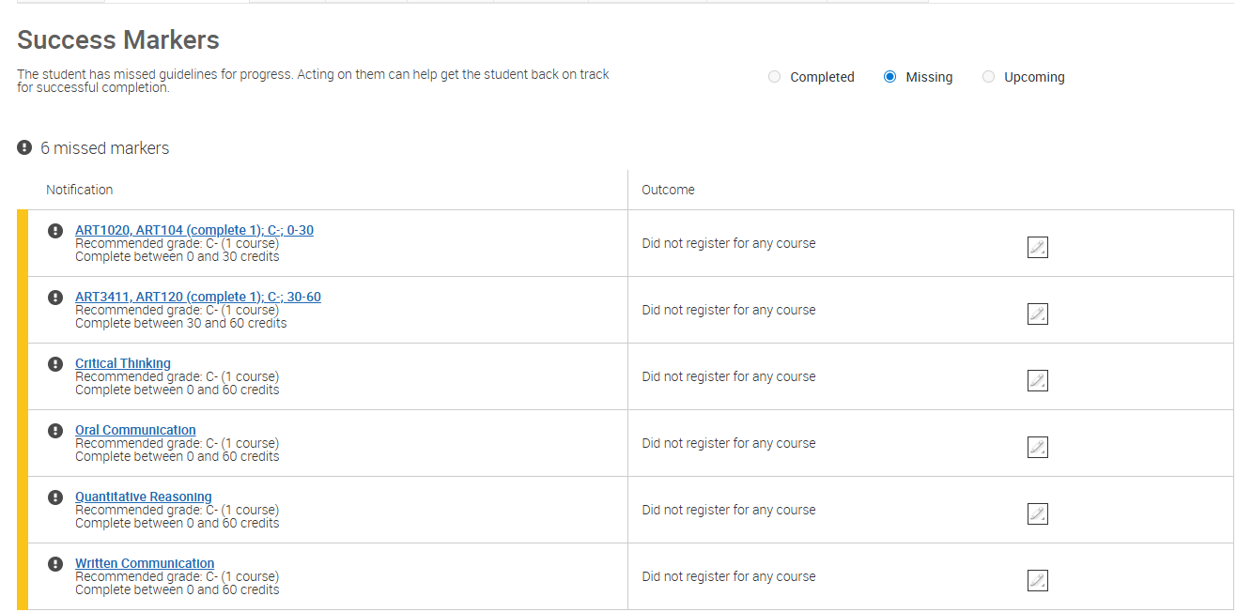
What are Success Markers?
  Courses and conditions (minimum grade/timing) tracked per student in Bay Advisor
  Golden 4 for all students
  Program-specific choices
Notes:
Bay Advisor is a tool that can help facilitate this. “Success Markers” is a term used by EAB to indicate program-specific milestones that are highly correlated with degree completion as based on historical data. Each “marker” consists of a course, a unit range for completion, and a recommended minimum grade. The Golden 4 are Success Markers for all students.

Slide 25
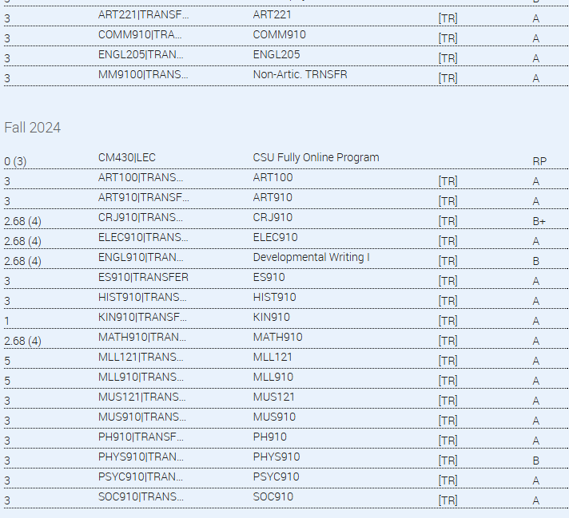
Problems with Current Success Markers
  Ubiquity of “false positives” and lack of upper division courses render Success Markers of limited value for transfer/continuing student campaigns.
  Majority of students are transfers, and Golden Four courses are evaluated as “missing.”
  Due for review/updating.
Notes:
Students flagged as missing Success Markers are often “false positives.” Since most of our students are transfer students and their courses don’t port into Bay Advisor correctly, they are considered missing their success markers. As such, these are not particularly useful for campaigns. For a variety of reasons, including this, we as an institution have not made much use of Success Markers.

Slide 26

Relevant Success Markers could facilitate targeted student communications.
  Bay Advisor
  - identifies all students enrolled in a course (even multiple sections)
  - identifies students who have missed success markers
  - allows for personalized templates to be sent via email and text through automation based on the conditions selected
  - facilitates communications at key junctures
  - introductions and encouragement before starting a Success Marker course
  - congratulations and encouragement after successful completion of a Success Marker course
  - outreach and support after missing a Success Marker
Notes:
However, there is potential. Bay Advisor provides easy ways to contact all students in a course through email and text (even multiple sections) so that we could send them encouraging communication, congratulations after completing the course, or outreach and support after mixing a Success Marker.

Slide 27
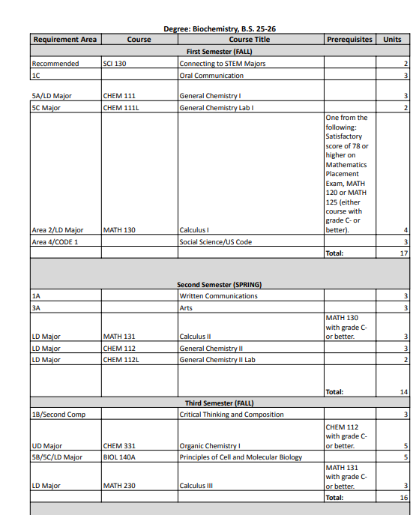
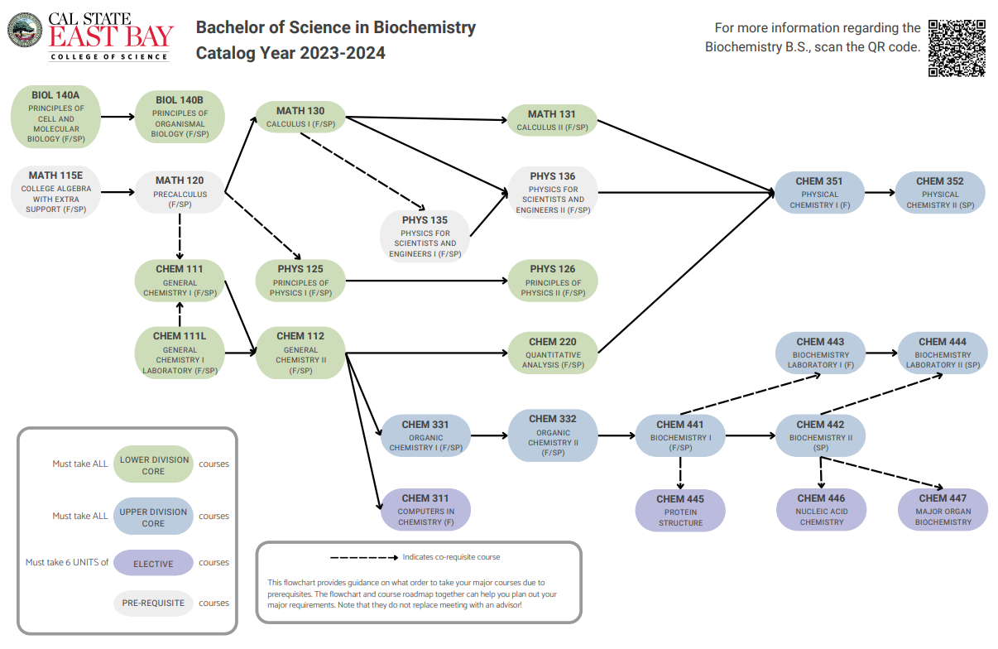
Not all classes are equal…
Notes:
Not all students have a great concept of what they are in for.

Slide 28
Time for Action
Notes:
Department chairs and other key faculty initiated this work this summer at these workshops. They will be coming to you for your input in the hopes that we can make department specific plans. I encourage you to participate in this process. We also plan to host student focus groups looking at the revised roadmaps and getting their input!

