Slide 1

AI Driven Learning:
Past Work and Future Directions
Overview of my past/future AI work at CSUEB
Presented By:
Dr. Jacob F. Miranda, Psychology Department
Matthew A. Baker, M.I.S.T. Lab Manager

Slide 2


Before we start
Please sign in
  Physical attendance sheet is circulating

Slide 3

Muwekma Ohlone Tribal Land Acknowledgment
for Cal State University East Bay located in Hayward, CA
Jalquin/Yrgin Ancestral Muwekma Ohlone Territory
We would like to recognize that while we gather at Cal State University East Bay located in Hayward, CA, we are gathered on
the ethno-historic tribal territory of the intermarried Jalquin (hal-keen) / Yrgin (eer-gen) Chochenyo-Ohlone-speaking tribal group, who were the direct ancestors of some of the lineages enrolled in the Muwekma Ohlone Tribe of the San Francisco Bay Area, and who were missionized into Missions San Francisco, Santa Clara and San Jose.
The present-day Muwekma Ohlone Tribe, with an enrolled Bureau of Indian Affairs documented membership of over 600 members, is comprised of all of the known surviving Indian lineages aboriginal to the San Francisco Bay region who trace their ancestry through the Missions San Jose, Santa Clara, and San Francisco, during the advent of the Hispano-European empire into Alta California beginning in AD 1769. They are the successors and living members of the sovereign, historic, previously Federally Recognized Verona Band of Alameda County now formally known as the Muwekma Ohlone Tribe of San Francisco Bay Area. Muwekma means La Gente – The People in their traditional Chochenyo-Ohlone language.
The land on which CSUEB in Hayward has been established, was and continues to be of great importance and significance for the Muwekma Ohlone Tribal people. This region extends to surrounding areas that held several Túupentaks (too-pen-tahks) (aka
Temescals), traditional semi-subterranean spiritual roundhouses. Túupentaks were places of celebrations, healing, rituals, dances, intertribal feasts, and religious ceremonies. Nearby ancestral heritage “shellmound sites,” such as those located at Máyyan Šáatošikma ~ Coyote Hills, Berkeley, and Emeryville, served as the Muwekma Ohlone Tribe’s territorial monuments and traditional cemetery sites for high lineage families, craft specialists, and fallen warriors.
Notes:
Read
As a result of recent news about the handling of sexual harassment reports in the CSU system. The Title IX Offices within the CSU system were audited by Cozen Connor in the beginning of the 2022. The report will be distributed soon with audit recommendations systemwide. After the October visit there were things we could improve and strengthen without having the audit report in hand.
I would like to use this time to update you with these updates.
Reporting Structure
Office location
Website
Office expansion ( support)
Organization of committees
Supportive Allies of Title IX

Slide 4


Notes:
Mentimeter: Link for word cloud https://www.mentimeter.com/app/presentation/alomiugq54kqyxc5xhyg7pvrkp5pi227/edit?source=share-modal

Slide 5
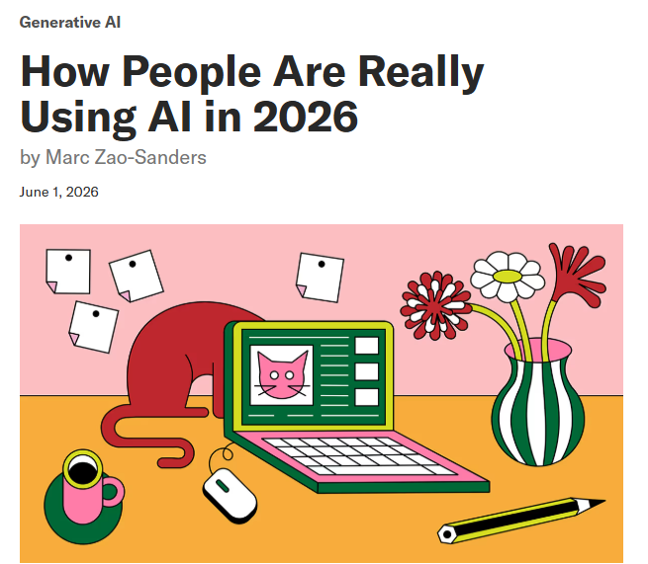
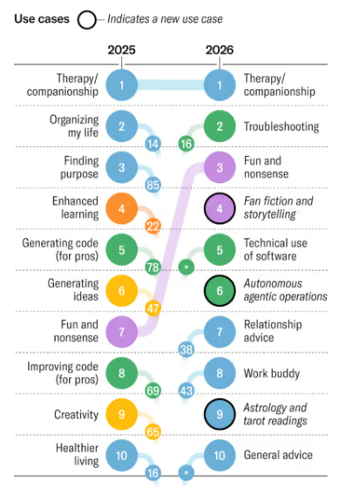
Notes:
Link: https://hbr.org/2026/06/how-people-are-really-using-ai-in-2026

Slide 6

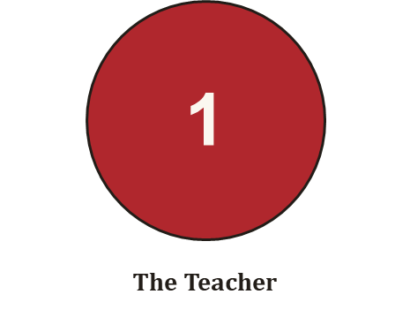
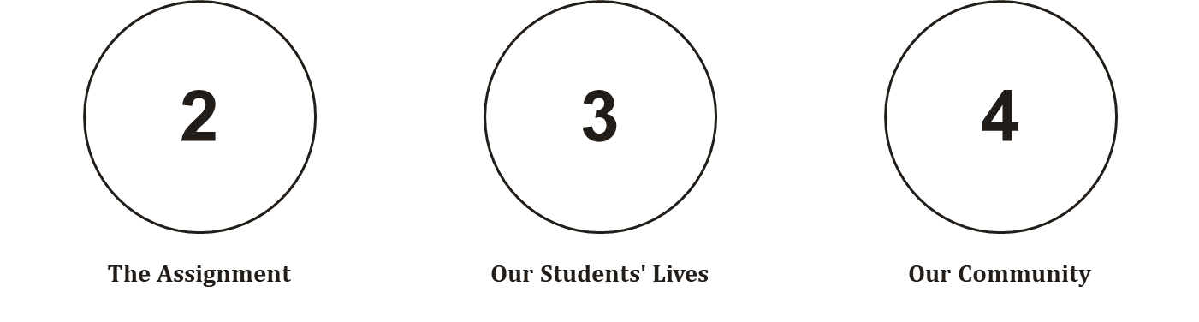

Slide 7

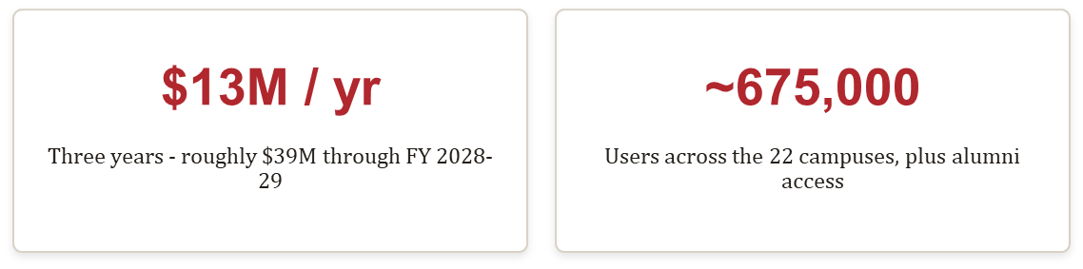
Renewed amid reported budget shortfalls, a CFA unfair practice charge, campus senate resolutions, and a faculty cancellation petition.
Sources: LAist; EdSource (May 2026).

Slide 8

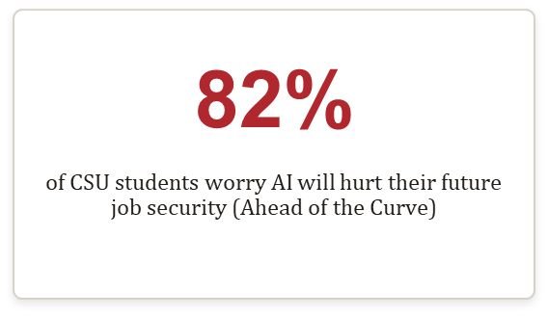
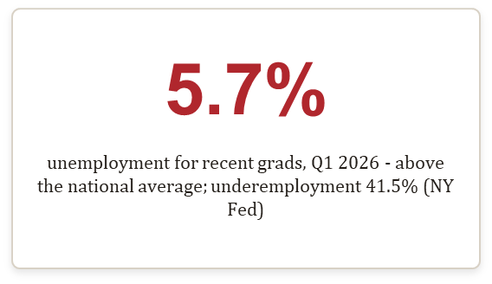

Slide 9
Four Initiatives: Past and Future
01
02
03
04
Faculty Learning Community - Spring 2026
The Assignment: Collaborating with History Department on Grant Funded Assessment
The Students: Collaborating with the Civil Rights Office
The Faculty: Conversation Spaces Opening Up.

Slide 10
01
The Teacher
The Spring 2026 Faculty Learning Community:
The Human Element in AI-Driven Learning.
(AI)

Slide 11
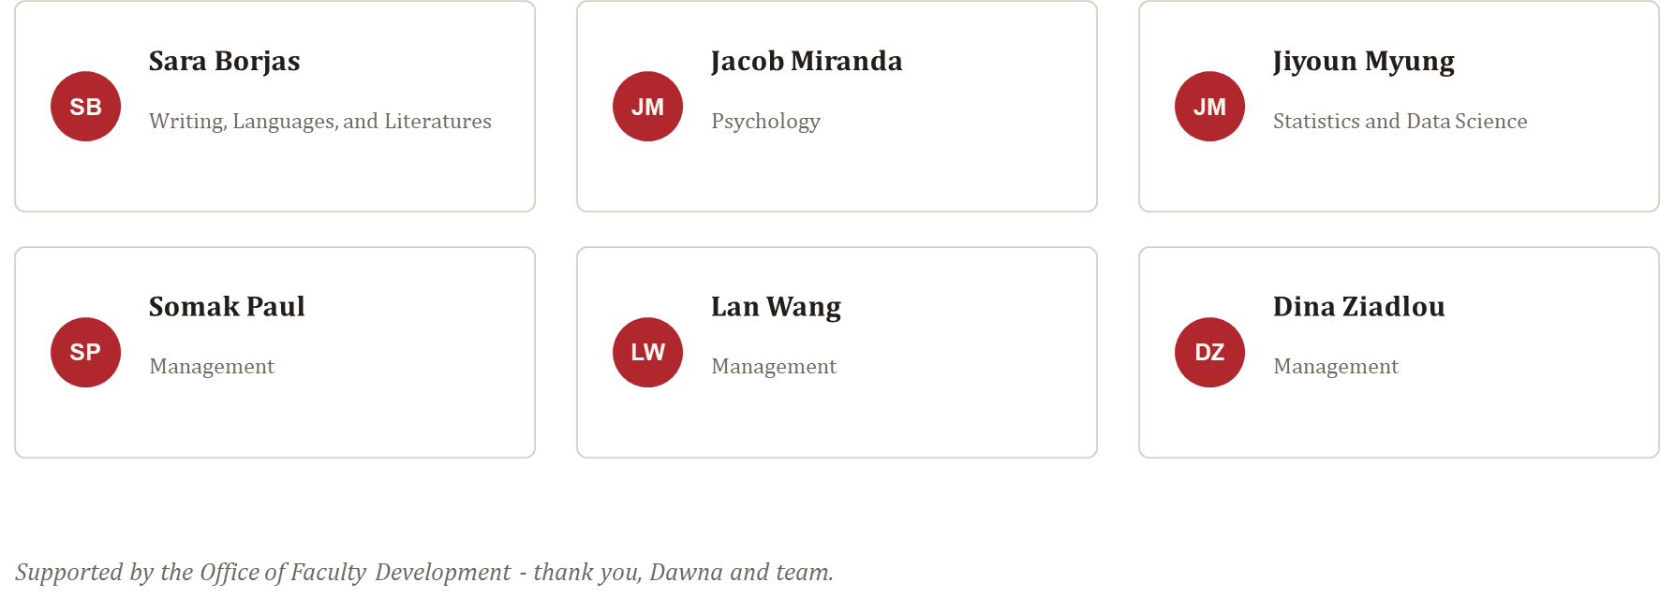
Who we were

Slide 12
—Slightly Provocative
“If a student can get a easy-to-understand, competent explanation of most concepts in your course from AI in 30 seconds… what exactly are students paying for?”

Slide 13
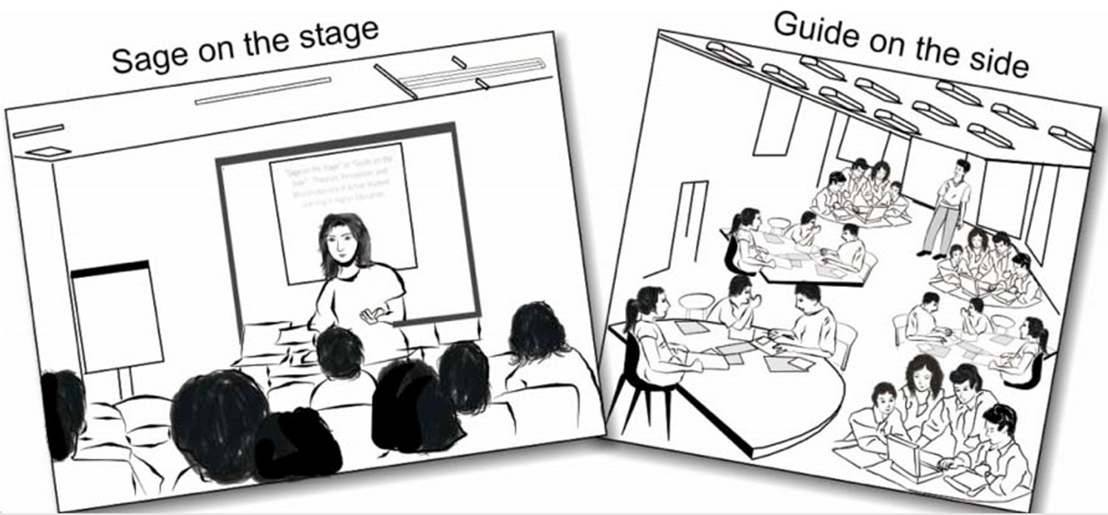
Before GPT
The ‘sage on the stage’ was dying in 1993.
Notes:
King (1993) coined the term sage on the stage vs guide on the side. It criticized ‘passive content delivery’. Criticized: lecture at them. Expect them to just know. That learning should be more than reading to them and rote memorization.

Slide 14
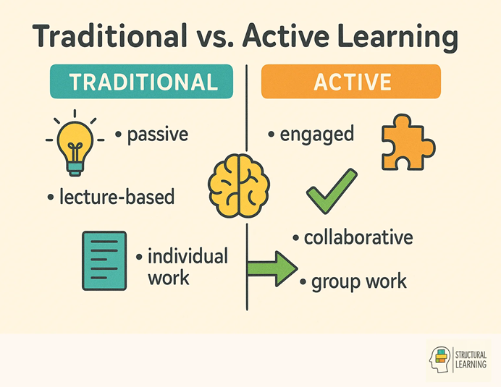
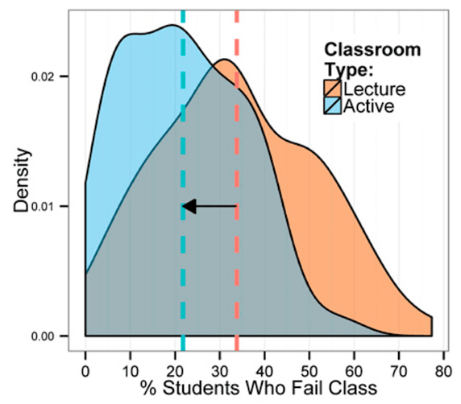
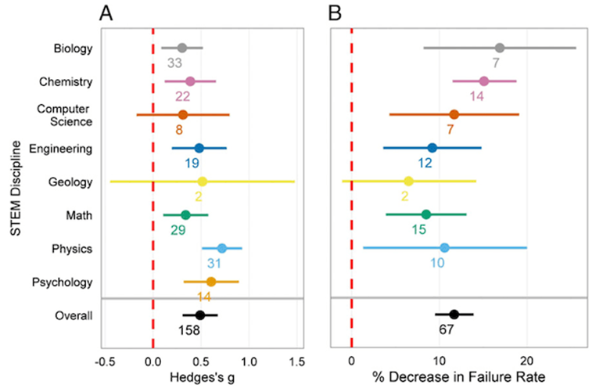
Freeman et al. (2014) and others evaluated the evidence of ‘active learning’. Evidence seems clear
Notes:
https://www.pnas.org/doi/pdf/10.1073/pnas.1319030111

Slide 15
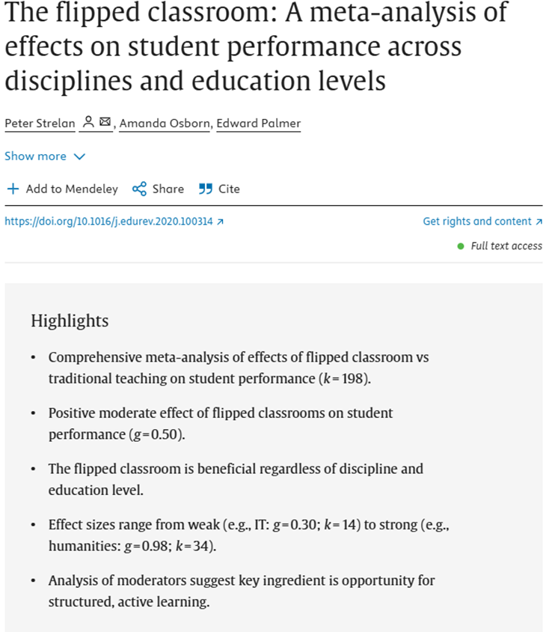
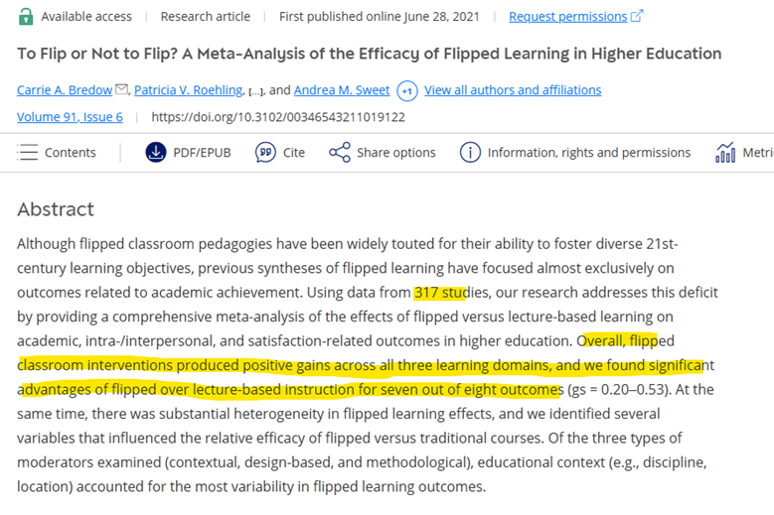
Not just one study, several meta-analyses
Notes:
https://www.sciencedirect.com/science/article/pii/S1747938X19301599
https://journals.sagepub.com/doi/10.3102/00346543211019122

Slide 16

Faculty survey, about 1 in 5 are strong opponents of AI, but…
AI did not create the shift towards ‘degree = career’. Convos about ‘is college worth it’ were already happening.

Slide 17
—Slightly Uncomfortable
“What exactly are students paying for?”
GenAI can now do the ‘passive lecture’. A student can ask AI at 2 AM for personalized examples

Slide 18
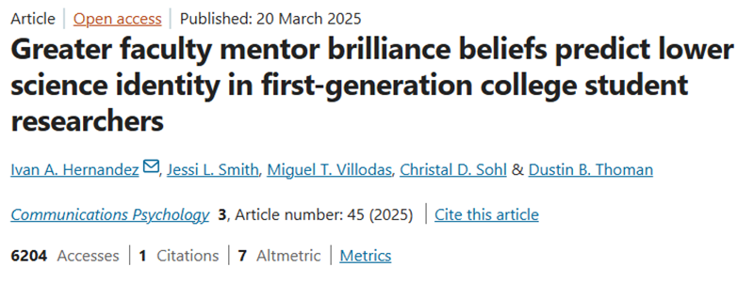
Hernandez (2025) – The expectations we come with about students. Do only ‘brilliant’ students succeed?
Notes:
https://www.nature.com/articles/s44271-025-00223-8
From abstract: These findings indicate that within faculty-led research labs – where participation is essential for STEM career advancement – faculty beliefs about who can participate and be successful in STEM can either undermine or promote equitable opportunities for first-generation college students to develop an identity in science that would motivate long-term STEM persistence.
That ‘persistence’

Slide 19
What AI-driven learning does well
Available 24/7 - no office hours required
THE STRONGEST PRO-AI EVIDENCE
A purpose-built AI tutor in Harvard physics doubled learning gains in less time.
Personalized pacing and instant feedback
Infinite patience - no question is embarrassing
Kestin et al. (2025), Scientific Reports - randomized trial, n = 194.
Scaffolding on demand, at 2 AM
Caveat: one course, one carefully engineered tutor. The design was the intervention.
Notes:
'I want to be fair to the tool - this is a real randomized trial.' Then the caveat: generic chatbot use does not inherit this result.

Slide 20
What it does not do
SOCIAL PRESENCE
COGNITIVE OFFLOADING
Identical feedback produced stronger effort when students believed a human wrote it.
Frequent unstructured AI use correlates with weaker critical thinking.
Morris and Maes (2026)
Gerlich (2025), n = 666 - correlational
CONFIDENCE EFFECT
Higher confidence in AI predicts less critical thinking; confidence in yourself predicts more.
Lee et al. (2025), Microsoft / CMU, n = 319
The differentiator is not whether AI is present. It is whether the human keeps doing the cognitive work.

Slide 21
Belonging & Social Captial/Connection
Belonging*
Strayhorn (2019)
Rajkumar et al. (2022)
Fundamental human need.
Need for belonging especially high for marganizlized students.
70~85% of jobs flow though networks and ‘weak ties’.
GPA?
Resumes?
Us, The Professor
NACE Dataset: Suggests that in 2019, 73% looked at GPA.
In 2025, only ~40% did.
Most hiring managerse aren’t checking themselves. Resume may be dead (85% of the time)
Usually the most powerful ‘weak tie’ first generation students know.

Slide 22
The professor is often the most powerful
weak tie a first-generation student knows.
70-85%
Belonging is a fundamental need - highest stakes for marginalized students (Strayhorn, 2019).
AI can explain a concept at 2 AM. It cannot introduce a student to a colleague, write the letter, or believe in them out loud.
of jobs flow through networks and weak ties
Notes:
The emotional center of Act 1 - slow down. At an HSI where roughly 40% of our undergraduates identify as Latine, this is not an abstraction.

Slide 23

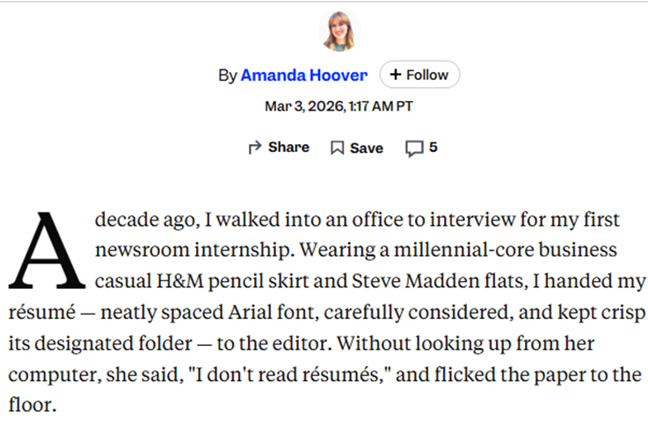
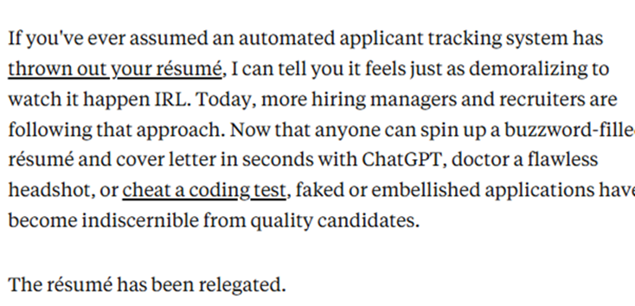
Notes:
March 3rd 2026
Source: https://www.businessinsider.com/hiring-managers-arent-reading-resumes-slop-2026-3

Slide 24
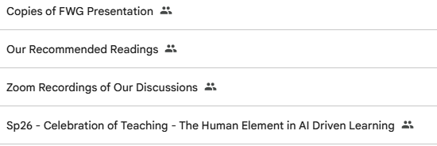
“Never forget, there is a human element to preserve in the first place. It's OK to navigate a period of confusion and uncertainty. In fact, it's human.”
Our Group’s Collective Message

Slide 25
02
The Assignment: Collaborating with History Department on Grant Funded Assessment

Slide 26

Critical Engagement with AI in General Education
Notes:
NOTE: to change background photo, edit the master style slide.

Slide 27
Can we harmonize student practice with AI and GE learning objectives?
Critical thinking
Finding “voice” as writers
“Humanizing perspective”
Reflective civic engagement
Disciplinary practices: Historians are truth-seeking, through validation of evidence

Slide 28
Revised Assignments
Iteration and prompting, research practices, corroboration
AI Assignment
Pre-Test
Evaluate
Post-Test
Analyze

Slide 29
Assignment example
Select one group of late nineteenth-century Californians to research: Chinese laborers, free and enslaved Black people, white laborers, or corporations
Use ChatGPT to create an essay (approximately 900-1200 words) that explores how your chosen group tried to use state and/or federal constitutions or laws to defend their interests and secure their position in California’s society and economy.
Use one of the peer-reviewed scholarly articles to corroborate, refute, or elaborate upon the claims made by ChatGPT. Using Microsoft Word’s “track changes,” include page citations for quotes and other specific evidence you add to the paper.
Identify claims made by GPT that cannot be corroborated, refuted, or elaborated upon by the article and thus require additional research.
You must make at least five meaningful revisions and/or flags for further research to the essay.
Pre-Test
Generate Essay
Evaluate
Post-Test
Analyze

Slide 30



Three Basic Categories
AI Knowledge & Use
AI Attitudes & Values
Academic Perceptions
How does an AI assignment interact with student perceptions?
How do students feel about their academic performance?
Do students know what resources are available or how to use them?

Slide 31
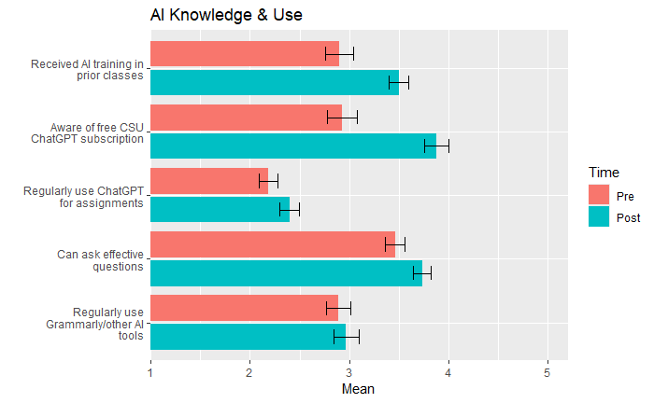
AI Knowledge & Use
Significant findings:
Increased student awareness of free CSU subscription
Students received training for the first time
  Increase in ability to prompt “effective questions”
Increased use of Chat GPT
  but not “other” AI tools
Learning

Slide 32
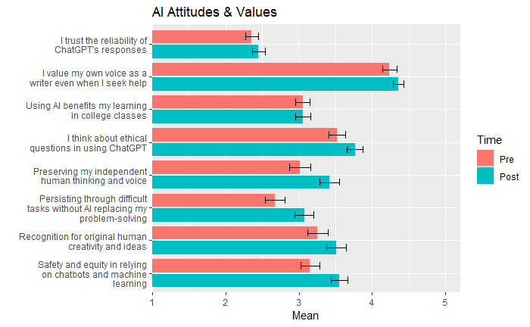

Slide 33
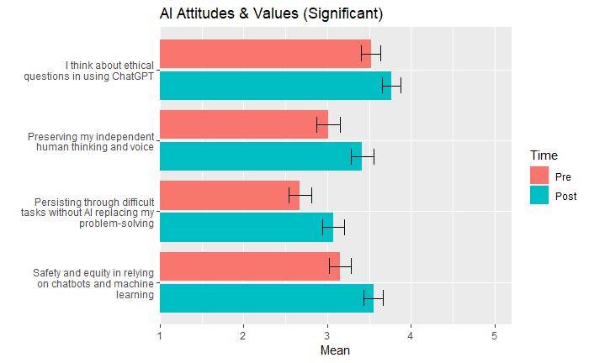
AI Values & Attitudes
Increases in:
Considering ethical questions
Concern over:
  the preservation of one’s human thinking and voice
  Resilience regarding demanding academic tasks in the face of AI
  Safety and equity when relying on chatbots

Slide 34
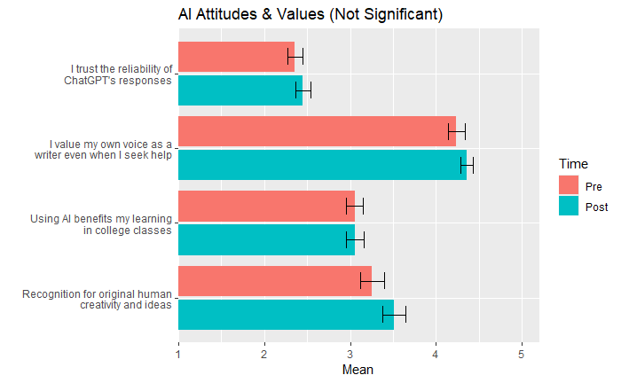
AI Values & Attitudes
No Change:
Students don’t tend to trust the reliability of ChatGPT any more than they did before
They value their voice as a writer, both before and after the intervention
  Remember: they were concerned about preserving it
They are neutral regarding its benefits
Their concern over human creativity

Slide 35
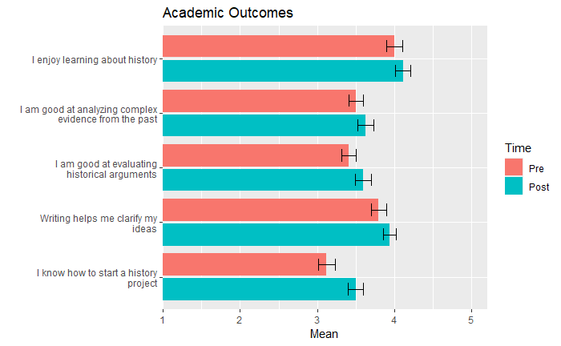
Academic Perceptions
What about their learning?
No negative impact
Increase in perceived argument and project-initiation skills
  Shows how AI infused assignments may improve academic confidence

Slide 36
Study conclusions
Introducing AI-infused activities/assignments may not imperil GE Learning Outcomes
Students could benefit from guided practice to evaluate AI outputs right now

Slide 37
Why is this Important?
AI literacy is increasingly relevant to today’s job market and media landscape
Guides future studies beyond self-reported efficacy or attitudes
Empirical analysis can help to resolve AI uncertainty, especially in academic settings

Slide 38
Thank You
History Department Collaborators
Roger Baldwin, Greg Brueck, Bridget Ford, Samantha Francois, Anna Rose, and Jessica Weiss

Slide 39
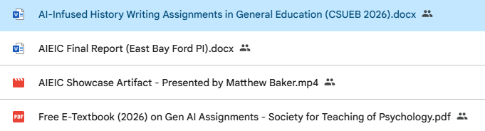
Resources

Slide 40
03
Our Students’ Lives
Coming back to that mentimeter poll

Slide 41
Before AI entered the picture
(a) 1 in 6
People worldwide experience loneliness (WHO Commission, June 2025)
(b) ~871,000
Deaths per year linked to loneliness and isolation
(c) 20.9%
Of adolescents report the highest lonelinest

Slide 42
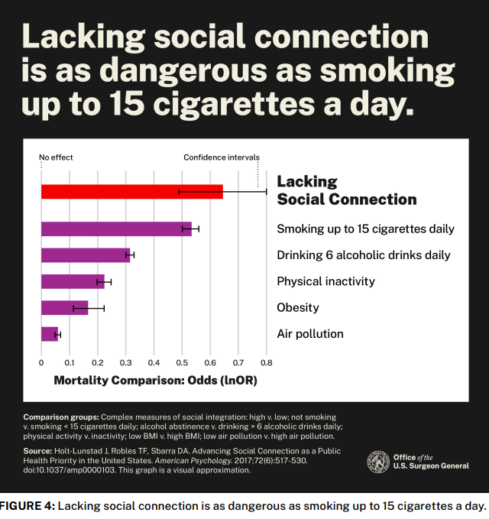
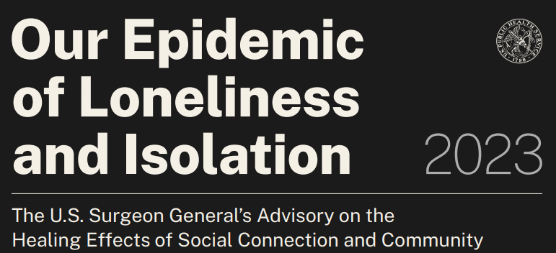

Slide 43
AI companions are already mainstream
From a nationally representative survey, Common Sense Media (July 2025); n = 1,060 US teens
72%
52%
33%
80%
have used an AI companion
use them regularly
chose an AI over a person for something important
still spend more time with real friends
These teens are our incoming freshmen. And note the 80%*

Slide 44
What heavy AI use looks like
MIT MEDIA LAB / OPENAI (2025)
STUDENTS THEMSELVES ARE SPLIT (HEPI 2026)
~40M conversations analyzed + a 4-week RCT (~1,000 participants). Higher daily use correlated with higher loneliness, emotional dependence, and lower socialization - concentrated in a small subset of heavy users.
20% / 21%
say AI makes them lonelier / say less lonely
Not yet peer-reviewed; partly company-affiliated.
Does loneliness drive use, or use drive loneliness? Nobody knows yet. This is an open research question

Slide 45
California just made this a legal category
Aug 2025
Raine v. OpenAI filed; seven more suits follow in November
Sep 2025
FTC inquiry: seven companion-chatbot companies ordered to explain minor safety
Oct 2025
SB 243 signed - first-in-the-nation companion chatbot law
Jan 2026
SB 243 takes effect: AI disclosure, crisis protocols, protections for minors
Plus APA health advisories on AI and adolescent wellbeing (2025). Regulators, courts, and clinicians are all moving.

Slide 46
ANNOUNCING
A first look at AI + connection
on our campus
New collaboration: Jolani Hironaka, Director, Civil Rights Office x the M.I.S.T. Lab x Drs. Negin Toosi and Michael Stanton
RQ1
What is the prevalence of AI use on our campus?
RQ2
What is the prevalence of AI companionship use?
RQ3
What early associations do we see with campus relationships?
Anonymous · short · student lottery incentive · descriptive first - establishing the baseline our campus does not have
Notes:
'Why the Civil Rights Office? Because social connection and belonging ARE climate and equity issues - loneliness concentrates among the young and the disadvantaged. Jolani saw that immediately.'

Slide 47
04
The Community:
Pros and Cons: We Need to Talk (About AI)

Slide 48
From the 2025 Faculty Survey…

Slide 49
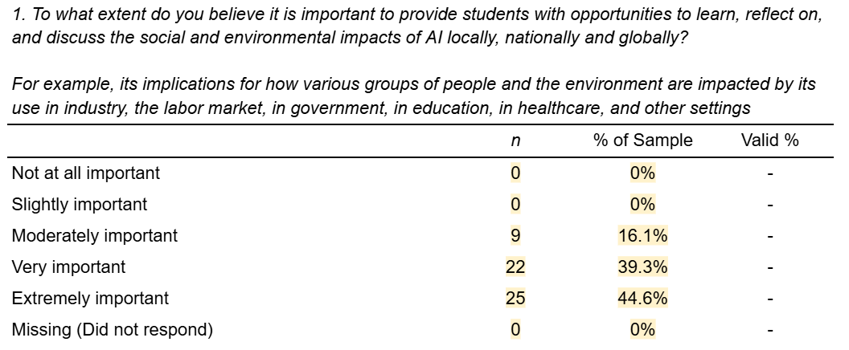
Beliefs Regarding Faculty Obligation to Students on Social and/or Environmental impact

Slide 50
AI as a Topic in the Classroom has the ONLY two use-cases with 0% Uncertainty.
T7. AI as a Topic in the Classroom | Uncertain if Appropriate
T7.i Teaching students how to critically evaluate AI-generated content | 0%
T7.ii Discussing the ethical and/or social justice implications of AI in my discipline | 0%

Slide 51
‘What support do you need to implement A.I’...
“I think this is a really presumptuous starting point. Faculty were not consulted when the chancellor decided to contract with AI companies. I think the lack of transparency is not a good starting point for a community of academics who are in the business of knowledge production.
Having said that, I get the counterpoint of "well, it's already here, and it's not going anywhere" and "if you can't beat them, join them." But, having critical discussions about what it means for a campus, research, and educational communities, to have A.I. and how it impacts us societally, professionally, etc. is important for all of us to be better informed, and in turn, inform, the tech companies who are using and sharing these AI technologies. Facilitating those dialogic spaces is critical for any university to have and we are missing those. Since the CSU put in some big bucks, presumably, for the AI contract, they should spread those resources to encourage these types of conversations in multidisciplinary and interdisciplinary ways.”

Slide 52
An Initiative to have honest conversations: PROS AND CONS: WE NEED TO TALK (ABOUT AI)
Just a discussion.
Not to change minds.
No one has to leave an enthusiast or a Luddite.
Understand the gray areas. Come in good faith.
By faculty, for faculty.
with Dr. Michael Stanton · Session 1: September 29th, (1 to 3 PM; Hybrid) · Session 2: November TBD
Notes:
This slide IS the identity of the series - read it slowly. 'The 1-in-5 of you who are strong AI opponents - per our own survey - are not the problem to be managed. You are half the conversation.'

Slide 53
If a student can get an easy-to-understand, competent explanation of most concepts in your course from AI in 30 seconds...
what exactly are students paying for?
Notes:
Say nothing. Let it hang for a full beat before advancing.

Slide 54
MY ANSWER
Your relationships.
Your judgment.
Your genuine belief in them.
Your network.
Your presence.
...and each other. That’s the “Human-Element”
Notes:
'That last line is what this year taught me. The human element is not just what each of us brings to a classroom. It is what we build between us.'

Slide 55
THANK YOU for attending!
Discussion if time allows!

