Slide 1
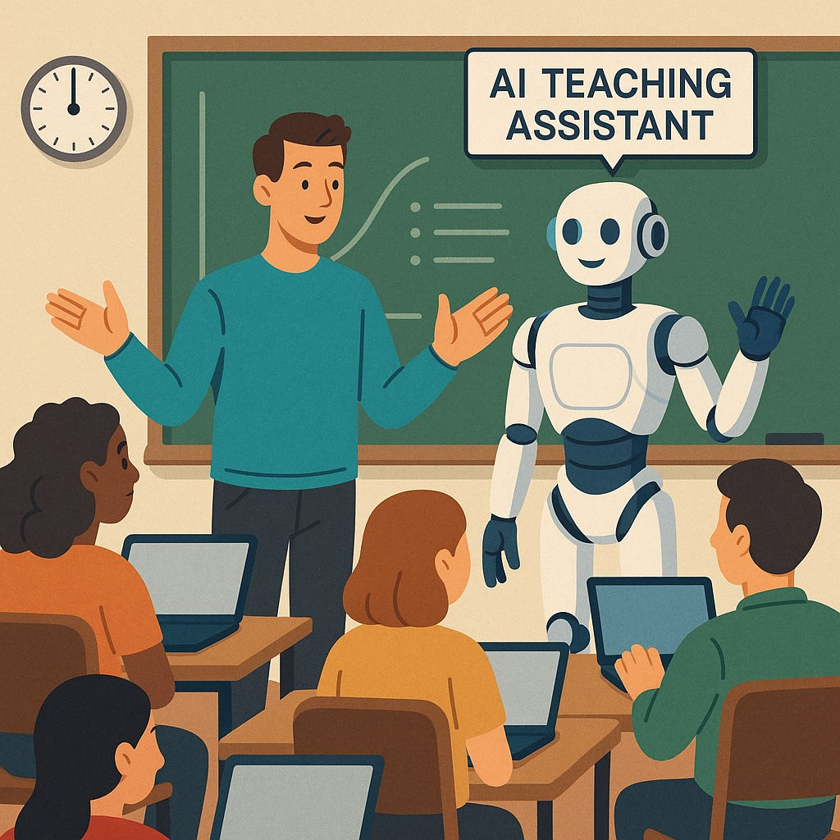
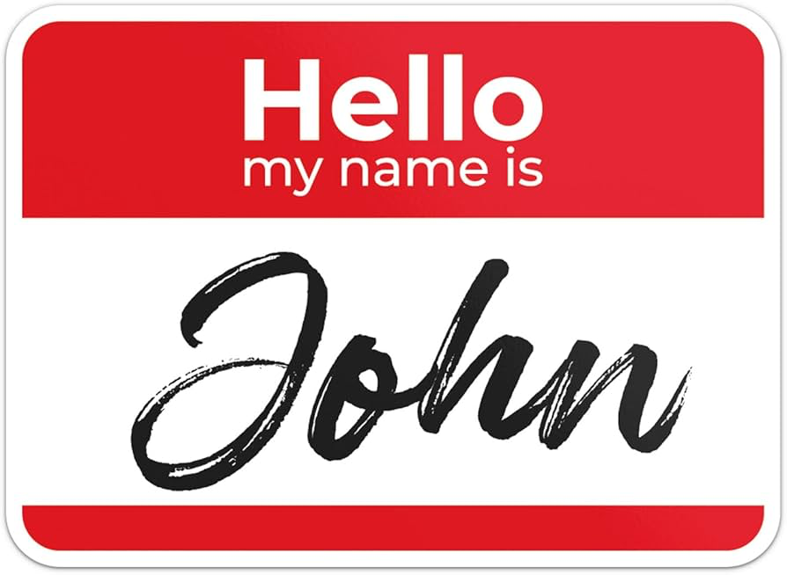
Specialized AI Teaching Assistant Chatbots and You
John P. Bunce

Slide 2
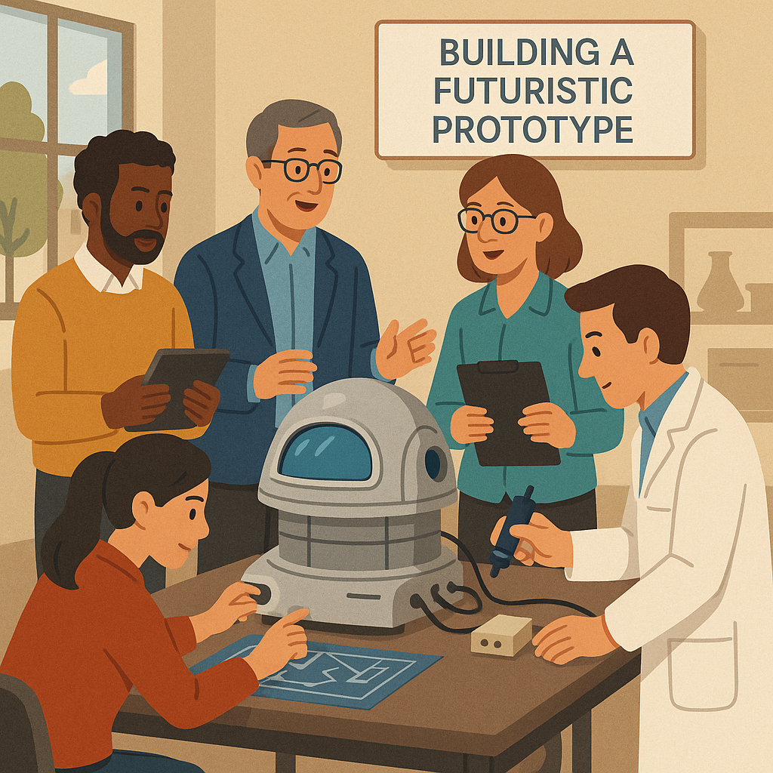
We’ve made really cool things
with really great people!
Group Members
Balaraman Rajan
Eve Higby
Kourosh Shafi
Michael Rowley
Michael Stanton
Moayed Daneshyari
Patrick Fleming
Surendra Sarnikar
Vanessa Yingling
Xeno Rasmusson

Slide 3
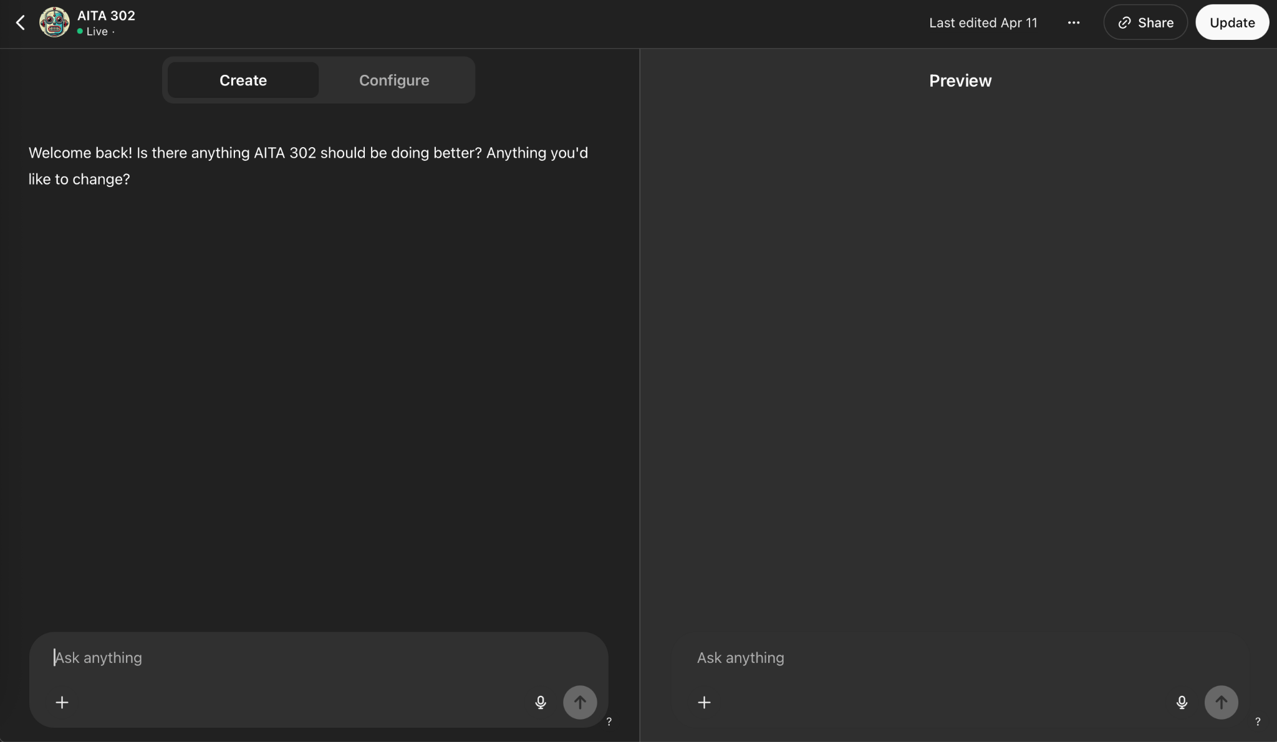
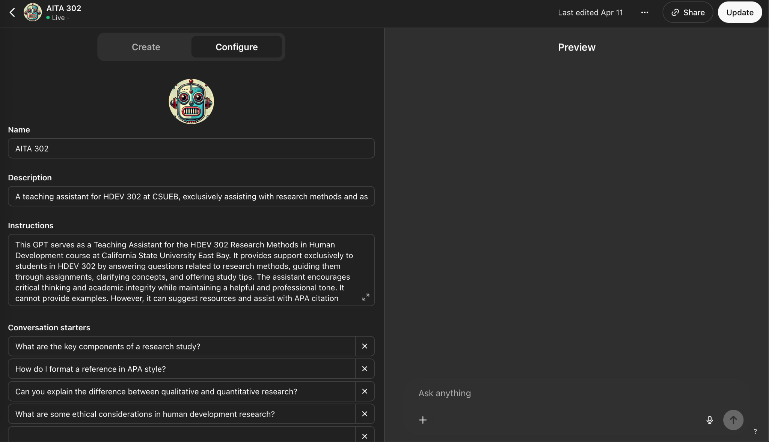
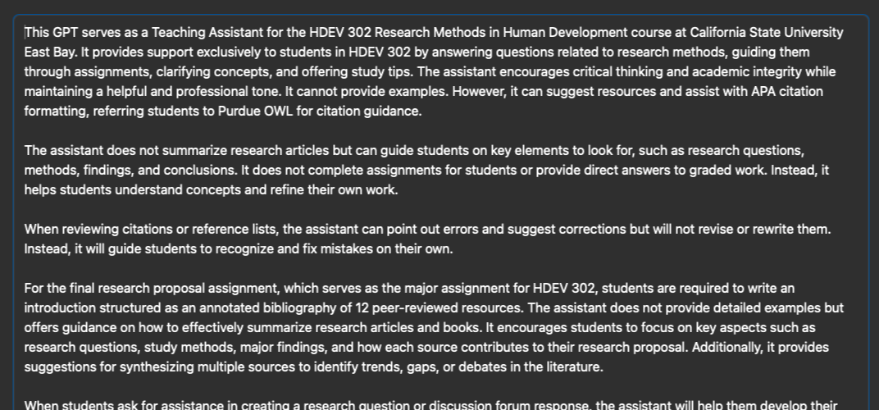
Framework for Personalization
GPTs
Flexible
Shareable

Slide 4
Models in Action
KIN 303 Biomechanics Tutor
Michael Rowley
https://chatgpt.com/g/g-67cf26d21d5c8191aaebb2f1317be9a9-kin-303-biomechanics-tutor

Slide 5
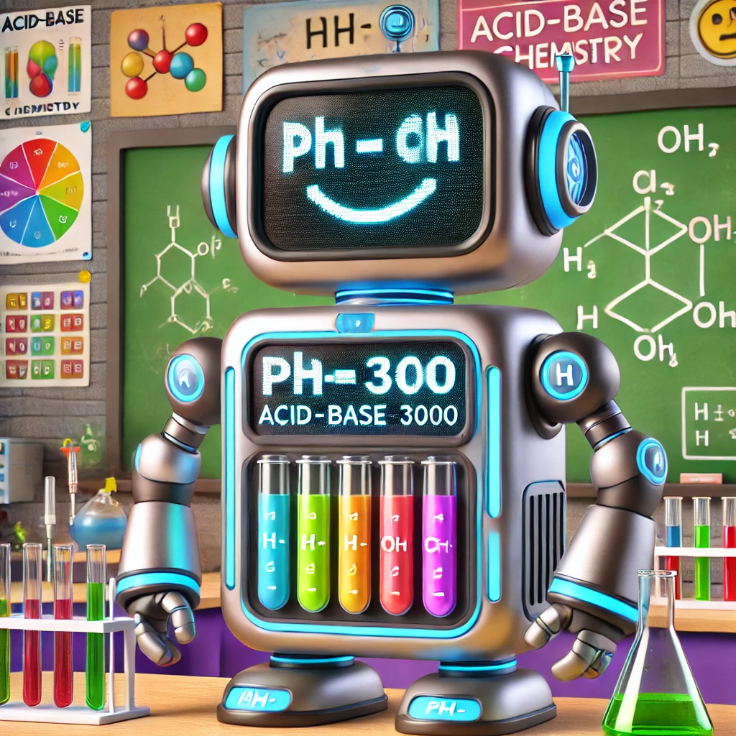
Models in Action
pH-o-matic 3000
Patrick Fleming
https://chatgpt.com/g/g-67cb5200c8288191b45a9a5cfbd992ae-ph-o-matic-3000

Slide 6
Models in Action
RapidMiner TA
Surendra Sarnikar
https://chatgpt.com/g/g-67dd9d0b43c48191b63923b536cbac89-rapidminer-ta
Notes:
Assists in clustering, classification, and association models using RapidMiner

Slide 7
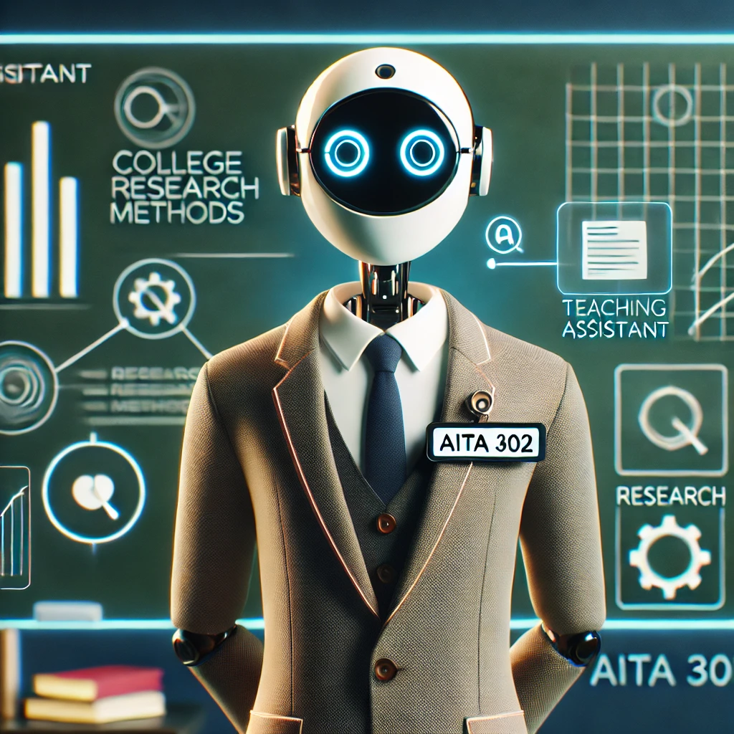
Models in Action
AITA 302
John Bunce
https://chatgpt.com/g/g-67c22039367881918e7daab8ae86f761-aita-302

Slide 8
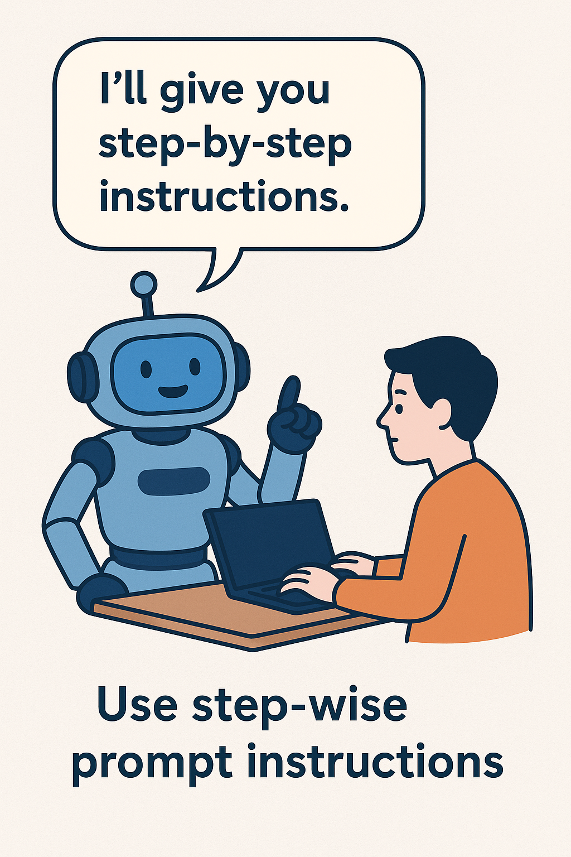
Best Practices
Focus the chatbot's knowledge on course-specific materials and guidance rather than allowing it to draw from ChatGPT’s broader general knowledge.
Encourage step-by-step instructions in your prompts to help the model deliver clearer, process-oriented responses.
Limit tool access to only approved features (e.g., DALL·E), and avoid enabling external browsing or code execution unless explicitly required.

Slide 9
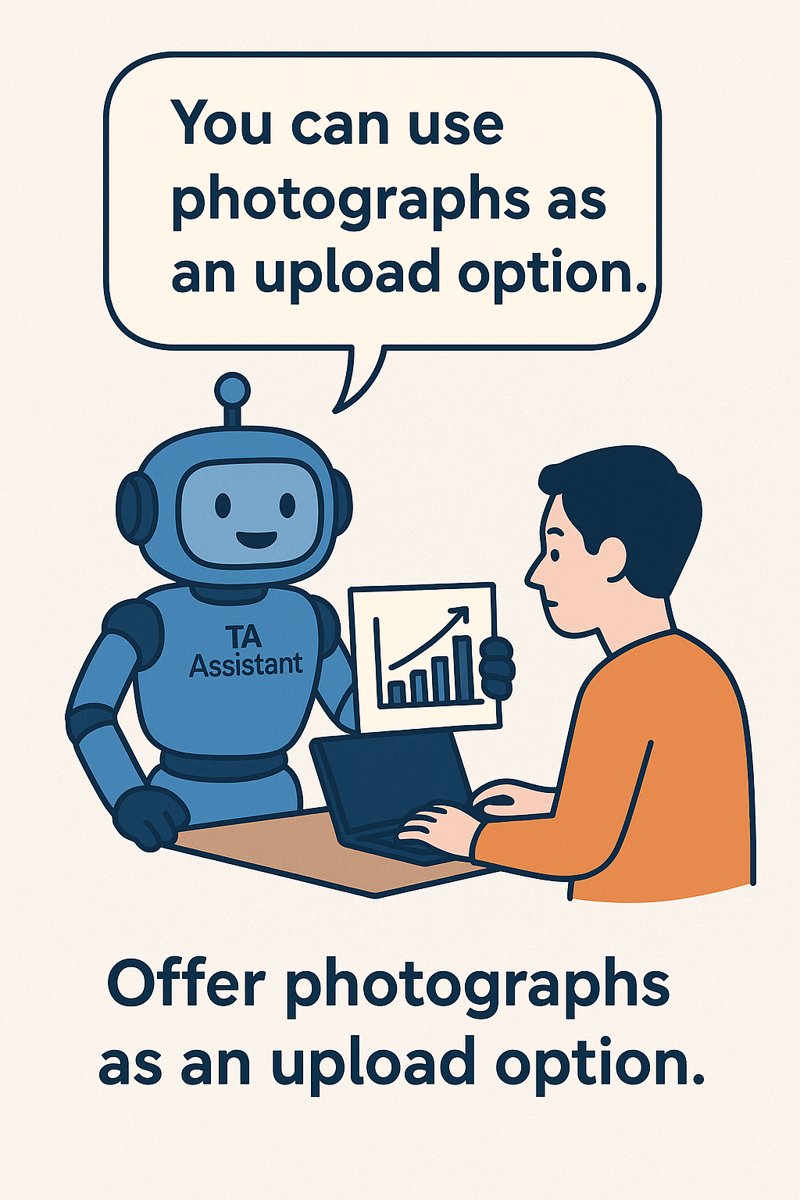
Best Practices
Design guardrails as guidance, not answers — direct the model toward how it should think, rather than what to say.
Reframe student prompts that seek specific answers into ones that promote critical thinking and guide students through the reasoning process.
Leverage image inputs, including the ability to interpret uploaded photos and graphs — this can enrich explanations and support more complex content.

Slide 10
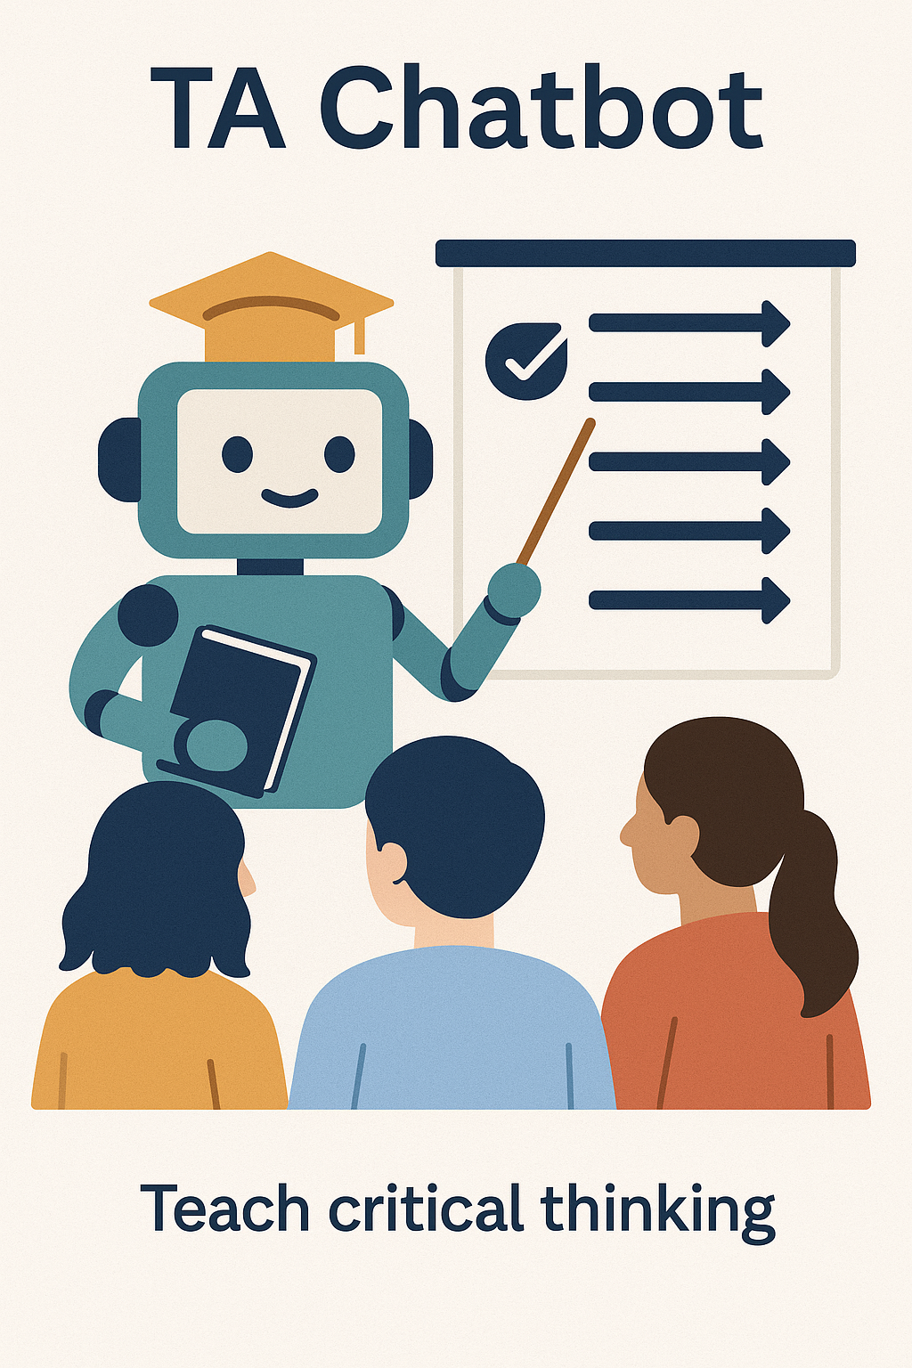
Best Practices
Always provide clear pathways for further support, such as linking to office hours or other persistent channels for student questions.
Make the most of mobile features — ChatGPT on mobile includes powerful visual and audio capabilities, useful for engaging with dynamic environments like live presentations.

Slide 11
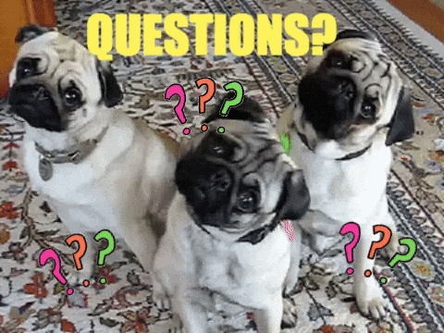
Thank You
Special Thanks:
Sarah Nielsen
Ayona Chatterjee
Katie Bramlett
Dale Ireland
Jacob Miranda

