Slide 1
The Human Element in AI-Driven Learning
Sara Borjas; Department of Writing, Languages, and Literatures
*Jacob Francisco Miranda; Department of Psychology
Jiyoun Myung; Department of Statistics and Data Science
*Somak Paul; Department of Management
*Lan Wang; Department of Management
Dina Ziadlou; Management

Slide 2
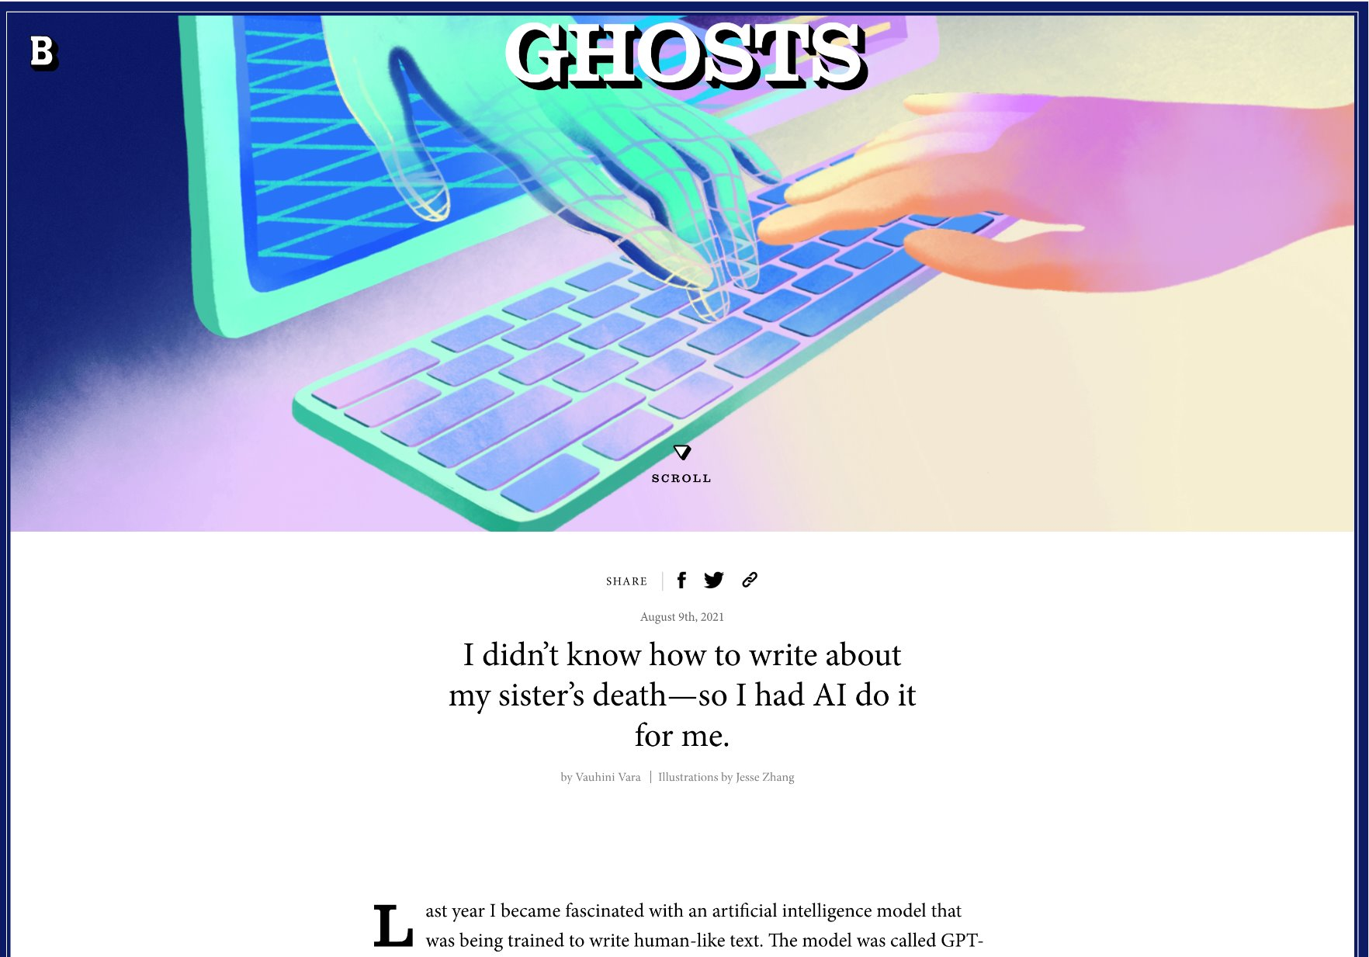
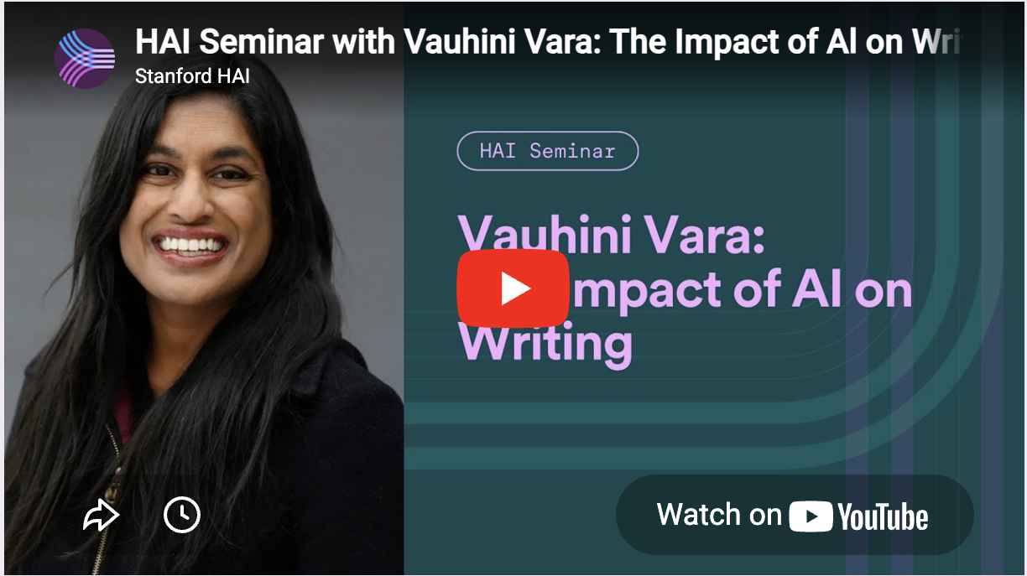

Sara Borjas; Department of Writing, Languages, and Literatures
Presentation: Reflection on Vauhini Vara's seminar at Stanford Institute for Human-Centered Artificial Intelligence, May 2025: "Vauhini Vara | The Impact of Al on Writing : What We Stand to Gain- and Lose- in Communication”
Central Insights:
  Writing isn't output—it's thinking. AI both helps us and exploits us. While readers may be satisfied by AI-generated writing, Vara was not satisfied as a writer by AI-generated writing.
  We have so much work to do our jobs responsibly with AI and it can feel Sisyphian(endless).
Central concerns:
  How do we work responsibly on this Sisyphian task?
  What is the university's responsibility to ensure that I know how to responsibly express and engage with AI so that it does not harm students, personally or systematically? Think environmental racism, future generations, and exploitation by prominent AI companies like OpenAI.

Slide 3

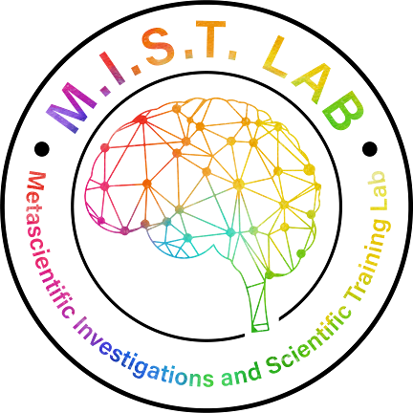
Jacob Francisco Miranda; Department of Psychology
Presentation:
The Psychology of the Human Element in AI-Driven Learning
The Human Element that we bring:
Our relationships and network
Our expert judgement
Our presence
And our genuine belief in their success.
That’s not something AI can replace. ~

Slide 4
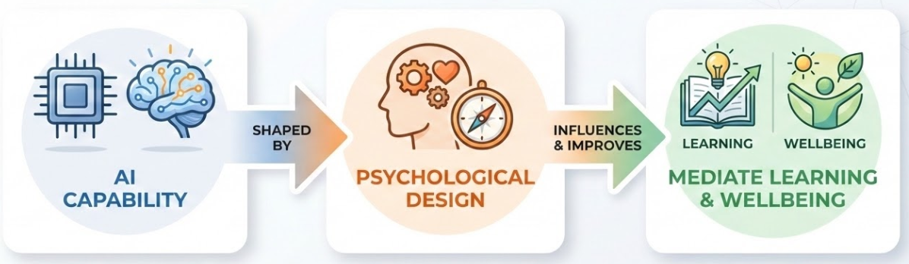

Jiyoun Myung; Department of Statistics and Data Science
Presentation: Recent Research on AI in Psychology and Education
Infographic by Gemini
When AI substitutes for human interaction or agency, it can increase loneliness, reduce belonging, and undermine long-term learning.
AI is not inherently beneficial or harmful. Its effects depend on whether it is designed with psychological principles (e.g., scaffolding, engagement, cognitive load) in mind.
Throughout this workshop, I have reflected on how to incorporate the human element into my Statistics classes in this rapidly changing AI era. While I have not yet fully determined the best approach, I am beginning to see a (clear) direction.

Slide 5

Somak Paul; Department of Management
Presentation: Syncing Mind and Machines: Hybrid Cognitive Alignment as an Emergence Coordination Mechanism in Human-AI Collaboration
Key Takeaways:
Conventional top-down organizational design involving hierarchy, plans, routines may not work in human-AI collaboration projects.
Organic bottom-up emergence, including mutual adjustment, collective sensemaking etc., has to be considered as well.
Organizational design, AI’s material properties, and human–AI interactions mutually affect one another and collectively drive who does what in human-AI collaboration projects.
Open Question:
How do we acknowledge AI as fundamentally a labor issue and collectively decide from below to what extent AI should be integrated in collaboration projects?

Slide 6

Lan Wang; Department of Management
Presentation: A Literature Review on Human Element in AI
Our discussion brought together diverse expertise and domain knowledge.
It was valuable not only to talk about AI itself, but also to see how perspectives vary across different disciplines.
The human element in AI involves recognizing and preserving the uniquely human competencies that AI can enhance, but not substitute.
I was truly inspired by everyone’s enthusiasm and curiosity in exploring this topic.

Slide 7

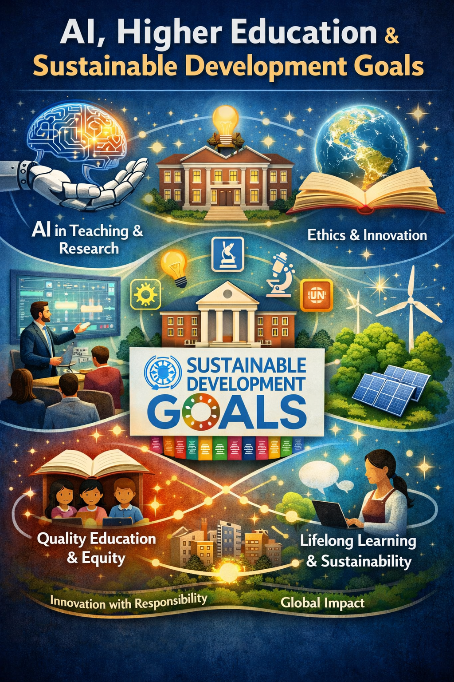
Dina Ziadlou; Department of Management
Presentation: AI, Higher Education and Sustainable Development Goals
​
In my presentation on AI, Higher Education, and the Sustainable Development Goals (SDGs), I explore how artificial intelligence is reshaping the future of academia while advancing global sustainability priorities. The discussion highlights how AI-driven tools can enhance teaching, learning, research productivity, and institutional decision-making, enabling higher education institutions to become more adaptive, inclusive, and data-informed. At the same time, I emphasize the critical role universities play in aligning innovation with ethical responsibility and societal impact, particularly in addressing equity, quality education, and lifelong learning. By connecting AI applications in higher education with the SDGs, the presentation underscores how technology can serve as a catalyst for achieving the vision of the United Nations Sustainable Development Goals, while ensuring that digital transformation remains human-centered, sustainable, and globally relevant.
Open Q: How to Keep Human in the Loop and encourage the students understadn their capabilities, critical thinking, and innovations over the AI?

Slide 8
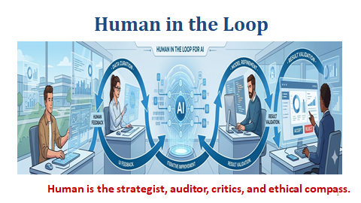
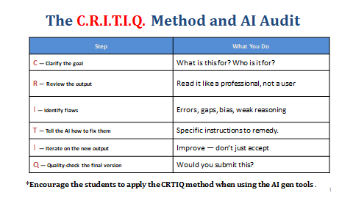
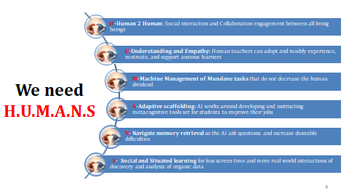

Slide 9

QR Code- Shared Resources
Our presentations
Our recommended readings
This Presentation
https://drive.google.com/drive/folders/1iEm1RA4THKAS5KnNFTPbEUvXKB4AX3EX?usp=drive_link

Slide 10
Our Group’s Collective Message
Never forget, there is a human element to preserve in the first place.
As AI continues to replace many entry-level jobs, students (including myself) feel uncertain about how to adapt. However, it is important to remember that at the center of all these changes, humans still play a critical role, and we should not lose sight of that.
It’s OK to navigate a period of confusion and uncertainty.
In fact, it’s human.

Slide 11
Thank You to Dawna and the OFD for supporting us!

