Slide 1
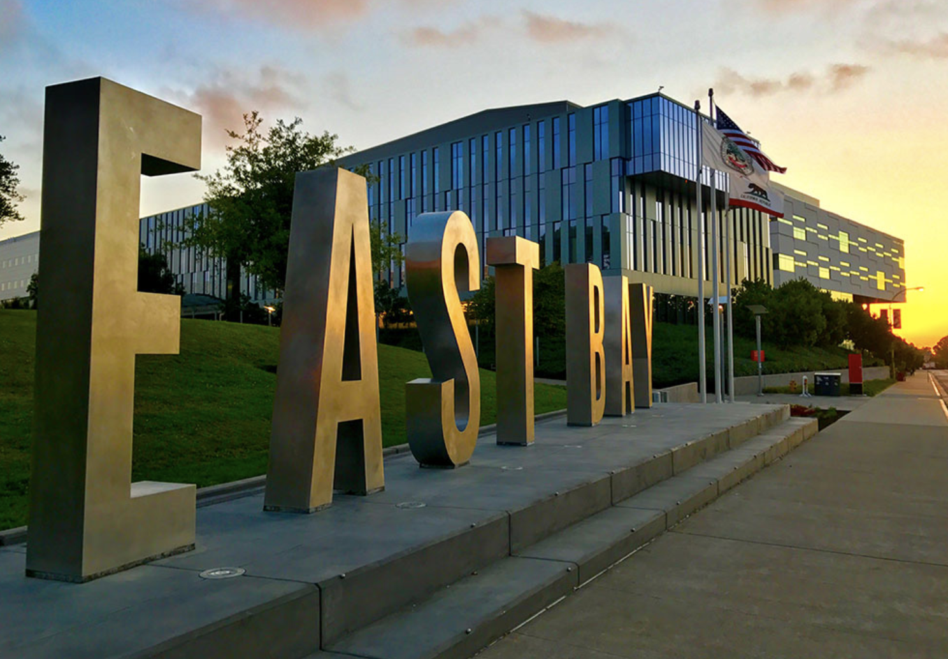
Fall 2023 Orientation Student Financial Services Department Office of Financial Aid & Scholarships
finaid@csueastbay.edu

Slide 2
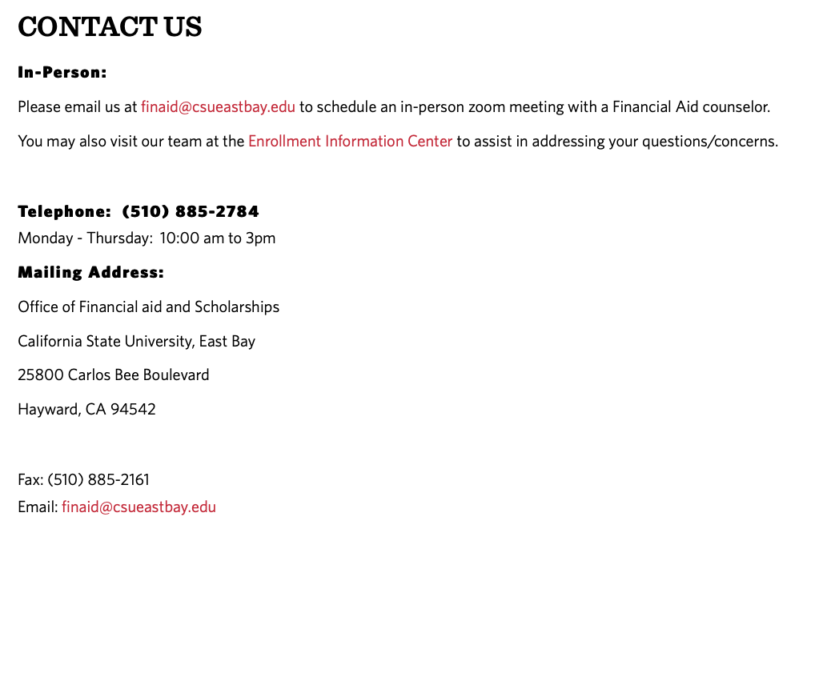
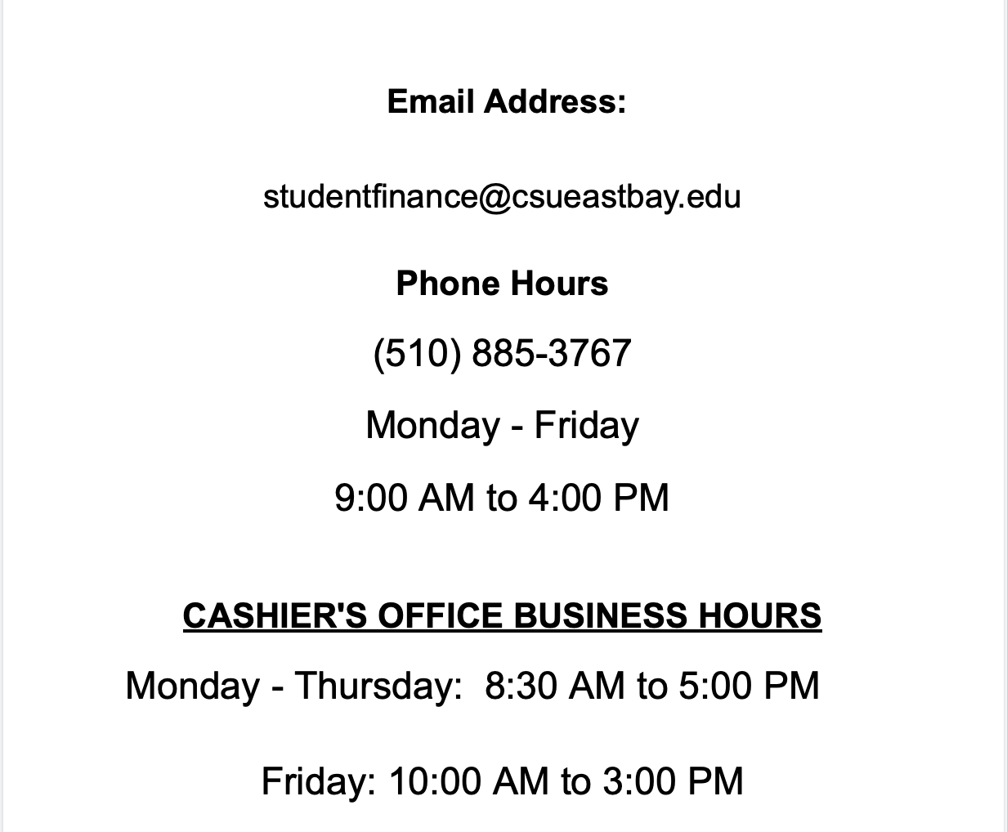
Housekeeping Rules
Please do not share your personal information on the Chat!!!

Slide 3
Difference Between OFAS & SFS
Office of Financial Aid & Scholarships = We give you money | Student Financial Services Department = We take it away
Authorizes Funds | Disburses Funds
Aid Eligibility | Billing Transactions
Awarding | Refund Checks
FAFSA/CADAA/Pioneer Scholarship Application | Payment Transactions

Slide 4
Office of Financial Aid and Scholarships
Financial Aid- Important Deadlines
2023-2024 California Dream Act Application (CADAA Application) and
Free Application For Student Aid (FAFSA) Available October 1, 2022
Deadline March 2, 2023- dream.csac.ca.gov or studentaid.gov
2023-2024 Pioneer Scholarship Application Available October 1, 2022
Deadline to most scholarships March 10, 2023- https://csueastbay.scholarshipuniverse.com
-It’s not too late to submit applications for Financial Aid consideration for the 2023-2024 Academic Year!
For the 2024-2025 Academic Year- FAFSA/CADAA has a tentative go-live date of December 2023!
Please stay tuned!
finaid@csueastbay.edu

Slide 5
NAVIGATING OUR WEBSITE
Announcement Page –Financial Aid
Main Student Financial Services Page
How to Determine How Much You Owe
MyCSUEB

Slide 6
Financial Aid- Subject to Adjustments-Add/Drop through Census
Financial Aid Offer Assumes Full-Time Enrollment and Requires that Students Maintain Satisfactory Academic Progress
Enrollment levels
FT=12units, TQT= 9-11units, HT=6-8units, LTHT=1-5units : Undergraduates
FT = 8 units, HT = 4 units : Graduates
Enrollment check for Grants/Scholarships
Eligibility determined by enrolled units at Census Date (generally the 15th day of instruction)
Enrollment requirements
Pell Grant prorated for FT, TQT , HT, LTHT
State University Grant requires 6u (4units for Graduates)
Cal Grant prorated for FT, TQT , HT (no LTHT)
EOP requires FT
Loans require HT
Middle Class Scholarship *(Based overall on Cost of Attendance)*

Slide 7
SAP Appeals
Financial Aid Offer Requires that Students Maintain Satisfactory Academic Progress.
Students who do not meet SAP standards are disqualified from Financial Aid. Students who are appealing are not guaranteed an approval and is independent from the billing deadline. Limit 2 Appeals per career.
67% Pace of Progression (Earned Units v. Attempted Units)
2.0 Cumulative Grade Point Average (3.0 Graduate)
2.0 Grade Point Average on your 2nd year (3.0 Graduate)
150% Maximum Time Frame Completion of Published Program
Financial Aid will only cover courses that count towards their degree

Slide 8
Verification Process
Federal Verification
The FAFSA/CADAA application may be flagged for Verification by the Federal Student Aid Department. Upon receipt of your FAFSA, (if chosen for verification) the Financial Aid Office will notify students via email with instructions on what and how to complete the Verification Process.
Students who are flagged for Federal Verification will receive an ESTIMATED Financial Aid Award. We will not be able to provide you with your Financial Aid until you complete all Verification Requirements.

Slide 9
Appeals
Special Circumstance Appeal
The Financial Aid Application requests information based on the prior-prior year income. However, if the student income changes drastically due to unforeseen circumstances: contact the Financial Aid Office to see whether they might be eligible for a Special Circumstance Appeal. Wait until the initial financial aid offer is provided to appeal (finaid@csueastbay.edu)
Reasons Include:
Loss or Drastic Reduction of Income
Death of Parent/Spouse
Natural Disaster (for example, COVID-19, California Fires)
Divorce
Out of Pocket Medical Costs (not covered by insurance)
Dependency Override
NOTE:
Wait to receive the initial (OFFICIAL) Financial Aid Offer before you appeal
Submitting an Appeal does not guarantee that you will receive additional aid
Submitting an Appeal will not postpone the payment deadline
You will be required to submit documentation to verify your reason to appeal

Slide 10
The Cal Grant / Middle Class Scholarship
Set up WebGrants4Student account (mygrantinfo.csac.ca.gov)
See on which school’s roster your Cal Grant is parked
Change your school based on where you are attending
Middle-Class Scholarship and Cal Grants will not be posted likely until August.
You cannot accept Middle Class Scholarship Until Official
Cal Grant is an estimate based on initial application of admission and FAFSA/CADAA- subject to change by August
Even if CSAC tells you that you’re eligible, you may still lose eligibility if you do not meet their requirements and submit the information that they need in a timely manner! Review the details to every correspondence from them! (READ THE FINE PRINT)

Slide 11
Student Financial Services
Let’s talk about your bill!

Slide 12
Thank you!

