Slide 2
FINANCIAL SERVICES
Procurement
General Accounting
Cashiers Office
University Budget Office
Accounts Payable
Finance Support Unit
Student Financial Services
Support Services
Asset Management
Bay Card

Slide 3
Agenda
Welcome – Maureen Pasag, Associate VP, Financial Services
Topics
Delegation of Authority (Contractual) - Jon Medwin, Director, Procurement Services
Fiscal Responsibilities - Rabi Joseph, University Controller
The Facilities World - Winnie Kwofie, Associate Vice President, FD&O
Hospitality Policy - Tammy Heard, Accounts Payable Technician, Lead
Anna Bento, Accounts Payable Technician & P-Card Administrator
Bay Card - Julie Yin, Business Analyst
Updates
Vendor Data Record (VDRs) Level 1 Data
Property Management Announcement
Closing - Maureen

Slide 4
Y
U
FINANCE
INCLUDED
Delegation of Authority (Contractual)

Slide 5
What is a Contractual Delegation of Authority?

Slide 6
What is a Contractual Delegation of Authority?
It is the legal power to act in the name of the Board of Trustees of California State University and California State University East Bay (CSUEB). The DOA binds the University to an obligation or promise.

Slide 7
Contractual Delegation of Authority
The University is not bound by and does not recognize as binding any promise or obligation made by an unauthorized person.

Slide 8
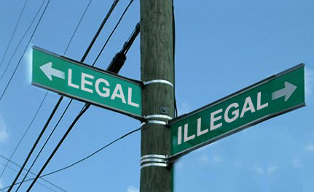
Contractual Delegation of Authority
Know the difference
One of the elements of a contract includes the authority to execute.
There are significant ramifications for acting in a capacity as if one had a DOA

Slide 9
CSUEB Staff/Faculty with a Contractual DOA Must:
Act within the limits of their power and delegation, as documented, as an example on the following slide;
Comply with all relevant University policies, procedures, internal controls, guidelines, and laws when exercising delegated authority.

Slide 10
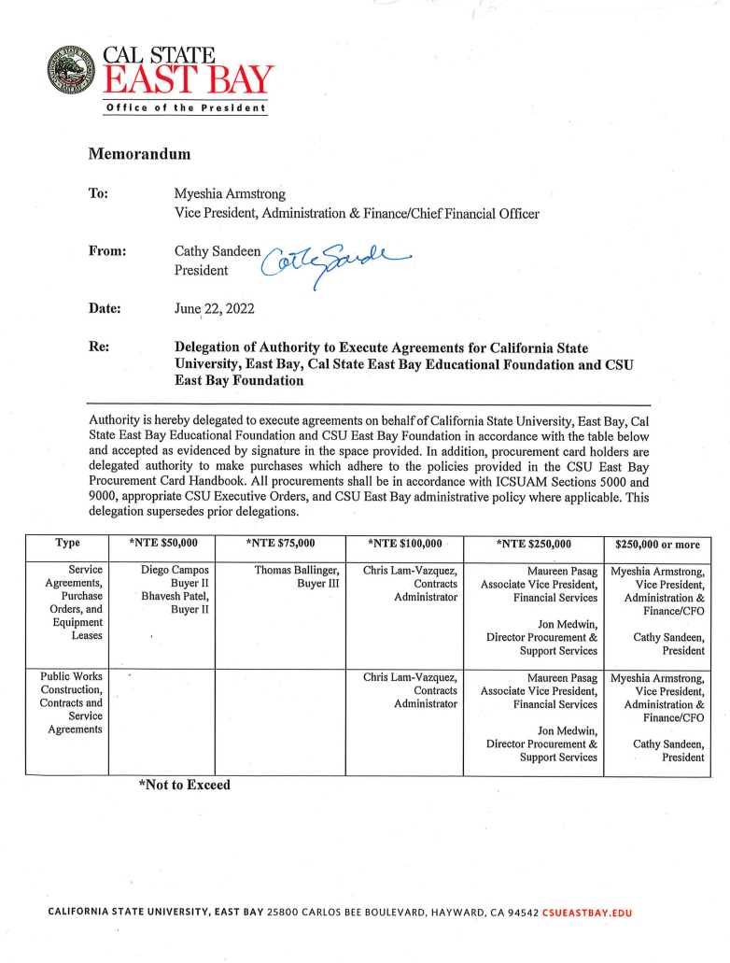

Slide 11
CSUEB Staff/Faculty with a Contractual DOA (con’t)
Must avoid even the appearance or presence of conflicts of interest, and never sign any document or obligate the University to an agreement in which he or she may have a personal interest in.
When a transaction is of an unusual nature or outside the normal course of University activities and practices, but within their DOA, the agreement should be elevated to a higher organizational level before it is executed.
Never sign an agreement/contract for which a DOA has not been previously provided.

Slide 12
Contractual Delegation of Authority
Who can enter into CSUEB agreements and/or contracts?
Only those individuals who receive a formal (written) Delegation of Authority may enter into agreements.

Slide 13
Unauthorized Purchase Request Policy and Form
CSUEB has established a campus Unauthorized Purchase Request Policy and Form. See PolicyStat: https://csueastbay.policystat.com/policy/12042327/latest
The intent of this policy is meant to curtail unapproved/unencumbered spend and ensure that individuals without a valid and current DOA do not bind the campus contractually and/or financially.
Those not adhering to the policy are required to complete an Unauthorized Purchase Request Form that must be signed by the Vice President of your area and the Vice President of Administration & Finance. The form is initiated by the Procurement Office.

Slide 14
Unauthorized Purchases
There are two primary avenues to procure goods or services:
Procurement Card for allowed goods/services <$10,000 (This dollar amount has been recently revised from $5,000 to $10,000.)
Through a requisition process that will lead to the issuance of a Purchase Order.

Slide 15
Unauthorized Purchases
CSUEB staff shall not:
Use their personal credit card or funds to purchase University goods or services. Doing so, and seeking reimbursement, could obligate the University to pay for an unauthorized expense.
Use the requisition number to order supplies or services prior to the issuance of a Purchase Order.
Provide the Purchase Order Number or an unsigned copy of a PO to a vendor before it has been approved by a member of the Procurement Office and conveyed to the vendor.
Issue a requisition after an order has been (improperly) placed, or after goods or services have been received. This is called an “after the fact” purchase, also known as a “confirming order”. These types of orders are not allowed.

Slide 16
Quiz Question #1
What form needs to be signed by both the Vice President/Provost of your division and the Vice President of Administration & Finance in a situation where a requisition was not generated, or a P-Card was not utilized, to acquire a commodity?

Slide 17
Answer to Quiz Question #1
The Unauthorized Purchase Request Form. This form is routed to the offending party via AdobeSign.

Slide 18
Quiz Question #2
True or False, a person who has received a Delegation of Authority shall:
Act within the limits of their power and delegation, as documented by their designated DOA; AND
Be aware of and comply with all relevant University policies, procedures, internal controls, and laws when exercising authority.

Slide 19
Answer to Quiz Question #2
True

Slide 20
Questions & Answers
Please ask any questions that you may have about this presentation through the Zoom Chat function.

Slide 21
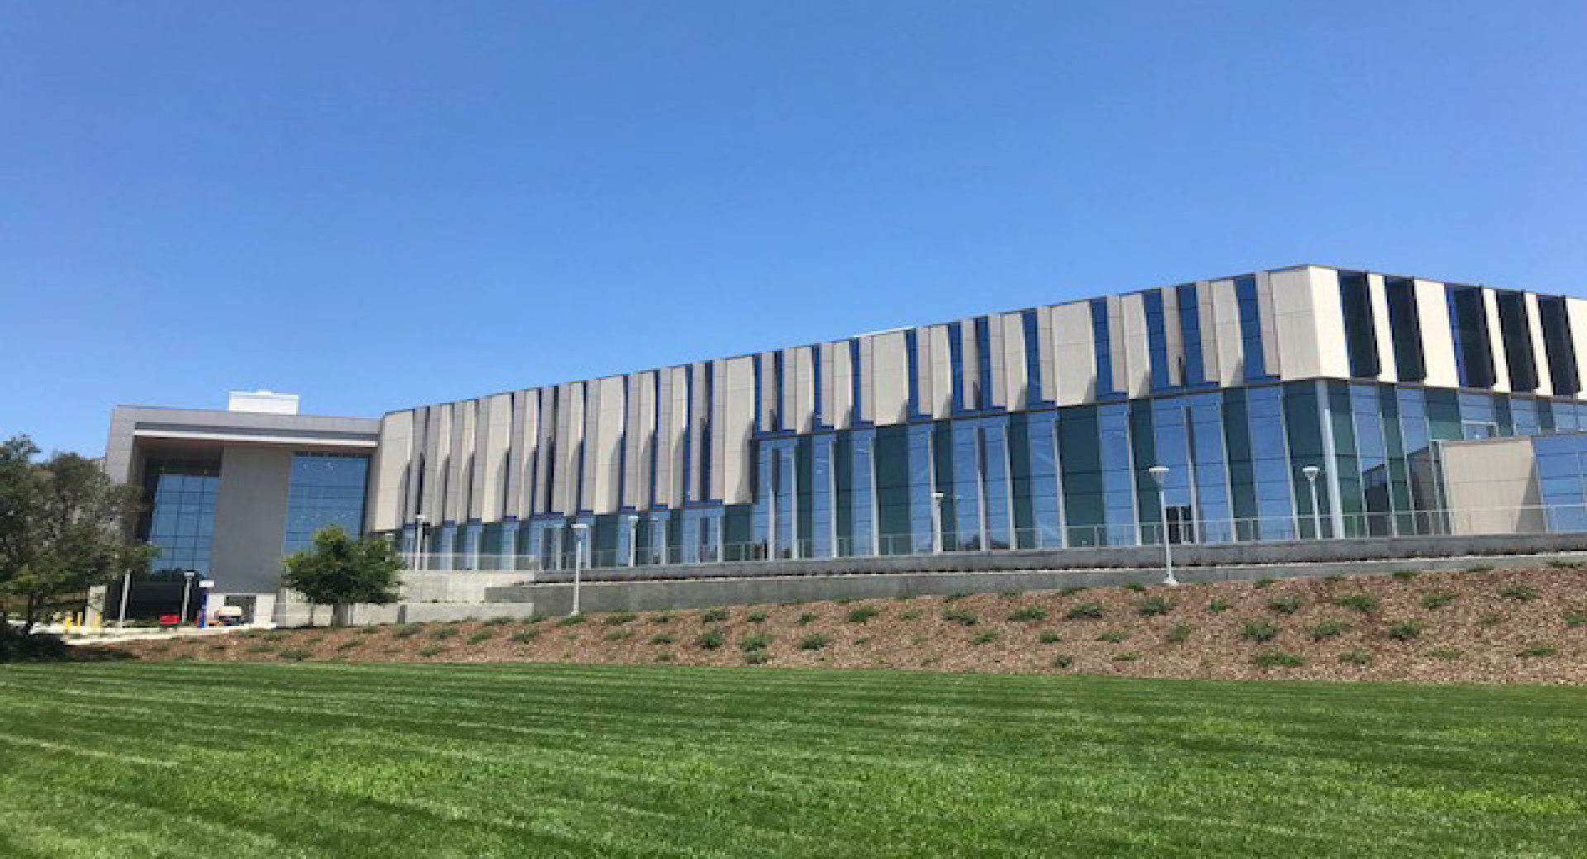
Fiscal Responsibilities
September 29, 2022

Slide 22
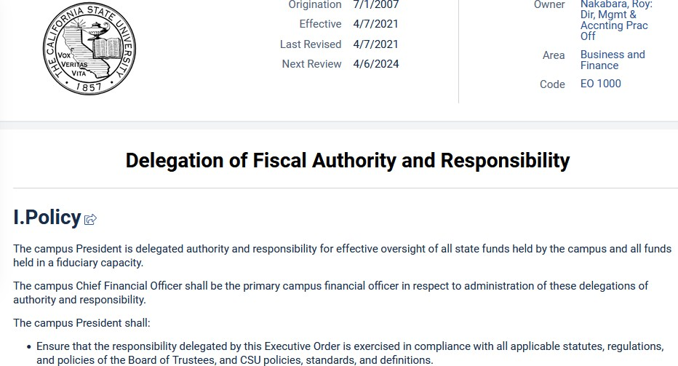

Slide 23
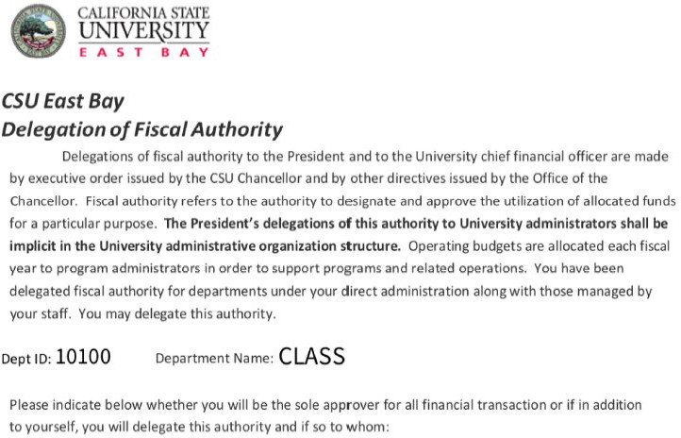
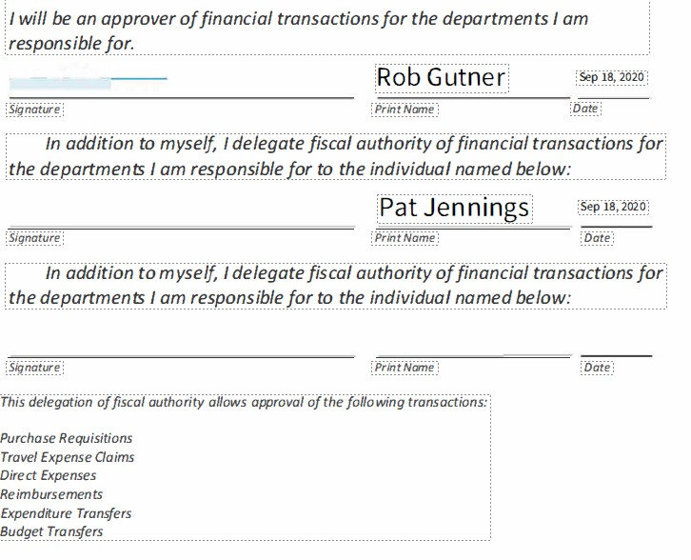
Delegation of Fiscal Authority Form

Slide 24
New Campus Policy - Fiscal Responsibilities
Purpose:
Each employee is responsible for the financial controls relevant to their role at CSU East Bay.
“Fiscal Responsibilities” policy outlines basic guiding principles and required departmental controls, including responsibilities at different organizational levels.
Guiding Principles for Financial Controls:
Clear and defined roles and responsibilities. Policies based on principles with minimal exceptions.
Risk assessment – potential threats and exposures, internal and external factors.
Control activities – i.e. complete and current policies and procedures.
Monitoring provides oversight by assessing the effectiveness of internal controls.

Slide 25
Dept Level –Financial Controls
Departmental level requirements for financial controls:
Preparation of a budget plan
Processing and approving financial transactions
Financial reviews
Internal controls and management responsibilities

Slide 26
A) Preparation of a budget plan
Budget should reflect the department’s operational plans
Understanding of major budget components
Review, approval, and endorsement of the budget

Slide 27
B) Processing and Approving Financial Transactions
Ensure proper approvals have been obtained from employees who have delegated fiscal authority.
Approvers must ensure financial transactions, including amounts and chartfields are accurate.
Compliance review – is the expense consistent with polices?
Management review – is the expense part of the budget and is an appropriate use of dept resources?
Two step approval – individuals should not approve their own expense.

Slide 28
C) Financial Review
Regularly review budget vs actual activity
Reviews must include budget variances, fund balances, determine if financial transactions are appropriate and correct.
Department trend analysis
Use of Finance Data Warehouse reports to identify outliers and trends.

Slide 29
D) Internal Controls and Management Responsibilities
Preventive vs Detective Internal controls
Preventive Controls – more efficient, before they occur
Detective Controls – after they occur, at the back end
Adequate internal controls allow managers to delegate responsibilities with reasonable assurance that expectations are met.
Ensure departments operate efficiently and effectively.

Slide 30
TRIVA QUESTION (1 )
What are the three must have elements of a Chartfield?
Fund, Dept ID, Account
Fund, Program, Class
Account, Project, Class
Dept ID, Fund, Project

Slide 31
Answer ( 1 )
( A ) Fund, Dept ID, Account

Slide 32
TRIVA QUESTION (2)
Who is responsible for setting up adequate financial controls?
Executive Management
Finance Department
Faculty & Staff with delegated financial authority
All of the above

Slide 33
Answer ( 2 )
( D) All of the above

Slide 34
Thank you!

Slide 35
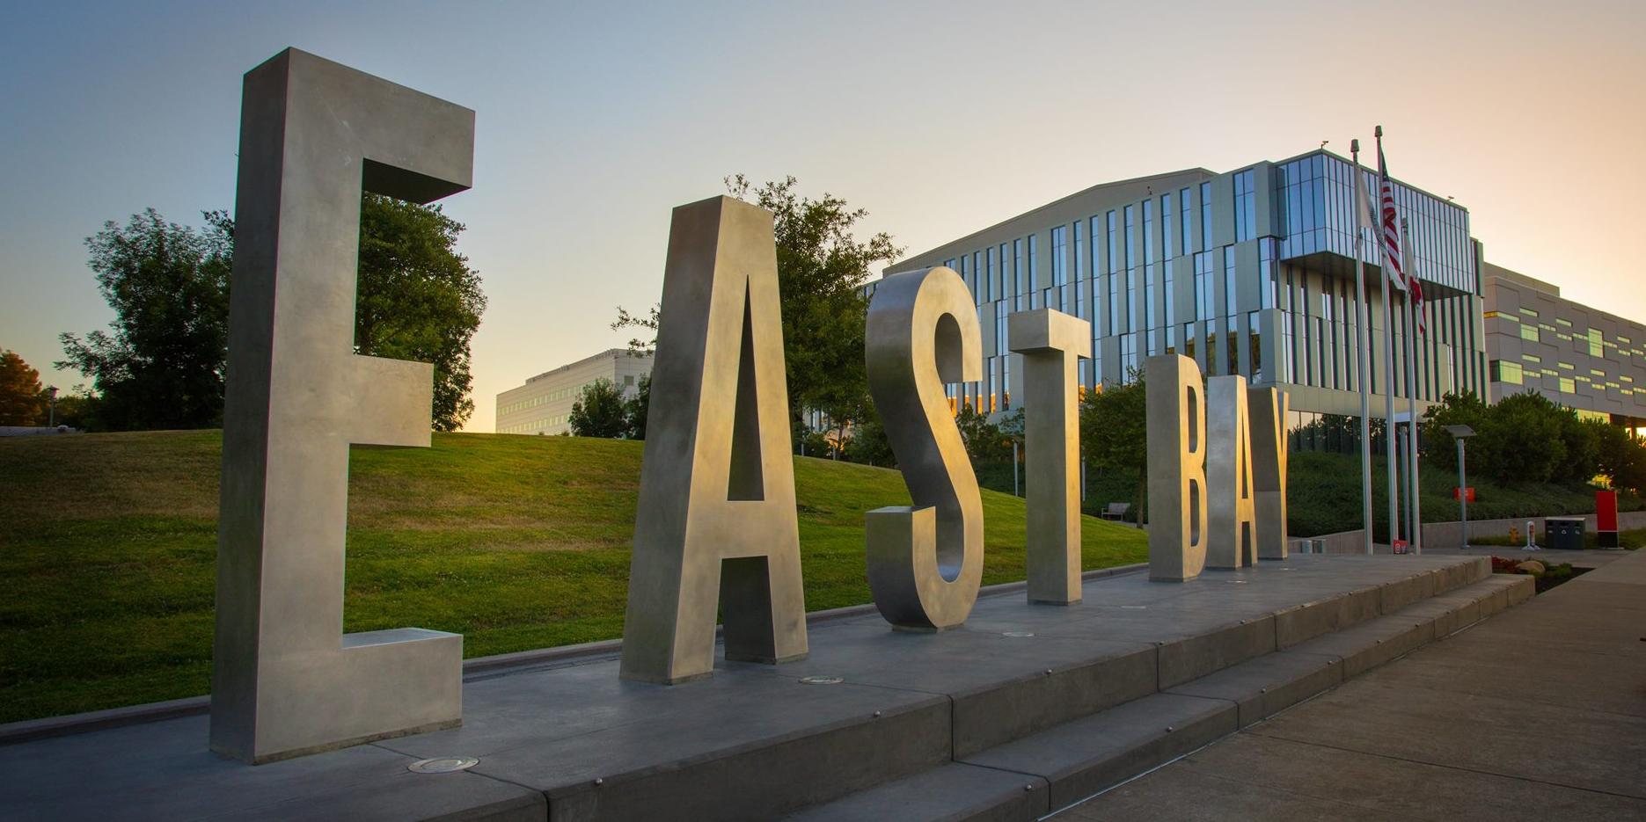
Finance FYI - The Facilities World
Presenters: Winnie Kwofie, AVP, FD&O
Denise Johnson, Director, Business Operations, FD&O

Slide 36
What does FD&O actually do?
Notes:
What does Facilities do?
Spa services
Order pizza
maintenance and building services
all the above

Slide 37
It depends….

Slide 38
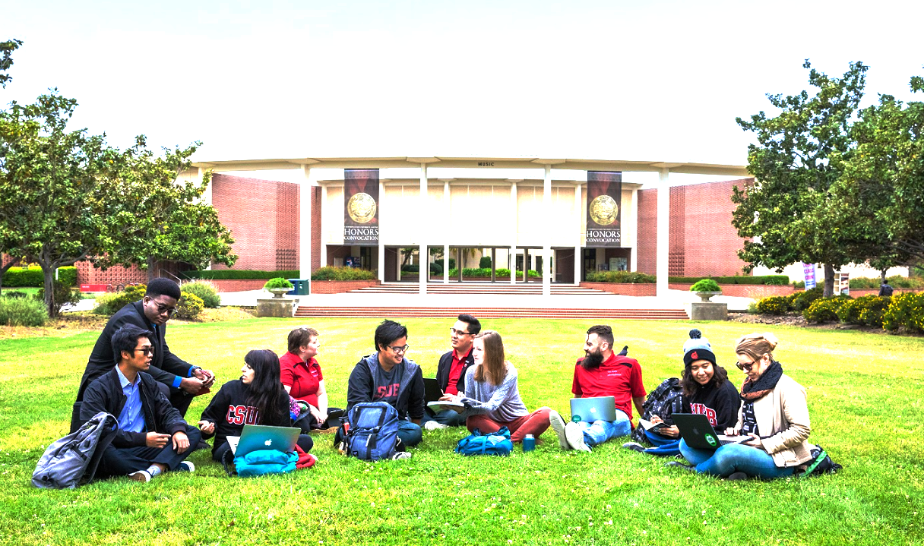
Our Mission
To set the mood on the campus to ensure every space is welcoming, and stimulate, learning, collaboration and discovery
Our Vision
To be model Facilities department in the CSU system
What We value
Customer experience
Cultural Diversity
Communication
Collaboration
Team Spirit
Notes:
add concord map

Slide 39
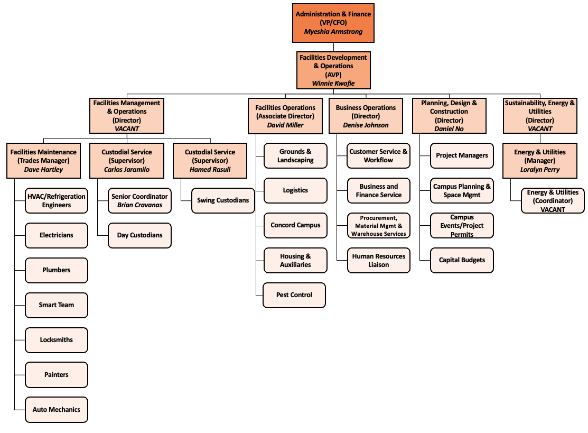
Who we are…

Slide 40
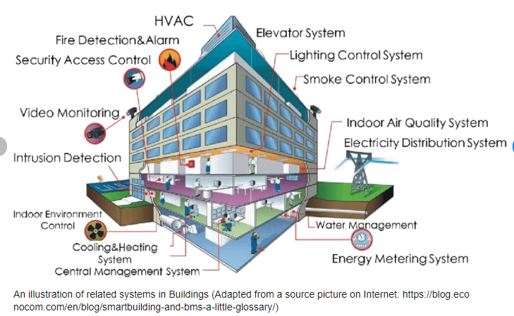
What we do…
Notes:
add pix of what we do

Slide 41
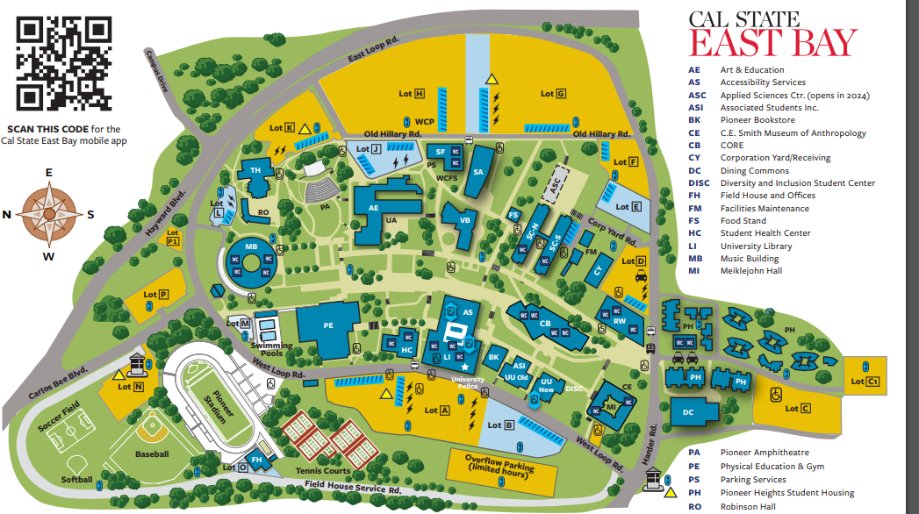
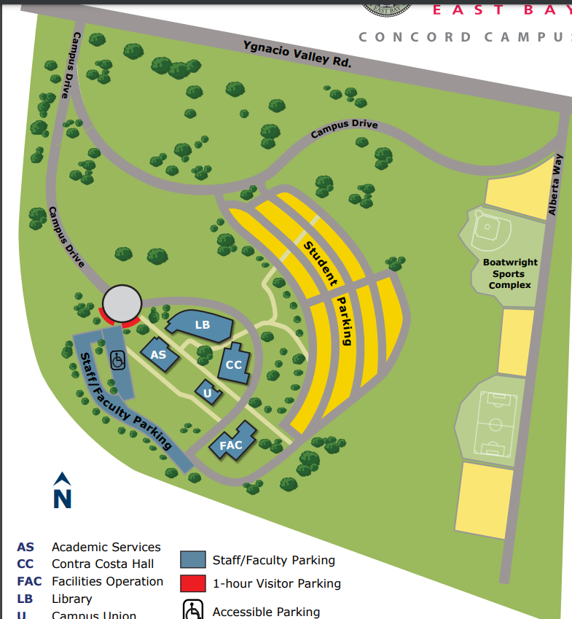
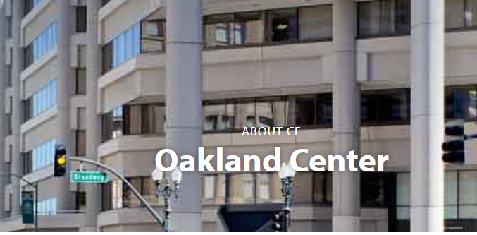

Slide 42
Know your campus and FD&O
How many campuses does CSUEB have?
3 campuses:
Hayward
Concord
Oakland (Leased space)
What is the size of land CSUEB occupies?
748 acres
Approx. 567 football fields
What is the size of our assignable area in buildings
Approx. 2 million SQFT.
Approx. 35 football fields
How many buildings and sport facilities do we have?
47 buildings and 6 sport facilities

Slide 43
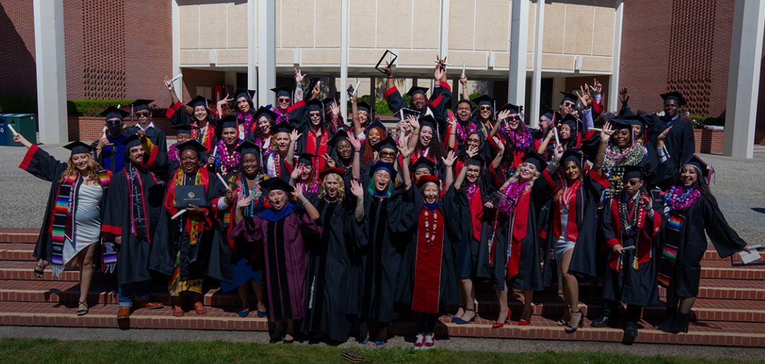
Who we serve …

Slide 44
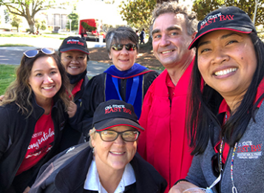
Who we serve …
Notes:
add pix of what we do

Slide 45
Our Partners…
Chancellor’s Office
Campus Leadership
Student Affairs
Exterior Agencies
Academic Affairs
Associated Students Incorporated
Chief of Staff
Financial Services
Housing
Concord
Deans
Diversity Office
UU
Risk Management
Office of Accessibility
Academic Senate
EH & S
RAW
University Advancement
Human Resources
Parking & Transportation
Police Department
Executive Facilities Officer
Facilities Service Units and External Contracts

Slide 46
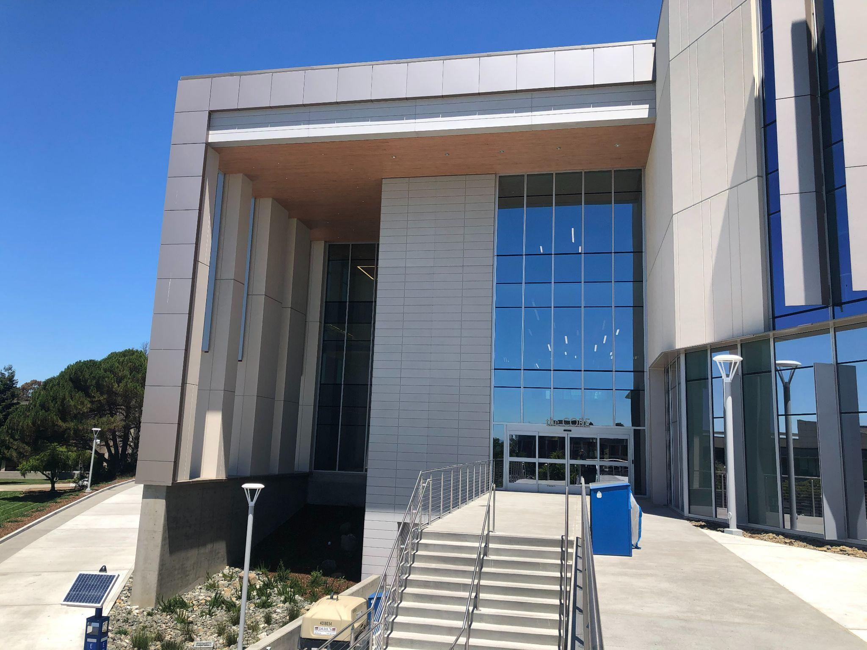
Our capital asset and infrastructure
Current value of buildings as of 2018: $800M
Core building : $100M plus
Campus Infrastructure of 2018: $400M
Capital Program Budget: approx. $200M
Core Building
Applied Science Center
Deferred Maintenance
Capital Renewals
Notes:
add pix of what we do

Slide 47
Operating Budget
FD&O Operational Budget
approx. $10M
Travel
1%
Contractual Services
8%
Maybe pie chart with the DeptID for the various services
Salaries and Wages
77%
Operating Expenses
14%
Notes:
DENISE
10m$ operating
100m-300m capital

Slide 48
Our Process
Work Request
Work Order
Work Order Evaluation
Work Order Assigned
Work order request
Service Desk Phone Number
(510) 885-4444
Trades
PDC
Completed Work Order
Notes:
Denise

Slide 49
We ensure your safety and security - Key Requests
Be a friend
Don’t lose your keys!!!
CSUEB Key Policy & Procedure
Key Request Form

Slide 51
Y
U
FINANCE
INCLUDED
Hospitality Policy
CSUEB effective date Sept. 2021

Slide 52
Who does the policy apply to?
Applies to:
CSUEB Campus, including ASI
Oakland Center
Concord Campus
Auxiliaries (Foundation and Ed Foundation)
This includes all payment methods

Slide 53
What is a Hospitality expense?
Hospitality expenses are necessary, appropriate to the occasion, reasonable in amount, and serve a business purpose consistent with the mission and fiduciary responsibility of the CSUEB.
Expenses that relate to an official CSUEB business event
Activities that promote CSUEB to the public
When an employee acts as an official host:
Occasion must serve a clear business purpose
No personal benefit derived by the host or other employees
The approving authority must evaluate the importance of the event in terms of costs, benefits to be derived, and any alternatives that would be equally effective.

Slide 54
Hospitality Examples
When CSUEB . . .
Hosts or sponsors a business meeting
Hosts official guests with an interest in CSUEB
Hosts or sponsors a meeting of a learned society or professional organization
Hosts receptions held in connection with conferences, meetings of student organizations, and student events such as commencement

Slide 55
Hospitality Meeting Examples
Academic Senate
Campus meetings of deans and directors
Employee morale functions
Extended formal training sessions
It is highly encouraged that events/meetings are held on campus due to Risk Management requirements, sustainability impacts, and catering agreements.
Meetings that occur on a regular or frequent basis are not permitted under this policy.

Slide 56
Hospitality Expenditures
Food – maximum per person rate (includes food, beverage, labor, all tax, delivery fees, tips, etc):
Breakfast: $30
Lunch: $45
Dinner: $75
Light Refreshments: $20
Our on-campus caterer, Chartwells, has the first right of refusal for orders totaling $250 or more.

Slide 57
Hospitality Expenditures (cont’d)
Awards, Prizes, and Cash Equivalents
Pre-approvals are required
Supporting documentation is needed
Clear description of award program and business purpose
Eligibility requirements
List of recipients with net ID’s or EMPL ID’s
Cash equivalents not to exceed $25 per recipient per event
Non-cash awards and prizes not to exceed $50 (including tax and shipping) per recipient per event

Slide 58
Hospitality Expenditures (cont’d)
Gift Cards:
All gift cards must be:
Secured properly, such as in a locked drawer or safe
Maintained by an ongoing inventory of issuance and distribution which may be subject to audit
Gift cards may affect a student’s financial aid or an employee’s W-2

Slide 59
Unallowed Expenditures
Birthday celebrations
Weddings
Anniversaries
Baby showers
Parties

Slide 60
Funding Sources – State Funds
May be used to pay for awards and prizes to employees for exceptional contributions, to students for excellence, and individuals to participate in a research-funded survey or study.
May be used for employee recognition, official presentations for length of service awards, or exceptional contributions with at least 5 years of service.
Allows for official employee morale-building and appreciation activities that serve a clear business purpose.

Slide 61
Funding Source – Unable to use State Funds
For any expenditure prohibited by applicable laws, regulations, or agreements including the California Budget Act
To pay for alcoholic beverages or memberships in social organizations
Local trust agreements (LTA) must be on file when expenditures vary from the standard restrictions (this would apply to a PRxxx fund).

Slide 62
State Funds
Include some of the following funds:
EB001, PRxxx, PExxx, PLxxx, PVxxx, PUxxx, and PTxxx funds
State funds are those State University Trust funds that are continuously appropriated by the legislature (EC 89700-89726)

Slide 63
Additional Information
Acknowledgement of Receipt form is found in the Adobe Sign Workflow
Link to the Accounts Payable web page:
https://www.csueastbay.edu/accounting-fiscal/accounts-payable.html
CSUEB Hospitality Policy can be found in the CSUEB Policy Library:
https://www.csueastbay.edu/policy/index.html

Slide 64
QUESTION #1
True or False: You can provide food for weekly on-campus meetings totaling $125, using an outside vendor.

Slide 65
Answer #1
False. Weekly meetings are not considered infrequent, per policy.

Slide 66
QUESTION #2
Who does the hospitality policy apply to?

Slide 67
Answer #2
Everyone!

Slide 68
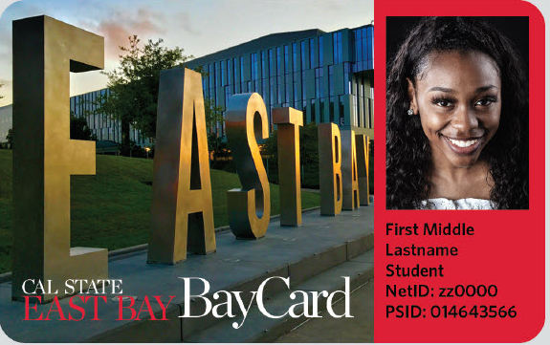
Bay Card - Mobile vs. Physical
Julie Yin
CSUEB Bay Card Office

Slide 69
What is New?
Check your bay card balance
Review your Bay Card transaction history
Bay Card low balance notification
Barcode scan
Bay Card account barcode
Access campus life: Services, Event, Access, Purchase, Map and Favorites

Slide 70
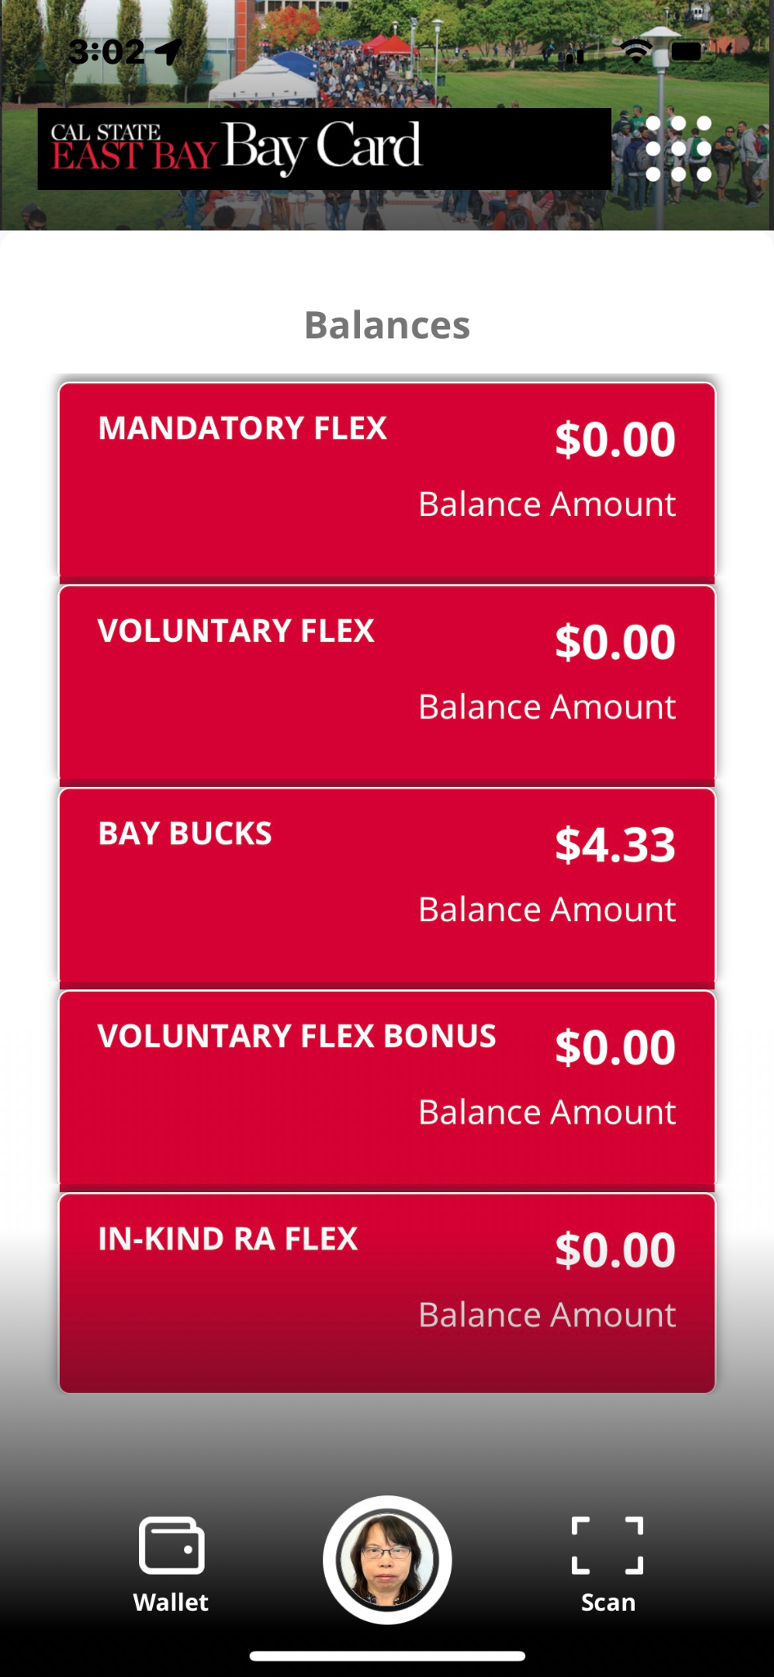
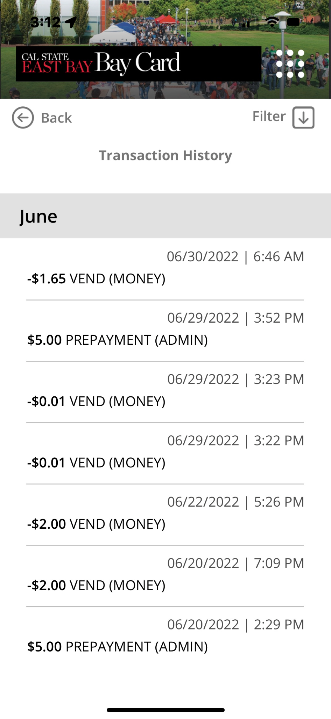
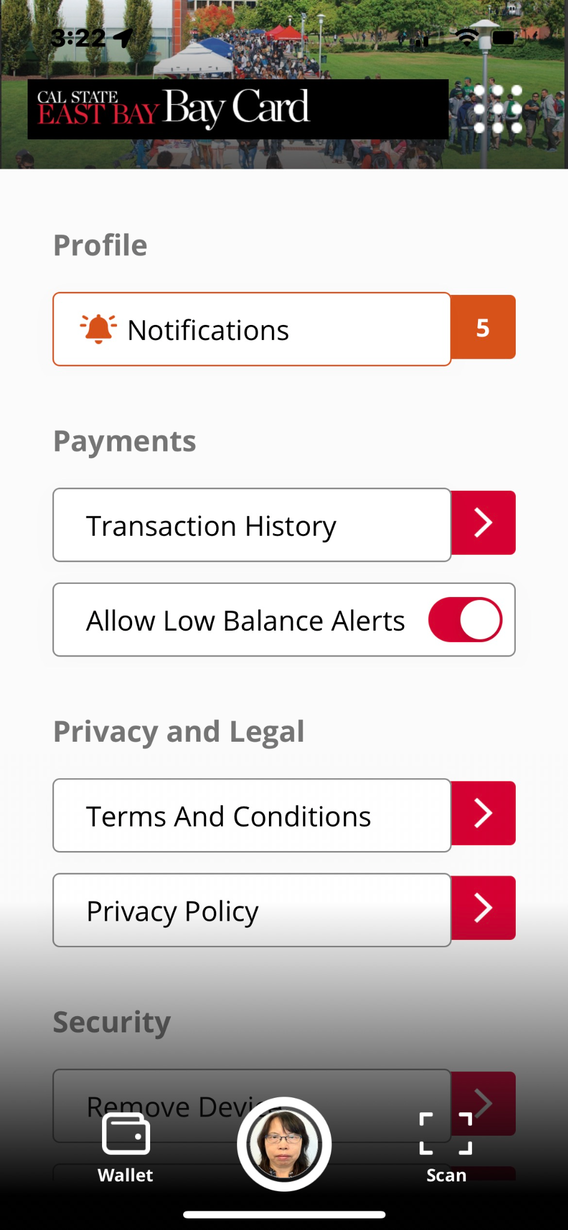
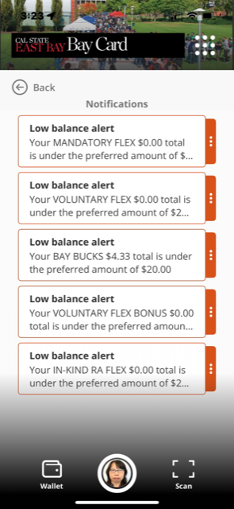
How to check your transaction and balance on your Bay Card App

Slide 71
Using Your Bay Card
Dollars stored in an account to be used on campus
Copying, Printing and Duplicating
Only Bay Bucks can be used to pay for these
Bookstore, Vending, Dining purchases
Student Health and ASI Business Center
Add value using your credit card, debit card, cash and etc.

Slide 72
What else can the Bay Card do?
Act as CSUEB Library Card
Grant access to Pioneer Dining meal plans
Grant access to Pioneer Housing room
Grant entry to Rec & Wellness Center
Grant entry to campus events (Job Fair)
Grant access to Bay Bucks
Grant access to Free Shuttle to BART

Slide 73
Adding Bay Bucks
Online: csueastbay.edu/baybucks
Guest Deposit
Enter Student’s 9-digit PS ID (on their card)
Enter Student’s First and Last Name
Visa, MasterCard, American Express & Discover
Students can login with their NetId and password to add themselves

Slide 74
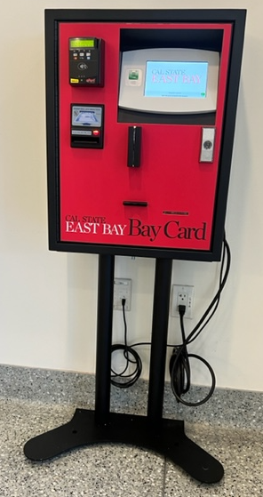
Adding Bay Bucks
In Person @ ITC Machine
VISA, MasterCard, American Express, Discover and cash
Locations:
Cashier Office
CORE ( the first floor)
Student Administrative Building

Slide 75
BAY CARD MOBILE Applications -
Click on the App and search for TouchNet 360u
Select TouchNet 360u
Please Note: To add money to your account you must first SAVE A PAYMENT METHOD by logging in to your account

Slide 76
Pharos Print
CSUEB issued Bay Card ( Physical, Mobile and guest Card ) can be used for print, copy at any Pharos printer
You can only have one card registered at a time
You must manually register your Bay Card to the Pharos Print System.
You must have Bay Bucks balance to pay for printing.
Each time you replace or receive a new Bay Card you will need to register the new card.

Slide 77
Take it Everywhere.
Quiz:
How do you load $$$ to your Bay Card?
Where can you check your Bay Card $$$ balance?
Julie Yin
CSUEB Bay Card Office

Slide 78
Take it Everywhere.
Answer:
How do you load $$$ to your Bay Card?
Where can you check your Bay Card $$$ balance?
Login your mobile app 360 u and open the transaction page
Or
Julie Yin
CSUEB Bay Card Office

Slide 79
Vendor Data Record –VDR Updates
Per Vendor Master File- Best Practices & Identified Audit Issues published by Chancellor’s Office in September 2021, all VDR’s are now being validated using IRS portal based upon their TIN/SSN and Legal Name/Last Name.
All level one data (SSN) and non Purchase Order VDR requests should now be sent to Accounts Payable at accounts.payable@csueastbay.edu to facilitate the VDR process. All Purchase Order VDR requests should be attached to the requisition request and sent directly to Procurement in the PS system.
For direct payment requests (Check Requests, and STLS forms), we will need both the VDR and Invoice before it can be set up in the PS system. The name and address on the Invoice must match the VDR. This also applies to student reimbursements.
Takeaway …. All VDR’s are now being validated, Level 1 data should now be sent to Accounts Payable as opposed to General Accounting, and all information on Invoices and VDR’s must match to avoid any delays in processing.

Slide 80
Y
U
FINANCE
INCLUDED
Property Management Announcement

Slide 81
Property Management Audit Response
A Computer/Laptop/Tablet Audit was conducted through Property Management with response due to the findings by November 18, 2022.
The response is time sensitive.
We are seeking their timely cooperation when departments are contacted by a representative from Property Management.
As a reminder, never order computers, tablets, or laptops via a P-Card. Also, if you ever receive direct delivery of such assets, you need to coordinate with Property Management for asset tagging and with ITS for imaging before the asset is put into service.

Slide 82
THANK YOU FOR VIEWING TODAY’S “FYI” SESSION!
Watch your email inbox for our Online Survey – please take a few moments to share your feedback on today’s session and your ideas for future sessions!
Today’s slides will be available in the Finance website under Financial Services Resource Center.

