Slide 1
Y
U
FINANCE
INCLUDED
ADOBE PRESENTATION: ACCOUNTS PAYABLE WORKFLOW FORMS
AP DEPARTMENT
Angie Trujillo and Anna Bento

Slide 2
INTRODUCTION
A
Accounts Payable has successfully transitioned to and implemented full usage of electronic modalities for all our processes.
-Streamlined process
-More efficient approval process routing
-More sustainable approach (electronic storage vs paper)
Documents will continue to be submitted electronically (i.e., Adobe Sign), replacing paper submissions

Slide 3
ACCESS FORMS
A
All Accounts Payable forms can be accessed one of the following ways:
Accounts Payable website, under Forms: https://www.csueastbay.edu/accounting-fiscal/accounts-payable.html
Adobe Sign login from the Staff page
Sign in directly to Adobe Sign: https://sign.csueastbay.edu/

Slide 4
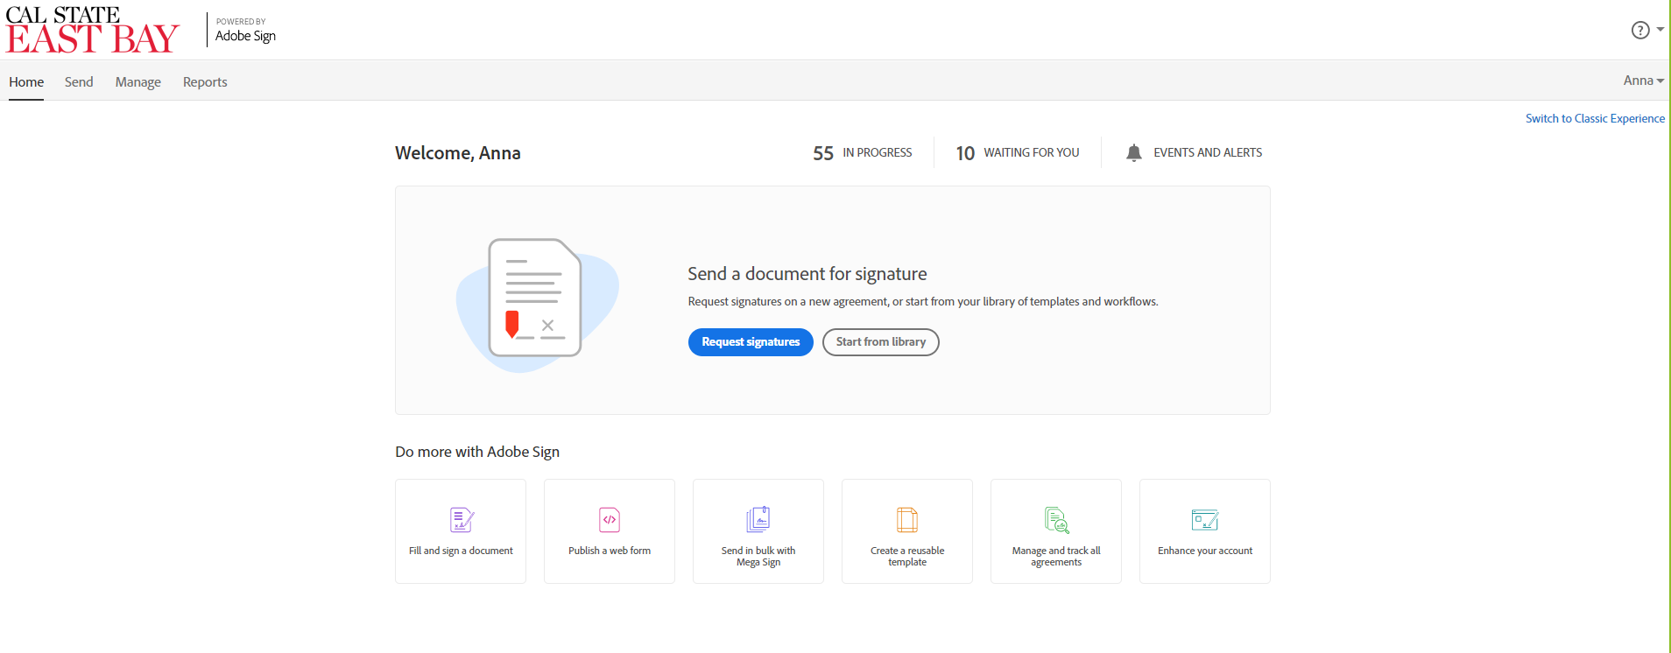
ADOBE SIGN – HOME PAGE

Slide 5
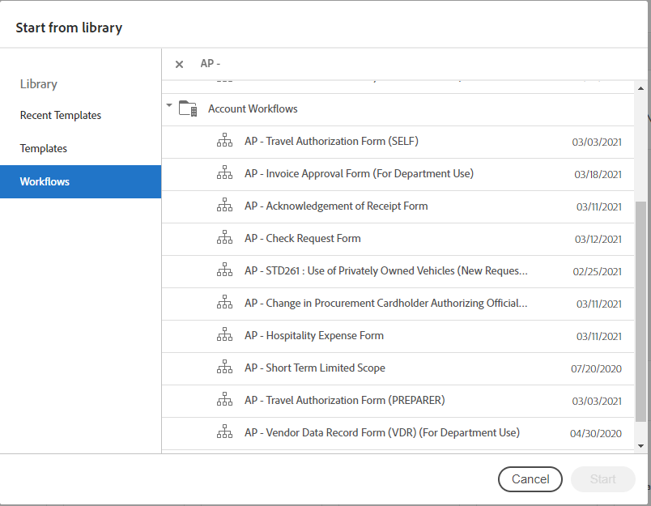
WORKFLOW
Notes:
Select Workflow
Selecting the form from Workflow, will assure that it is routed to the correct approvers and will generate the mandatory Final Audit Report page. The Final Audit Report page includes all necessary information regarding approvals.
In the Search field, you can access all of the Accounts Payable forms by entering “AP –”

Slide 6
ACCOUNTS PAYABLE FORMS
AP – Check Request Form
AP – Invoice Approval Form (For Department Use)
AP – Short Term Limited Scope
AP – Travel Expense Form
AP – Hospitality Expense Form
AP – Vendor Data Record Form (VDR) (For Department Use)
AP – STD261 : Use of Privately Owned Vehicles
AP – Travel Authorization Form (SELF)
AP – Travel Authorization Form (PREPARER)
AP – Change in Procurement Cardholder Authorizing Official/Chartfield
Notes:
All of our forms are available on the Workflow. Here is a list of the forms, which includes the Check Request Form, Invoice Approval form, and STLS, to name a few.

Slide 7
VENDOR DATA RECORD (VDR)
There are two categories for VDRs
Vendors with Level 1/sensitive data – Social Security numbers, usually individuals/sole proprietors:
Contact General Accounting at general.accounting@csueastbay.edu and provide the vendor’s name and email address. A secure VDR will be emailed to the vendor for completion.
Please let the vendor know to expect such an email.
If it’s a student payment, be prepared to answer student inquiries as part of program support.
FAQs coming soon
Vendors with Taxpayer ID numbers, non-sensitive data:
Use the Adobe Sign AP Vendor Data Record Form (For Departmental Use) found in the Workflow.
Notes:
It is important to note that, if level 1 data is to be provided, there are specific steps to follow. These steps can be found by clicking on the “Instructions” link next to the VDR form from the Accounts Payable website.

Slide 8
TRIVIA TIME
Question: When preparing an AP form in Adobe Sign, do I select it from the Templates or the Workflow section?

Slide 9
Answer: Select it from the Workflow section, which includes all AP forms.

Slide 10
Question: Can I submit a paper check request form?

Slide 11
Answer: We have now successfully implemented the Adobe Sign Workflow for all AP forms. The Adobe form should be used for Check Request submissions.

Slide 12
Q & A

Slide 13
Y
U
FINANCE
INCLUDED
Printer Update
Support Services
Dayrll Lewis

Slide 14
Objectives
CSUEB’ Business RMC and CSUEB have begun to work together on this project and have identified key business objectives that will serve as the foundation to our activity:
Streamline processes and procedures that improve operations
Lower overall cost related printing, copying, faxing, and scanning/imaging
Standardization of Desktop Printers
Right-size the fleet – consolidated approach
Reduce printers and move to MFD’s
Reduce the number of models for both MFD’s and Desktop Printers
Minimize or remove the use of P-Cards for printer & toner acquisition

Slide 15
Timeline
Phase 3 | Task | Date
Stage 1 | Analysis Planning | 3/01/2021
Stage 2 | On Site Analysis – Data collection end user interviews | 3/23/2021 – 4/23/2021
Stage 3 | Analyze Current Processes | 4/26/2021 – 5/10/2021
Stage 4 | Validate Findings– review raw data and preliminary findings | 5/14/2021
Stage 5 | Present recommendation based upon findings validation | 5/21/2021

Slide 16
Q & A

Slide 17
Y
U
FINANCE
INCLUDED
Fiscal Year-End
Procurement
Chris Lam-Vasquez & Jon Medwin

Slide 18
Purchasing Tips
Review Open Purchase Orders throughout the year:
Performed at least monthly.
More frequently as year-end approaches.
Email “close purchase order” requests to Purchasing Chris Lam-Vazquez (CLV) to close out inactive PO’s.
List should be in numerical order.

Slide 19
Year End Reminders
June 7, 2021
Procurement will continue to process close out.
New requisitions received after this date will be dated for the new fiscal year.
Requisition's processing time vary greatly, depending on its complexity and scope.
Contact Jon Medwin - Email: jon.medwin@csueastbay.edu Phone: (x5-7225) with any questions.
Notes:
The look of the front page of PeopleSoft will be changing.
PeopleSoft functionality will not be changing!
The front page will be have a predetermined list of tiles set by the Chancellor’s Office and Board of Trustees.
You will be able to move your existing tiles to up to (4) undefined pages for your working pleasures.

Slide 20
Year End Reminders
P-Card: Transactions posted to the US Bank statement by May 25th will be included in the current fiscal year.
Certify: University-paid expenses (i.e., air travel, Enterprise Car Rental, etc.) should be processed timely:
Check your Certify wallet for unclaimed expenses.
Unclaimed transactions posted thru June 30th will be accrued
Accrued expenses include incurred fees for future travels.
Transactions/requests received by the cut-off date:
Included in current fiscal year.
Items received after the due dates will be processed as time permits.

Slide 21
TRIVIA TIME
Question: What format should departments submit their PO close requests?

Slide 22
Answer: List PO in numerical order

Slide 23
Question: In what fiscal year will Purchasing recognize requisitions received after June 7, 2021?

Slide 24
Answer: FY 21/22

Slide 25
Question: By what process will Accounting recognize unclaimed expenses for the current fiscal year?

Slide 26
Answer: Accrual

Slide 27
True or False
P-card statement dated 5/28/2021 will be included in fiscal 20/21.

Slide 28
Answer: False

Slide 29
Questions

Slide 30
Y
U
FINANCE
INCLUDED
Financial Services Year-End Deadlines
GAO
Elaine Tayag & Donna Arredondo

Slide 31
Effective/Successful Year-End Indicators
Slide title
One Touch Approach
Reviews and reconciliations occur throughout the year
Check balances/transactions at least monthly
More frequently as year-end approaches

Slide 32
Effective/Successful Year-End Indicators
Year Round Transaction/Balance Reviews include:
Requisitions
Encumbrances and POs
Accounts Payable
Fund and DeptID Balances
Accounts Receivable Billing Requests
Transfers (Budget, Expense, Payroll)
Other allocations (i.e., Federal Work Study)

Slide 33
Year Round Reviews
Requisitions, Encumbrances & POs
Ensure encumbrance/PO balances are accurate
Identify invoices that need submission to AP
Follow-up with vendors, if needed
Work with buyers to close out any Reqs or POs that are no longer needed on a regular, and on-going basis throughout the year

Slide 34
Year Round Reviews
Fund-DeptID-Program-Class-Project codes:
Make sure all chartfield values are correct at the transaction level.
Chartfield values include:
Account
Fund
Dept ID
Program (if applicable)
Class (if applicable)
Project (if applicable)

Slide 35
Year End Reminders
P-Card transactions posted to USBank statement by May 25
Will be included in the current fiscal year
Last ones to record for the year
Consist mostly of May transactions
Certify’s unclaimed company credit card transactions will be accrued by Accounting, included with June expenses.

Slide 36
Year End Reminders continued
Submit transactions or other requests by the cut-off dates
Allow for normal processing times and inclusion within the current fiscal year
Items received after the due dates will be processed as time permits

Slide 37
Year End Reminders continued
Monday June 7, 2021:
Notify Procurement of any remaining purchase orders that are no longer needed (no further invoices or purchases)
New requisitions received after this date will be dated for the new fiscal year
For guaranteed processing, submit final non-payroll expenditure transfers, budget transfers and payroll adjustment requests

Slide 38
Year End Reminders continued
Wednesday June 30, 2021:
The Cashier’s Office will close at 1:00 P.M.
The month of July:
The year-end close work continues “behind-the-scenes”
Ensure department resources are available for inquiries
Please contact Accounting or Procurement for any questions.

Slide 39
TRIVIA TIME
Question: When is the deadline to submit Budget, Payroll and Expense transfers?

Slide 40
Answer: The deadline to submit Budget, Payroll and Expense transfers is:
June 7th, 2021

Slide 41
TRIVIA TIME
Question: How often should you review data warehouse financial reports, such as manage my budget?

Slide 42
Answer: At least monthly

Slide 43
TRIVIA TIME
Question: At what time on June 30, 2021 will the Cashier’s Office close?

Slide 44
Answer: 1:00pm

Slide 45
Questions
Thank You!

Slide 46
Y
U
FINANCE
INCLUDED
COVID-19
CARES Act Funding
CSUEB Financial Services
Presenter: Kim Napoli

Slide 47
CARES Act Overview
The Coronavirus Aid, Relief and Economic Security (CARES) Act was passed by the U.S. Government in March 2020, to provide support in the wake of the coronavirus public health crisis and associated economic fallout.
One section of the CARES Act established the Higher Education Emergency Relief Fund (HEERF), which provides funding to the nation's colleges and universities.

Slide 48
CARES Act Overview
HEERF primary uses:
Provide no less than 50% of its total HEERF funding for emergency grants to students.
Cover a portion of specific unbudgeted costs and lost revenue due to the disruption of campus activities due to the COVID-19 pandemic.

Slide 49
CSUEB HEERF Round 1
HEERF Grant | Amount Received | Date Received
Student Emergency Grants | $7,308,674 | 04/25/20
Institutional portion - 18004 a(1) | $7,308,673 | 05/06/20
Minority Serving Institution (MSI) - 18004 a(2) | $1,128,222 | 05/31/20
Total | $15,745,569

Slide 50
CSUEB HEERF Round 1
HEERF Institutional portion Criteria and Eligible Costs
Demonstrate a clear nexus to significant changes to the delivery of instruction due to the coronavirus.
Expend the funds within one year of grant agreement.
Examples of Eligible Costs:
Provide emergency financial aid grants to students.
Refunds made to students for housing, food, or other services that Institution could no longer provide.
Hardware, software, or internet connectivity that Institution may have purchased on behalf of students or provided to students.
Exclusions:
Payment to contractors for pre-enrollment activities.
Capital outlays associated with facilities related to athletics, sectarian instruction, or religious worship.
Senior administrative/executive salaries, benefits, bonuses.

Slide 51
CSUEB HEERF Round 2
The US Dept of Education recently released additional support funds under the Coronavirus Response and Relief Supplemental Appropriations Act 2021 (CRRSAA), otherwise known as HEERF II.
Same purpose as initial HEERF, must demonstrate nexus to both pandemic and instruction medium change.
HEERF II costs must be incurred on or after March 13, 2020 and spent within one year from grant issuance date.

Slide 52
CSUEB HEERF Round 2
HEERF II funds can be used to defray expenses associated with the coronavirus and lists out the following examples:
Lost revenue
Technology costs associated with a transition to distance education
Faculty and staff trainings
Payroll

Slide 53
CSUEB HEERF Round 2
CRRSAA (HEERF II) Grant | Amount Received | Date Received
Student Emergency Grants | $7,308,674 | 01/17/21
Institutional portion | $16,934,978 | 01/17/21
MSI portion | $1,643,146 | 03/05/21
Total | $25,886,798

Slide 54
CSUEB HEERF
Total Budget and Expenditure Reporting under CARES Act Sections 18004(a)(1) and (a)(2) Institutional /MSI Portion
Institution Name: California State University, East Bay As of: 03/31/21
Category | Amount in (a)(1) and (a)(2) institutional dollars | Explanatory Notes
Providing additional emergency financial aid grants to students. | $ 2,999,216 | Additional student aid grants
Providing reimbursements for tuition, housing, room and board, or other fee refunds. | $ 3,406,596 | Housing and parking refunds
Covering the cost of providing additional technology hardware to students, such as laptops or tablets, or covering the added cost of technology fees. | $ 562,034 | Laptops and hotspots
Subsidizing off-campus housing costs due to dormitory closures or decisions to limit housing to one student per room; subsidizing housing costs to reduce housing density; paying for hotels or other off-campus housing for students who need to be isolated; paying travel expenses for students who need to leave campus early due to coronavirus infections or campus interruptions. | $ 3,066,008 | Added housing costs incurred due to an intentional decision to reduce housing density
Campus safety and operations. | $ 271,330
Purchasing faculty and staff training in online instruction; or paying additional funds to staff who are providing training in addition to their regular job responsibilities. | $ 85,000 | Provided faculty with distant learning training
Purchasing, leasing, or renting additional equipment or software to enable distance learning, or upgrading campus wi-fi access or extending open networks to parking lots or public spaces, etc. | $ 45,961 | Additional Laptops
Total of Expenditures | $ 10,436,145

Slide 55
TRIVIA TIME
One section of the CARES Act established funding to the nation's colleges and universities. Which one is it?
HEEFF
HERFF
HEERF
HAPPYHR

Slide 56
One section of the CARES Act established funding to the nation's colleges and universities. Which one is it?
HEERF

Slide 57
Trivia Question
Question: HEERF expenses must occur on or after what date?

Slide 58
Trivia Question
Answer: March 13, 2020

Slide 59
Trivia Question
Question: Provide one of the two criteria for the Institutional portion of HEERF funding:

Slide 60
Trivia Question
Answers:
1 - Demonstrate a clear nexus to significant changes to the delivery of instruction due to the coronavirus.
2 - Expend the funds within one year of grant agreement.

Slide 61
Questions

Slide 62
Y
U
FINANCE
INCLUDED
CORE Building
CSUEB Planning, Design, & Construction
Presenter: Sharon Chen-Bateman

Slide 63
Exterior

Slide 64
CORE Building
A new 3-Story, 100,000 sq ft building located at the former trailer row at the center
of the campus.

Slide 65
Exterior Finishes

Slide 66
Interior

Slide 85
Thank You

