Slide 2
FINANCIAL SERVICES
Procurement
General Accounting
Cashiers Office
University Budget Office
Accounts Payable
Finance Support Unit
Student Financial Services
Support Services
Asset Management
Bay Card

Slide 3
Agenda
Welcome – Maureen Pasag, Associate VP, Financial Services
Topics
Hospitality Policy – Sai Vang, Director Procurement Services
Tammy Heard, Accounts Payable Technician II
Chartwells Catering – Paul Chan, Sr Catering Director
Assessment Management Process - Tom Poon, AVP Risk Mgmt & Internal Control
Gene Lim, Deputy Chief Information Officer
Announcements
“Virtual Terminal” Payments – Aaron Ledesma, Assoc. Director Student Financial Services
Closing – Maureen Pasag

Slide 4
Y
U
FINANCE
INCLUDED
Hospitality Policy
CSUEB effective date August 2023
Sai Vang & Tammy Heard

Slide 5
Who does the policy apply to?
Applies to all hospitality expenses regardless of funding source and payment method:
CSUEB Campus
Oakland Center
Concord Campus
Auxiliaries (ASI, Foundation and Ed Foundation)
Notes:
Sai
The Hospitality Policy applies to all hospitality expenses regardless of funding source and payment methods. This includes restricted grant funds and auxiliaries such as ASI and the Foundation.

Slide 6
What is a Hospitality expense?
Hospitality expenses are necessary, appropriate to the occasion, reasonable in amount, and serve a business purpose consistent with the mission and fiduciary responsibility of the CSUEB.
Expenses that relate to an official CSUEB business event
Activities that promote CSUEB to the public
When an employee acts as an official host:
Occasion must serve a clear business purpose
No personal benefit derived by the host or other employees
The approving authority must evaluate the importance of the event in terms of costs, benefits to be derived, and any alternatives that would be equally effective.
Notes:
Sai
READ SLIDE

Slide 7
Hospitality Examples
When CSUEB . . .
Hosts or sponsors a business meeting
Hosts official guests with an interest in CSUEB
Hosts or sponsors a meeting of a learned society or professional organization
Hosts receptions held in connection with conferences, meetings of student organizations, and student events such as commencement
Notes:
Sai
READ SLIDE and provide examples:
Hosts or sponsors a business meeting such as an employee recognition event.
Hosts official guests with an interest in CSUEB such as a prospective student event or potential donor.

Slide 8
Hospitality Meeting Examples
Academic Senate
Campus meetings of deans and directors or department
Employee morale functions
Formal training sessions
Student Clubs
Events/meetings occurring more than once a month are not permitted under this policy.
Notes:
Sai
READ SLIDE. Emphasis change to hospitality policy defining re-occurring events/meetings more than once a month are not permitted.

Slide 9
Hospitality Expenditures
Food – maximum per person rate (includes food, beverage, labor, all tax, delivery fees, tips, etc):
Breakfast: $40
Lunch: $55
Dinner: $85
Light Refreshments: $30
Our on-campus caterer, Chartwells, has the first right of refusal for orders totaling $250 or more.
Notes:
Tammy

Slide 10
Hospitality Expenditures (cont’d)
Awards, Prizes, and Cash Equivalents
Pre-approvals are required via Hospitality Justification Form
Supporting documentation is needed
Clear description of award program and business purpose
Eligibility requirements
List of recipients and relationship to CSUEB
Cash equivalents not to exceed $25 per recipient per event
Non-cash awards and prizes not to exceed $50 (including tax and shipping) per recipient per event
Notes:
Tammy

Slide 11
Hospitality Expenditures (cont’d)
Gift Cards:
All gift cards must be:
Secured properly, such as in a locked drawer or safe
Maintained by an ongoing inventory of issuance and distribution which may be subject to audit
Gift cards may affect a student’s financial aid or an employee’s W-2
Gift cards for employees are reported to payroll
Notes:
Tammy

Slide 12
Unallowed Expenditures
Hospitality expenses that are of a personal nature and not related to the active conduct of official CSUEB business, such as:
Birthday celebrations
Weddings/Anniversaries
Funerals
Baby showers
Parties
Notes:
Tammy

Slide 13
Funding Sources – State Funds
May be used to pay for awards and prizes to employees for exceptional contributions, to students for excellence, and individuals to participate in a research-funded survey or study.
May be used for employee recognition, official presentations for length of service awards, or exceptional contributions with at least 5 years of service.
Allows for official employee morale-building and appreciation activities that serve a clear business purpose.
Notes:
Tammy

Slide 14
Funding Source – Unable to use State Funds
For any expenditure prohibited by applicable laws, regulations, or agreements including the California Budget Act
To pay for alcoholic beverages or memberships in social organizations
Local trust agreements (LTA) must be on file when expenditures vary from the standard restrictions (this would apply to a PRxxx fund).
Notes:
Tammy

Slide 15
State Funds
Include some of the following funds:
EB001, PRxxx, PExxx, PLxxx, PVxxx, PUxxx, and PTxxx funds
State funds are those State University Trust funds that are continuously appropriated by the legislature (EC 89700-89726)
Notes:
Tammy

Slide 16
Hospitality Justification Form
All hospitality expenses must have a completed Hospitality Justification Form (located in AdobeSign) submitted along with supporting backup documentation. Information required on the justification form includes:
Type of event (department meeting, host of official guest, etc.)
If the meeting is reoccurring.
The business purpose of the meeting or event.
Type of hospitality (meals/refreshments, service recognition, etc.)
Location and date(s).
List of attendees and their business relationship to the campus.
The cost of the meal per attendee.
For a large group where the names of attendees are unknown, a description of the group and estimated cost of the meal per attendee is sufficient.
Notes:
Sai
Previously, a Hospitality Expense Form was required for all hospitality expenses. The update to the policy now requires the Hospitality Justification Form. This is not only a change to the name but also additional required information. [READ bullet points in slide).
The updated Hospitality Justification Form is available in AdobeSign under the Library.

Slide 17
Hospitality Justification Form (con’t)
Notes:
Chris
The Hospitality Justification Form is now available in AdobeSign under the Library Workflow.

Slide 18
Hospitality Justification Form (con’t)
Approving Authority
Any department providing hospitality must have the expenditure approved by the delegated approval authority.
The individual making the order/purchase may not also approve.
Individuals with delegated approval authority may not approve their own expenses and individuals may not approve expenses of their supervisor. The exception is approval of the President's expenditures by the Chief Financial Officer.
Payment or reimbursement of hospitality expenses for recreational, sporting, or entertainment events be approved by the President or their designee.
Payment or reimbursement of hospitality expenses for a spouse/domestic partner/significant other of an employee be approved by the President or their designee.
Notes:
Sai
Updates to the Hospitality Policy clarifies who the approving authorities for Hospitality expenses. It is the department’s responsibility to ensure the proper approvers sign the Hospitality Justification Form. The policy updates clarifies that [READ SLIDE].

Slide 19
Procedure
Obtain quote(s)
Complete Hospitality Justification Form
Purchase Method:
PCard or Reimbursements: Attach Hospitality Justification Form and supporting documentation in Certify (Process by Accounts Payable)
Purchase Order: Attach completed Hospitality Justification Form and supporting documentation to requisition (Processed by Procurement Services)
Notes:
Sai
READ SLIDE

Slide 20
Additional Information
Acknowledgement of Receipt Form located in the AdobeSign
Link to the Accounts Payable web page:
https://www.csueastbay.edu/accounting-fiscal/accounts-payable.html
CSUEB Hospitality Policy can be found in the CSUEB Policy Library:
https://csueastbay.policystat.com/policy/14263671/latest
Notes:
Sai
READ SLIDE

Slide 21
Thank you! Questions?
Notes:
Sai

Slide 22
Y
U
FINANCE
INCLUDED
Chartwells Catering
Paul Chan

Slide 23
In order to streamline and develop more environmentally friendly processes, staff from Student Affairs, Accounts Payable (AP) and Chartwells teamed up to develop a new catering invoice payment process, effective January 2020.

Slide 24
Department Process
Department places the order through the Chartwells Pioneer Catering system. The following information will be captured:
Chartfield String
Approver (cannot be the same person who places the order and must follow Delegation of Authority)
List of attendees (either attach a list or the email invite/flyer which has names of attendees)
List of attendees (either attach a list or a flyer of the event with names of attendees)
List of attendees - either key into system or attach list (or a flyer of the event) with attendee information
Hospitality Justification Form will also need to be attached
Note: It is important that the information entered is accurate to avoid processing delays.
The Chartwells Pioneer Catering system will automatically route the catering request to the approver. Upon approval, Chartwells will begin to work with the department on the event.

Slide 25
AP Process
After the catering event, the approved invoice will be electronically submitted to AP.
AP will review the chartfield string, approver name and attendee information.
AP will process the catering invoices after a three-day waiting period.
With this new process, there is no longer a need to route a printed catering invoice to the originating campus department.

Slide 26
If an Invoice Needs to be Revised
Department must notify AP within three business days after the event to pull the invoice.
Department must immediately contact Chartwells so that an updated invoice can be issued.
In this case, the updated invoice will be routed manually to the campus department. The campus department will need to record the chartfield string on the paper invoice, approve the invoice and attach the attendee information and send to AP Department for payment processing.
If you have any questions, please contact
Martin Castillo, Associate Vice President, Campus Life at 5-3601
or Mark Almeida at 5-4376.

Slide 27
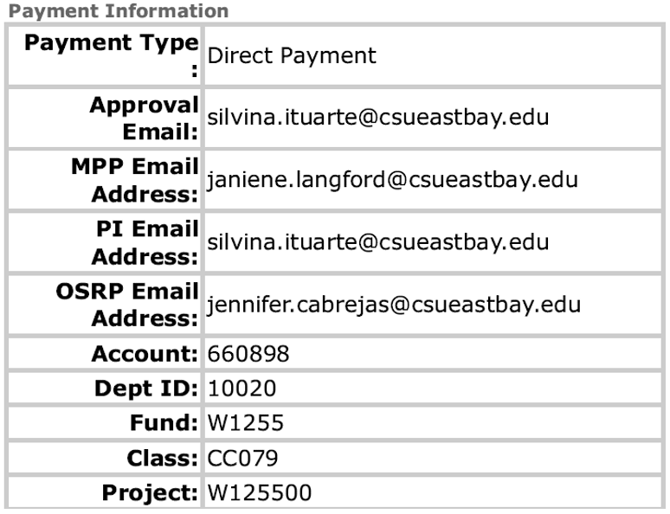
Grant Fund Process
The PI and ORSP approvals are only for orders charged against grant funds. The grant funds are the funds that start with a "W", accompanied by a 6-digit project code that also starts with a "W". The form should include the approval email addresses from: (1) the department's approver who has delegation of fiscal authority; (2) the PI who oversees the fund, and (3) ORSP (Jennifer Cabrejas). The order placer would be able to get this information from their department's budget person.
Here's a sample of a correct order for a grant fund:

Slide 28
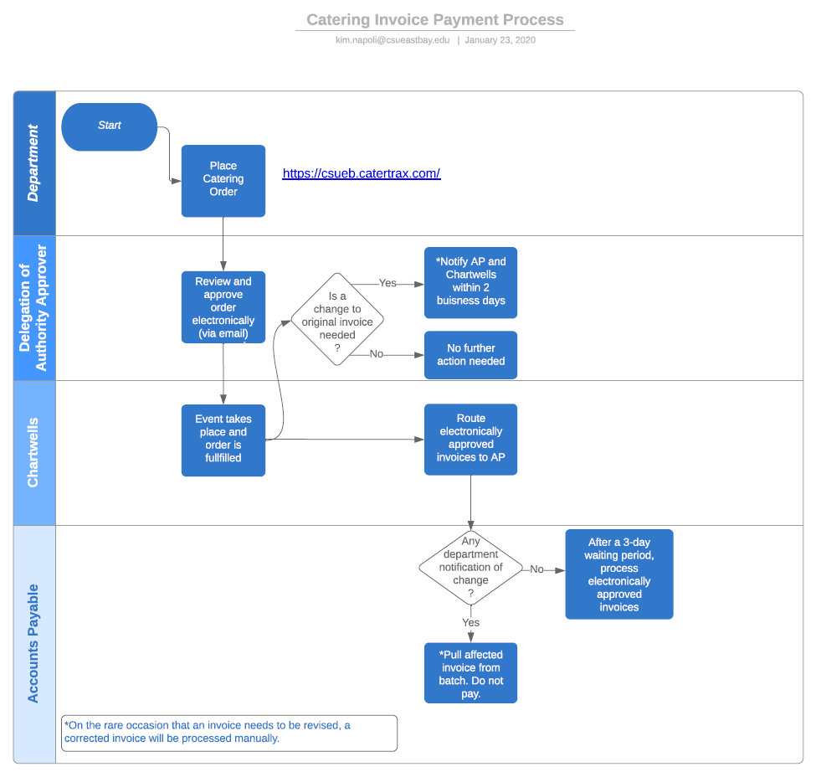

Slide 29
QUESTIONS??
Notes:
Sai

Slide 30
Y
U
FINANCE
INCLUDED
Asset Management
Process
Tom Poon & Gene Lim

Slide 31
Assets
In accordance with CSU Policy titled Administration of University Property, certain property that is used for Cal State East Bay business must be tagged, tracked and inventoried by Property and Asset Management office.
Capitalized equipment
Unit cost $5,000 or more
Non-capitalized equipment (excluding computer devices)
Unit cost $2,500 - $4,999
Easily subject to theft or loss
Computer devices, regardless of cost, are tagged, tracked and inventoried by Information Technology Solutions.

Slide 32
ITS Asset Tracking
Revision to the asset tracking process includes:
Tighter integration with device management tools for devices in the field
Revised process on device reporting and review
Extension of device “check-in” to outside the campus network
Data encryption extended to devices, most likely to whole campus at some point
eWaste process still pretty solid and unchanged at this time

Slide 33
Roles and Responsibilities
Faculty and Staff – obligation to safeguard University equipment by:
Taking reasonable security precautions to discourage loss, theft or misuse
Preventing disclosure of protected data
Reporting missing, lost, stolen or vandalized property Missing Items Report
Stolen equipment must be reported to UPD if on campus, or local authority if off-campus
Providing reasonable care, maintenance, and use of equipment to prevent damage
Returning equipment in satisfactory condition

Slide 34
Roles and Responsibilities
Departments
Ensuring that all purchased property is delivered to shipping and receiving
Notifying the Property and Asset Management office of/to:
Inter-department property transfers Property Transfer Form
Loan University equipment Property Custody Receipt
Missing asset/equipment Missing Items Report
Dispose of equipment Property Survey Report
Assisting the Property and Asset Management office in:
Annual tracking of department inventory
Physical inventory process

Slide 35
Questions
www.csueastbay.edu/riskmanagement/support-services/
Dayrll.lewis@csueastbay.edu
510-885-2120

Slide 36
Y
U
FINANCE
INCLUDED
ANNOUNCEMENT
COMING SOON!
“Virtual Terminal”
Integrated Payments
Video Overview
Aaron.Ledesma@csueastbay.edu

Slide 37
THANK YOU FOR VIEWING TODAY’S “FYI” SESSION!
Watch your email inbox for our Online Survey – please take a few moments to share your feedback on today’s session and your ideas for future sessions!
Today’s slides will be available in the Finance website under Financial Services Resource Center.

