Slide 1
Graduate Equity Fellowships California Pre-Doctoral Scholars Chancellor’s Doctoral Incentive Program
Kevin Brown, Director
Office of Graduate Studies
Kevin.Brown@csueastbay.edu

Slide 2
California State University Scholarships and Fellowships
Goal: To increase the level of diversity in the CSU faculty body
Method: Expand the pool of newly minted PhD’s from which the CSU draws its faculty by providing funding and mentorship throughout graduate career
The CSU funds three programs:
Graduate Equity Fellowships
Pre-Doctoral Scholars Program
Chancellor’s Doctoral Incentive Program

Slide 3
What is the Graduate Equity Fellowship Program?
Graduate Equity Fellowship Program:
Seeks to increase the diversity of students completing graduate degree programs at Cal State East Bay
Encourages continuation towards doctoral programs
Promotes consideration of university faculty careers
Provides fellowships for Cal State East Bay students with educationally or economically disadvantaged backgrounds who have had success in overcoming these disadvantages
GEF

Slide 4
What the Graduate Equity Fellowship Program Offers
Graduate Equity Fellowships are grants ranging from $500 up to $2000 per year.
Maximum of 2 years of support
GEF

Slide 5
Who is Eligible to Apply for a GEF?
Must be considered a resident of the State of California for fee purposes
Must have maintained a GPA of at least 2.70 in all undergraduate work
Must have maintained a GPA of at least 3.25 in any graduate work
Must be admitted to CSUEB and to a state-supported Master's program as a classified or conditionally classified student
GEF

Slide 6
Who is Eligible to Apply for a GEF?
GEF
Also:
Must have completed a Free Application for Federal Student Aid (FAFSA) or California Dream Act Application (CADAA) and have financial need of at least $1,000
Must enroll in a minimum of 8 units per semester applicable to the master's degree during the academic year of your award, with graduation planned no earlier than Spring semester of that year. This requirement will be enforced - no exceptions.
Must demonstrate the potential to succeed in graduate school and to complete a master's degree program in no more than two years, as evidenced by coursework and letters of recommendation.
Must have not received more than one previous Graduate Equity Fellowship.

Slide 7
Application Details
Components of the application:
Program Application Form
Statement of Purpose
Two Letters of Recommendation using Recommendation Form
Transcripts (graduate CSUEB or undergraduate)
GEF

Slide 8
Application – Student Section
One essay:
New applicants: your academic and personal background and educational and/or professional achievements, how this fellowship will help you achieve your career/professional goals, including a university faculty career, if applicable; and a discussion of any educational disadvantages you have overcome.
Renewal applicants: Describe your academic achievements during the first year that you received the award. How has the fellowship enhanced your current educational experience and how a renewal will help you achieve your career/professional goals?

Slide 9
Application – Faculty Section
Two letters of recommendation
One must be from a faculty member
Also complete Recommendation Form
Should waive right of access to recommendation
Provide form to letter writer

Slide 10
What are the evaluation criteria?
Potential for success in completing a master’s program (e.g., academic record, written communication skills)
Interest in and potential for a faculty career
Supportive recommendations
Level of economic and educational disadvantage

Slide 11
Application Deadline/ Information
Application Deadline: Submitted to Graduate Studies by
5:00 PM, May 1st, 2022
Application and information available at:
https://www.csueastbay.edu/graduate-studies/graduate-opportunities.html
Or email gradstudies@csueastbay

Slide 12
Timeline
Beginning of Spring semester 2022: Request letters of recommendation
March or April 2021: Write Statement of Purpose
May 1, 2022: applications due to Office of Graduate Studies
End of May, 2022: Awards are made and applicants notified
Before Fall semester 2022 and Spring semester 2023: funds are disbursed through Financial Aid department

Slide 13
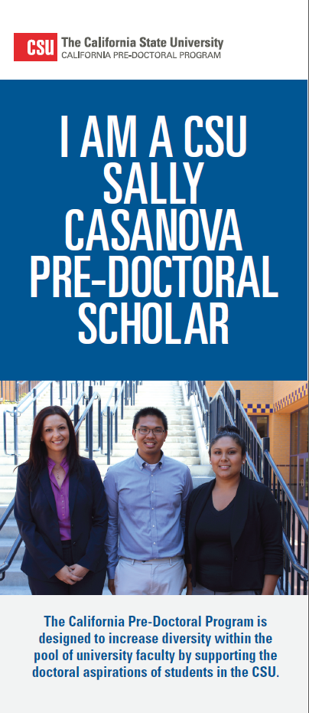
What is the California Pre-Doctoral Scholars Program?
California Pre-Doctoral Program:
This is the 32nd year!
Founded in 1989, by the CSU and UC
Funded by the CSU from the California Lottery Fund
Goal: To increase the pool of newly minted PhD’s from which the CSU draws its faculty.

Slide 14
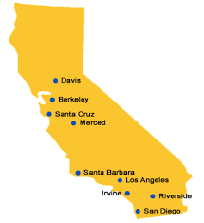
California Pre-Doctoral Scholars Program Details
Supports doctoral aspirations of students who have experienced economic and educational disadvantages
Places special emphasis on increasing number of CSU students who enter doctoral programs at UC institutions

Slide 15
What the Pre-Doctoral Program Offers
$3,000 in funding to explore and prepare to succeed in a doctoral program
Opportunities to work one-on-one with faculty from both CSU and doctoral-granting institutions
Designation as a “Sally Casanova Scholar”
Participation in a summer research experience at a doctoral-granting institution

Slide 16
What activities does Pre-Doctoral funding support?
Visits to doctoral-granting institutions to explore opportunities for doctoral study
Travel to a national symposium or professional meeting in your chosen field;
Related activities such as membership in professional organizations and journal subscriptions
Graduate school application and test fees.
Participation in a summer research experience
at a doctoral-granting institution

Slide 17
Who is Eligible to Apply for the Pre-Doctoral Program?
Must be a junior, senior or master’s student
Must be U.S. citizen or permanent resident
Must be enrolled at a CSU in Spring 2022 and be enrolled in at least one semester of the 2022-2023 academic year (Fall 2022 – Spring 2023)
Must have a faculty sponsor from CSUEB who will be available for the program period
Must be interested in obtaining a
research doctorate

Slide 18
Role of the CSUEB Faculty Advisor
Guide you through the program
May accompany you to campuses for site visits or to professional conferences and meetings
Provide you with information about academic careers, helps to identify institutions with programs that match your interests/goals
Help to ensure that you are prepared
for doctoral study

Slide 19
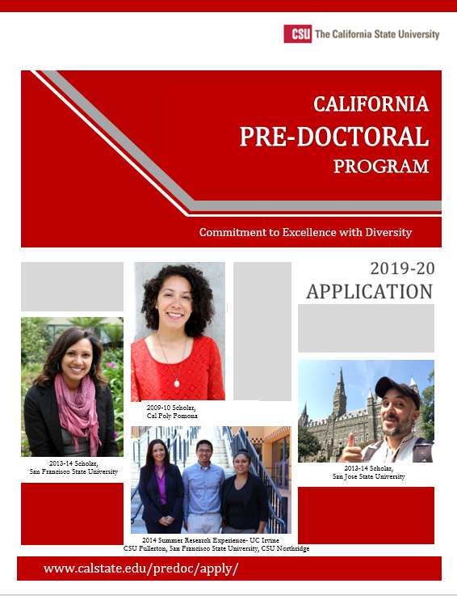
Application Details
Only applications that have been viewed and approved by the campus coordinator are eligible for submission
Components of the application include:
Personal Information
Educational Information
Three Essays
Faculty Mentor Letter of Recommendation
Student Budget Plan
Transcripts

Slide 20
Application – Student Section
Three essays:
Field of study you plan to pursue – preparation for this field
Information about your research interests
Career goals, and interest in and preparation for a university faculty career

Slide 21
Application – Faculty Section
Faculty Sponsor/Student Plan
Activities, timeline and budget
Faculty Statement – how does plan address applicant’s educational needs and objectives
Faculty statement of student responsibilities in the Pre-doc program

Slide 22
What are the evaluation criteria?
Potential for success in completing a doctoral program (e.g., academic record, academic experience, written communication skills)
Interest in and potential for a faculty career
Willingness and ability to teach a diverse student body
Faculty sponsor willingness to provide mentoring
Realistic and appropriate plan, budget and timeline
Level of economic and educational disadvantage

Slide 23
Application Deadline/ Information
Application Deadline: Submitted to Graduate Studies by
5:00 PM, February 1st, 2022
Applications reviewed and students given URL for online submission – upload deadline is 5:00 PM, February 18th, 2022
Application and information available at:
https://www.csueastbay.edu/graduate-studies/graduate-opportunities.html
and on the CSU Pre-Doctoral Program website
Appointments available!
email gradstudies@csueastbay

Slide 24
Timeline
Now: Secure faculty sponsor, write essays
Early December 2021: Application period opens
December or January: Interested students must meet with campus coordinator
February 1, 2022: applications due to Office of Graduate Studies
February 18, 2022: Applications due via the online site
March/April 2022: Applications are reviewed and scored
May 2022: Eligibility of potential scholars are verified
June 2022: Applicants who are selected as Sally Casanova Scholars and Honorable Mentions are identified

Slide 25
What is the Chancellor’s Doctoral Incentive Program (CDIP)?
Goal: Increase the number of faculty with the qualifications, motivation, and skills needed to teach the diverse students of the CSU.
CDIP prepares promising doctoral students for CSU faculty positions by providing financial support, mentorship by CSU faculty and professional development and grant resources.

Slide 26
Chancellor’s Doctoral Incentive Program Details
Provides student loans to individuals pursuing full-time research doctoral degrees at accredited universities throughout the United States.
CSU faculty member provides mentorship, e.g., suggested conferences, projects, strategy to gain employment at CSU.
Awardees may apply for mini-grants to
support research, or travel grants to
support conference presentations.

Slide 27
CDIP Program Description
Offers loans up to $10,000 per year over 5 years, with a maximum amount of $30,000.
Forgivable at the rate of 20 percent for each year of full-time teaching employment in the CSU or 10 percent for each year of part-time teaching employment in the CSU.
For recipients not teaching in the CSU, loans are repayable over a 15-year period starting one year after completion of, or withdrawal from,
full-time doctoral study.

Slide 28
CDIP Participant Eligibility
New or continuing full-time students who will be in research doctoral programs in AY 2022-2023 at accredited universities anywhere in the United States are invited to apply to CDIP.
Lecturers who are enrolled full-time in a doctoral program are eligible and encouraged to apply.
U.S. citizenship is not required, but applicants
must be eligible to work in the United States.

Slide 29
CSUEB Faculty Mentor
Applicants to the CDIP must be supported by a full-time tenured or tenure track CSU Faculty Mentor.
The mentor must prepare a written statement with the student.
The faculty mentor assists the student in his/her doctoral program and helps the student understand the workings of higher education institutions and the
faculty labor market specific to particular
disciplines.

Slide 30
Application
Applications are available online only
Applications are submitted directly to the Chancellor’s Office, with a copy to CSUEB
For the purposes of the CDIP application, “your campus” is the one where your CSU
Faculty Mentor is employed (CSUEB).

Slide 31
Application Checklist
Submit the following documents:
A current curriculum vitae, limited to four pages
Statement of qualifications and motivation, limited to three pages CSU Collaborative Plan of Support, developed by CSUEB faculty advisor, and applicant
Three professional letters of recommendation, one of which is from your CSUEB faculty mentor
A recent CSU faculty position announcement in your
general field that has recently been posted at a
CSU campus
Application information and sample statements and faculty
support plans are available on the CSU CDIP website

Slide 32
Application Timeline
Now: Secure faculty sponsor, write statement, develop plan, request letters of recommendation
December or January: Interested students must meet with campus coordinator
Application Deadline: All documents submitted to Chancellor’s Office by 5:00 PM, February 1st, 2022
Campus committee reviews and forwards
to CSUEB president.
CSU-wide committee reviews and makes
awards

Slide 33
Good Luck with the Process!
Please email:
gradstudies@csueastbay.edu
Questions?

