Slide 1
Financial Aid
CSUEB Graduate School Fair 2021

Slide 2
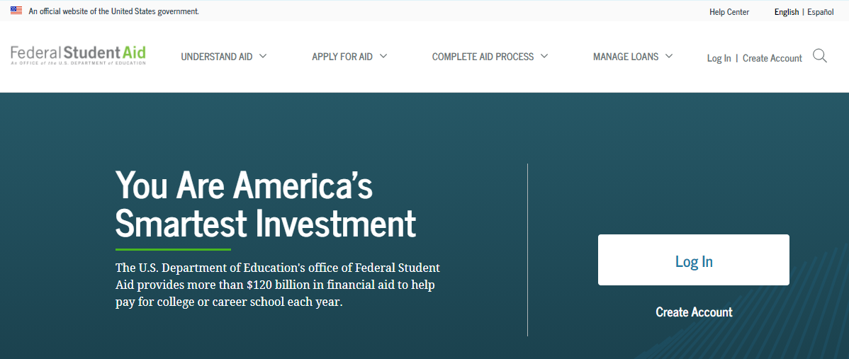
File FAFSA or CA Dream App March 2nd priority deadline
US Citizen or Permanent Resident
Not Permanent Resident But Have AB540 Status
www.fafsa.gov
https://studentaid.gov
state aid only
https://www.csac.ca.gov/how-apply
Applications calculate EFC (Expected Family Contribution), which determines eligibility for grants and certain loans

Slide 3
2021 – 2022
2021 -22 aid year is:
Fall 2021 to Spring 2022
plus Summer Term 2022
Next aid year is 2022-23:
Fall 2022 to Spring 2023
plus Summer Term 2023
Fall 21 Admit
Spring 22 Admit

Slide 4
FAFSA Dictates Income Year provide what is asked for
Applications use income from prior-prior calendar year to determine Expected Family Contribution (EFC = index we use to determine your aid eligibility)
FAFSA 2021-22 (began Fall 2021) requires 2019 income
FAFSA 2022-23 (begins Fall 2022) requires 2020 income
answer questions based on correct calendar year

Slide 5
Basic Steps read Horizon email, MYCSUEB msgs, emails at your FAFSA account
Use the FAFSA IRS Data Retrieval Tool (if eligible) to simplify process
Check FAFSA application for errors when submitting or changing info
Check your MyCSUEB > To Do List
An item (21/22 Fin Aid Verification) will appear when you are selected for a process called verification.
Complete “To Do List” ASAP

Slide 6
Graduate Loan Options not enough for living expenses
Federal Direct Unsubsidized Loan (no subsidized loans)
Maximum of $20,500 per year ($12,500 for prerequisite coursework)
Current 2021-22 interest rate 4.30% Loan fee 1.057% (thru 10/21)
Federal Graduate Plus Loan option (credit-based, no adverse credit history)
Current 2021-22 interest rate 5.30% Loan fee 4.228% (thru 10/21
See federal interest rates at: https://studentaid.gov/understand-aid/types/loans/interest-rates

Slide 7
2021-2022 Financial Aid Year
Fall 2021, Spring 2022, Summer 2022 (academic year)
We will offer maximum student loan eligibility under Fall - Spring: Annual Loan Limit $20,500
Log into National Student Loan Database System
https://nslds.ed.gov
to check your aggregates (borrowing history)
Other Resources:
Graduate PLUS Loan (if meets credit criteria)
Credit-based private educational loan (alternative loan)

Slide 8
Standard Award Pattern
State University Grant (SUG) Eligible + Student Loan
Student Loan only
Fall 2021
$3,588 SUG
$10,250 Unsub Loan
Graduate PLUS Loan (up to Cost of Attendance)
Spring 2022
$3,588 SUG
$10,250 Unsub Loan
Graduate PLUS Loan (up to Cost of Attendance)
Self-Support Summer 22
$0 SUG
$? Loan
Graduate PLUS Loan (up to Cost of Attendance)
Fall 2021
$10,250 Unsub Loan
Graduate PLUS Loan (up to Cost of Attendance)
Spring 2022
$10,250 Unsub Loan
Graduate PLUS Loan (up to Cost of Attendance)
Self-Support Summer 22
$? Loan
Graduate PLUS Loan
(up to Cost of Attendance)

Slide 9
Cost of Attendance (COA)
Ex. Off-Campus, COA $30,814 / Year
Ex. Living with Parent, COA $24,370 / year
Fall 2021 (COA 15,407)
$3,588 SUG
$10,250 Unsub Loan
Graduate PLUS Loan (up to COA)
Spring 2022
$3,588 SUG
$10,250 Unsub Loan
Graduate PLUS Loan (up to COA)
Self-Support Summer 22
$0 SUG
$0Loan
Graduate PLUS Loan
(up to COA)
Fall 2021 (COA 12185)
$ 8,000 Unsub Loan
Spring 2022 (COA 12185)
$8,000 Unsub Loan
Self-Support Summer 22
$ 4,500 Loan
Graduate PLUS Loan = $3500 or
up to Summer COA

Slide 10
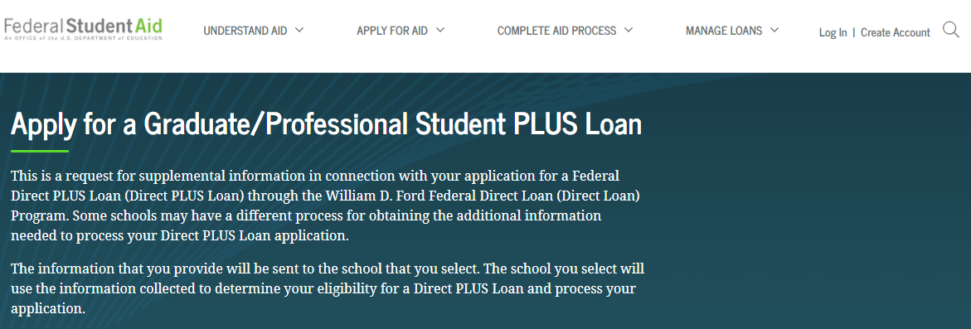
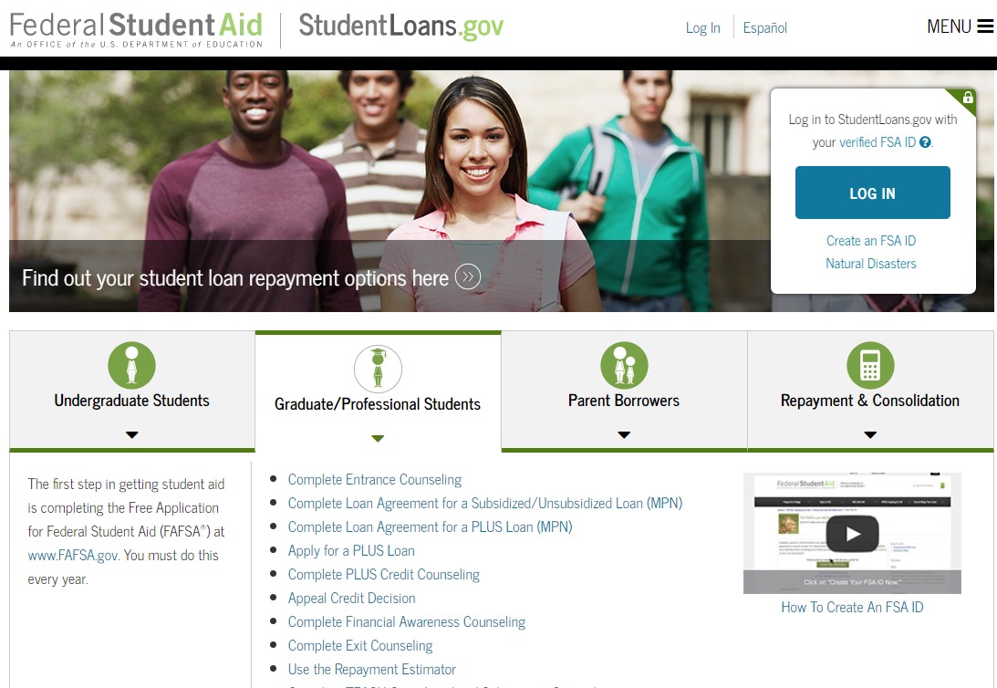
Graduate Plus Loan
https://studentaid.gov/plus-app/grad/landing

Slide 11
Two Program Categories different fee structures
State-support programs (6.1 or more units = $4,214.5)
Pay fees under the CSU system-wide model: state tuition fee ($3,588)+ CSUEB campus fees ($626.5)
Additional $396/unit for nonresidents
Self-support
Pay per-unit or per-semester/term fees for the specific program
All fees listed subject to change

Slide 12
State-Support MBA Program
Two fee tiers:
Full Time fees (6.1 or more units)
$4,214.5/semester for upper-tier state tuition fee $3,588 campus fees $626.5
Prof Prg Fee $270 for each unit taken during the semester
Part Time fees (1 to 6 units)
$2,708.5/semester (1 to 6 units)
state tuition fee $2,082 campus fees $ 626.5
Prof Prg Fee $270 for each unit taken during the semester
State University Grant (if eligible) pays state tuition fee
Must have 6 units to collect $2,082
Must have 7 units to collect $3,588
CA resident, EFC≤5,500, must submit FAFSA before March 2

Slide 13
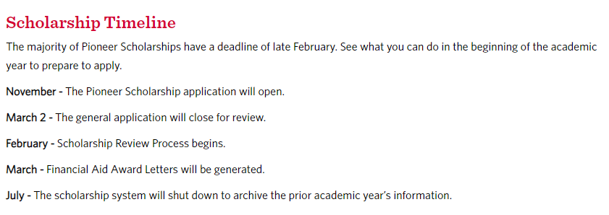
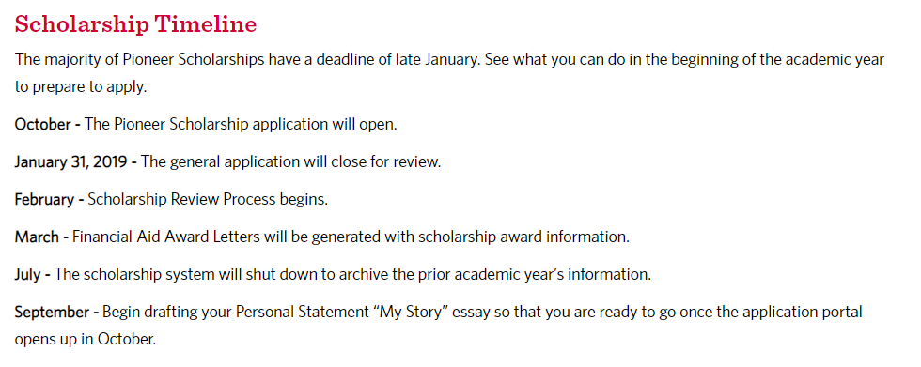
Pioneer Scholarships http://www.csueastbay.edu/financialaid/scholarships/
2020-21 Pioneer Scholarship Application November 1 - March 2

Slide 14
Beware of Loan Lifetime Limits
Graduate/Professional Students
Subsidized + Unsubsidized Loan
Lifetime Limit = $138,500
Log into (NSLDS) National Student Loan Database System to check your aggregates (borrowing history)
(https://studentaid.gov using FSA ID)

Slide 15
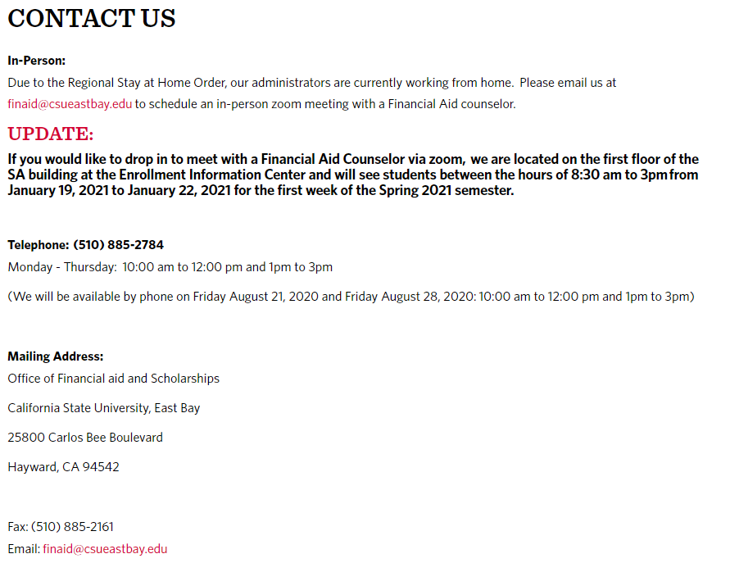
Questions?

