Slide 1


Office of Admissions
Karina Ramirez & Leslie Chavarin
Graduate Admissions
California State University, East Bay
Gradadmission@csueastbay.edu

Slide 2

Agenda
University Admission Requirements vs. Departmental Requirements
When to Apply
How to Apply - Cal State Apply (CSA)
Departmental Applications vs. 4th quadrant
Next Steps

Slide 3
University Admissions Requirements
Have completed a four-year college course of study and hold an acceptable baccalaureate degree from an institution accredited by a regional accrediting association or shall have completed equivalent academic preparation as determined by appropriate campus authorities.
Be in good academic standing at the last college or university attended.
Have attained a cumulative grade point average of at least 2.5 in an acceptable earned baccalaureate degree, or a grade point average of at least 2.5 in the last 60 semester units (90 quarter units) attempted, or hold an acceptable post-baccalaureate degree earned at a regionally accredited institution.
Notes:
Applying to Graduate School is a two step process.
First you must apply and meet the Universities Admission requirements
Graduate applicants must hold an acceptable baccalaureate degree, be in good academic standing at the last college or university attended, and meet the CSU’s minimum GPA requirement.
Please note:The Admissions Office does not require letters of recommendation, or test scores. However academic departments can require them.

Slide 4
Departmental Admissions Requirements
Individual graduate departments may have additional admission standards and/or deadlines for their programs. Contact your academic department for more information.
Please visit the Colleges and Departments of your Graduate Program and/or contact the Program Coordinator.
https://www.csueastbay.edu/graduate-studies/graduate-program-directory.html
Notes:
Departmental Admission Requirements
Academic departments have their own set of requirements.
Not all departments require the same documentation so it is important to contact them ahead of time and find out what is required.

Slide 5
When to Apply
Spring Admission
July 1 – November 1
Fall Admission
Preview August 1
Submit October 1 – June 1
Summer Admission
December 1 – March 15
Please visit our Application and Document Deadlines page for the most up to date information.
*Reminder, some programs will have earlier application cycles and departmental deadlines. Please reach out to the individual academic department for details.

Slide 6

How to Apply
What You Need On Hand:
A list of all the institutions attended prior to and after your B.A. or B.S. degree with dates of attendance
Social Security number, if you have one.
Your citizenship status
A method of payment You can pay the application fee by credit card.
  Note: there are no application fee waivers for graduate students
Annual income: Your parents’ if you are a dependent; your income if you are independent

Slide 7

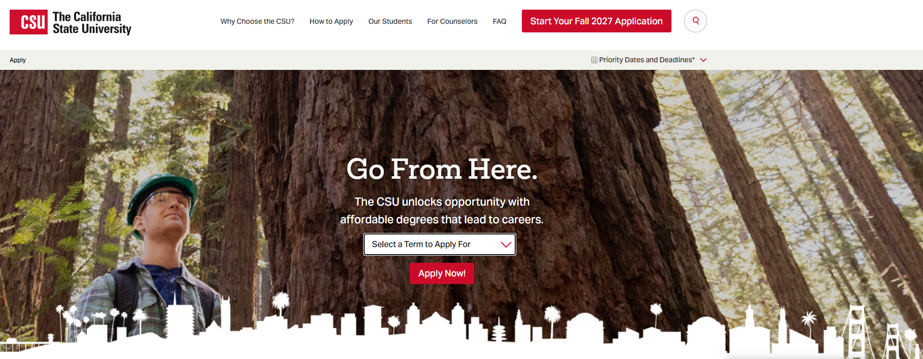
Cal State Apply
www.calstate.edu/apply
www.calstate.edu/apply
Notes:
On the main CSA page, you can select the term you are applying for
Please note: This is the only page where you can switch the term

Slide 8
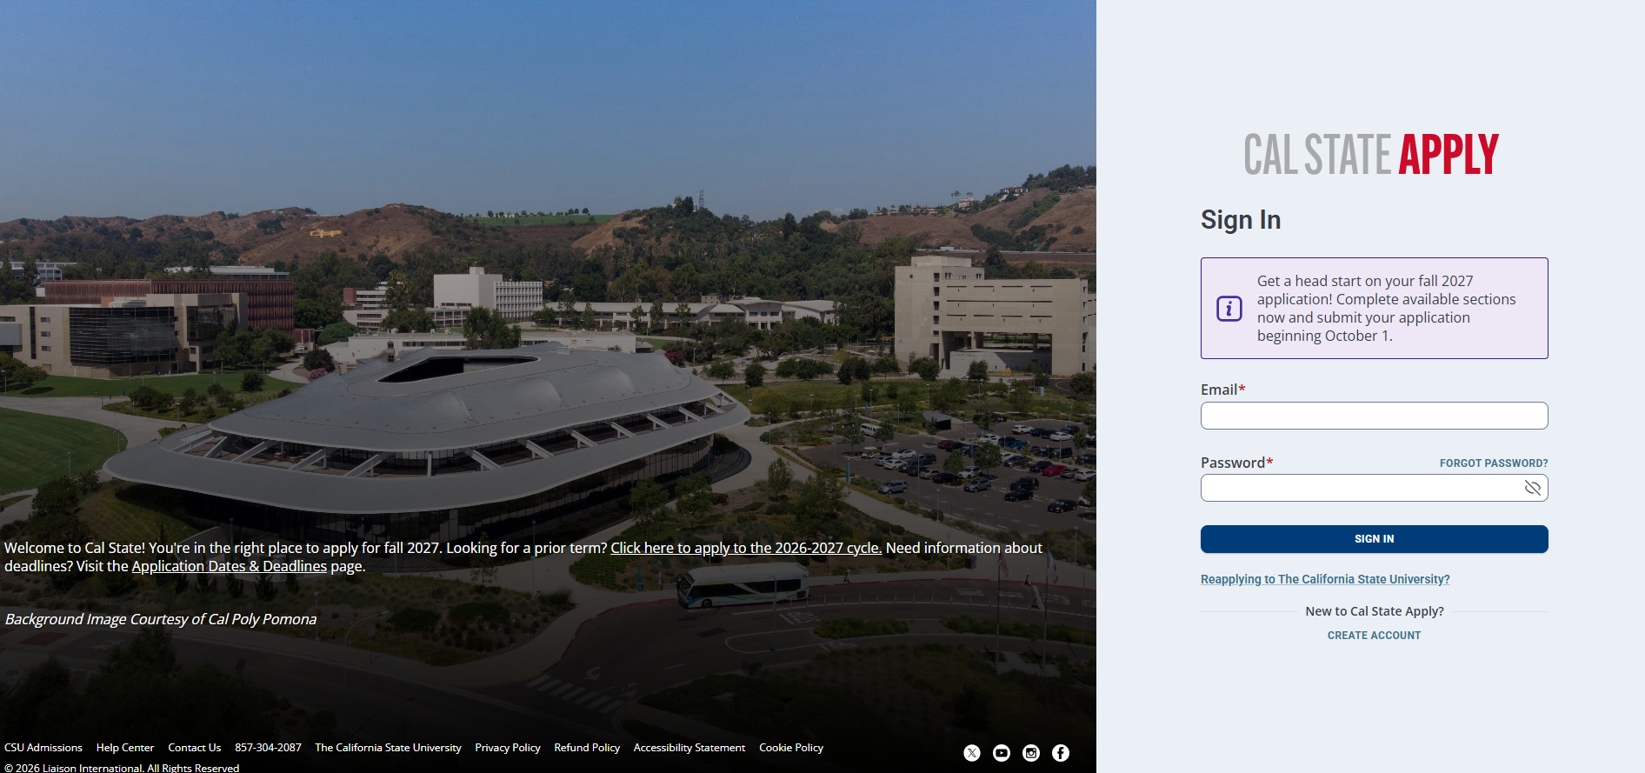
Log In
Notes:
If you have used CSA before, you can use the same login credentials. Otherwise, you will need to create an account.
This is what it will look like when you sign in with previous credentials

Slide 9

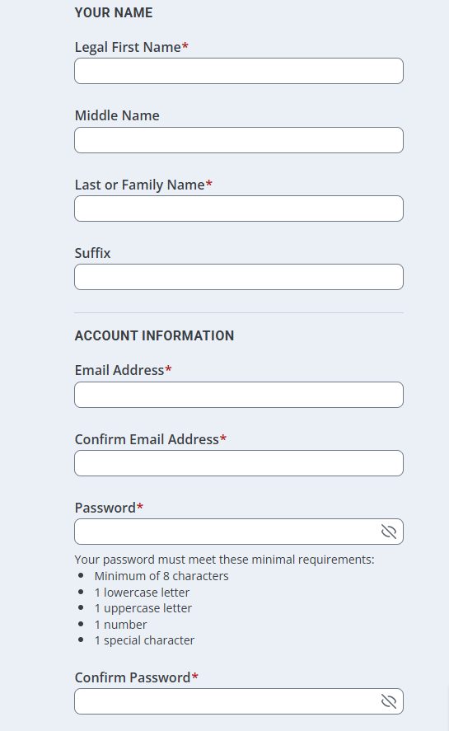
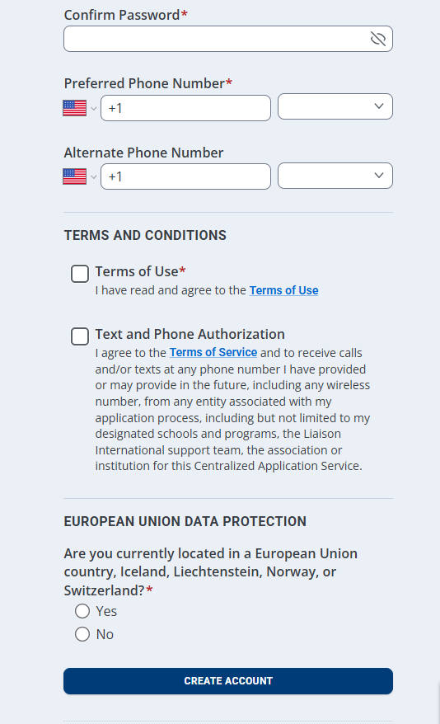
Creating an Account
Notes:
This is what it will look like when creating an account.
Fill in all areas that have an asterisk

Slide 10

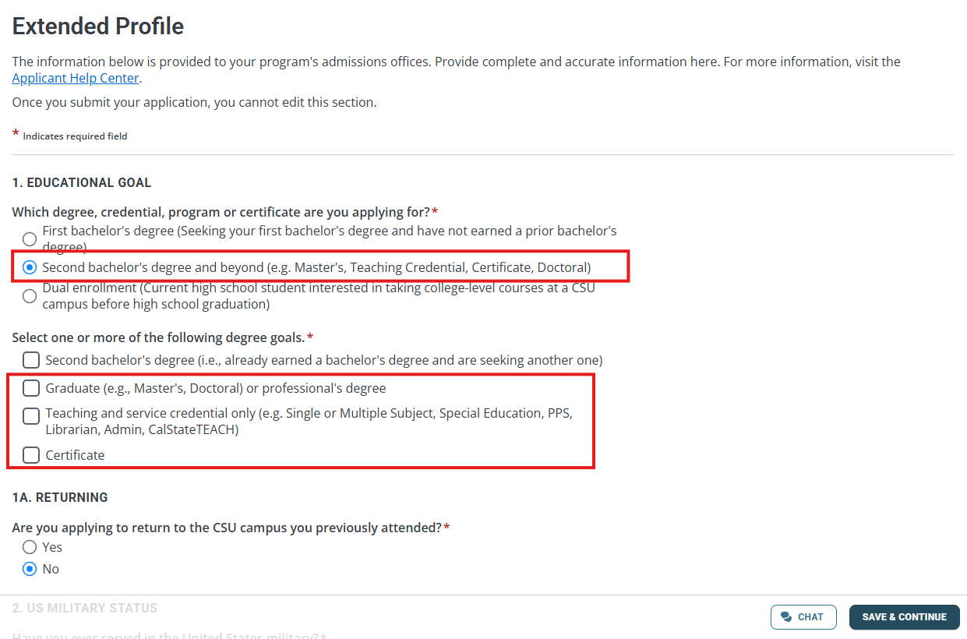
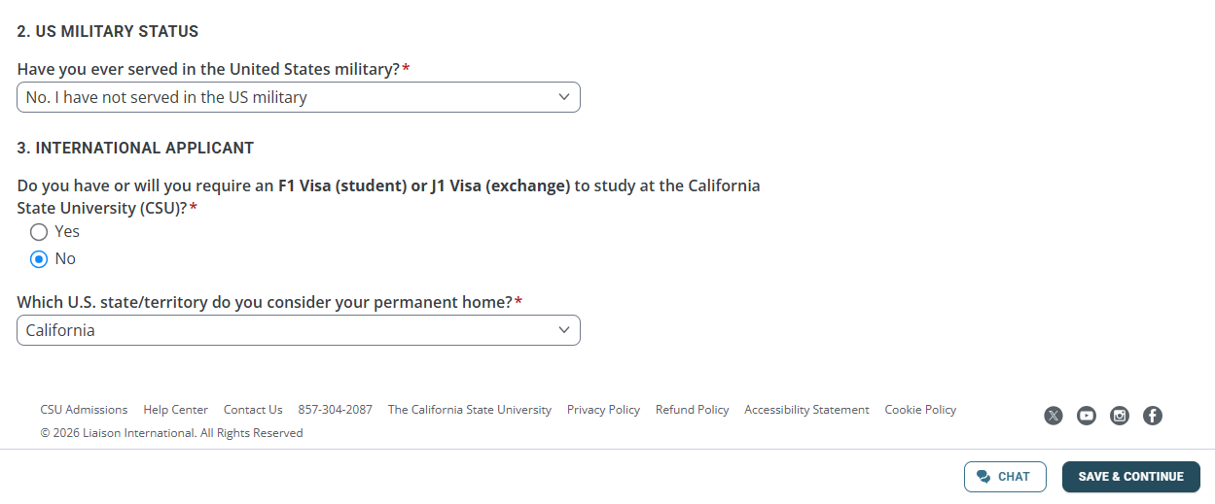
Extended Profile Set Up
Notes:
What you select will determine which programs you will be able to see
For question 1A - You should only answer yes to “Returning” if you are COMING BACK TO FINISH a masters degree that you started at CSUEB.

Slide 11
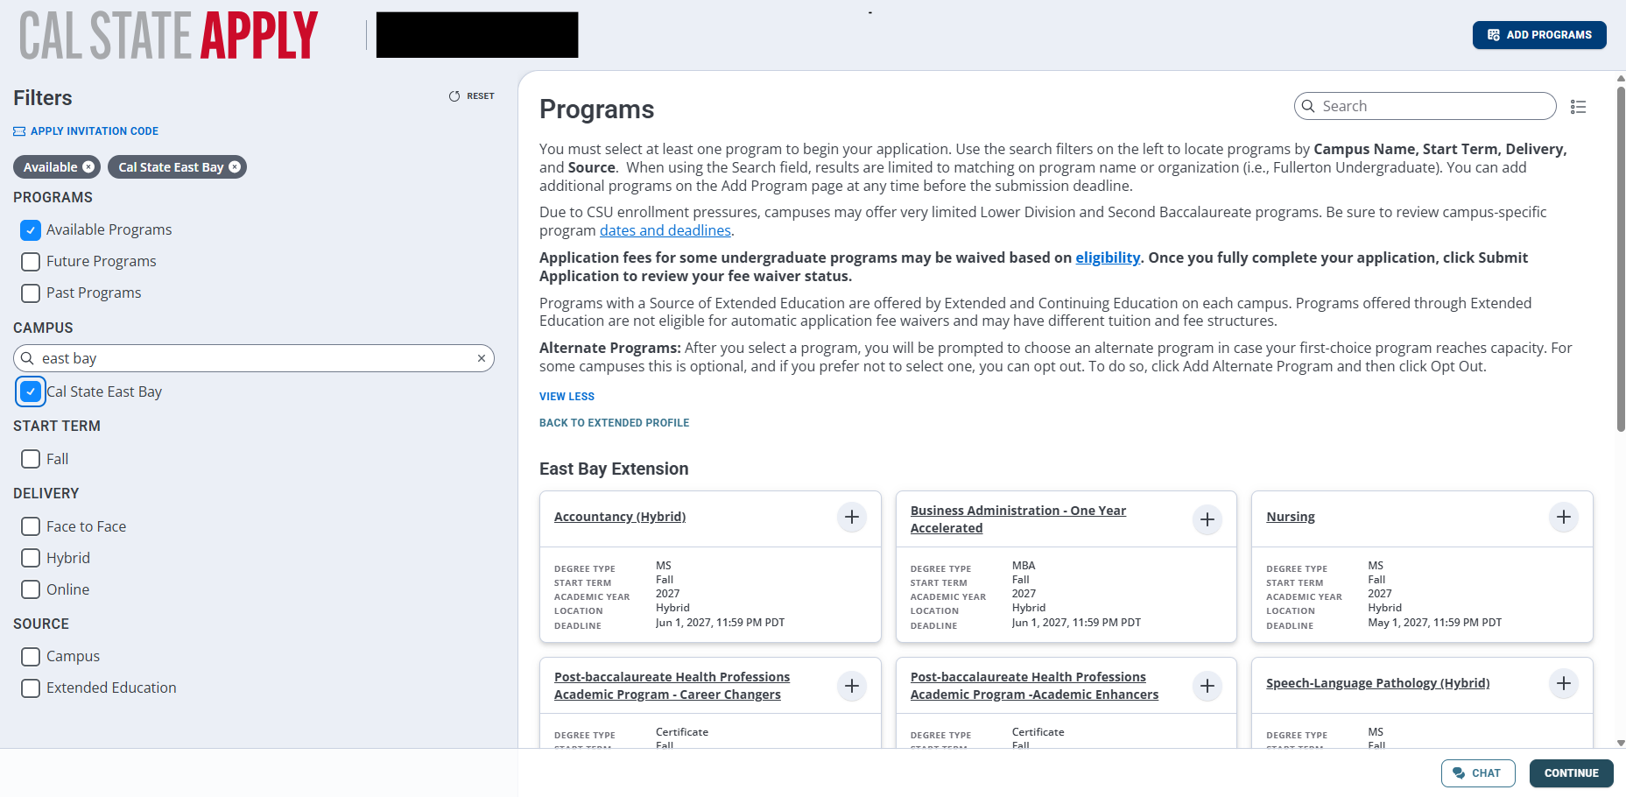
Selecting Major
Filter
Click to add
Click to continue
Notes:
You can only apply to one graduate program at a time, but you can apply to multiple CSU’s.
There is a filter option that can be used to find your campus or modality of choice.

Slide 12
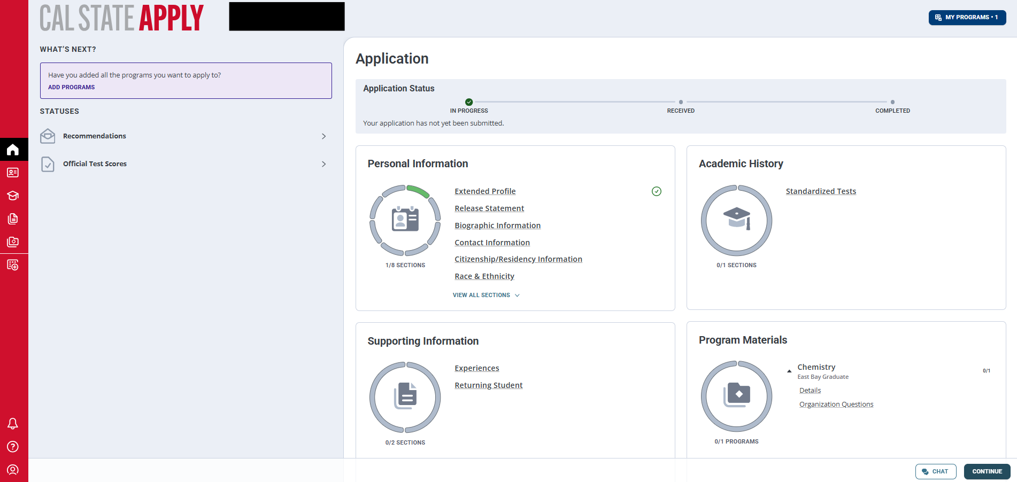
Quadrants
Notes:
Once you select your desired program you will see the 4 quadrants.
All quadrants need to be completely filled out.

Slide 13
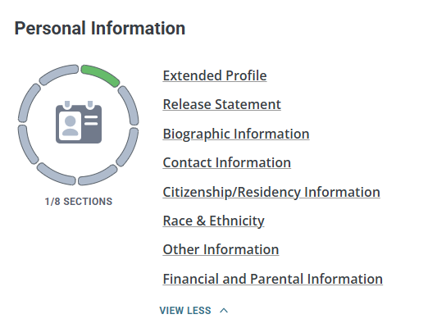
Quadrant 1 - Personal Information
Notes:
The first quadrant is the “personal information” section that requires basic personal information from the applicant about themselves.

Slide 14

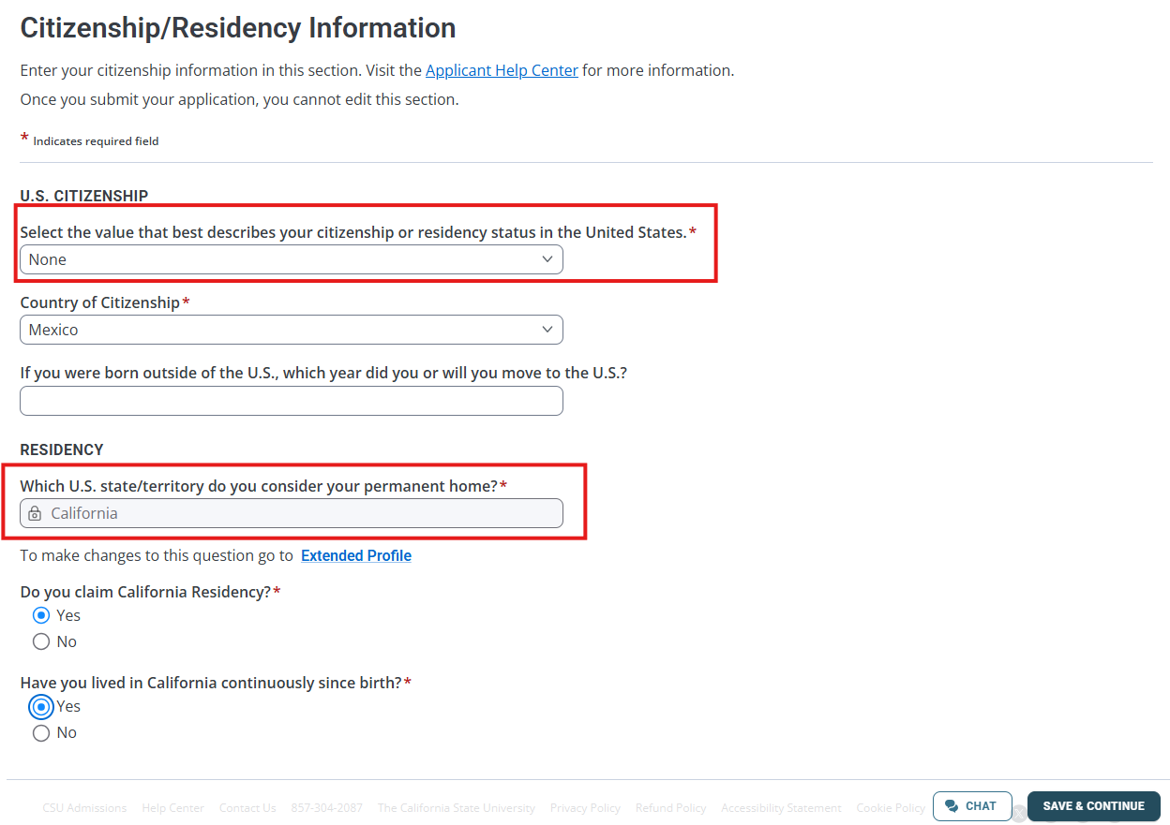
AB540
AB540 Applicants should select None
Applicants that reside in CA should select CA regardless of US Citizenship status
Notes:
For AB540 applicants - Please note: you should select none on the very first question that asks for the description of your status.
As for the residency question, applicants who reside in CA, regardless of their status should select California.

Slide 15
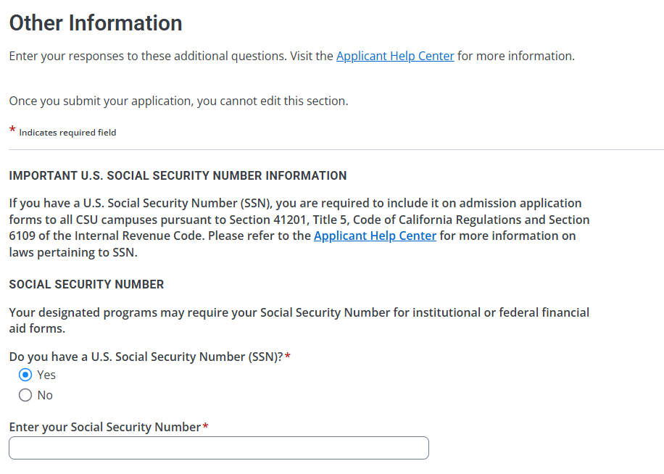
SSN
Recommend entering a SSN
Notes:
If you DO have a SSN, enter it on this screen before proceeding.
If you don’t enter your SSN number it may lead into financial aid issues.

Slide 16

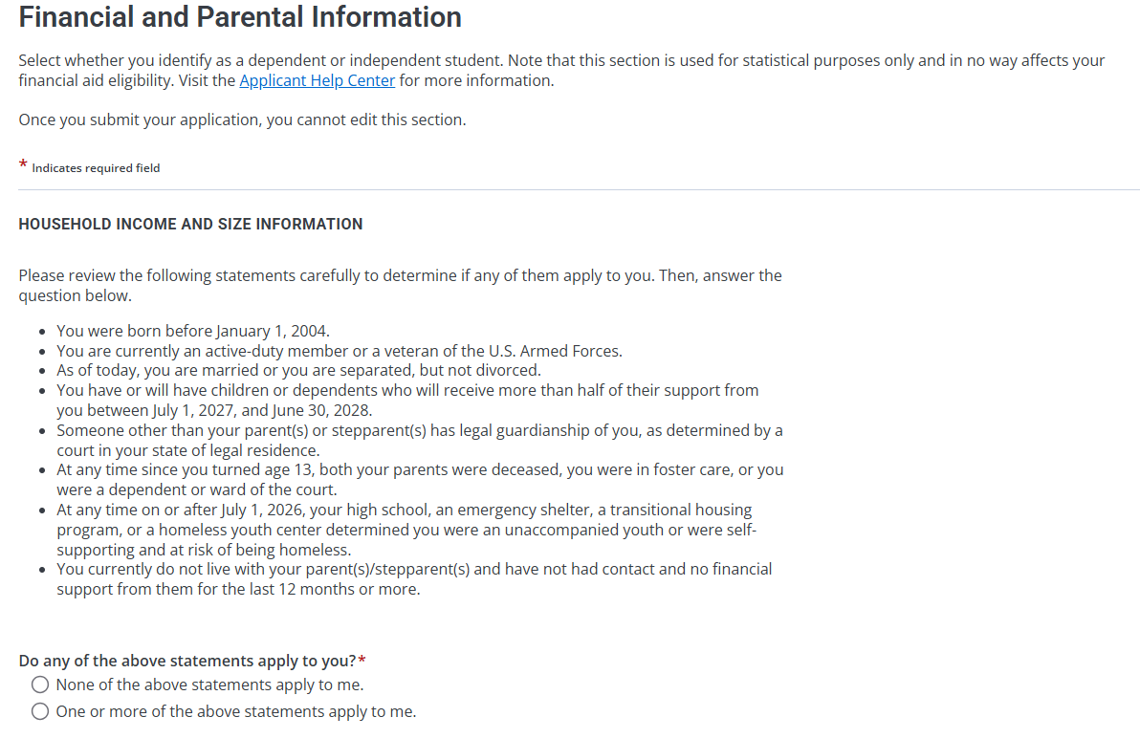
Independance
Notes:
If you are unsure if you should be classified as dependant or independent, this screen has a detailed description that will help you make the decision.

Slide 17
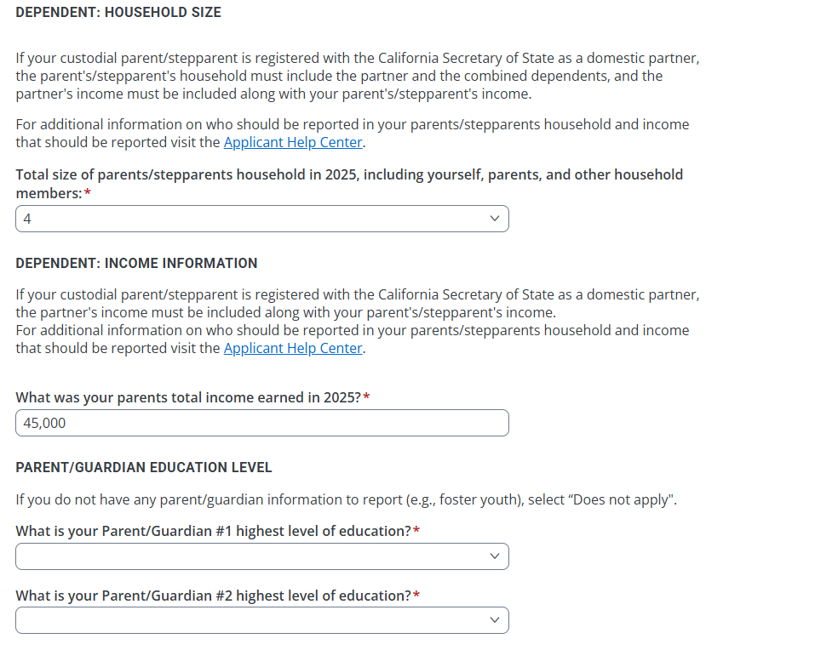
Financials
Notes:
For dependents, fill in household size, income information and education level for parent/guardian
For independent, fill in household size, dependent children, income information, and parent/guardian education level

Slide 18
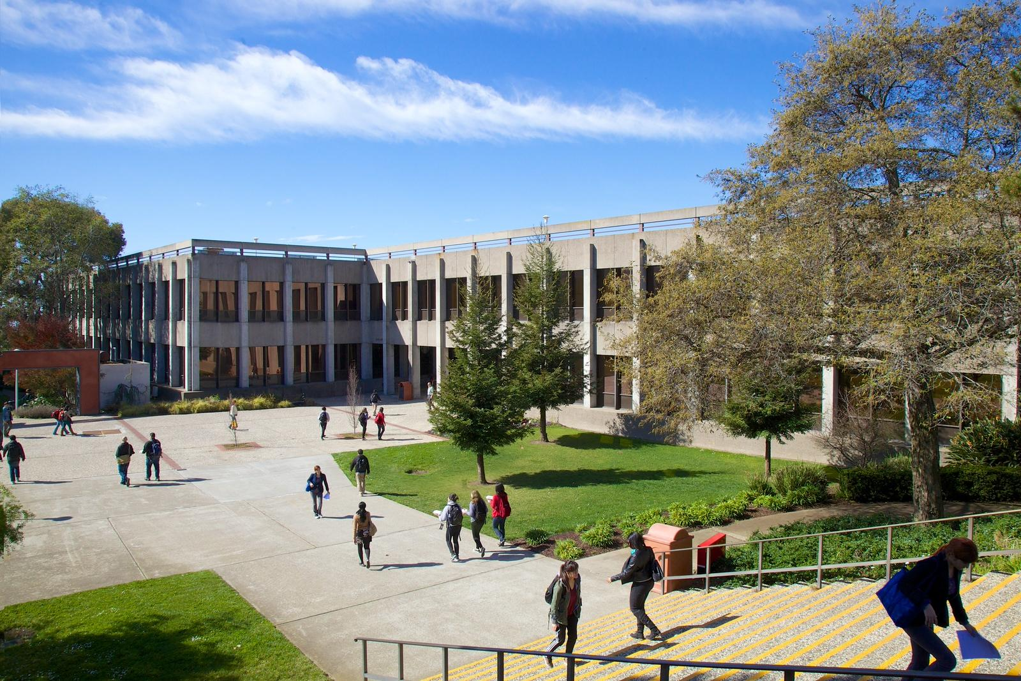
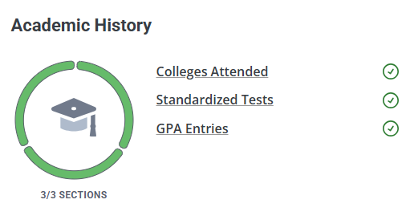
Quadrant 2 - Academic History
Notes:
Second quadrant.
This is where you will need to list all your colleges attended before and after your bachelors degree.

Slide 19

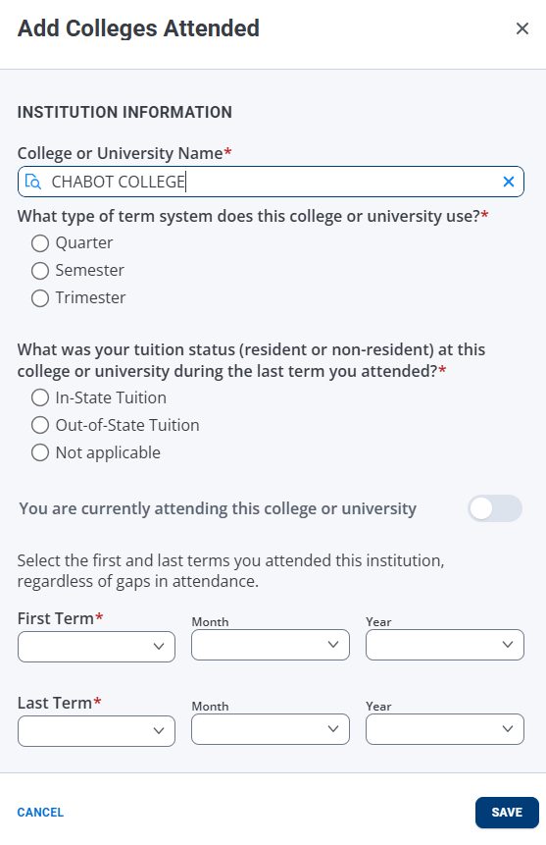
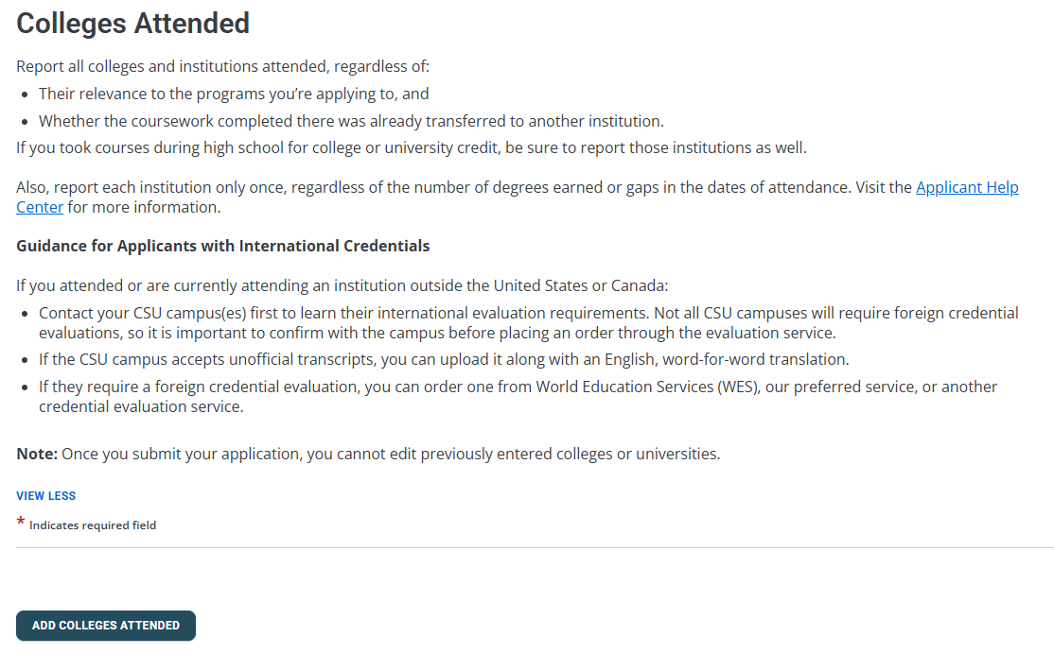
Notes:
Entering colleges is simple, add, and search for the school.
Once the college has been added, you’ll be prompted to add your GPA for each school.

Slide 20

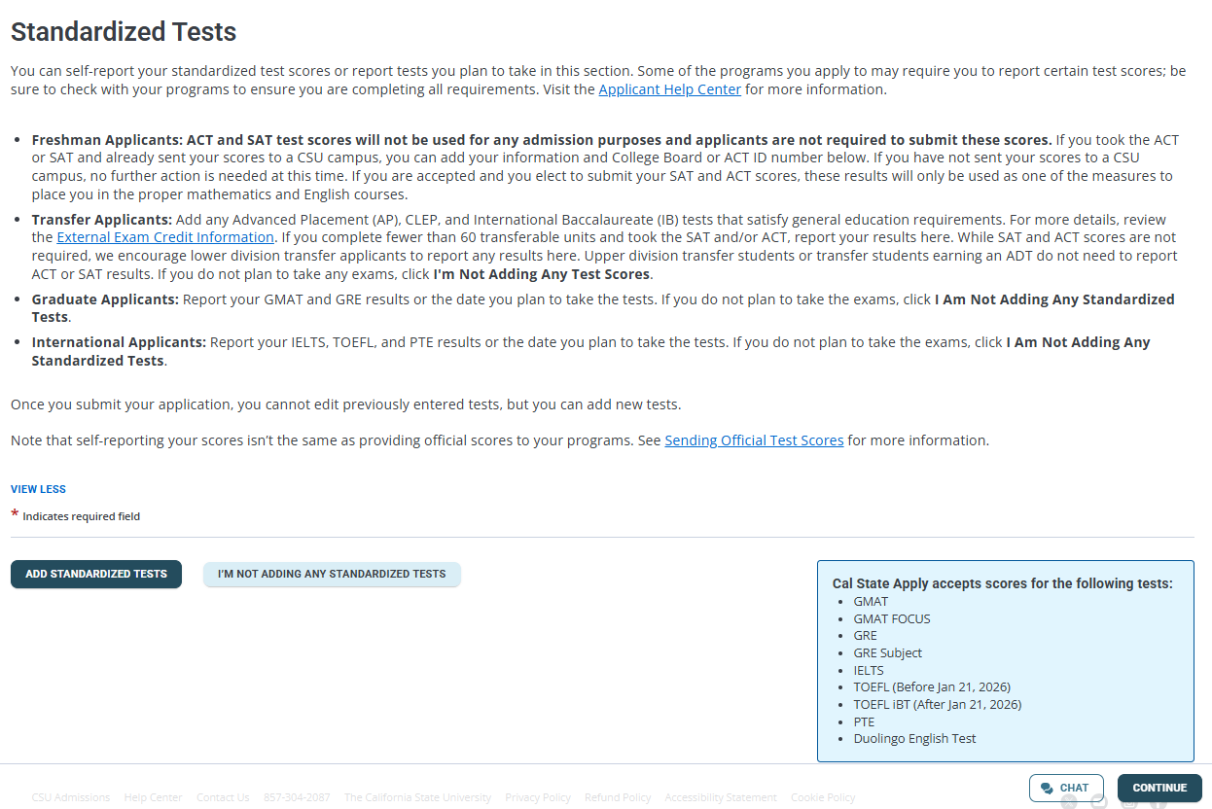
The following test scores are accepted
Notes:
The next section of this quadrant asks for you to enter unofficial test scores.
If you do not have any to report, you can click the “I am not adding any standardized tests” button and it will bypass this section for you.
However if your department requires scores, it is important that you list them.

Slide 21
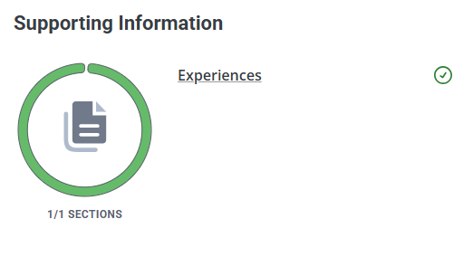
Quadrant 3 - Supporting Information
Notes:
Now we are entering the third quadrant where you can list your experience.

Slide 22
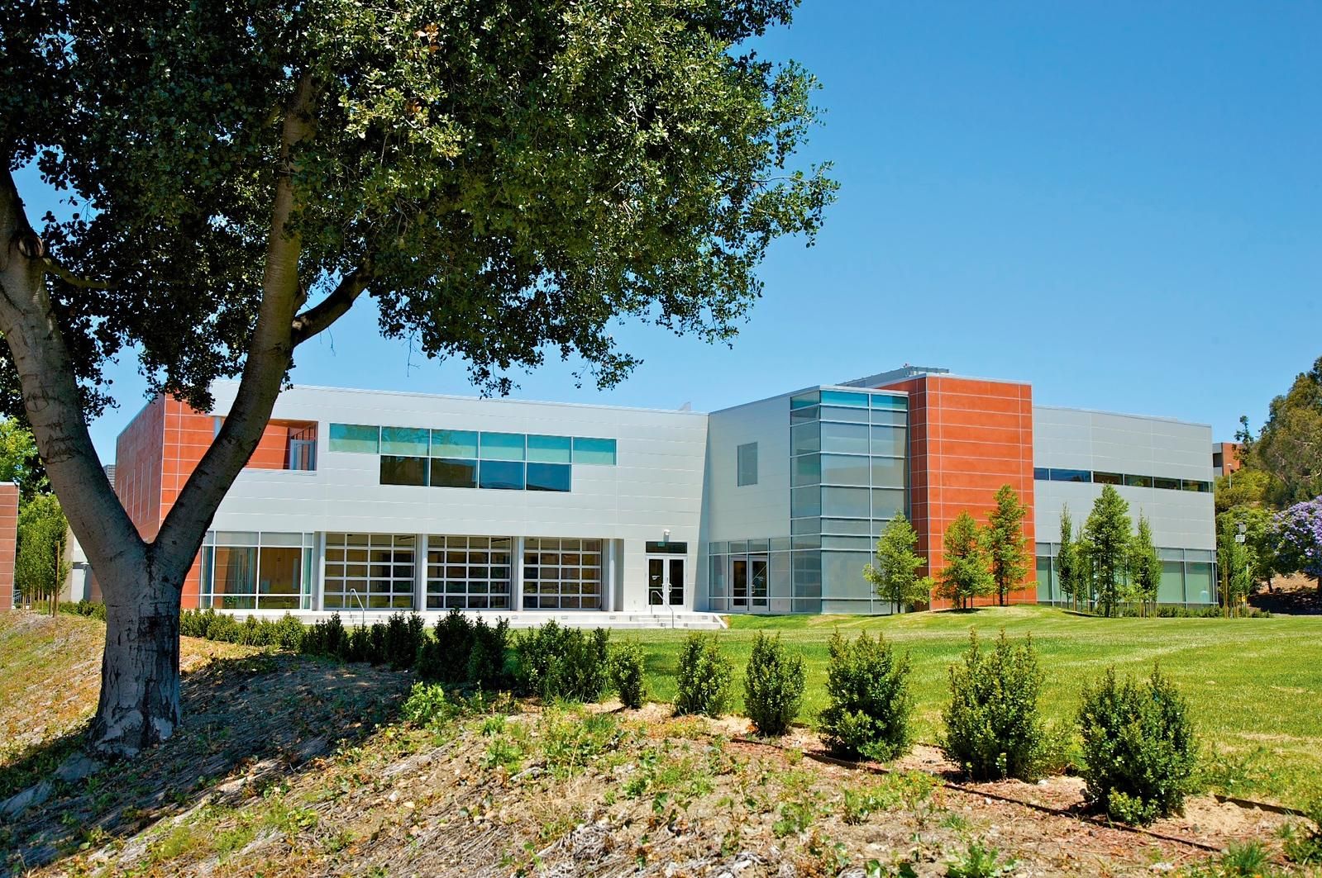
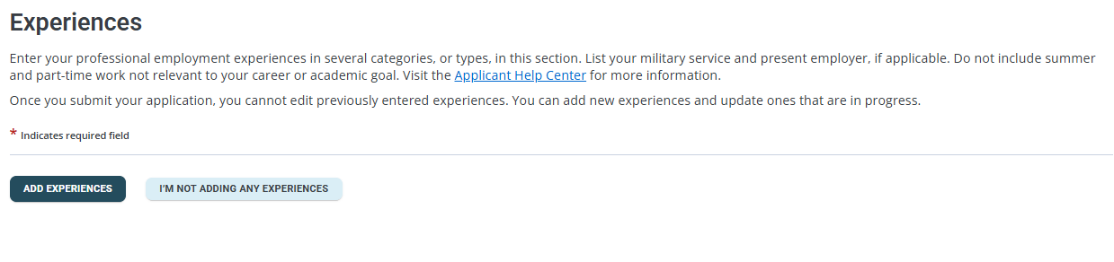
Quadrant 3 - Supporting Information
Notes:
The third quadrant is the supporting information quadrant.
This is the section where you will have the opportunity to list your work, internship, or volunteer experience.

Slide 23
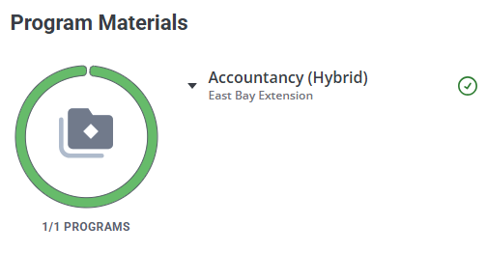
Quadrant 4 - Program Materials
Notes:
The fourth quadrant is the program materials.

Slide 24
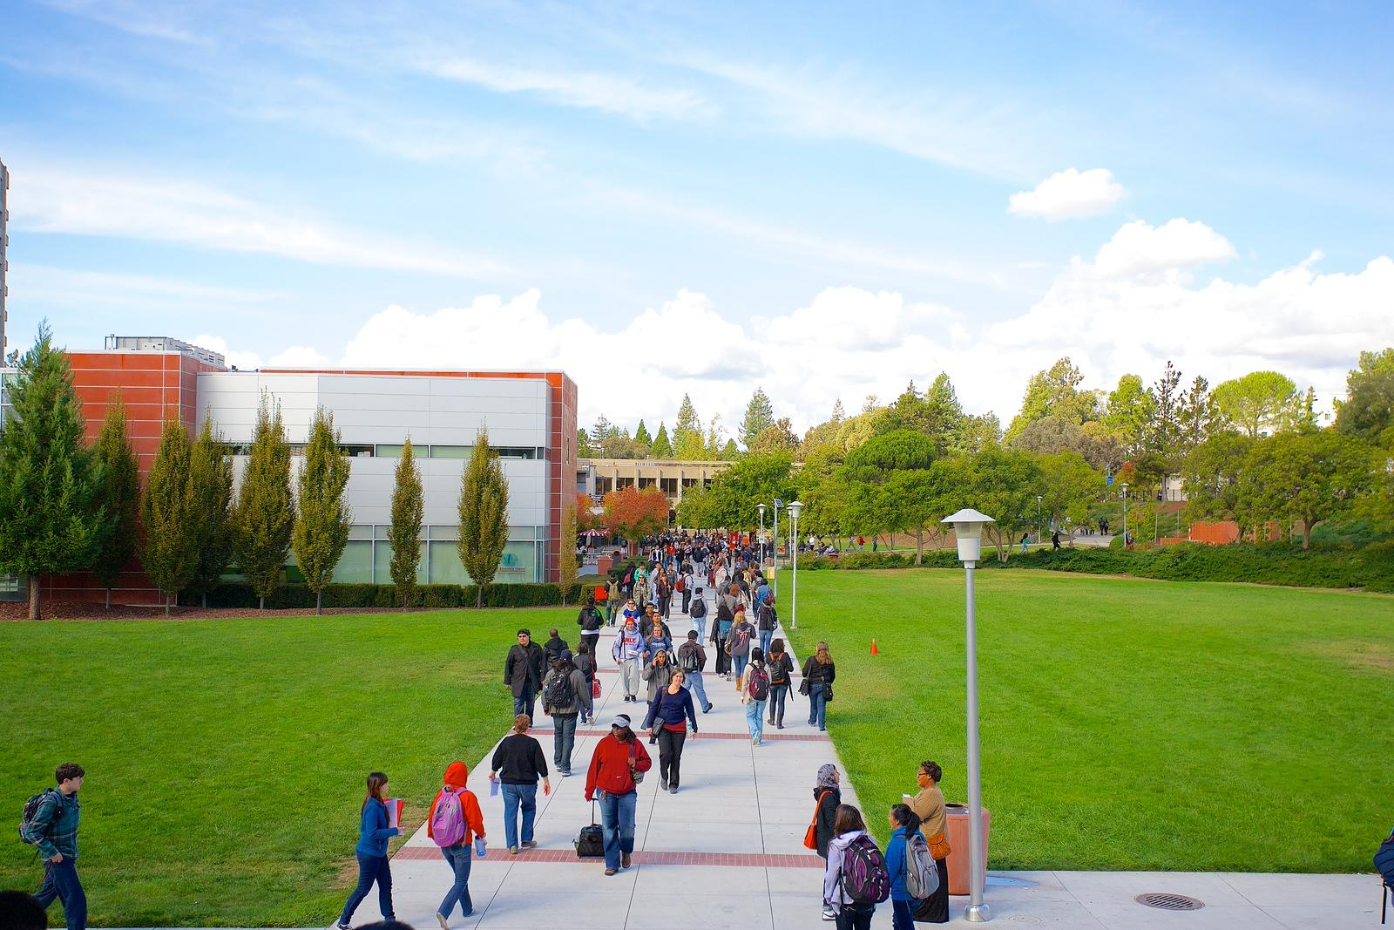
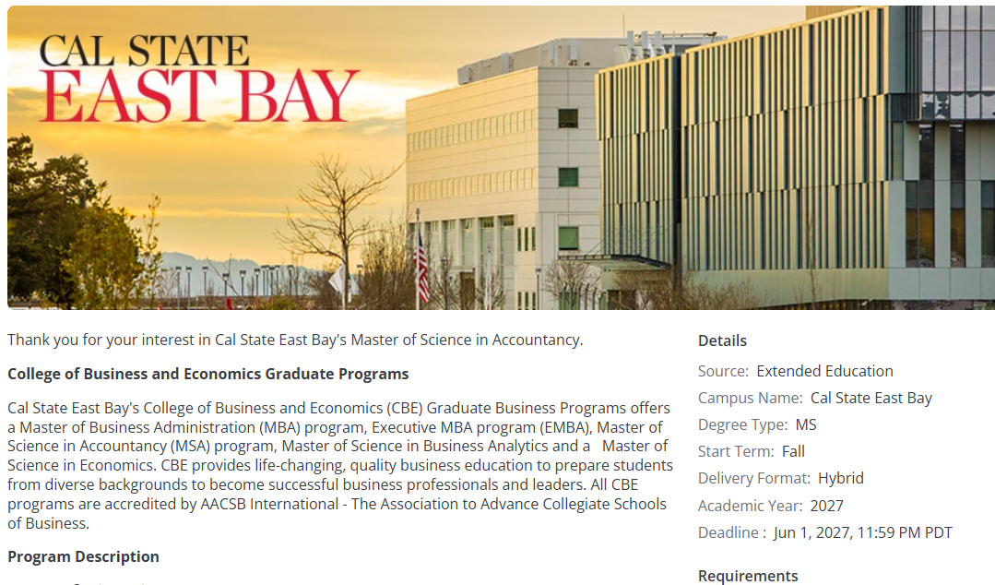
Quadrant 4 - Program Materials
Notes:
The fourth quadrant is where you will find a catalog description of the major you are applying for.
You can also find contact information, and departmental application requirements.
For some majors, you may have the opportunity to submit your statement of purpose, letter of Recommendations, and unofficial transcripts.

Slide 25

Departmental Application vs 4th quadrant
If you haven't begun the departmental application process, now is the time to start.
Please note that not all departments use the 4th quadrant for application submissions. Be sure to check with your specific program to find out their submission process.
Departmental deadlines may differ from the university's general deadlines.
For more information or to address any questions about your program, please contact the program coordinator.
Notes:
In addition to completing the steps in the 4 quadrant, graduate students are still required to submit the departmental application.
Each department has different admission requirements, so it is important that you communicate with your program coordinator and find out more information.

Slide 26
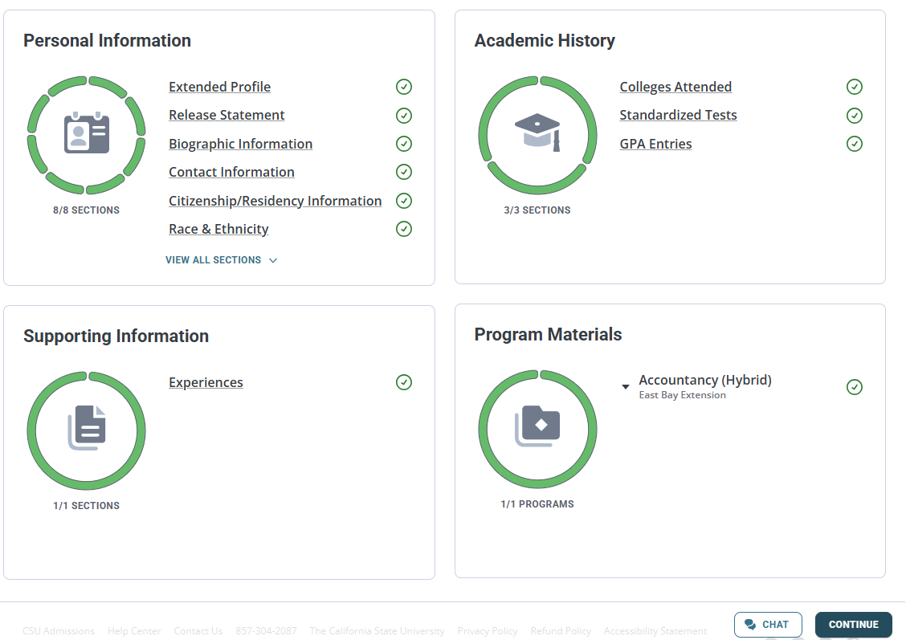
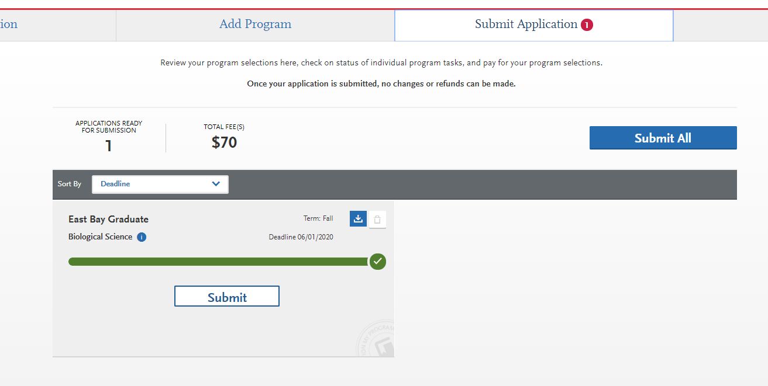
Submitting your Application!
Check the program and campus
Submit App
Once all quadrants are filled out, proceed to submit
Notes:
Once all quadrants are completed and have turned green, your last step is to verify the program, term, and the campus you are applying for before you click the submit all button.

Slide 27
Next Steps-University
Activate your NetID
Check your Horizon Email and MyCSUEB portals
Contact your Academic department for additional requirements
Pay attention to University & departmental document deadlines
Accept your admission offer
Enroll in classes
Pay your tuition fees
www.csueastbay.edu/admissions/graduate-requirements/next-steps.html
Notes:
Once you have submitted your application, you will receive a welcome email and letter with your NetID.
Your NetID allows you online access to student self-service systems such as your horizon email, Canvas, and MyCSUEB. You will need to activate it with the provided instructions.
Regularly check your Horizon email account for important messages from the University.
Don’t forget to check your MyCSUEB portal for outstanding requirements and to check your application status. You will also be able to accept your admission offer and enroll in classes through MyCSUEB.
Make sure to pay your fees! It is important so that you avoid being dropped from your classes.
For a complete list of next steps, links, and other helpful information, please visit our next steps webpage. The link is included in this slide.

Slide 28
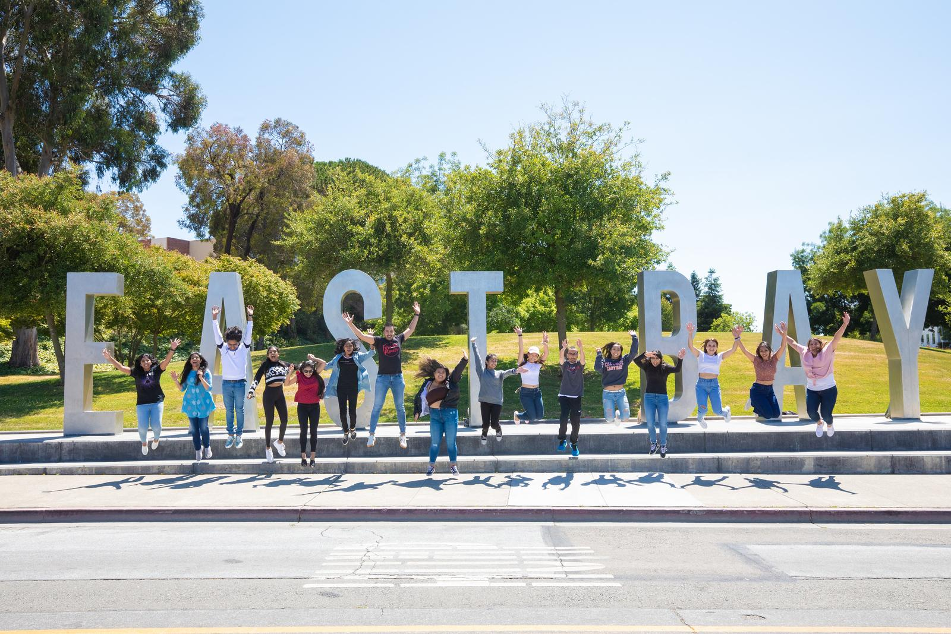
Thank you!
We sincerely wish you the best in your academic endeavors and hope to see you as part of our campus community soon!
QUESTIONS?
Contact the Office of Admissions by phone at (510) 885-3500 (option #3),
Monday through Thursday 10 a.m. – 3 p.m. or via email
gradadmission@csueastbay.edu
https://www.csueastbay.edu/online/degree-programs/online-programs.html
https://www.csueastbay.edu/aps/graduate-studies/graduate-program-directory.html
Notes:
Thank you everyone for your time. We look forward to reviewing your application.
For any questions please feel free to call or email us.

