Slide 1
Office of Financial Aid & Scholarships finaid@csueastbay.edu
Notes:
NOTE: to change background photo, edit the master style slide.

Slide 2
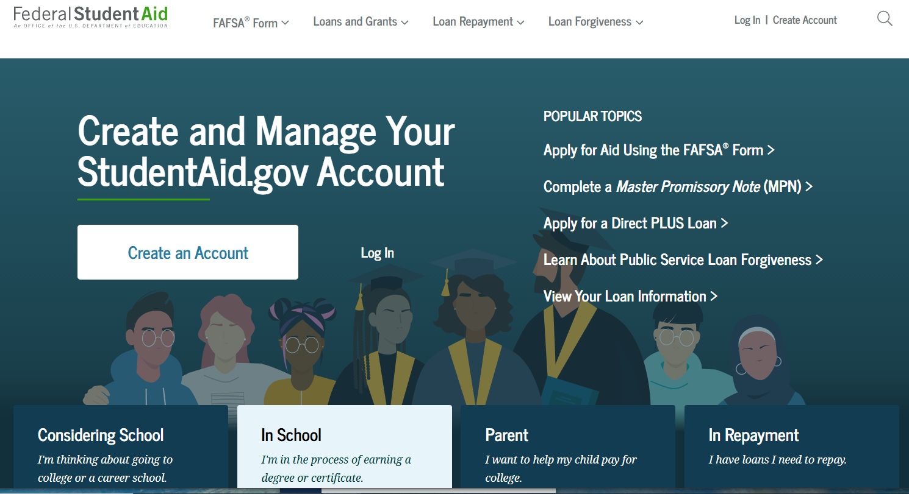

Applying for Financial Aid: 2026-2027
Free Application for Student Aid (FAFSA): studentaid.gov
California Dream Act Application (CADAA): dream.csac.ca.gov

Slide 3
Financial Aid - Important Dates
2027-2028 FAFSA : expected to open on October 1, 2026
Fall 2027/Spring 2028
FAFSA Application Priority Deadline (studentaid.gov): March 2, 2027
California Dream Act Application (CADAA Application)
Priority Deadline March 2nd : dream.csac.ca.gov.
Pioneer Scholarship Application Portal will open at the end of the year.
csueastbay.scholarshipuniverse.com
Financial Aid Workshops coming: https://www.csueastbay.edu/financialaid/

Slide 4
Graduate Loan Options
Federal Direct Loan
(no Subsidized loans)
  Unsubsidized (8.07% GRD)
  Will accrue interest while the student is in school
Other Lending Options –
Private Loans - Available through private lenders
  https://www.salliemae.com/
  https://www.collegeave.com/
Graduate PLUS loans
Due to the One Big Beautiful Bill Act (OBBA), the Grad PLUS loan is no longer an option.
*Maximum of $20,500 per year
Fall26/Spring27/Summer 27
($12,500 for prerequisite coursework)
*Check studentaid.gov for most up to date interest rate
*Graduate students enrolled in less than full-time status (8 units) per semester will be subject to the new 26/27 federal loan proration requirements.

Slide 5
Beware of Loan Lifetime Limits
Graduate/Professional Students
Subsidized + Unsubsidized Loan
Lifetime Limit = $257,500
New Graduate Student Aggregate Loan Limit
$100,000, does not include amounts borrowed at the undergraduate level. Does include graduate amounts previously borrowed.
* Prior to 7/1/12, graduate and professional students were eligible to receive subsidized loans. The new aggregate limit includes all subsidized and unsubsidized loans borrowed at the graduate or professional level. The limit excludes undergraduate borrowing.
Log into (NSLDS) National Student Loan Database System to check your aggregates (borrowing history)
(https://studentaid.gov using FSA ID)

Slide 6
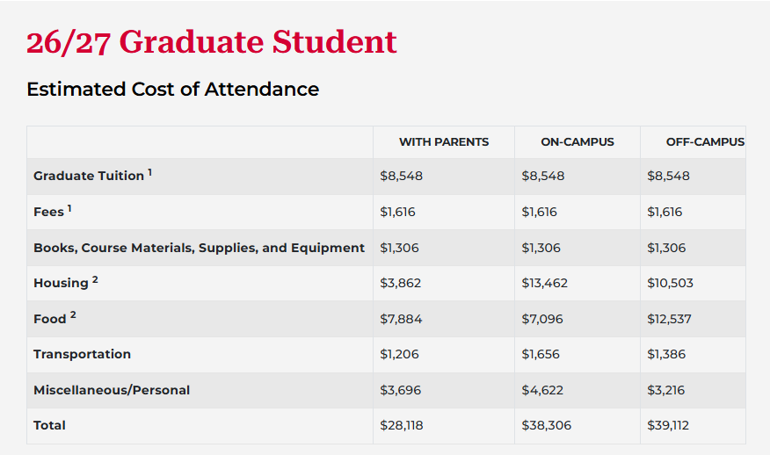
Direct Cost: (Billed Directly by Institution):
Tuition Fees, Room and Board
Indirect Costs: (Estimated Expenses Incurred by the Student)
Books & Supplies, Transportation, Room and Board for Off Campus or living with parents, Miscellaneous/Personal Cost

Slide 7
MONITOR YOUR HORIZON EMAIL ACCOUNT!
Financial Aid Award letter
How to find your 26/27 Award Offer
Award Offers are emailed to student’s CSUEB Horizon email account and available to view on MyCSUEB (click on the Financial Aid tile, View Financial Aid, 2027).
Please check your CSUEB Horizon email account regularly and use it when emailing our offices (include your NET ID in all correspondence).
Students receive adjusted Award Offers every time there are changes/updates to their financial aid.
Emailed Award Offers include a legend that details enrollment and eligibility requirements
Visit our website and check out, Understanding your Aid Package, for this important information.
Estimated Aid: Please review your To-Do List on your MyCSUEB portal and submit all required documents. You will receive a final Award Offer when we have completed the review of your file. Note that an estimated aid package is not official and will not be taken as payment by the Student Financial Services Department.

Slide 8
Contact Us
In-Person
To get in contact with a Financial Aid Counselor, please call us at the phone number below, or visit the
One-Stop at Perry’s Nest (formerly known as the Enrollment Information Center) on the first floor of the Student
Administration (SA) building.
Telephone:
(510) 885-2784
Monday - Thursday: 10am to 3pm
The phone lines will be open from 9am - 4pm from Monday - Friday during the first two weeks of the Fall, Spring, and Summer semesters.
Mailing Address
Office of Financial Aid & Scholarships
California State University, East Bay
25800 Carlos Bee Boulevard
Hayward, CA 94542
https://www.csueastbay.edu/financialaid/contact-us.html

Slide 9
Thank You!

