Slide 1
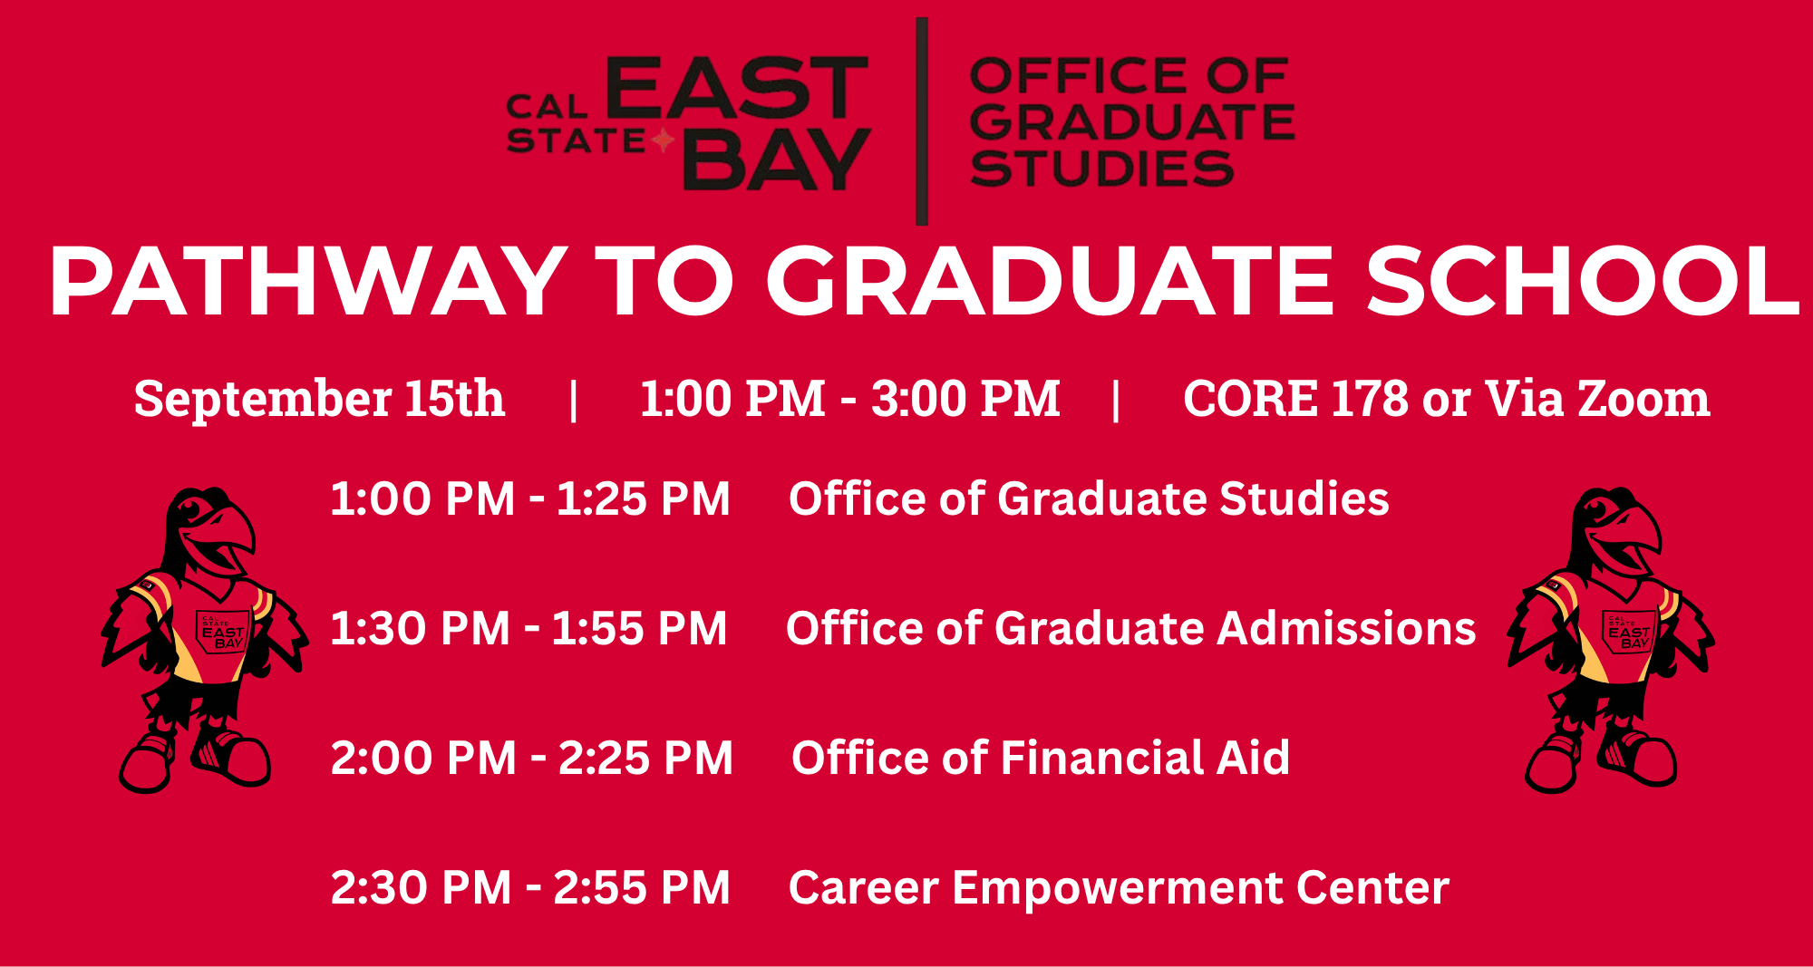

Slide 2
Office of Graduate Studies
Joshua Kerr
Director of Graduate Studies
gradstudies@csueastbay.edu
Notes:
NOTE: to change background photo, edit the master style slide.

Slide 3
Is Graduate School Right for You?
Notes:
NOTE: to change background photo, edit the master style slide.

Slide 4
Why Go To Graduate School?
Job Opportunities
  Some positions require a graduate degree
Career Advancement
  Bachelor has become entry-level degree
  Higher-level positions and decision-making power require education beyond undergraduate
Career Change
  New discipline or specialization within existing discipline

Slide 5
Why Go To Graduate School?
Some positions require a Master’s degree
  Education Administrators (ex. Principal)
  Statisticians/Mathematicians
  Epidemiologists
  Counselors (Most types)
  Social Workers (Mental Health and Healthcare)
  Librarians
  Physician’s Assistants and Nurse Practitioners
  Speech Language Pathologists
  Genetic Counselors

Slide 6
Why Go To Graduate School?
Job Opportunities
  Some positions require a graduate degree
  Look at Bureau of Labor Statistics
Career Advancement
  Bachelor has become entry-level degree
  Higher-level positions and decision-making power require education beyond undergraduate
Career Change
  New discipline or specialization within existing discipline

Slide 7
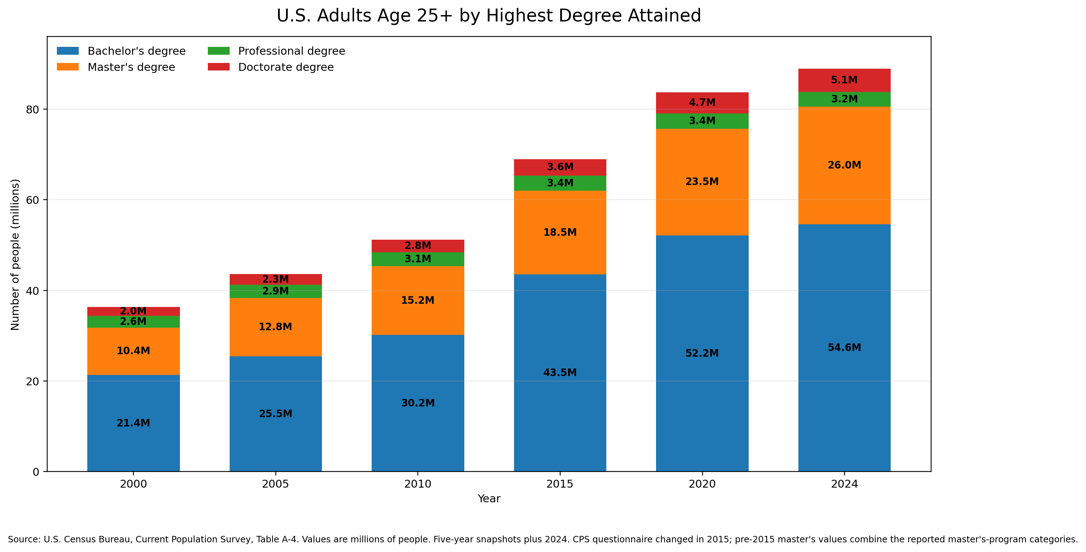

Slide 8
Why Go To Graduate School?
Increase Income and Earning Potential
  Median annual earnings in 2025 for those who hold master’s degree was more than $15,000 (~19%) higher per year than for those with bachelor’s degrees
  Those with advanced professional degrees earn $37,000 per year more than BA/BS
  Those with graduate degrees also less likely to be unemployed

Slide 9
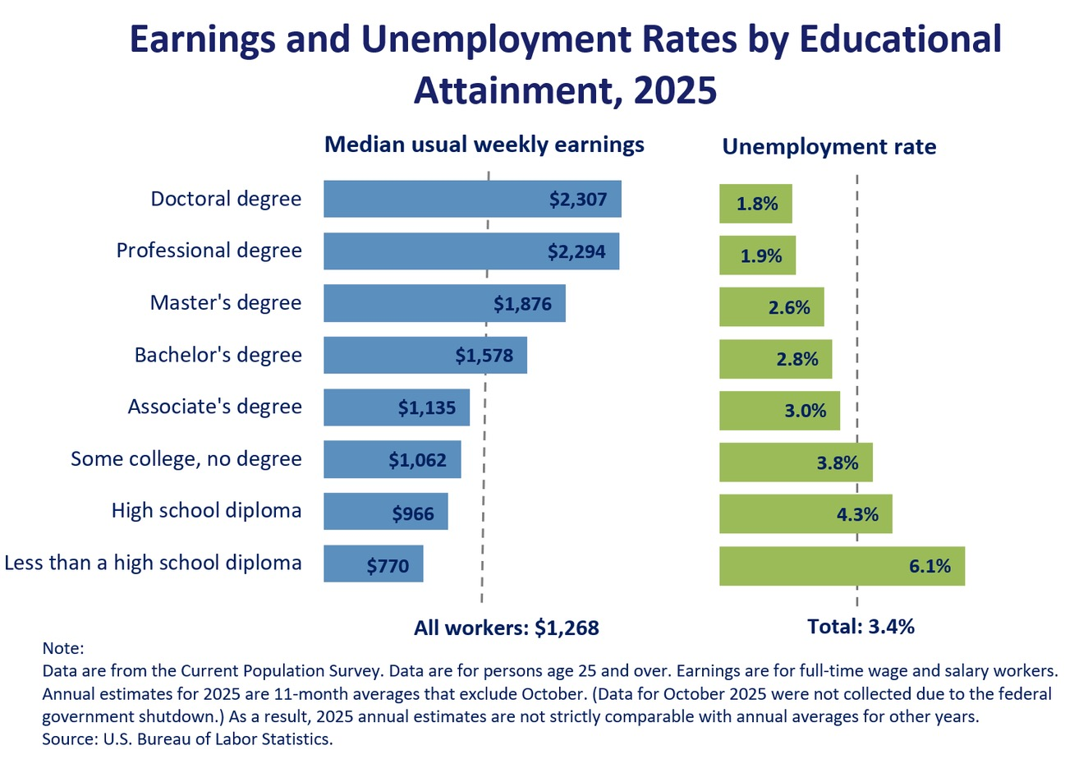

Slide 10
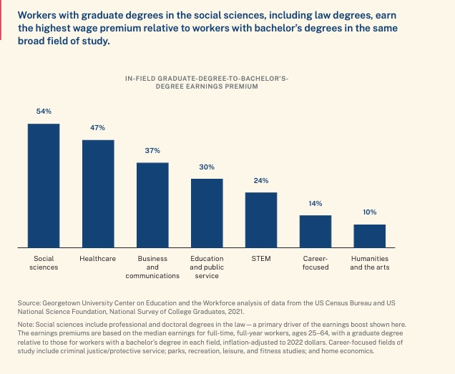

Slide 11
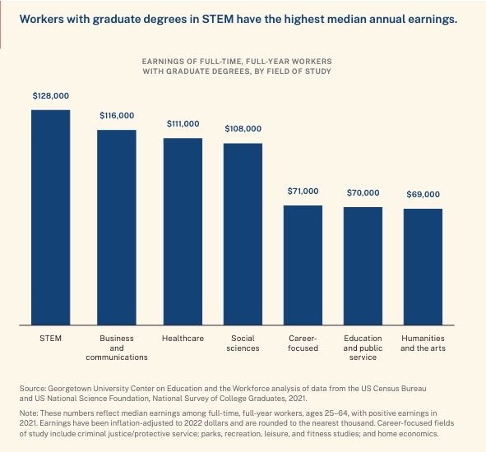

Slide 12
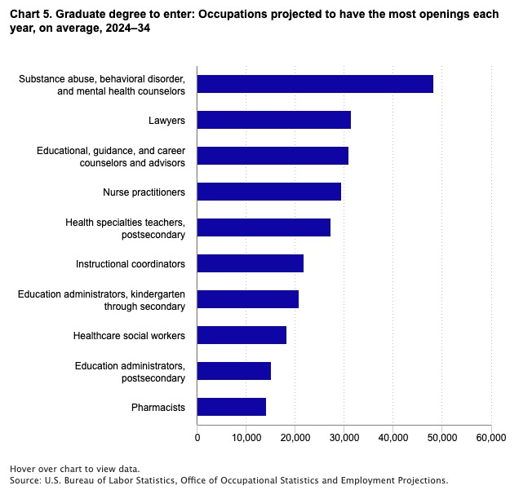

Slide 13
Why Go To Graduate School?
  Because you want to
    Opportunity to learn about things that interest you most!
  Research opportunities
    Access to advanced equipment and tools
      Research Equipment
  Upgrade your education
    If it has been a while since you completed your undergrad degree
  Employer incentives

Slide 14
Why Shouldn’t You Go To Graduate School?
  Not sure if the job you want requires a graduate degree
    Contact Career Empowerment, graduate coordinators, potential employers
  Can’t find a job
    First determine reason, perhaps internship or freelance work would be more helpful
  Haven’t done cost-benefit analysis
    Look at cost to obtain degree (tuition, opportunity cost, time)

Slide 15
Why Shouldn’t You Go To Graduate School?
  Easier than getting a job
    Professional student?
  Haven’t clearly identified reason to go
    Make an informed choice based on your goals

Slide 16


Choosing Cal State East Bay
Personal, Professional, Achievable

Slide 17

Personal
Wide variety of programs
Late afternoon, evening, weekend classes
Hybrid and online instruction
Courses in many programs meet one night per week
Small class sizes

Slide 18
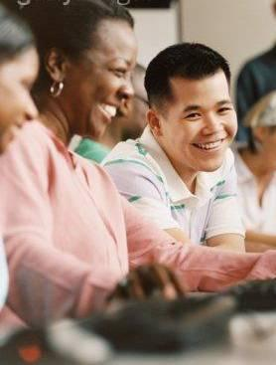
Professional
Ph.D. Full-Time Faculty
Outstanding Practitioner Faculty
Regionally Accredited University
Professional accreditations

Slide 19

Achievable
Most Programs Can Be Completed in 2 Years or Less
Affordable Costs
Fees subject to change

Slide 20

Achievable
Online Masters Programs
MS Curriculum and Instruction
MS Early Childhood Education
MS Reading and Literacy
MS Hospitality, Recreation, and Tourism
MS Special Education
MBA Global Innovators*
MS eLearning*
MS Educational Leadership*
MS Speech-Language Pathology*
* Offered through self-support

Slide 21
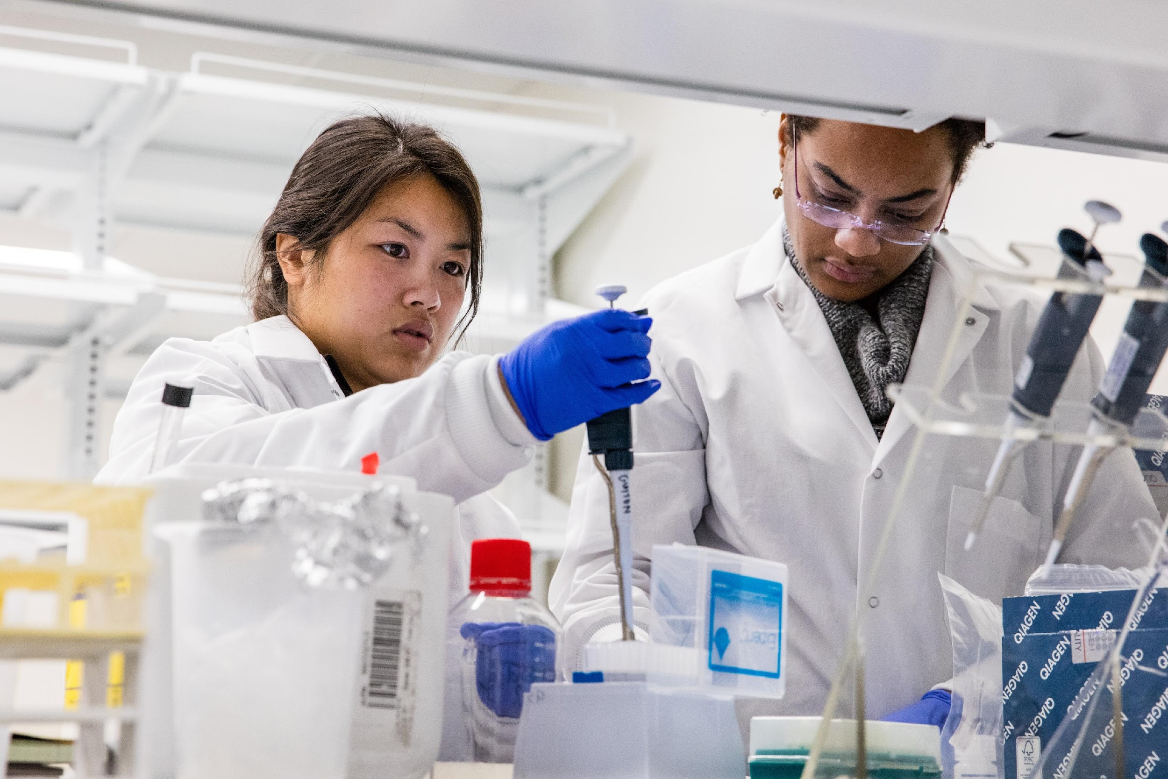
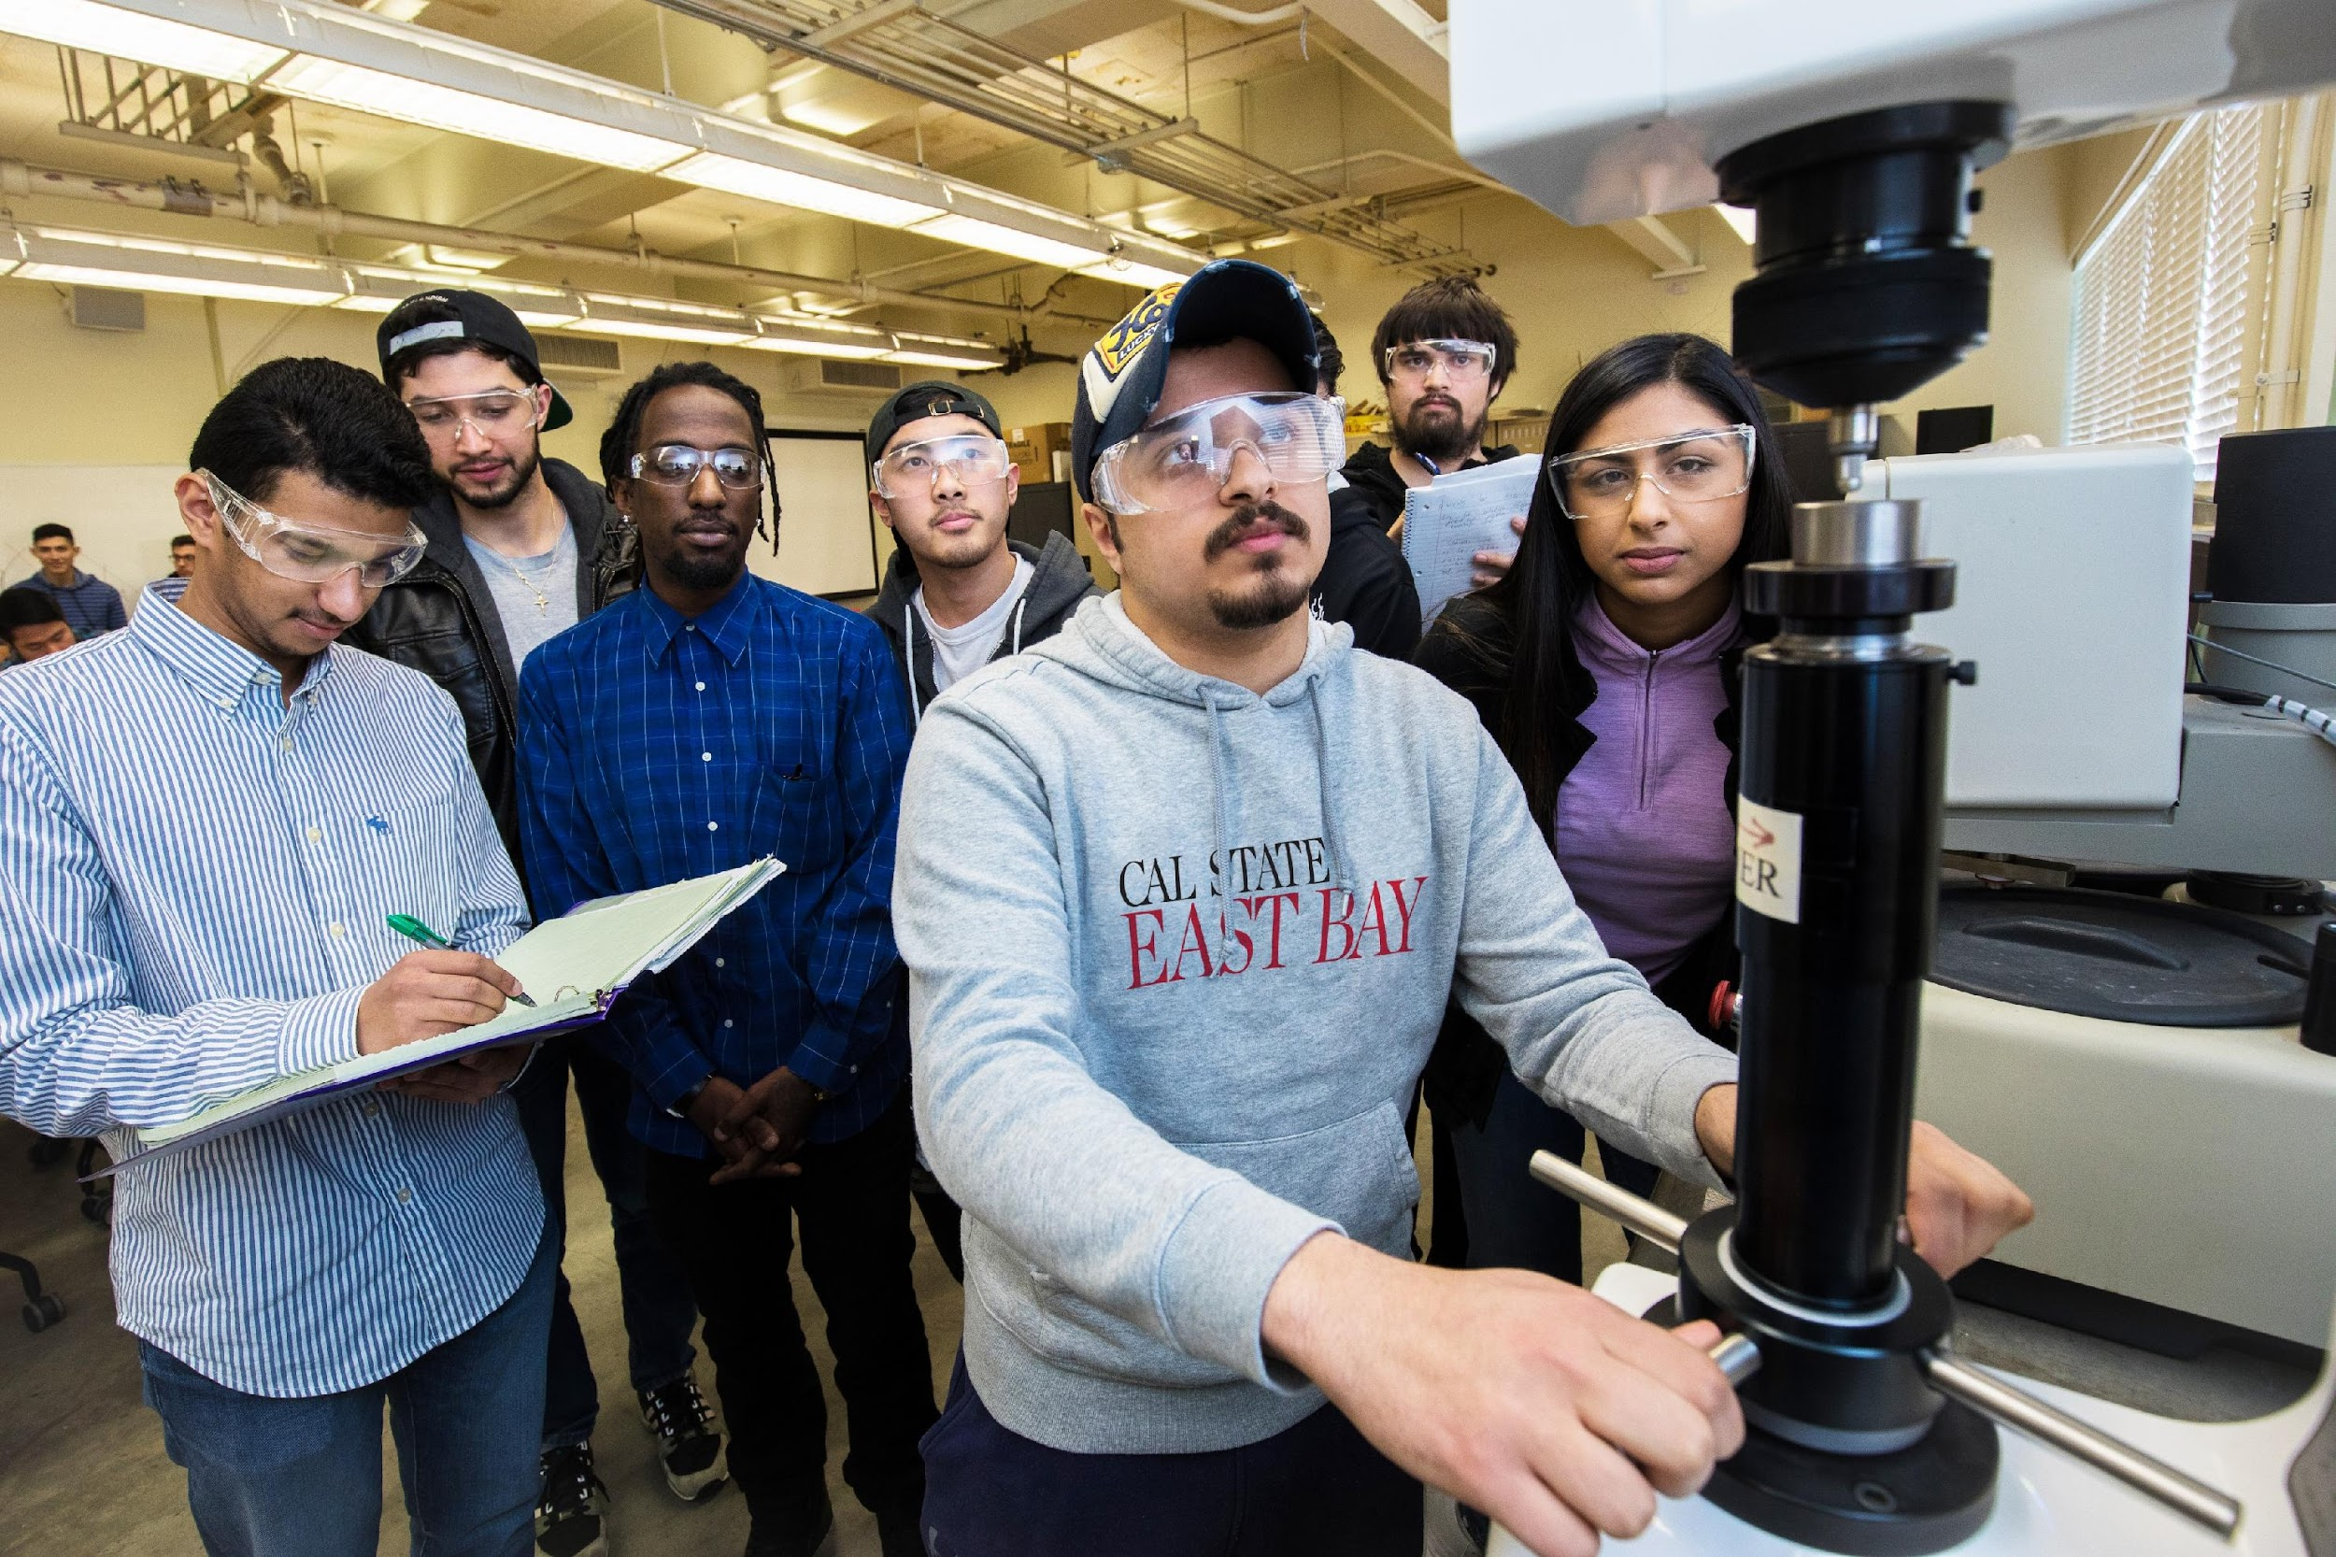
Office of Graduate Studies
https://www.csueastbay.edu/graduate-studies/
Provides resources and guidance for prospective and current graduate students

Slide 22
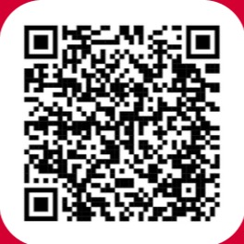
California State University, East Bay
Your Best Choice for Graduate Education

Slide 23
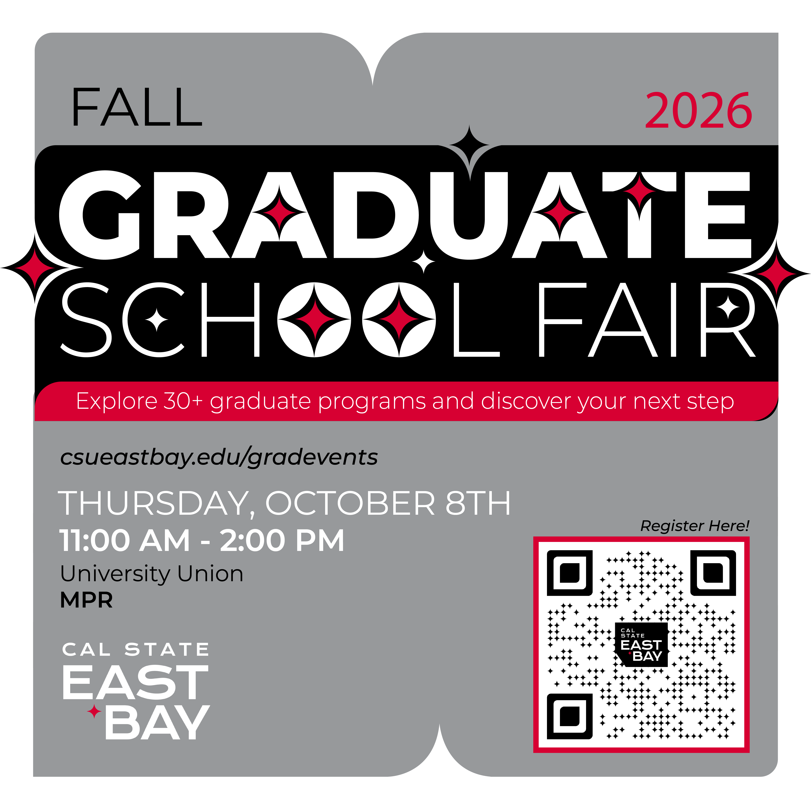
Fall 2026 Graduate School Fair
Thursday, October 8th, 2026
11:00 AM - 2:00 PM
The California State University, East Bay, Office of Graduate Studies invites interested participants to our Fall 2026 Graduate School Fair.
Representatives from over 50 graduate programs from Cal State East Bay, and a selection of CSUs, UCs, and private universities will be available to answer questions about their graduate programs, admission requirements, and more.
The event will be held in-person in UU MPR on the Hayward campus.
Use this QR code to register!

Slide 24
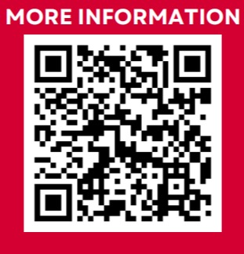
Fall 2026 FAST Student Information Seminar
Tuesday, September 15th, 2026
FAST programs allow eligible undergraduate students to begin taking graduate-level courses during their senior year and double-count up to 12 units toward both their bachelor’s and master’s degrees.
Topics discussed during the session:
What FAST programs are and how they work
The benefits of participating in a FAST program
Eligibility and admission requirements
How and when to apply
What to expect as you progress from your undergraduate to graduate program
Available FAST programs and resources https://www.csueastbay.edu/graduate-studies/fast-programs.html (recording available soon!)

Slide 25
Pathway To Graduate School
1:00 PM Is Graduate School Right for You?
  Office of Graduate Studies
  Joshua Kerr
1:30 PM How to Apply to Graduate School
  Office of Graduate Admissions
  Karina Ramirez & Leslie Chavarin
2:00 PM Cost of Attendance
  Office of Financial Aid
  Kristen Lem
2:30 PM Personal Statement and Scholarship Essays
  Career Empowerment Center
  Clark Boothby & Eric Viacrusis

