Slide 1
Office of Financial Aid and Scholarships
Understanding your 2020-2021 Financial Aid Offer Letter
Your 2020-2021 Cal State East Bay Financial Aid is ready.
To accept or decline your financial aid, log into your MyCSUEB, click on View Financial Aid and choose the 2020 academic year. There, you will be able to accept or decline any student loans or federal work study that may have been offered. You may also adjust the amount of loan that you would like to accept.
Please note that Federal Work Study funds will not be directly applied to your account. To receive Federal Work Study funds, you will need to find employment and you will be paid through payroll. For more information about our available jobs on campus, please visit Academic Advising and Career Information via their website at http://www.csueastbay.edu/aace.
Please remember that you are not obligated to accept any of the student loans that are offered to you. However, should you decide to accept them you will be required to complete the Stafford Loan Entrance Counseling and Mastery Promissory Note.
If you have not done so already and wish to accept your Federal Loans, please accept the loans through your MyCSUEB account and visit studentaid.gov to complete the additional requirements. Note – Students who have been flagged for verification will not be able to accept their loans until their FAFSA has been verified.
Entrance Counseling:
If you have not previously received a Direct Loan or Federal Family Education Loan (FFEL) and you decide to accept your loan(s), the Federal Government will require that you complete an online entrance counseling to ensure that you understand the terms and conditions of the loan(s) as well as your responsibilities as the borrower.
Undergraduate, graduate, or professional students who borrow Direct Subsidized Loans, Direct Unsubsidized Loans, or Direct Plus Loans must complete the Entrance Counseling requirement.
Mastery Promissory Note:
The Subsidized/Unsubsidized Loan Mastery Promissory Note (MPN) is a legal document in which you agree to repay your federal student loan(s) and any accrued interest and fees to the Department of Education through your loan servicer. There is one MPN for Direct Subsidized/Unsubsidized Loans and a different MPN for Direct PLUS Loans.
Please keep in mind that our goal at Cal State East Bay is to make the financial aid process as simple and as transparent as possible. If you have any questions or concerns regarding your 2019-2020 Financial Aid, please don't hesitate to contact us at (510) 885-2784 or finaid@csueastbay.edu.
finaid@csueastbay.edu
Notes:
Starting the second week of March 2020, the Office of Financial Aid and Scholarships began to send out Financial Aid Offer letters to Admitted students for the 2020-2021 Academic Year. If you have submitted your FAFSA application and have not received an email correspondence from us within 5 business days of the submission of your application, please contact us at finaid@csueastbay.edu. If your Financial Aid application was flagged for a review process called verification, please make sure that you have submitted all the required documents because we will not be able to provide you with an official Financial Aid Offer Letter until we have completed our review process and the Federal Student Aid Department has accepted and approved any applicable corrections. For those students requesting a Deferral for the Student Intent to Register (or SIR)Fee, we will need you to have an OFFICIAL 2020-2021 Financial Aid Offer Letter in order to review your eligibility for the SIR Fee Deferral. Remember that the Priority Deadline for the FAFSA Application and the Dream Act Application was March 2.

Slide 2
Types of Financial Aid
Grants & Scholarships
Federal Pell Grant
Federal SEOG Grant
Educational Opportunity Program (EOP)
Cal Grant A or B
Middle Class Scholarship
State University Grant
Chafee Grant
Notes:
When you log into your MYCSUEB account, you may see one or more of components of the following types of Grants and Scholarships. While the Pell Grant and the Supplemental Educational Opportunity Grant are from the Federal Department of Education, The Cal Grant, Middle Class Scholarship, and Chafee Grant are from the California Student Aid Commission. The State University Grant is an Institutional fund that is governed by the California State University System.

Slide 3
Types of Financial Aid
Federal Work Study
Paid via Payroll
Must find a job from the campus (off campus jobs also available)
Amount paid according to pay rate (typically minimum wage) and hours worked
Must work no more than 20 hours a week
Notes:
Another type of Financial Aid is the Federal Work Study. You might have received this fund if you indicated on the FAFSA application that you were interested in receiving Federal Work Study Funding. Unlike the other types of Financial Aid, students receive Federal Work Study funding via payroll. To receive this fund, you will need to apply for a job at one of our campus departments. Some jobs are also off campus. Once you secure a position with one of our Federal Work Study employers, you will receive pay according to the hours that you’ve worked from our payroll department. Federal Regulations require that you limit your work to 20 hours a week.

Slide 4
Types of Financial Aid
Loans
Federal Direct Stafford Loan
Subsidized (4.53%)
Will not accrue interest while the student is enrolled at least half-time or more.
Unsubsidized (4.53%)
Will accrue interest while the student is in school
Federal Direct PLUS Loan (7.08%)
Parents of Dependent Students
Dream Loan (5.05%)
AB540 Students Private Loans
Available through private lenders for students who submit the FAFSA as well as the CADAA
Notes:
The Financial Aid Offer may also include The Federal Direct Subsidized and, or or the Federal Direct Unsubsidized Loan. The difference between the Subsidized Loan and the Unsubsidized Loan is that the Government pays the interest as long as the student is enrolled in at least half-time (or 6 units). The Dream Loan is also available for students who demonstrate need and submit the California Dream Act Application. Parents can also borrow on their dependent child’s behalf through the Federal Direct Plus Loan program. Students and parents who borrow from The Federal Direct, Federal Direct Plus, and the Dream Loan qualify for an In-School Deferment; where they can opt to postpone repayment for as long as the student maintain at least a half-time enrollment.

Slide 5
Direct Loans www.studentaid.gov
Federal Direct Student Loan Program No Credit Check
 | Dependent | Independent
Freshman | $5,500 ($3,500) | $9,500 ($3,500)
Sophomore | $6,500 ($4,500) | $10,500 ($4,500)
Junior and Senior | $7,500 ($5,500) | $12,500 ($5,500)
Aggregate | $31,000 ($23,000) | $57,500 ($23,000)
Dream Loan: The annual loan maximum is $4,000 with a lifetime aggregate limit of $20,000
*funding is limited and based on a first come first serve basis
Notes:
Freshmen Dependent Students can receive upto $5,500 in Federal Loans;$3,500 of which can be Subsidized, depending on eligibility while Independent Freshmen can receive upto $5,500 in Federal Loans;$3,500 of which can be Subsidized, depending on eligibility. Sophomore Dependent Students can receive upto $6,500 in Federal Loans;$4,500 of which can be Subsidized, depending on eligibility while Independent Sophomores can receive upto $10,500 in Federal Loans;$4,500 of which can be Subsidized, depending on eligibility. Junior and Senior Dependent Students can receive upto $7,500 in Federal Loans;$5,500 of which can be Subsidized, depending on eligibility while Independent Juniors and Seniors can receive upto $12,500 in Federal Loans;$5,500 of which can be Subsidized, depending on eligibility. Dependent Students can borrow upto $31,000 in federal loans; 23,000 of which can be subsidized. Independent Students can borrow upto $57,500 in federal loans; 23,000 of which can be subsidized. Dream Loan recipients can borrow upto $4,000 each year with a maximum lifetime limit of $20,000. If you would like to be considered for the Dream Loan, reach out to the Financial Aid Office as funding is limited and students and are given on a first come, first serve basis.

Slide 6
Steps to taking Federal Loans
For Direct Subsidized/Unsubsidized Loan:
- Accept the amount that you need for the year via your MYCSUEB Portal
- Complete Direct Loan Entrance Counseling via studentaid.gov
- Complete Direct Loan Master Promissory Note via studentaid.gov
For Direct Parent Plus Loan
- Visit studentaid.gov to apply
- Complete the Plus Loan Master Promissory Note
For Dream Loans
- Contact the Office of Financial Aid and Scholarships at finaid@csueastbay.edu
The Office of Financial Aid and Scholarships will receive your information and authorization directly from the Federal Student Aid Department.
Notes:
The Office of Financial Aid and Scholarships serve to provide our students as much financing options as possible but remember that you are not obligated to take out any loans that are offered to you. However, if you would like to apply for the loans, you will need to make sure to complete the necessary requirements. To accept the Subsidized Loan, the Unsubsidized Loan or both, please visit your MYCSUEB portal and indicate the amount that you would like to receive for the year. Then, you must visit studentaid.gov to complete the required Entrance Counseling and sign the Master Promissory Note. To apply for the Federal Direct Parent Plus Loan, parents must visit studentaid.gov to apply and to complete the Plus Loan Master Promissory Note. For Dream Loan applicants, please contact the Office of Financial Aid and Scholarships via email at finaid@csueastbay.edu.

Slide 7
Parent Plus Loan www.studentaid.gov
Credit-based loan with two steps:
Apply for credit decision
Sign promissory note (MPN) if approved ** Can borrow up to COA after all student aid **
If denied:
Parents can appeal the credit decision or re-apply with an endorser.
Student is eligible for additional Unsubsidized Loan if parent is denied.
Notes:
While Undergraduate Federal Loans and Dream Loan applicants aren’t required to go through a credit history check, Parent Plus Loan borrowers must first apply for a credit check decision. Students who’s Parents are denied a Parent Plus Loan may request an increase in their Unsubsidized loan by contacting the Office of Financial Aid and Scholarships.

Slide 8
Award Requirements
Financial Aid Offer Assumes Full-Time Enrollment and Requires that Students Maintain Satisfactory Academic Progress
(Students who receive State Grants are strongly encouraged to maintain 15 units in order to receive funding throughout their enrollment)
Enrollment levels
FT=12u, TQT= 9-11u, HT=6-8u, LTHT=1-5u
Enrollment check for Grants/Scholarships
Eligibility determined by enrolled units at Census Date (generally the 15th day of instruction)
Enrollment requirements
Pell Grant prorated for FT, TQT , HT, LTHT
State University Grant requires 7u
Cal Grant prorated for FT, TQT , HT (no LTHT)
EOP requires FT
Loans require HT
Notes:
The 2020-2021 Financial Aid Offer is based on an assumption that students will maintain a full time enrollment and requires that they meet Satisfactory Academic Progress. Should students drop classes up until the semester’s published census date, their Financial Aid may be reduced according to their units of enrollment. The State University Grant requires a minimum of 7 units of enrollment, State Grants require at least half time or 6 units of enrollment, the Educational Opportunity Grant requires at least 12 units of enrollment, and Federal and Dream Loan applicants require at least half time or 6 units of enrollment.

Slide 9
Award Requirements
Financial Aid Offer Requires that Students Maintain Satisfactory Academic Progress
67% Pace of Progression (Earned Units v. Attempted Units)
2.0 Cumulative Grade Point Average
2.0 Grade Point Average on your 2nd year
150% Maximum Time Frame Completion of Published Program
Financial Aid will only cover courses that count towards your degree
Notes:
To maintain Financial Aid eligibility, students must meet and maintain Satisfactory Academic Progress and only take courses that count towards their degree. Undergraduate students that do not have a 2.0 Cumulative GPA at the end of their 2 year (5th Term) will automatically be suspended from financial aid. You must continue to make progress toward graduation by successfully completing 67% of the units that you attempt. To meet SAP standards, you must also reach your degree completion within 150% of your published program. For a Baccalaureate Degree, that’s 180 units.

Slide 10
Manage and Monitor Your Cal Grant
Set up WebGrants account (mygrantinfo.csac.ca.gov)
See on which school’s roster your Cal Grant is parked
Change your school based on where you are attending
Notes:
State Funding eligibility is often delayed when it comes to information sent to the Office of Financial Aid and Scholarships by the California Student Aid Commission. As such, it is important that students monitor their State Aid status directly through the California Student Aid Commission. The state may require that you complete additional requirements before they allow us to disburse your funds. Therefore, it is important that students visit mygrantinfo.csac.ca.gov to make sure that you keep up to date with your application. For students who included schools other than CSU, East Bay; please make sure that you update your profile with the Institution that you chose to attend.

Slide 11
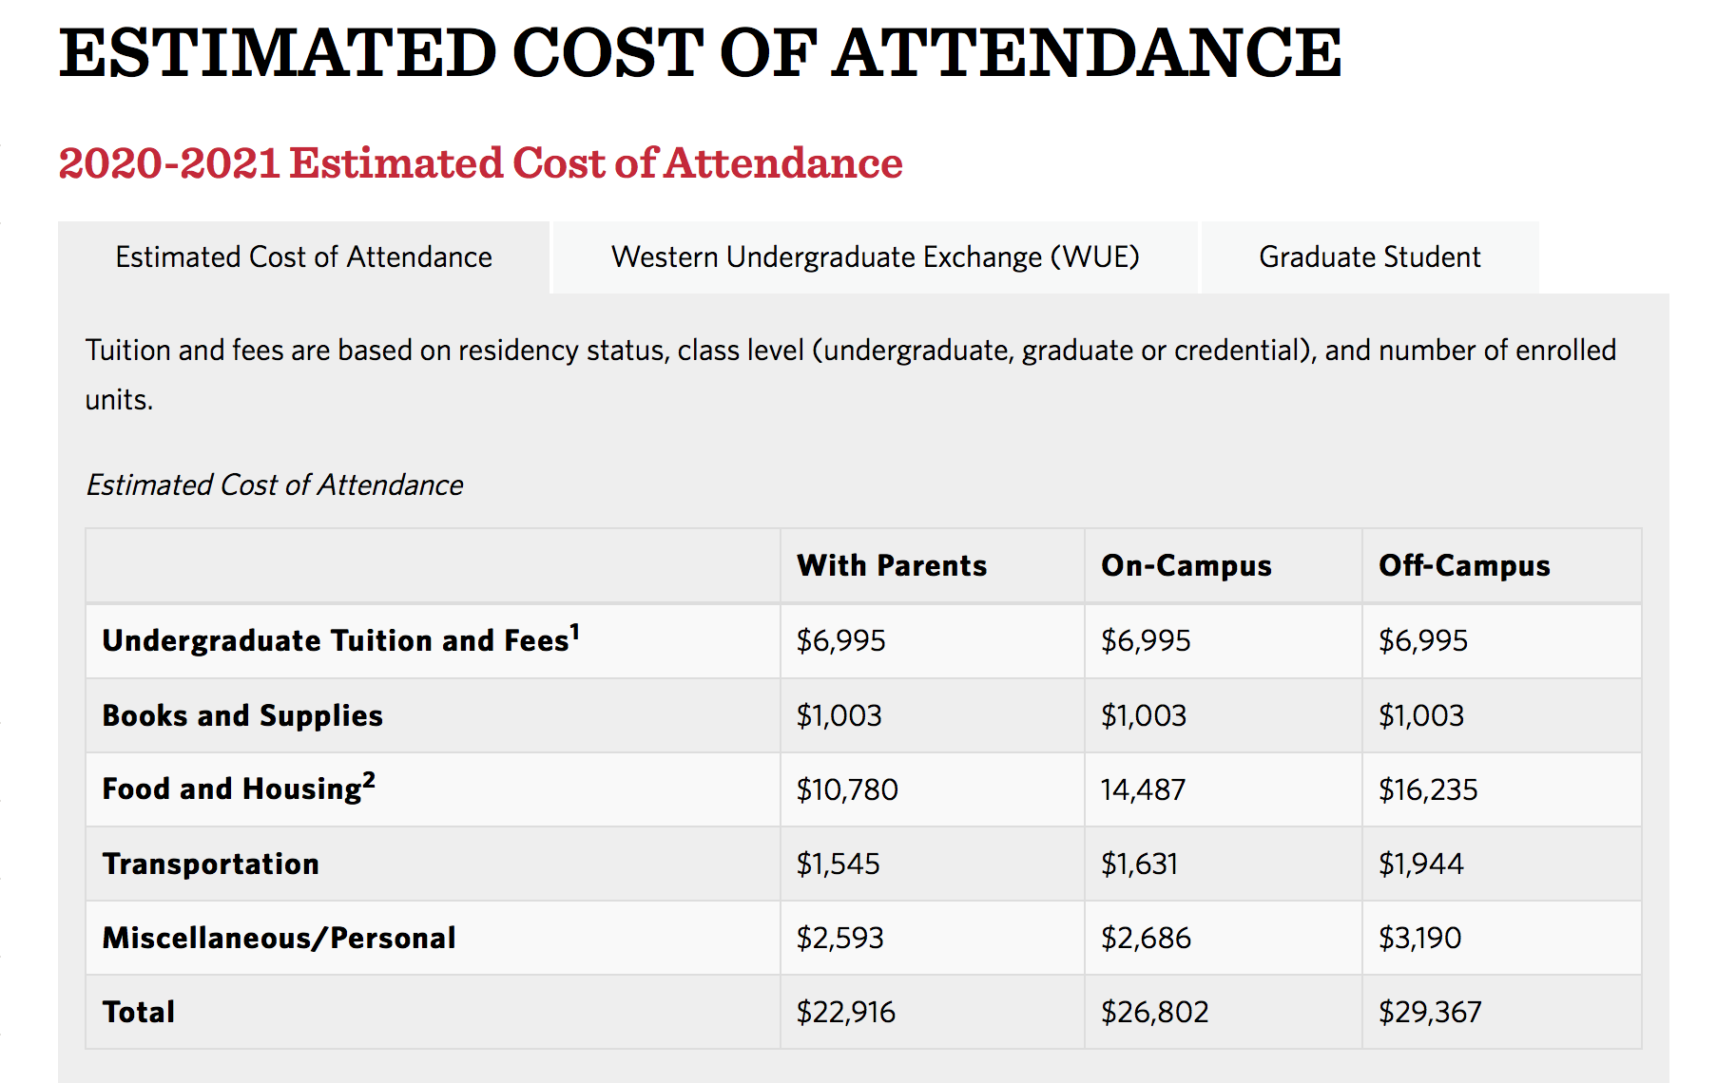
Notes:
This is the Estimated 2020-2021 Cost of Attendance.

Slide 12
Cost of Attendance
Direct Cost: (Billed Directly by Institution): Tuition Fees, Room and Board
Indirect Costs: (Estimated Expenses Incurred by the Student) Books & Supplies, Transportation, Room and Board for Off Campus or living with parents, Miscellaneous/Personal Cost
Notes:
The Estimated Cost of Attendance is comprised with the Direct Cost of tuition and fees, and if you’re living on campus, room and board. The indirect costs include estimates of the amount students spend on books and supplies, transportation, costs living off campus or with parents, and personal/miscellaneous costs.

Slide 13
Cost of Attendance
To Calculate Your Direct Cost:
Visit your MYCSUEB portal and review your ‘ACCEPTED’ Financial Aid Award. (Note, those with unofficial Financial Aid Offers must first complete required verification in order to get an Official Financial Aid Offer)
Take the total of your ‘Accepted’ Financial Aid Offer and the Total ‘Direct Cost’ to calculate your out of pocket cost
For example, if you are a student who will be living with your parents for the 2020-2021 Academic Year and you receive $5,195 in a Pell Grant, $1,000 in an EOP Grant, and $1,672 in a Cal Grant B:
Your total Scholarships and Grants for the year = $7,867
At full time status, your estimated Direct Cost = $7,020 for Tuition and Fees
This means that your total out of pocket = $847 for the year, or $423.50, per semester (estimated)
Notes:
To determine the amount that you will be billed, compare your total ‘accepted’ financial aid offer to the total Direct Cost. This will help you determine whether you will need the loans that are available to you. Note that students are billed per semester and financial aid is also applied to your bill in halves, with the first half disbursed during the Fall semester and the second half disbursed during the Spring semester. Students with unofficial Financial Aid offers must first complete their verification requirements in order to get an official, finalized 2020-2021 Financial Aid offer.

Slide 14
WE MIGHT NEED ADDITIONAL INFORMATION
Federal Verification
Your FAFSA application may be flagged for Verification by the Federal Student Aid Department. Upon receipt of your FAFSA, (if chosen for verification) The Financial Aid Office will notify you via email with instructions on what and how to complete the Verification Process.
Students who are flagged for Federal Verification will receive an ESTIMATED Financial Aid Award. We will not be able to provide you with your Financial Aid until you complete all Verification Requirements.
Notes:
If you were flagged for Federal Verification, you must first complete the verification requirements as instructed to you via email notification before you will receive an Official Financial Aid Offer. In fact, if you have submitted a Financial Aid application and it has been at least 5 business days since the date of your submission, check your email box and look for our verification notification. If you do not see an email notification and have not received a Official Financial Aid Offer Letter, please make check your spam folder or reach out to the Office of Financial Aid and Scholarships to request a status update. Students who are flagged for verification will only receive an unofficial, or ESTIMATED Financial Aid Offer that is subject to change after the verification review.

Slide 15
WE MIGHT NEED ADDITIONAL INFORMATION
What to Prepare?
Have your (if applicable) 2018 (Signed) Income Tax Return or Tax Return Transcript ready to submit when asked
Have your Parents’ (if applicable) 2018 (Signed) Income Tax Return or Tax Return Transcript ready to submit when asked
Complete any forms requested of you by the Financial Aid Office, ASAP!!
Be proactive and pay attention to your email box
Don’t be afraid to ask questions!!! (finaid@csueastbay.edu)
Most verification requirements can be completed online via csueastbay.verifymyfafsa.com
Notes:
There are various reasons as to why the Federal Student Aid Department may have flagged your application for verification. We may require that you submit verification of your citizenship or registration for selective service. Other verification flags require that you submit your, and or, or your parents’ signed 2018 Income Tax Return or Tax Return transcript and fill out additional verification forms. Most verification requirements can be completed online via csueastbay.verifymyfafsa.com

Slide 16
What Happens if Something Happened?
Special Circumstance Appeal
The Financial Aid Application requests information based on the prior-prior year income. However, if your income changes drastically due to unforeseen circumstances, contact the Financial Aid Office to see whether you’d be eligible for a Special Circumstance Appeal. (finaid@csueastbay.edu)
Reasons Include:
Loss or Drastic Reduction of Income
Death of Parent/Spouse
Natural Disaster (for example, COVID-19)
Divorce
Out of Pocket Medical Costs (not covered by insurance)
Dependency Override
Note- Wait until you receive your initial (OFFICIAL) Financial Aid Offer before you appeal.
- Submitting an Appeal does not guarantee that you will receive additional aid
- Submitting an Appeal will not postpone the payment deadline
- You will be required to submit documentation to verify your reason to appeal
Notes:
Here at CSU East Bay, we understand that certain circumstances happen that are beyond the control of our students. The Financial Aid application that you submitted is based on your 2018 income. Therefore, if your income has changed drastically due to unforeseen circumstances between 2018 and now, we urge you to contact us at the Office of Financial Aid and Scholarships to discuss your option for a possible recalculation of your Financial Aid Application. Reasons include and are limited to- Loss or Drastic Reduction of Income, Death of Parent/Spouse, Natural Disaster, Divorce, Out of Pocket Medical Costs that are not covered by insurance, change in Dependency Status. Please wait until you receive your official financial aid offer before you appeal. If you are flagged for verification, please complete your verification before you appeal. Remember that submitting an appeal does not guarantee that you will receive additional aid. Submitting an Appeal will not postpone the payment deadline, and you will be required to submit official documentation to verify your extraordinary circumstance.

Slide 17
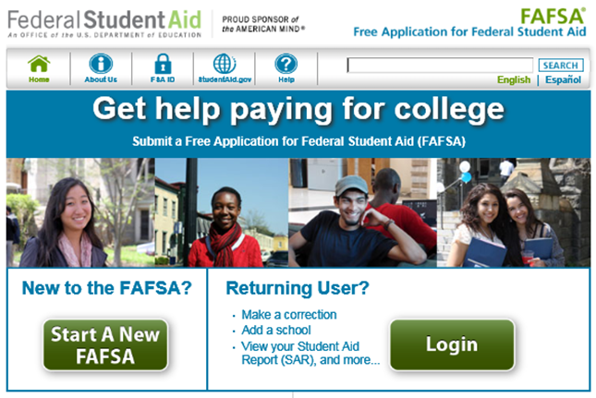
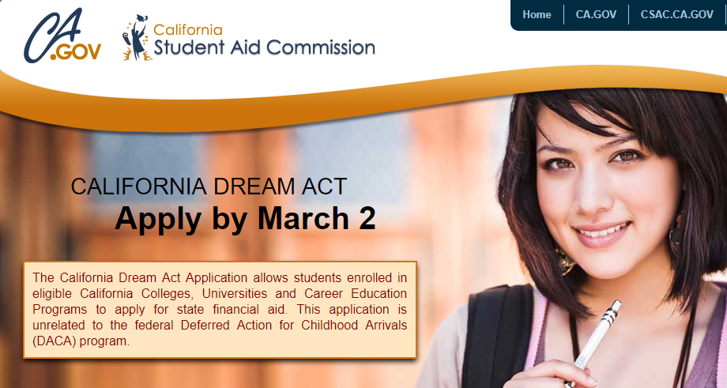
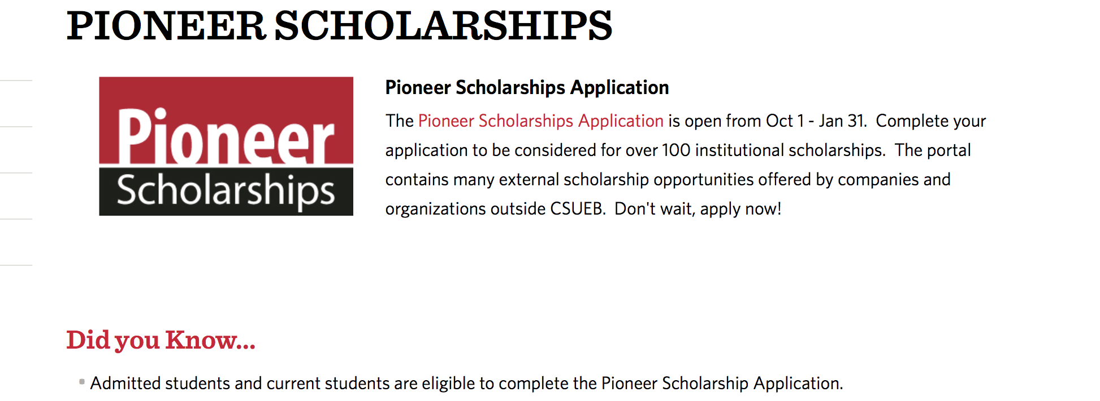
Yearly Application Process
Submit Application Oct 1st EVERY YEAR!
WWW.FAFSA.ED.GOV
HTTPS://DREAM.CSAC.CA.GOV
csueastbay.edu
Notes:
Remember that the Financial Aid Application Process happens every year. The FAFSA application, the California Dream Act Application, and the Pioneer Scholarships Application becomes available each year on October 1. For the 2021-2022 Academic Year, submit your FAFSA or CADAA application by March 2, 2021. Submit your Pioneer Scholarship Application by January 31. The Applications will be available October 1, 2020.

Slide 18
Awarding Process- Yearly
Submit the FAFSA/Dream Application by March 2
Submit the Pioneer Scholarship Application by January 31
Award Letters Emailed to Students Late March/April
Students Review their MyCSUEB To Do List verifying no outstanding items
Compare Awards to Direct Cost
Notes:
Each year, you will receive your financial aid notifications between March/April. Each year, you are required to complete all necessary verification items requested of you. Once you receive your Financial Aid, remember to compare the costs to your financial aid to determine how much you will need to pay.

Slide 19
2020-2021 Aid Year and Beyond
Starts with Fall 20 Semester
Ends with Summer Session (short)
Aid package will cover Fall and Spring
Summer aid only if any eligibility remains
Summer Year-Round Pell Grant (requires half-time enrollment)
No state aid for Summer term
Notes:
Remember that your Financial Aid is based on an assumption that you will be enrolled at full time for both the Fall and Spring term. Your Financial Aid will be applied in halves; the first half will be applied in the Fall and the second half will be applied during the spring. If you chose to enroll in the summer term, we will calculate your eligibility once your enrollment is determined.

Slide 20
Awarding Process – Semesters
1. Financial aid is typically disbursed within 10 days prior to the start of the term
2. Financial aid applies to student’s tuition, fees and on campus charges
3. Students sent a refund for any credit balance (check or direct deposit)
Notes:
Financial Aid is typically applied to your bill no earlier than 10 days before the start of the semester. The aid is first applied to your direct cost. If your Financial Aid for the term exceeds your costs, you will be issued a refund by the Student Financial Services Department.

Slide 21
Thank you!
finaid@csueastbay.edu
Tel: 510.885.2784
Phone Hours
Mon -Thur 8:00 AM - 4:00 PM
Fri. 10:00 AM – 4:00 PM Drop-In Counseling
Student Services Administration Bldg.
Mon - Thur 8:30AM - 5:30PM
Fri. 10:00AM - 5:00PM
(Please check our website for updated hours in compliance with the Alameda County ‘Shelter-In-Place’ Order)
Notes:
Please remember that our team at the Office of Financial Aid and Scholarships is here to help. Should you have any questions or concerns regarding your Financial Aid, please don’t hesitate to contact us.

