Slide 1
Think about the answer to the following questions
Welcome! While we wait for everyone to join us…
What do you use to study? (Materials, techniques, tools)
How do you use these? (What do you do with them?)
When do you study? (How often?)

Slide 2
Study Strategies
Project Impact
Winter 2016

Slide 3
Parts of Studying
What tools, techniques, & materials you use to study
How you engage with those tools/ The questions you ask yourself
When you study

Slide 4
Parts of Studying
WHAT
Learning Preference
Left brain/ right brain dominance
HOW
Self-quizzing
Meta-cognitive awareness
WHEN
Spaced
Personality Style
Understanding course expectations
Multi-modal learning
Avoiding cramming
Recognizing the difference between familiarity & learning

Slide 5

WHAT do I use to learn?
Sensory preference
Left brain/ right brain
personality
Notes:
Things to consider:
Sensory Preference- Visual, Auditory, Kinesthetic, Read/ Write learner?
Left brain/ right brain dominance- logical vs creative
Personality- I/E Sensing/ Intuition, Thinking/ Feeling, Judging/ Perceiving (see our other workshop on Discovering your personality!)
What is the goal of studying?
Bloom’s Taxonomy

Slide 6
Sensory Preference
Do you learn best by reading? Listening? Watching? Doing?
Do you prefer diagrams? Labs? Reading assignments? Class discussion?
In what subjects do you excel? What sensory preference is best served in that field?

Slide 7
Left brain/ Right brain dominance
Are you more verbal or visual?
Are you more logical or intuitive?
Are you more linear or holistic?
Are you more concrete or abstract?
Are you more time-oriented or spatial?
Do you focus on the details or main ideas?
In what subjects do you excel? Which brain dominance is best suited for this class?

Slide 8
Personality type
How do you prefer to interact with the world and where do you direct your energy?
Introversion / Extroversion
How do you prefer to process or take in information?
Sensing/ Intuition
How do you prefer to make decisions?
Thinking/ Feeling
How do you prefer to organize your life?
Judging/ Perceiving
Interested in learning more? See Marissa’s workshop!

Slide 9

STUDYING TECHNIQUES

Slide 10


Flash Cards
Notes:
There are many different techniques that you can use to help you study. Simply reading the information is often not enough for most people to commit information to their memory.
Flash cards are useful in many situations.
Write out your own
Print them out from computer- great idea if you type your notes, can copy and paste
Online versions- note card machine
Iphone
Flash cards are beneficial because they allow you to asses your own knowledge and quiz yourself.
Also, the act of making the flashcards IS studying
-looking up information and writing it out helps commit it to your long-term memory
Flash cards are great for visual learners if you include pictures in them.
If you are an auditory learner, trying reading them outloud.
If you struggle with language (ex: dyslexia) try and keep the words you write limited. Avoid full sentences and just use key phrases.
Manipulating your cards by placing like ones into piles is a common technique used for students with disabilities. The physical act of moving the cards is great for students who struggle with memory.

Slide 11

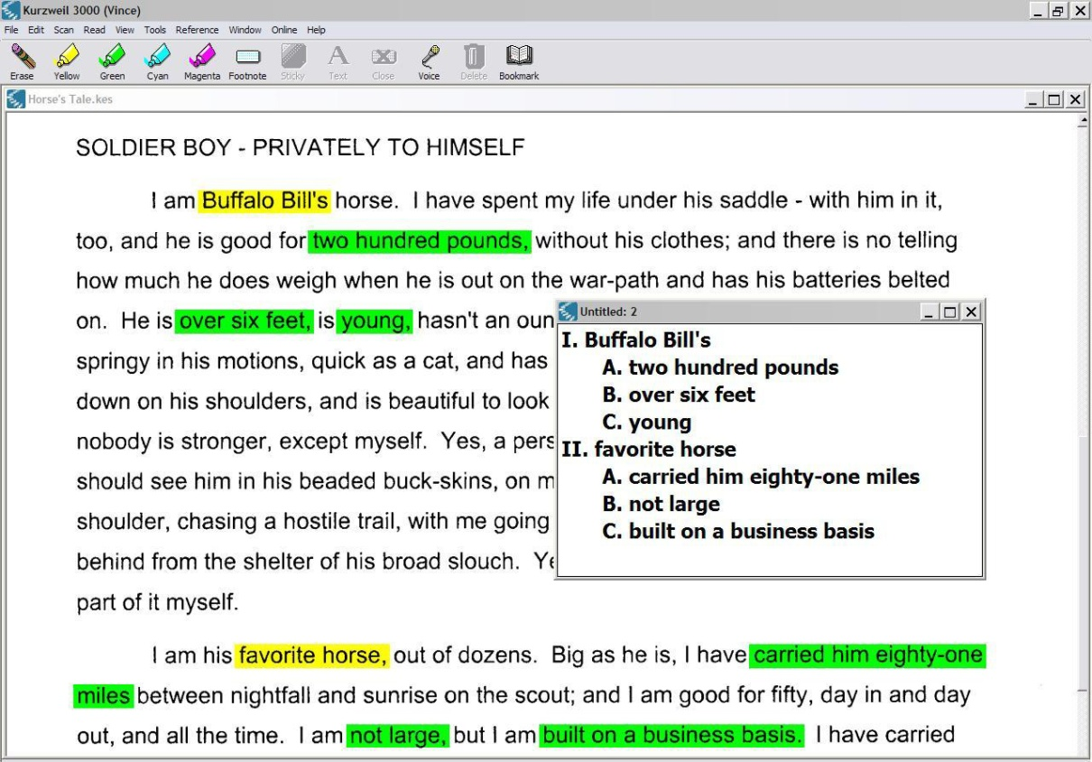
Color Coding
Notes:
I recommend to all my students that they make use of color coding.
Studies have shown that color coding information helps commit things to long term memory.
This technique is ideal for all kinds of learners.
Use the same color for a topic, and switch colors when you move onto another topic
-when you are in the exam and encounter a topic, you’ll find that you can easily recall what color you wrote the information in. Then, you’ll find that it is easier to recall the information
Use different colored pens or fonts when creating note cards or study guides
If you use kurzweil, make use of the different colored highlighters
- here you can see this student highlighted key terms in yellow, and then the corresponding details in green

Slide 12

Study Groups
Notes:
Study groups have numerous benefits
- they make studying much more fun
- if you don’t understand something, your peer may be able to help you
- likewise, explaining information to your peers helps you remember information
- you have access to many more students’ notes, so if you missed an important point in your own, you can find this out
- it ensures that you devote considerable time to studying
- talking about course topics also helps commit things to long term memory
Study groups are the best strategy for auditory learners. The reason is because you get to talk about the subject, and hear your peers discuss it

Slide 13
Create Your Own Pictures
Notes:
This technique is great for visual learners.
Create a picture that contains all the different components of a definition or concept.
Show example of major works of Jane Austen

Slide 14

Mnemonic Devices
Notes:
Mnemonic devices are also very useful for remember many different details
It is another strategy great for auditory learners
Create a word where each letter represents a detail
Create a rhyme
Create a sentence that will help you remember details
Give example:
-Every Good Boy Deserves Fudge
-Columbus sailed the ocean blue in 1492

Slide 15
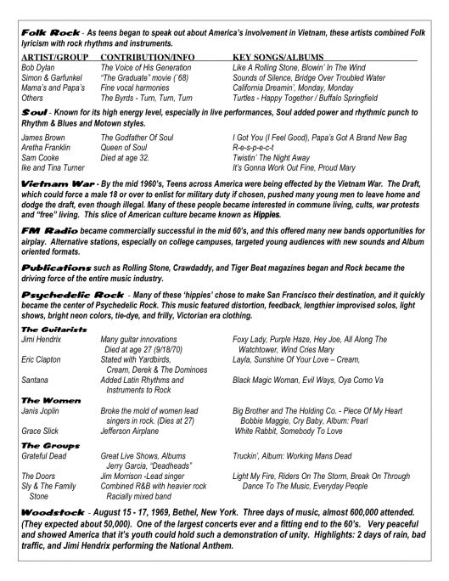
Create a Study Guide
Notes:
Study guides are great for every course
The process of creating it alone counts as studying!
I recommend this to all kinds of learners
- if you have a disability related language however, try and keep it as simple as possible.
- Like with the flash cards, just use key words
- Instead of using words, trying incorporating pictures or diagrams wherever possible

Slide 16

Quiz Yourself
Notes:
Most of us do this anyway, whether we realize it or not
The best way to quiz yourself is to do so honestly
Cover up your answers and try not to peek
This is a great way to figure out which topics you need to spend more time studying
Therefore, you should start quizzing yourself early in your studying sessions, and keep quizzing yourself throughout the whole process
This strategy is great for all kinds of learners, but you may want to adapt it if you are an auditory learner. Say your questions and answers out loud, or (even better) ask a friend or family member to quiz you

Slide 17
Talk to Your Professor
They want you to succeed
They were students once too!
Showing effort can help your grade
They may be able to give you tips about what to focus on

Slide 18
STUDYING FOR CERTAIN DISCIPLINES
Notes:
Everyone responds better to different studying techniques, and if you find one that works for you, you should use it.
However, you may find that some techniques fit certain courses better than others.
I compiled a list of techniques to try for different subjects, but remember any technique, if it works well for you, can be used in any class.

Slide 19
Science
Mnemonic devices
Focus on diagrams
Make sure you UNDERSTAND content, not just memorize it. This makes it much easier to remember

Slide 20
Mathematics
Do lots of practice problems with formulas and equations
Look over past homework
Try and understand the theory or logic behind the formulas you use

Slide 21
Humanities
Visualize the historical moment or story in the piece of literature
Create a study guide
Color code notes
Study groups

Slide 22



Language Courses
Study groups
Practice, practice, practice!
Flash cards for vocabulary
Write out conjugations

Slide 23
HOW do I engage with these materials?
Bloom’s Taxonomy

Slide 24
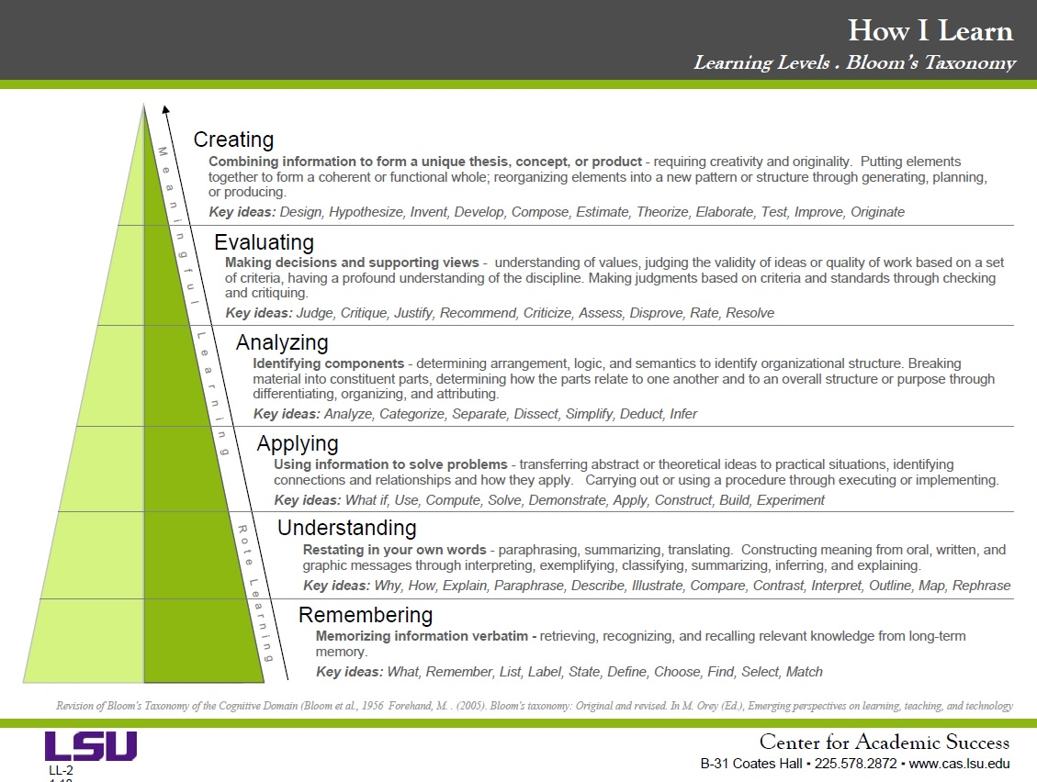

Slide 25
Look at your syllabi for “Learning Objectives” or “Learning Outcomes”
Look for action words

Slide 26
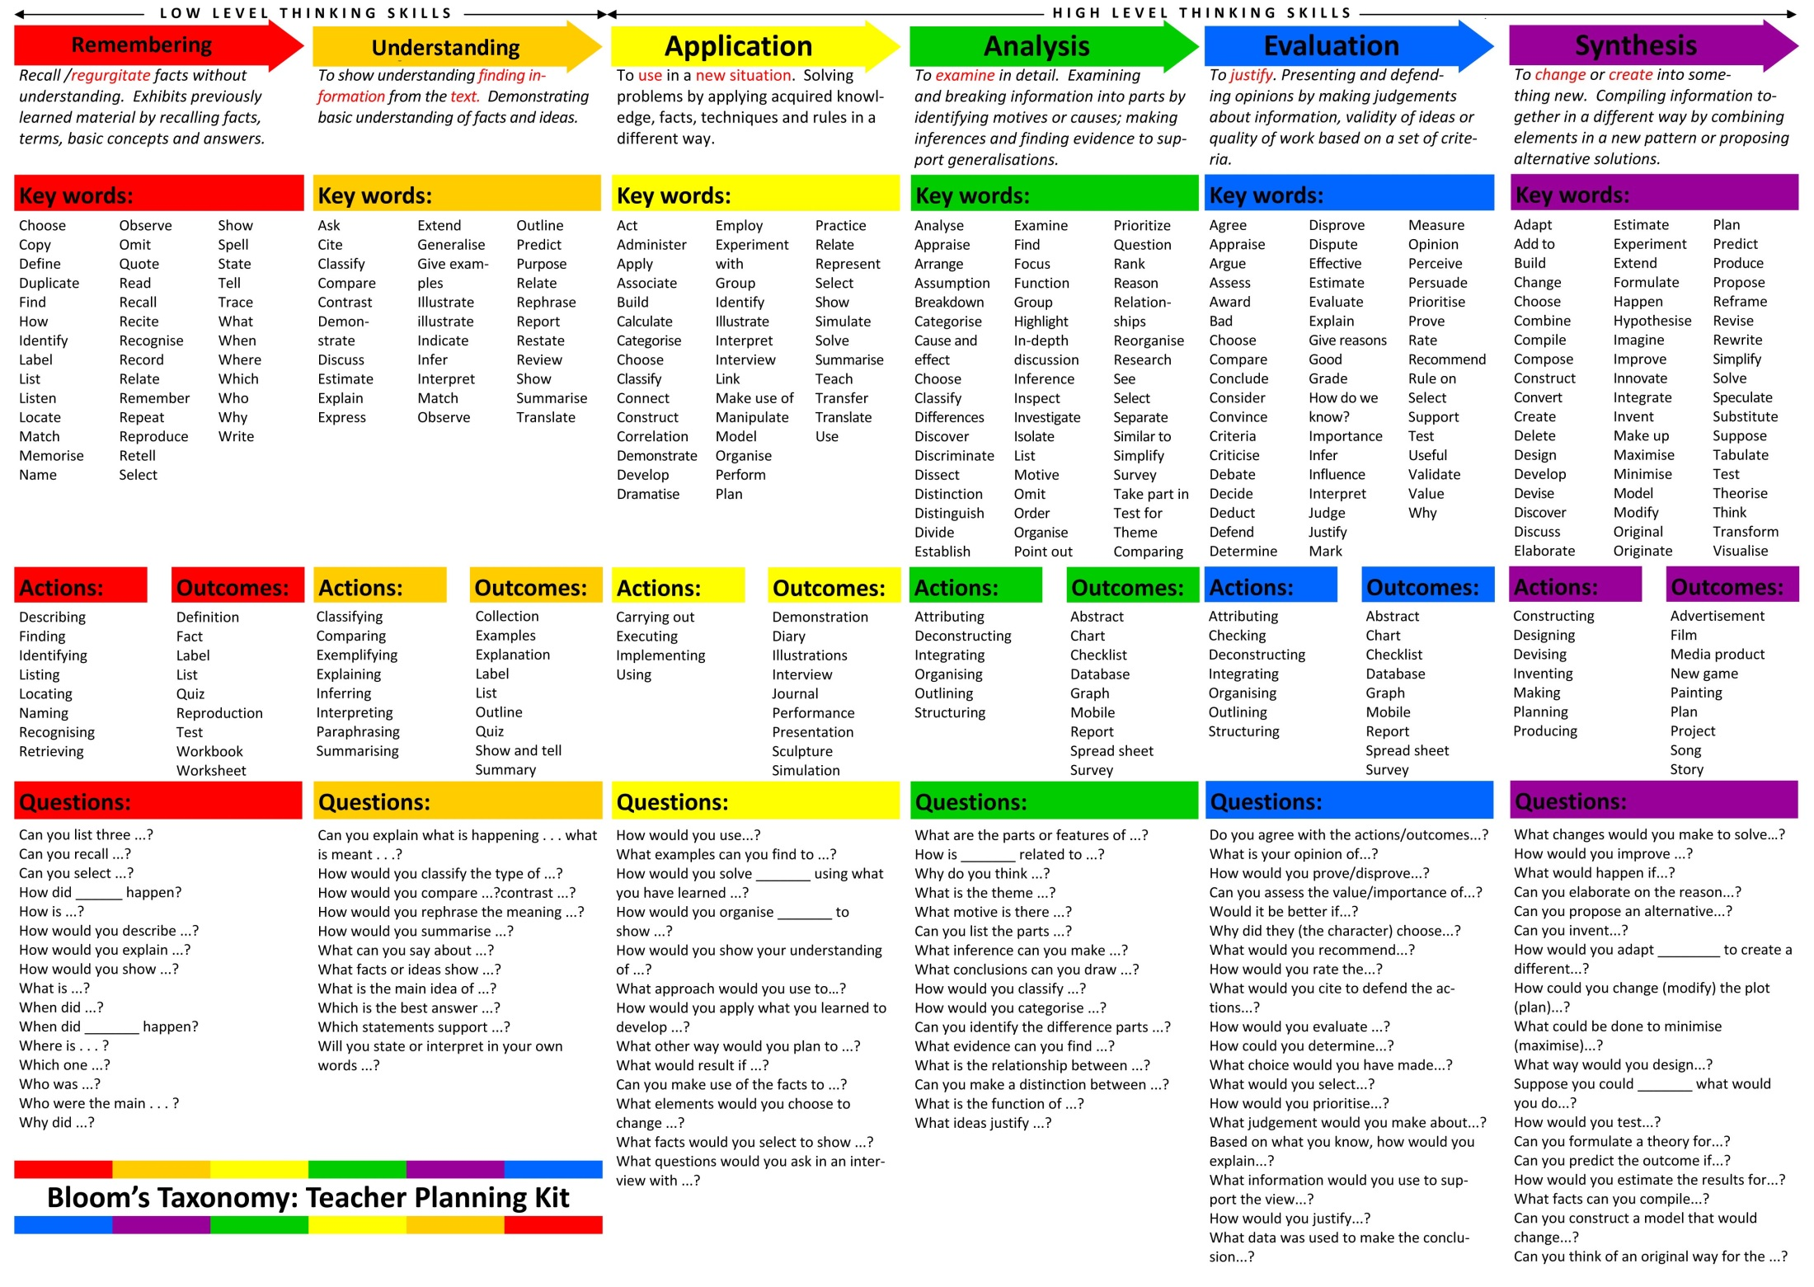

Slide 27
Choose Questions you can ask yourself when studying
AND… ask yourself “How will I know I’ve mastered the content and am not just familiar with it?”

Slide 28

Studying for Certain Types of Tests

Slide 29
Multiple Choice Exams
Balance your time between studying big concepts and smaller details
Don’t neglect any one area- balance your time between the main topics
Make lists and tables when studying
Hint: look at vocabulary, key people, key places

Slide 30
Answering Multiple Choice Questions
Look for key words: vocab, “except”
Process of elimination
Distinguish between right answer and “kind of” right answer
How to approach “All the following is true EXCEPT….” questions
  Underline/ circle the word EXCEPT
  Write the phrase “I am looking for the false answer” next to question
  Take each possible answer one by one
  “Speak” in your mind: ex: “A is true because __, so it cannot be A [cross out]”

Slide 31
Short Answer Exams
Goal: Understand “main idea” of every topic you covered
  Significance or “so what”
Practice your summarizing skills when studying
Hint: Look at cause and effect relationships
Hint: Look in your notes for numbered lists

Slide 32
Answering Short Answer Questions
Look for key words such as vocab, “significance,” and question words like “why,” “how,” and “what”
Ask yourself questions like: “What is the question asking? Is it a ‘why’ question? Is it asking me to list things? Is it asking me to explain ‘how’ something happened?”
Write information as it comes to mind, but make sure you get the most important points
Keep your eye on the clock
Always include the significance to the subject when defining terms
Don’t put down detailed information (ex: date) you are not sure about if it is not necessary

Slide 33
Essay Exams
Ask your professor for details ahead of time
  Introduction and conclusion?
Do an outline ahead of time if possible
Hint: What did your professor spend a lot of time on?
Study the “big picture”
  Look at your syllabus’ “learning objectives”
  Look at your syllabus’ topics in weekly schedule
  Are there reoccurring themes?
  Pretend you are the professor- what would you ask?

Slide 34

Answering Essay Questions
What is the question asking?
  Create a thesis statement first
Importance of an outline
Keep your eye on the clock

Slide 35
WHEN to study

Slide 36
Effective studying involves spaced self-quizzing and interleaving

Slide 37
Studying in High School vs Studying in College

Slide 38
Budget Your Time
Plan ahead
Incorporate studying into your school regiment all quarter long
Create a study schedule when exams are coming up
Notes:
Time management is essential to performing well on tests. To do well, you need to plan ahead. As soon as you know when your exam will be, whether it is the first day of class or a week into the quarter, you should begin planning your study sessions. Professors assume that you study a little almost every day, so in order to do well you should incorporate studying into your week all quarter long. As exams approach, creat a study schedule.
- Figure out what days and times you can devote to studying
- Decide what topics you will study on what days
- Stick to the schedule as closely as you can

Slide 39

Why You Should Avoid Cramming
Adds to stress
Inevitably, you forget some content
Does not commit things to long term memory
Notes:
First thing I want to discuss is why cramming is never a good idea. We cram when we leave studying to the last minute. The best way to avoid it is to start studying early. You should avoid cramming bc….

Slide 40
Help! The exam is tomorrow and I haven’t studied yet! What do I do?
While it’s never a good idea to fall behind in coursework, sometimes things get out of control
Take a deep breath
Make tough decisions on what to focus on with the time you have
  Focus on earlier material since its less fresh in your mind
  Focus on areas that will certainly be on the exam
  Plan out your essay question response
Notes:
Essay questions are usually weighted very heavily. Also, while preparing your essay answer, you’ll undoubtedly go over key terms that can be in short answer questions

Slide 41
Other tips…

Slide 42
Avoid Overworking Yourself
Getting burned out hurts your future performance
Try and make it a fun event
Give yourself lots of breaks (one ten minute every hour)
Keep your eye on the prize: remind yourself of your long-term goals

Slide 43

Avoid Distractions
Get all your supplies ready beforehand
Turn off television
Avoid Facebook
Listen to quiet music
Consider studying in Library
Notes:
There are a couple reasons you should consider studying in the library
- it is a great place, free of distractions
- You have access to tons of information, in case you find that your own notes aren’t enough
- You may run into classmates and can start an impromptu study group
- The physical act of going to a place designed for studying can get you in the right mind set
- Most importantly, it creates positive “peer pressure.” Seeing other students studying and working may push you to keep on track

Slide 44

Where Do I Start?
Make a list of the major topics covered in class
Take it one by one
Make use of course materials
Notes:
Many students feel overwhelmed at the prospect of studying, and don’t know where to start. Begin by making a list of the major topics that were covered in class and, if you are using a study schedule, figure out which days you can study each topic.
Take each topic one by one.
Make use of your course materials
- Your syllabus will probably list the major topics covered in class. This is usually in a schedule format
- Sometimes professors give you study guides. Answer all the questions on the study guide, and make sure you focus on all the topics he/she listed.

Slide 45
What to do with your Graded Exam
Learn from your mistakes
  What studying techniques worked?
  What could you have done better?
Always correct mistakes
Keep your exam
Reward yourself!

Slide 46

CONCLUSION

