Slide 1

Preparing for the W.S.T.: Developing Skills Part I
Elizabeth Chueka

Slide 2
6 Steps to a Great Essay
Adapted from 5 Steps in SCAA’s PowerPoint on UWSR
Notes:
Now that we have gone over the details of the WST and UWSR and discussed what they want your essay to look like, let’s get into how to create the type of essay the University is looking for. We will start this today and finish it in Part II.

Slide 3

6 Steps to A Great Essay
Analyze the Prompt
Pre-write
Create a Strong Thesis
Organize
Draft Essay
Revise
15 minutes
75 minutes
Notes:
The Six Steps to a Great Essay are…
Analyze the Prompt
Pre-write
Create a Strong Thesis
Organize
Draft Essay
What do you think the recommended time break down is for these steps?
The recommended time break down is 15 minutes to analyze, pre-write, create a thesis and organize your paper. Then, 75 minutes to write and revise.

Slide 4
Analyze the Prompt

Slide 5
Analyze the Prompt
All prompts follow the same basic structure
A topic (T)
One viewpoint (1VP)
An opposing viewpoint (OVP)
A command(C)
  Question + Call for Evidence
Notes:
The first step is to analyze the Prompt. All prompts that they offer for the Writing Skills Test can be broken down into the same basic structure.
A topic
One viewpoint
An opposing viewpoint
A command
Which includes a question and a call for evidence

Slide 6
Analyze the Prompt
We see cell/mobile phones almost everywhere, from cars and buses to restaurants and classrooms. Many people argue that cell/mobile phones have become a necessary part of modern life and, as such, should be unrestricted. Others argue, however, that they can be disruptive and thus there should be limitations on their use. Should there be regulations limiting the use of cell/mobile phones? Make sure you support your position with reasons, explanations, and examples.
Identify the topic (T)
Identify one viewpoint (1VP)
Identify the opposing viewpoint (OVP)
Identify the command(C)
  Question + Call for Evidence
Notes:
So let’s try to analyze prompt… This prompt may be a little difficult to follow for some of you- so I am going to break it down into separate sentences.

Slide 7
Analyze the Prompt
We see cell/mobile phones almost everywhere, from cars and buses to restaurants and classrooms.
Many people argue that cell/mobile phones have become a necessary part of modern life and, as such, should be unrestricted.
Others argue, however, that they can be disruptive and thus there should be limitations on their use.
Should there be regulations limiting the use of cell/mobile phones?
Make sure you support your position with reasons, explanations, and examples.
Identify the topic (T)
Identify one viewpoint (1VP)
Identify the opposing viewpoint (OVP)
Identify the command(C)
  Question + Call for Evidence
Notes:
It is a little easier to analyze the prompt when it is presented in this way. If you have trouble analyzing prompts you can rewrite prompts with spaces in between like this, or separate sentences with lines, or underline every other one.
So let’s read this…
Can you identify the sentence that presents the topic?
Can you identify the sentence that presents the first viewpoint?
Can you identify the sentence that presents an opposing viewpoint?
Can you identify the sentence that presents the question part of the command?
Can you identify the sentence that presents the call for evidence part of the command?

Slide 8
Analyze the Prompt
We see cell/mobile phones almost everywhere, from cars and buses to restaurants and classrooms.
Many people argue that cell/mobile phones have become a necessary part of modern life and, as such, should be unrestricted.
Others argue, however, that they can be disruptive and thus there should be limitations on their use.
Should there be regulations limiting the use of cell/mobile phones?
Make sure you support your position with reasons, explanations, and examples.
Identify the topic (T)
Identify one viewpoint (1VP)
Identify the opposing viewpoint (OVP)
Identify the command(C)
  Question + Call for Evidence
Notes:
Here are the parts of the prompt identified.

Slide 9
Analyze the Prompt
In the past few decades, salaries of entertainers and athletes have risen dramatically. Some people argue that they are entitled to make as much money as they can, while others argue that such salaries have risen to unreasonable levels. Are athletes and entertainers paid too much? Make sure you support your position with reasons, explanations, and examples .
Identify the topic (T)
Identify one viewpoint (1VP)
Identify the opposing viewpoint (OVP)
Identify the command(C)
  Question + Call for Evidence
Notes:
Let’s try another.

Slide 10
Analyze the Prompt
In the past few decades, salaries of entertainers and athletes have risen dramatically.
Some people argue that they are entitled to make as much money as they can, while others argue that such salaries have risen to unreasonable levels.
Are athletes and entertainers paid too much?
Make sure you support your position with reasons, explanations, and examples .
Identify the topic (T)
Identify one viewpoint (1VP)
Identify the opposing viewpoint (OVP)
Identify the command(C)
  Question + Call for Evidence
Notes:
Here we are with the sentences separated again
Can you identify the sentence that presents the topic?
Can you identify the sentence that presents the first viewpoint?
Can you identify the sentence that presents an opposing viewpoint?
Can you identify the sentence that presents the question part of the command?
Can you identify the sentence that presents the call for evidence part of the command?
.

Slide 11
Analyze the Prompt
In the past few decades, salaries of entertainers and athletes have risen dramatically.
Some people argue that they are entitled to make as much money as they can, while others argue that such salaries have risen to unreasonable levels.
Are athletes and entertainers paid too much?
Make sure you support your position with reasons, explanations, and examples .
Identify the topic (T)
Identify one viewpoint (1VP)
Identify the opposing viewpoint (OVP)
Identify the command(C)
  Question + Call for Evidence
Notes:
As you can see, in this situation one sentence presents both viewpoints.

Slide 12
Why analyze the prompt?
In order to get a good grade for “Task” you need to be sure your PAPER answers the…
Command:
both the question and call for evidence
Notes:
So- why analyze the prompt?
In order to get a good grade for the “Task” portion you need to be sure your paper answers the.. Command- both the question and the call for evidence. If your paper does not fully do one or the other, you may receive a developing competence or limited competence grade.

Slide 13
Analyze the Prompt
1. Analyze the Prompt
  A topic (T)
  One viewpoint (1VP)
  An opposing viewpoint (OVP)
  A command(C)
    Question + Call for Evidence
Some people believe that watching television is a worthless or meaningless activity, while others view it as a valuable way to relax or gather information. Is watching TV a valuable activity? Make sure you support your position with reasons, explanations, and examples.

Slide 14
Analyze the Prompt
Some people believe that watching television is a worthless or meaningless activity, while others view it as a valuable way to relax or gather information.
Is watching TV a valuable activity?
Make sure you support your position with reasons, explanations, and examples.
1. Analyze the Prompt
  A topic (T)
  One viewpoint (1VP)
  An opposing viewpoint (OVP)
  A command(C)
    Question + Call for Evidence

Slide 15
Analyze the Prompt
1. Analyze the Prompt
  A topic (T)
  One viewpoint (1VP)
  An opposing viewpoint (OVP)
  A command(C)
    Question + Call for Evidence
Topic: watching television
Some people believe that watching television is a worthless or meaningless activity, while others view it as a valuable way to relax or gather information.
Is watching TV a valuable activity?
Make sure you support your position with reasons, explanations, and examples.

Slide 16

Pre-write
Notes:
Let’s move on from analyzing the prompt. The second step to a great essay is to pre-write.

Slide 17
Pre-write
2. Pre-write
  List ideas supporting both sides
    List counterarguments as they come to mind
    List exceptions too!
  Pick a position
    YOU CANNOT BE IN THE MIDDLE
    MUST BE ON ONE SIDE OR THE OTHER
    Either entirely for, mostly for, entirely against, mostly against
  Clump ideas
Claim from Opposite View + Refute
Notes:
When you pre-write, you want to first list ideas supporting both sides of an argument. List ideas “for” and “against.” Be sure to list any exceptions you think of and counterarguments as they come to mind. Remember, a counterargument is a claim from the opposite view and your rebuttal to that claim. Next, you want to pick a position. You must pick one side or the other. You cannot be in the middle. You can be entirely for, mostly for, entirely against or mostly against something. Finally, you want to clump similar ideas together, and start to get an idea of your three or four body paragraphs.

Slide 18
Are athletes and entertainers paid too much?
Yes
No
This nation founded on free-market principles
Right to make as much money while they can
We determine their salary by our support of their work
Entertainers provide a valuable service- help us unwind.
Entertainers sacrifice their privacy, should be compensated
  Counterargument: many celebrities conduct “stunts” to purposely increase their fame.
  Counterargument: “any press is good press”
Civil servants- teachers, policemen, etc get paid far less and make a more meaningful impact on society
Their work does not leave a lasting impact on humanity
Sending a bad message to youth: you get rich by looking a certain way
  Counterargument: Some become rich because of actual athletic skill.
Notes:
So let’s see what a pre-write might look like for “are athletes and entertainers paid too much?”

Slide 19
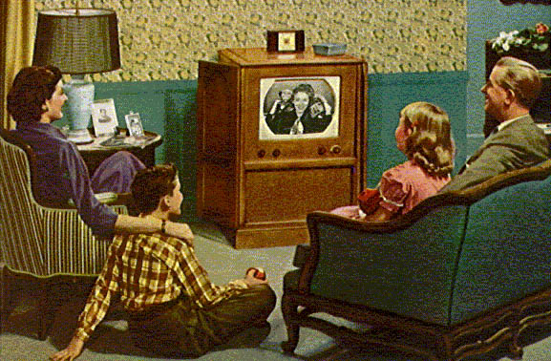
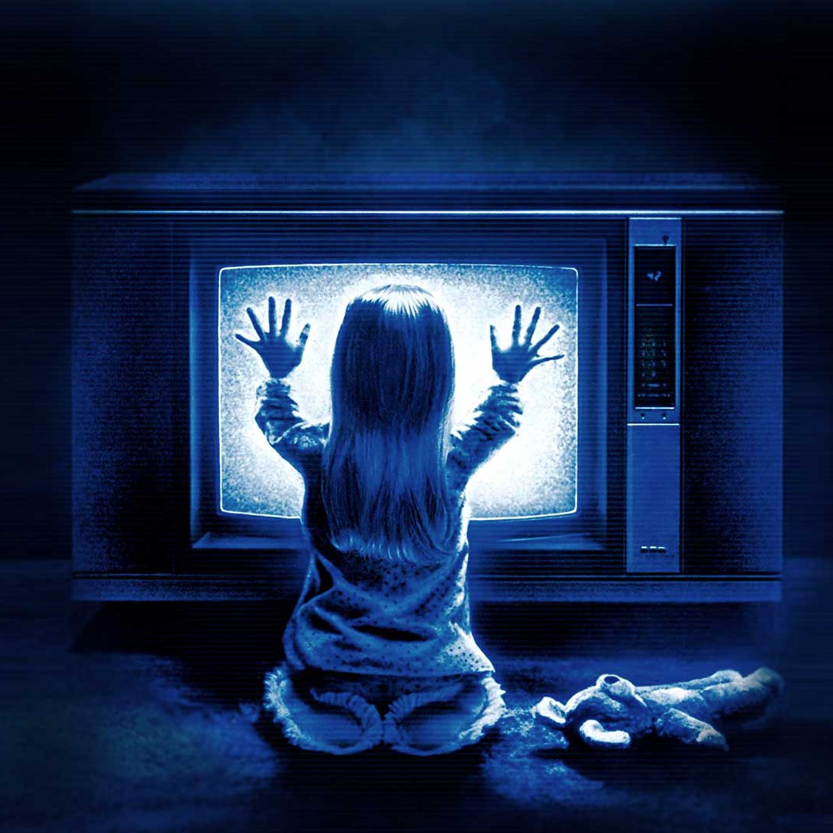
Let’s Pre-Write…
Is watching TV a valuable activity?
Notes:
BOARD ACTIVITY

Slide 20

Creating a Strong Thesis
Notes:
The next step to a great essay is creating a strong thesis. This part can be challenging, so don’t be afraid to spend some time on it.

Slide 21
Thesis: The old way
Take the Question and turn it into a statement
  Q: Is watching TV a valuable activity?
  T: Watching TV is/ is not a valuable activity because…
List your three reasons in your thesis
  Watching TV is/ is not a valuable activity because ____(1)____, ____(2)____ and ____(3)____.
Notes:
Some of you may have been taught to compose a thesis like this. This is what I call the old way.

Slide 22

Why is this not enough?
  Watching TV is/ is not a valuable activity because ____(1)____, ____(2)____ and ____(3)____.
How can we summarize this?
Notes:
BOARD ACTIVITY
This way of creating a thesis is not enough because it is too simple. It narrows yourself to three reasons. You want to summarize your reasons. Here are some examples of more advanced theses.
Example with a exception: “Watching TV is not a valuable activity because it does not help you improve yourself. The only exception to this is educational programs, which may serve to educate.”
Example with counterargument: Though some claim that watching TV will “rot your brain,” it actually can educate you. Watching TV is a valuable activity because it can present information in an effective format.
With 4 Reasons: Watching TV is a valuable activity because it provides many different types of people with an inexpensive opportunity to relax while simultaneously connecting with American culture.

Slide 23
Developing Skills Part 2
Learn to organize your essay, write effectively, and revise quickly

Slide 24
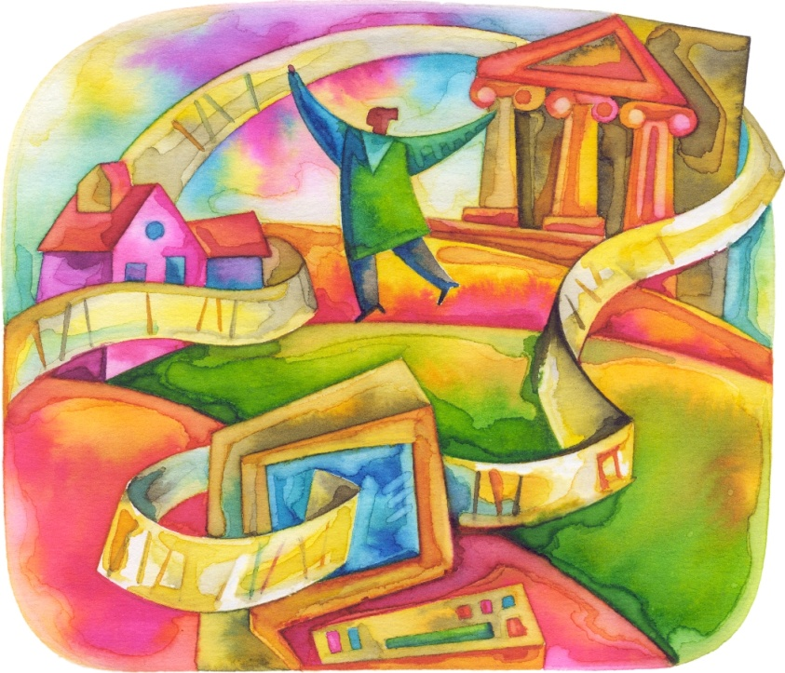
Questions?
Credits
Information for this presentation taken from:
Testing Office Website,
SCAA Website,
and SCAA Presentation on UWSR

