Slide 1
Graduation and Commencement Workshop

Slide 2
Graduation vs. Commencement
What is the difference?

Slide 3
When to File for Graduation
Currently accepting applications for Summer or Fall 2020
  Priority deadline: March 2
  Late deadline: April 1
You must have completed the University Writing Skills Requirement (UWSR) in order to file for graduation.

Slide 4
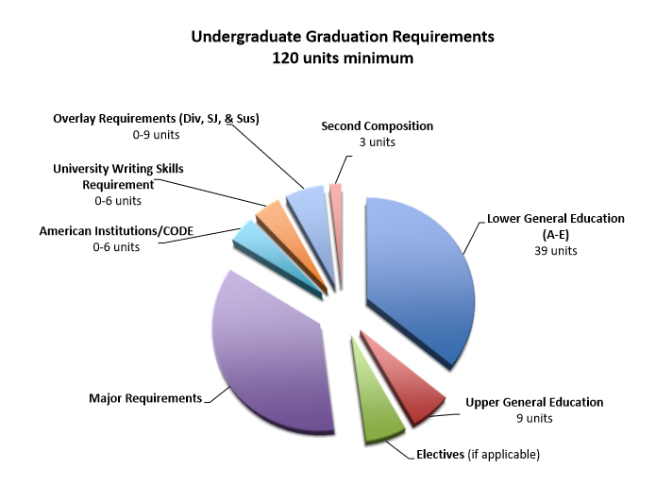

Slide 5
How to Graduate
DEPARTMENTS INVOLVED
Major Department
General Education/Academic Advisement Center
Graduation Evaluation (Office of the Registrar)

Slide 6
Major Department
Meet with your major advisor to review requirements.
Issues a major check notifying Graduation Evaluations (Registrar) of your major requirements. The process to review your file for graduation cannot begin until the major check is received

Slide 7
General Education Advising
All undergraduate students should consult with an academic general education advisor periodically to go over non-major requirements:
    General Education
    Graduation Requirements
    Unit Requirements

Slide 8
Notification from Graduation Evaluator
Once the major check is received by the graduation evaluator, they will work on your final review and send an email that summarizes the requirements necessary for graduation.
The timing of receiving this final review depends on the volume of graduation candidates and when the major check was received, so check your Horizon email often.

Slide 9
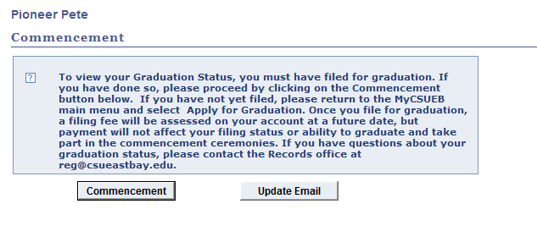
Graduation Status
Select the link in MyCSUEB called “Graduation Status/Commencement”
Notes:
Our local service area defines the geographic territory assigned to Cal State East Bay for the distribution of CSU systemwide information to counselors, students and family members.
Our local admission area is defined by the school districts and community colleges within our service area and an expanded region surrounding our designated service area. Geographical boundaries are used in categorizing the local admission area for all public, private, charter, and parochial schools.

Slide 10
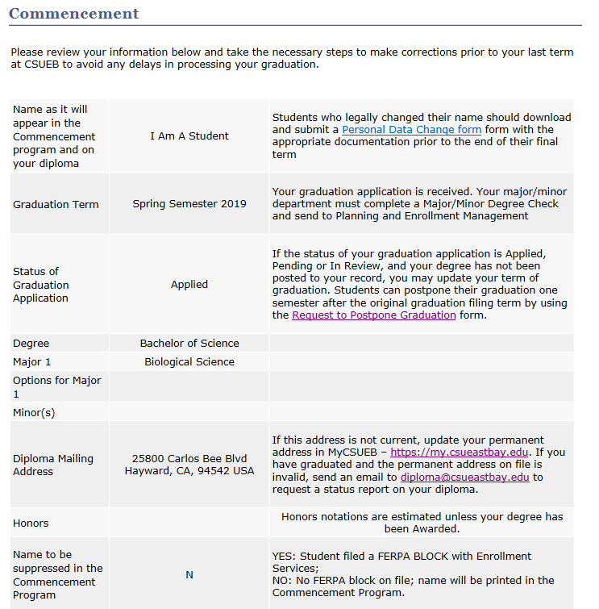

Slide 11
Graduation Status
APPLIED: Graduation application has been received
PENDING: Major check has been received by the Office of the Registrar.
IN REVIEW: Preliminary verification of degree requirements completed and the evaluator has sent a summary of graduation requirements to your Horizon email.
AWARDED: Degree is awarded and diploma ordered. Degree posting is on the transcript immediately.

Slide 12
Important Reminders
Continue to meet with major and academic advisors as appropriate.
After the final review is received, inform your graduation evaluator of any course substitutions approved so they can update your file.
Check to ensure that all majors/minors/options are officially recorded on your record.
Complete all degree requirements by the last day of the final term or your graduation may be delayed.

Slide 13
Important Reminders (cont’d)
Check your address on MyCSUEB. Your diploma will be sent to your permanent address on file, and is mailed 6-8 weeks after your degree is awarded.
Check your name in MyCSUEB. This is the name that will appear in the commencement program, and on your transcript and diploma. A “Personal Data Change” form can be submitted for legal name changes.

Slide 14
Postponing Graduation Term
If you are not going to complete all graduation requirements in the term in which you filed, complete a “Request to Postpone Graduation” form.
You can update your graduation one semester; undergraduate students will be charged a $25 postponement fee.

Slide 15
Commencement Program
The 2020 Commencement program will include the names of graduation candidates for Fall 2019, Spring 2020 and Summer 2020 as of April 1.

Slide 16
Commencement Regalia
Concord Grad Fest
    Redwood Room
    Tuesday, March 17th
    2:00pm – 6:00pm
Hayward Grad Fest
    New Union, Multi Purpose Room
    Tuesday, March 24th for Pre-order pick up only, 12noon – 6pm
    Wednesday & Thursday, March 25th & 26th 10:00am – 6pm
In Store
    At both Hayward and Concord Bookstores (while supplies last!)
    April 6th - Commencement

Slide 17
Grad Fest
Grad Fest is your last chance to get discounted regalia packages. There are three different packages to choose from. Additional regalia items will be sold á la carte.
Other services that will be available – Grad Photos, Diploma Frames, Class Rings, Custom Sashes, College and Ceremony Information, Parking Passes, Commencement Ticket Information, Accessibility Services and Cultural Celebration Information.
If you can not make it to Grad Fest, you still can purchase á la carte regalia in the bookstore beginning April 6th through Commencement.
Preorder now through February 16th online at herffjones.college.com/csueb for pickup.

Slide 18
Commencement Dates
College of Science
  Friday, May 15, 5:00 pm - Pioneer Stadium
  Arrival Time: by 4:00 pm, Softball Field (Lot N)
  Processional line-up: Approximately 4:30 pm
College of Letters, Arts and Social Science
  Saturday, May 16, 10:00 am - Pioneer Stadium
  Arrival Time: by 9:00 am, Softball Field (Lot N)
  Processional line-up: Approximately 9:30 am
College of Business and Economics & College of Education and Allied Studies
  Sunday, May 17, 10:00 am - Pioneer Stadium
  Arrival Time: by 9:00 am, Softball Field (Lot N)
  Processional line-up: Approximately 9:30 am

Slide 19
Concord Commencement
Concord ceremony
  Saturday, May 16 6:00 pm Concord Campus
Students who have taken any units in Concord will be invited to their commencement ceremony and will require an RSVP (link is online)
No tickets or parking permits are required.
You do not have to attend at Concord if you are invited, you may still choose to participate in the Hayward ceremony.

Slide 20
Commencement Day Information
Hayward Ceremonies: Admission tickets for your guests
Livestream
Parking and alternative transportation
Attire: Ed.D, Master’s, Credential, Bachelor’s candidates
Length of ceremony
Food and Drink
Accessibility – Students and Guests
Website
Weather

Slide 21
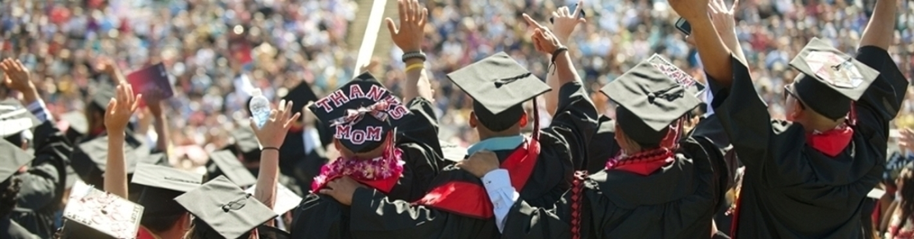
Congratulations!

