Slide 1


Presented by Student Health & Counseling Services
Naya Gordon, LCSW and Kathryn Kirkpatrick, LCSW

Slide 2

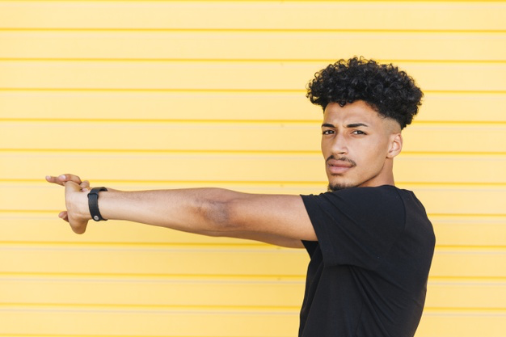
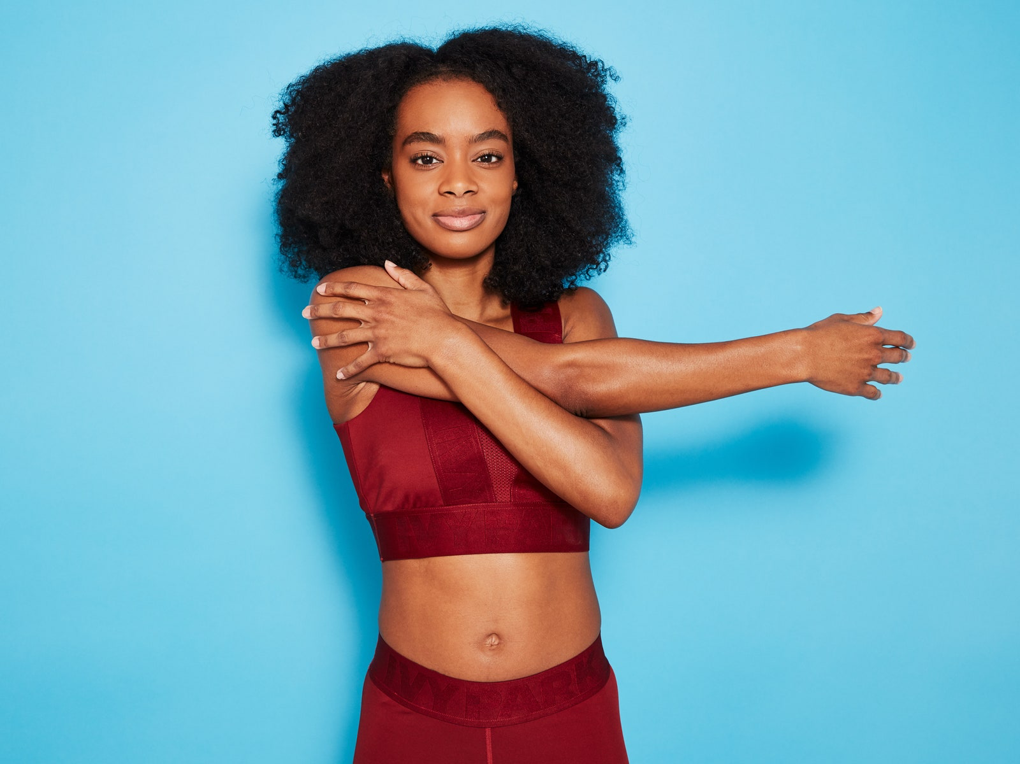
Let’s stretch…

Slide 3
Group Guidelines
Please mute your audio and type any questions into the chat box
Your video can be off or on, whatever makes you most comfortable
Chat privately for specific needs

Slide 4
Agenda
Introductions/Icebreakers
Group Agreements
Topics - what do you want from this group? What topics interest you?

Slide 5
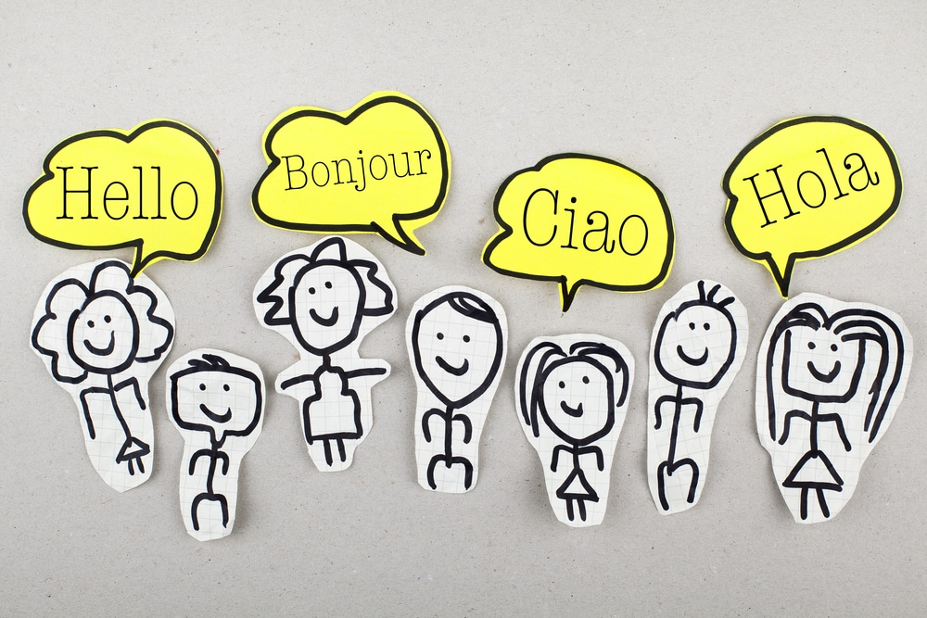
Introductions
Name
Pronouns
Year @ CSUEB
Major
What interests you about this group?
Anything else you want to share

Slide 6

Icebreaker
Two truths and a Lie

Slide 7
Group Agreements
and Values

Slide 8

What do you need to make this space inviting, safe, supportive….

Slide 9
Previous Agreements
Respect (i.e. listening to one another)
No judgement
Ask clarifying questions vs. making assumptions
Positive affirmations - creating an uplifting environment
Showing up - participate and make space for others to share
Clear communication - acknowledging what we are bringing into the space *having a hard day, feeling tired, etc.

Slide 10
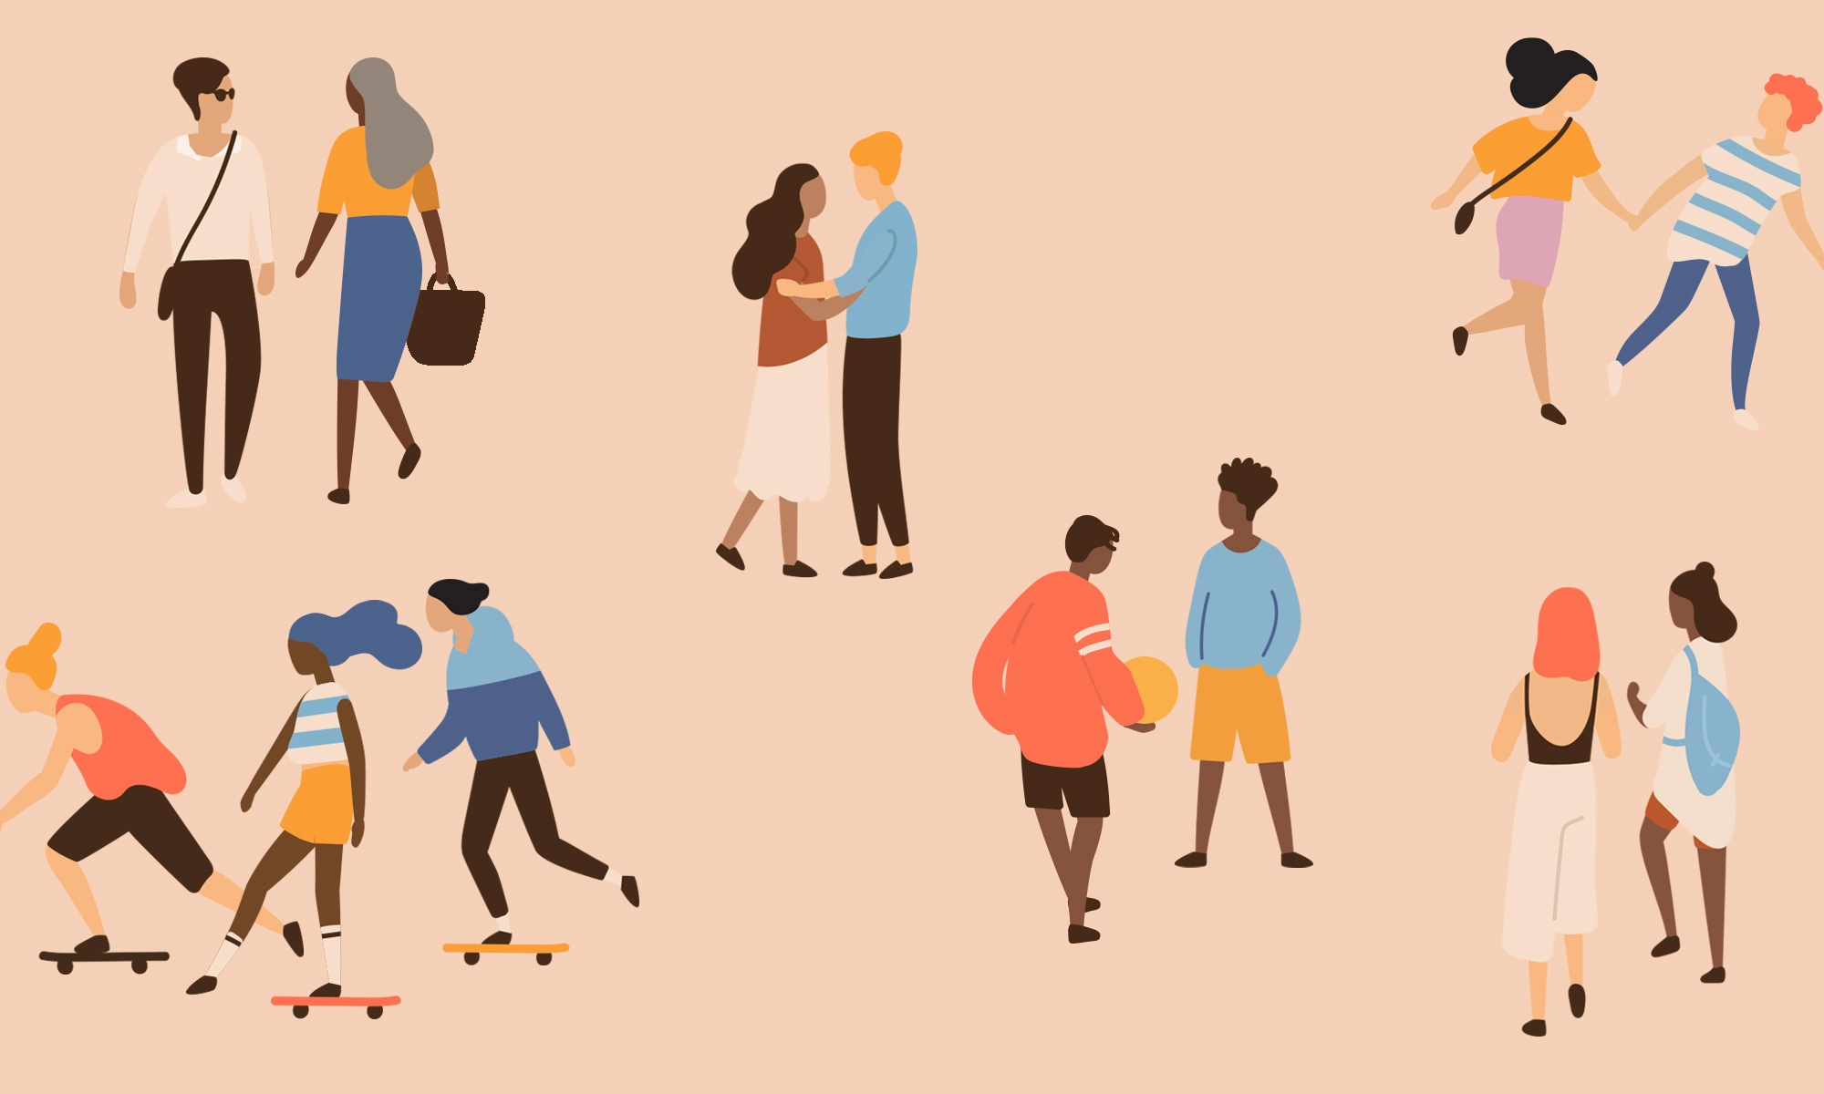
What topics would you like to discuss?
Note: “Healthy relationships” are not limited to romantic partnerships; we may discuss platonic, family, community,
workplace dynamics, etc.
What is a healthy relationship?
Boundaries
Familial/Foundational relationships
Conflict Resolution
Nonviolent Communication
Other ideas: Gender, Sex & Intimacy
Cultivating Secure Attachment w/ Self & Others
Red/Yellow/Green Flags…
Assertiveness & Apologies
Digital Boundaries
Power & Control & Consent
Notes:
Relationship patterns…..

Slide 11

Take Care and Stay Safe!
Thank you for joining us today!
Check-Out Reflection:
Continue to think about what topics you would like to discuss regarding healthy relationships.

Slide 12


