Slide 1


Presented by Student Health & Counseling Services
Naya Gordon, LCSW and Kathryn Kirkpatrick, LCSW

Slide 2
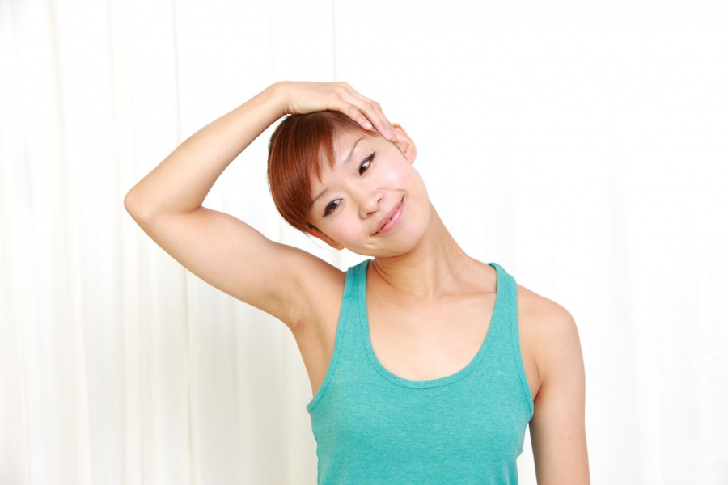
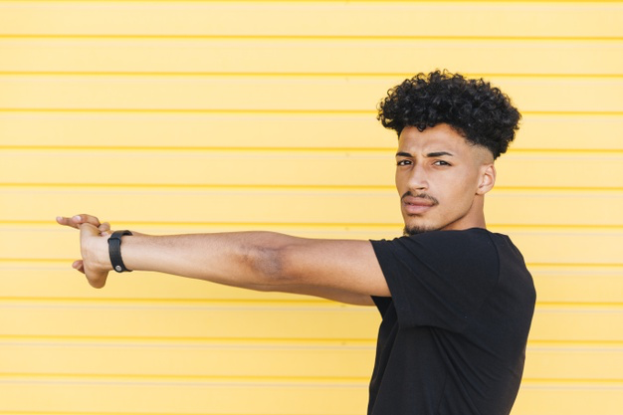
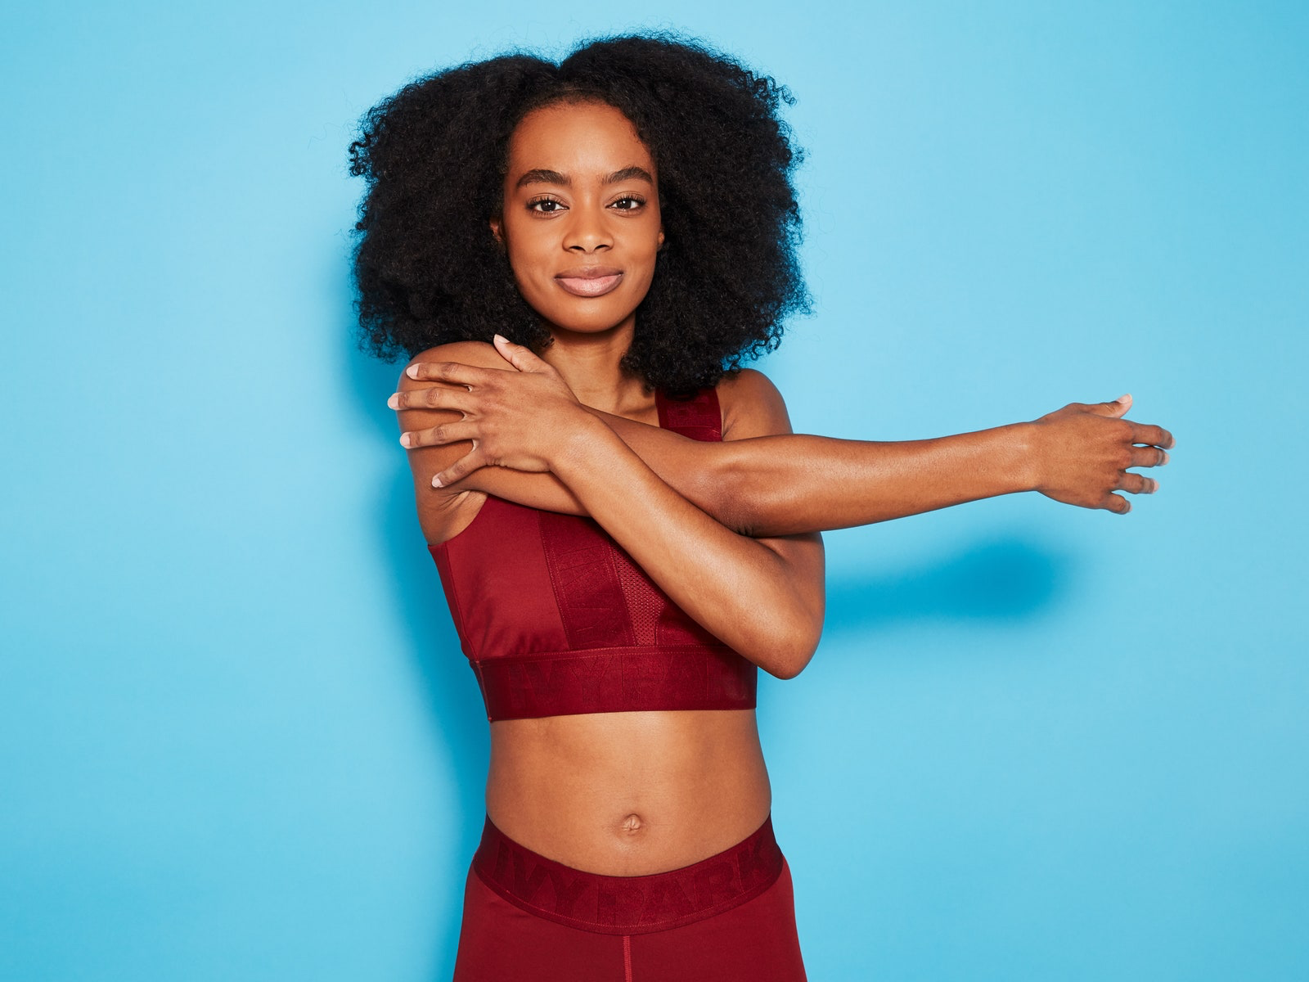
Let’s Stretch . . .

Slide 3
A Few Group Guidelines
Please mute your audio and type any questions into the chat box
Your video can be off or on, whatever makes you most comfortable
Chat Naya or Kathryn privately for specific needs

Slide 4
Group Agreements Group Values
Confidentiality
Judgement Free Zone
Respect each other
Listen to one another
Participate
Ask clarifying questions/no assumptions
Ask permission before giving advice
Acknowledge what we are bringing into the space
Trigger Warning (Let Folx Know)
· ·
·
Compassion
Empathy
Being open minded
Clear Communication
Uplifting one another
Be your own Boo/Take Care of Your Needs (Restroom, drinks, snacks, etc.) and communicate your needs.

Slide 5
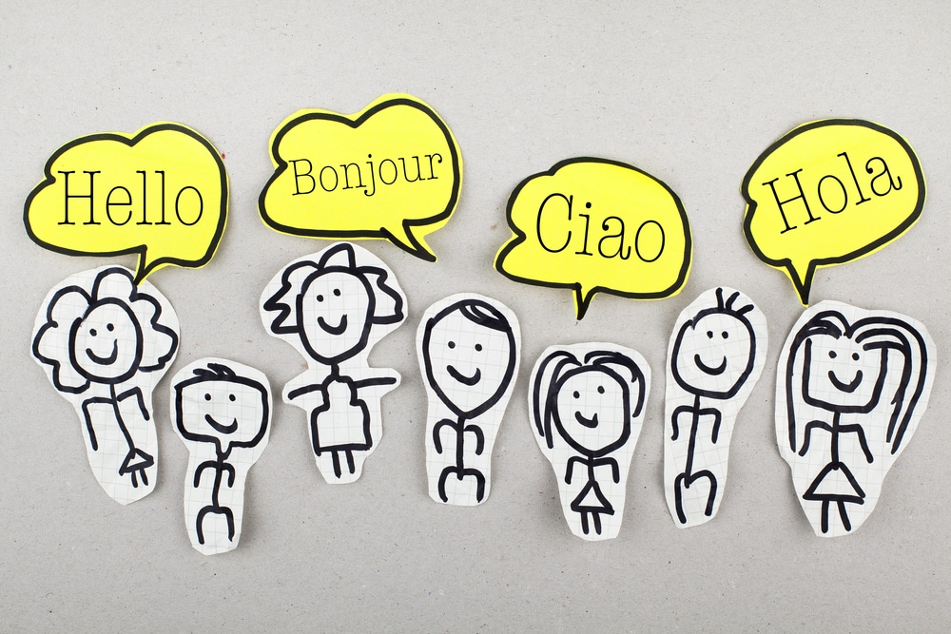
Introductions
Name
Pronouns
Year @ CSUEB
Major
Ice Breaker: If you were a superhero what would your superpower be?

Slide 6
Intentions for today’s Group:
What is a healthy relationship?
Explore the difference between healthy, unhealthy vs. abusive relationships?
Activity

Slide 7
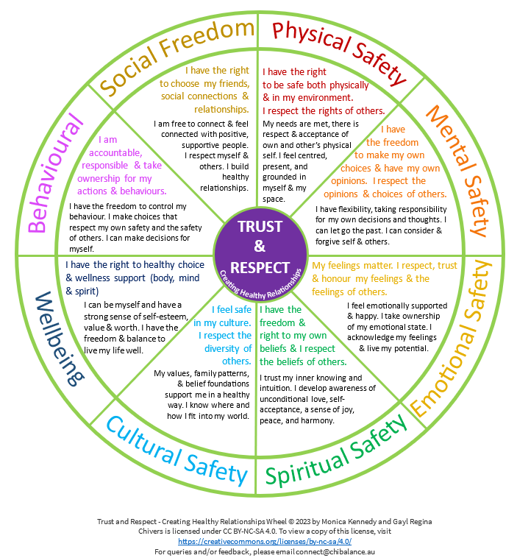

Slide 8
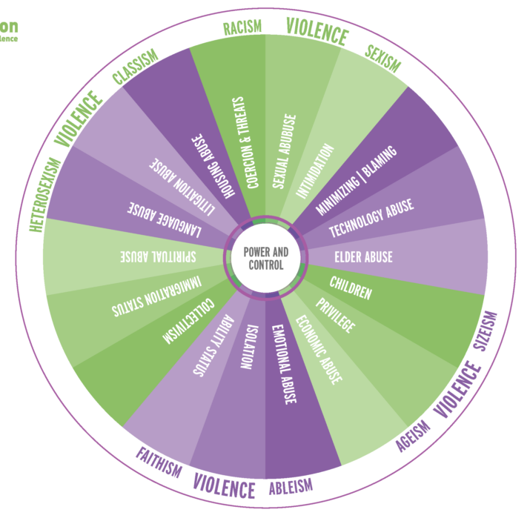
Notes:
Micro to macro level examples

Slide 9
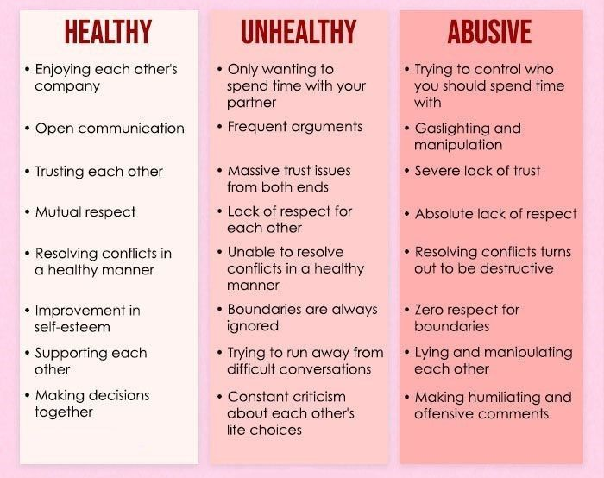

Slide 10

ACTIVITY: Identifying healthy vs. unhealthy dynamics in one your own relationships

Slide 11

Take Care and Stay Safe!
Thank you for joining us today!
Check-Out Reflection:
What is one thing you are taking from the group this week?
Please use the same link to return next week

Slide 12


