Slide 1


Presented by Student Health & Counseling Services
Naya Gordon, LCSW and Kathryn Kirkpatrick, LCSW

Slide 2

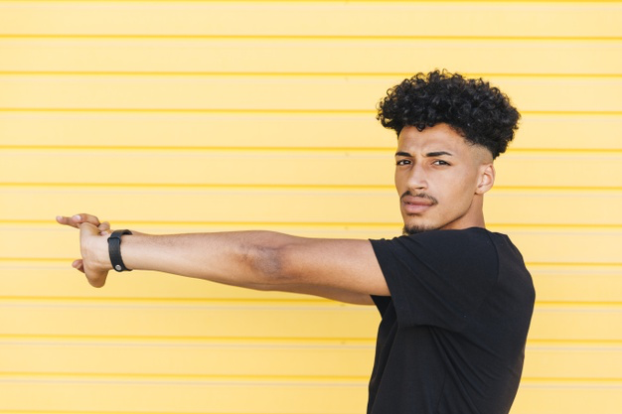
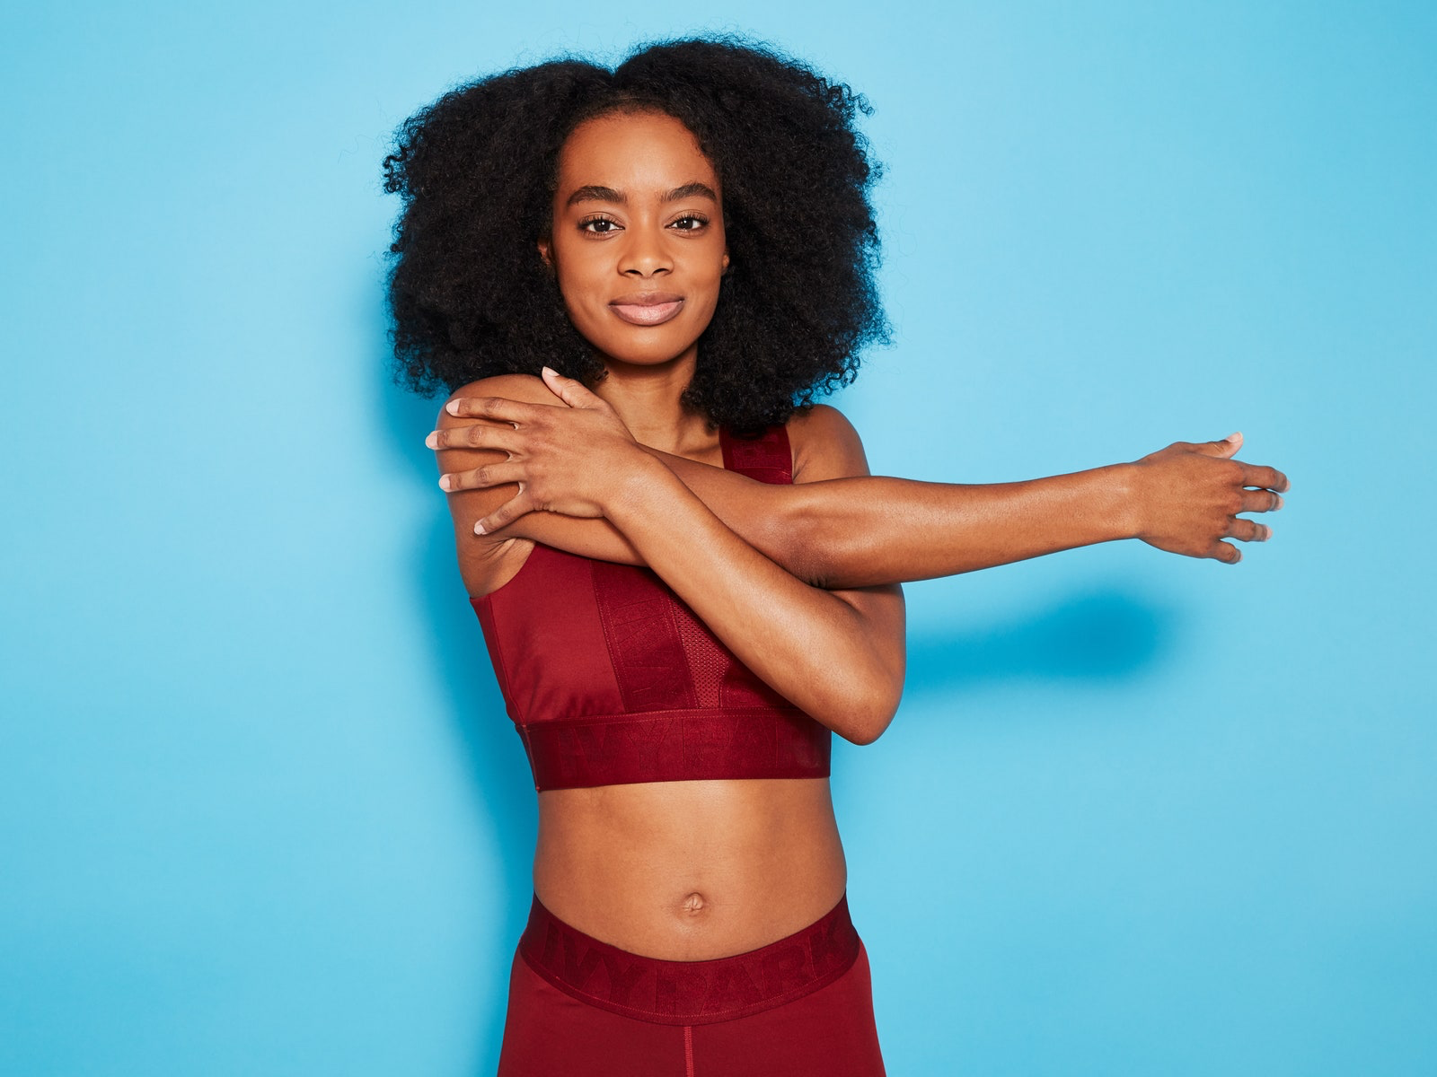
Let’s Stretch . . .

Slide 3
A Few Group Guidelines
Please mute your audio and type any questions into the chat box
Your video can be off or on, whatever makes you most comfortable
Chat Naya or Kathryn privately for specific needs

Slide 4
Group Agreements Group Values
Confidentiality
Judgement Free Zone
Respect each other
Listen to one another
Participate
Ask clarifying questions/no assumptions
Ask permission before giving advice
Acknowledge what we are bringing into the space
Trigger Warning (Let Folx Know)
· ·
·
Compassion
Empathy
Being open minded
Clear Communication
Uplifting one another
Be your own Boo/Take Care of Your Needs (Restroom, drinks, snacks, etc.) and communicate your needs.

Slide 5
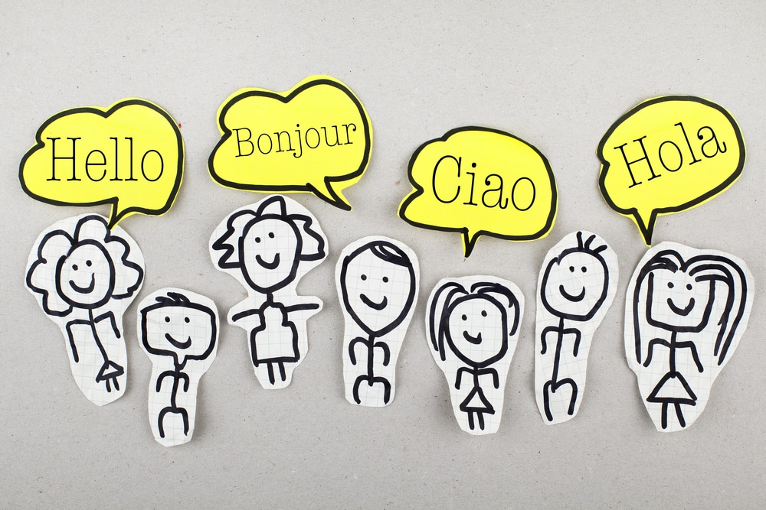
Introductions
Name
Pronouns
Year @ CSUEB
Major
Ice Breaker: What is your favorite Spring activity?

Slide 6
Intentions for today’s Group:
Review content from last week
Identify some of the differences between healthy, unhealthy vs. abusive relationships
Activity
Explore our values

Slide 7
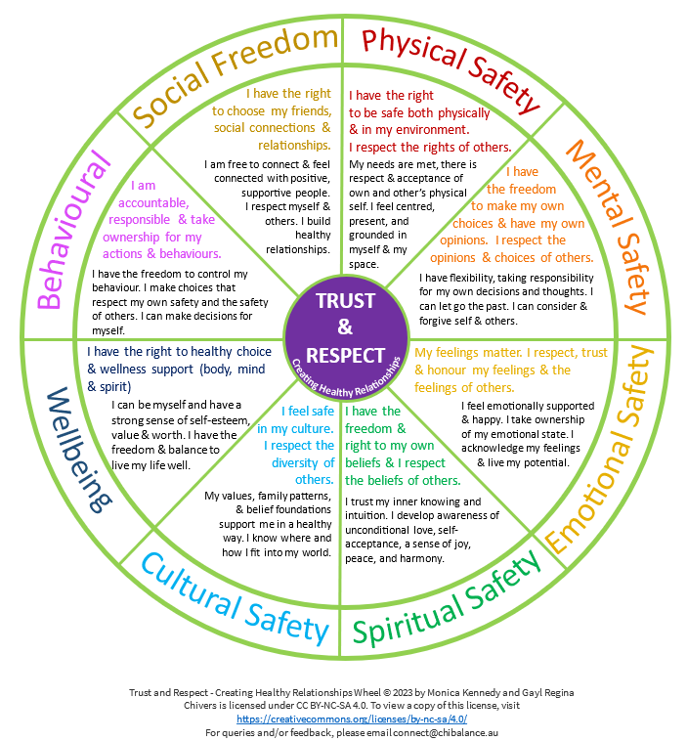

Slide 8
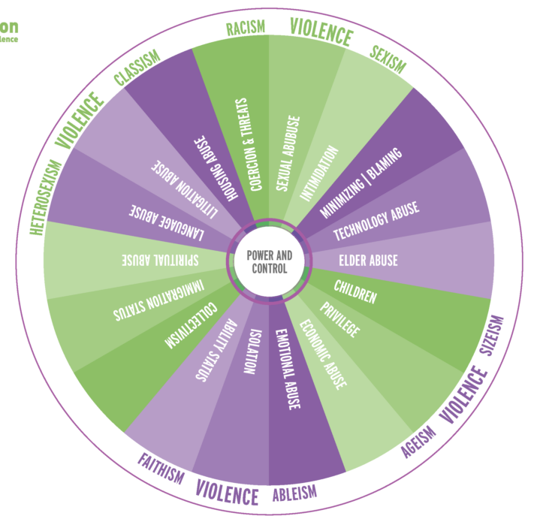

Slide 9
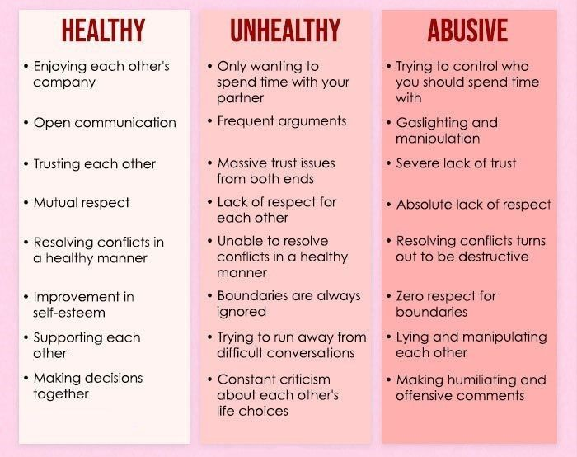

Slide 10

ACTIVITY: Identifying healthy vs. unhealthy dynamics in one your own relationships

Slide 11
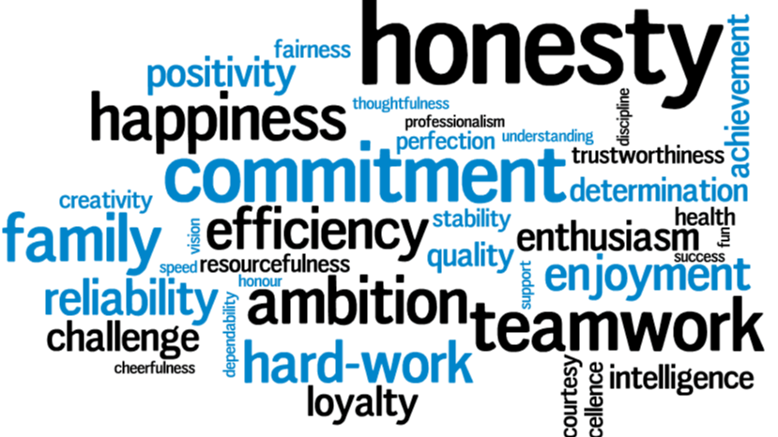
Identifying Our Values
Values are the things in life that you find most important. They define our actions and who we are. It’s important to identify our values so we can be true to ourselves.

Slide 12
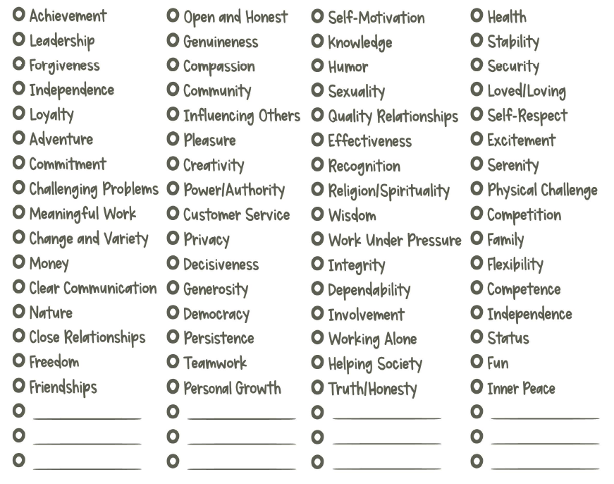
Review this list and identify which values are most important to you.

Slide 13

Values Discussion
What are your top six values?
How do your values impact your relationships?
How important is it to have shared values with your friends/partners/family members?

Slide 14

Take Care and Stay Safe!
Thank you for joining us today!
Check-Out Reflection:
  What is one thing you are taking from the group this week?
Please use the same link to return next week

Slide 15


