Slide 1


Presented by Student Health & Counseling Services
Naya Gordon, LCSW and Kathryn Kirkpatrick, LCSW

Slide 2


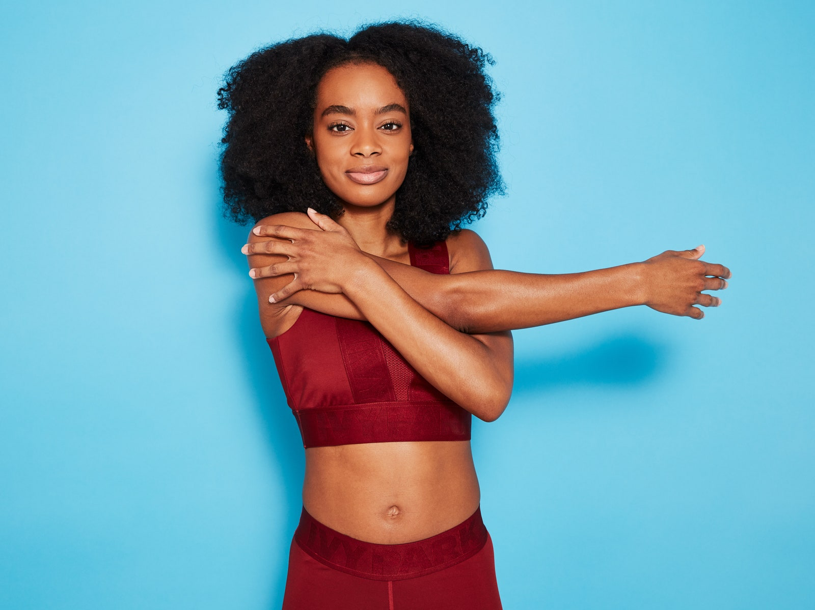
Let’s Stretch . . .

Slide 3
A Few Group Guidelines
Please mute your audio and type any questions into the chat box
Your video can be off or on, whatever makes you most comfortable
Chat Naya or Kathryn privately for specific needs

Slide 4
Group Agreements Group Values
Confidentiality
Judgement Free Zone
Respect each other
Listen to one another
Participate
Ask clarifying questions/no assumptions
Ask permission before giving advice
Acknowledge what we are bringing into the space
Trigger Warning (Let Folx Know)
· ·
·
Compassion
Empathy
Being open minded
Clear Communication
Uplifting one another
Be your own Boo/Take Care of Your Needs (Restroom, drinks, snacks, etc.) and communicate your needs.

Slide 5
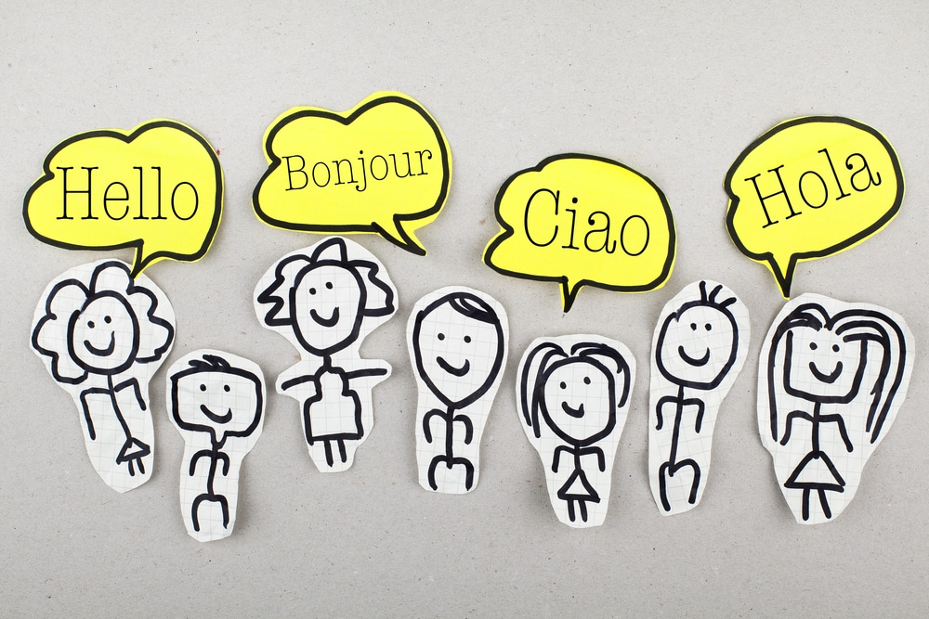
Introductions
Name
Pronouns
Year @ CSUEB
Major
Ice Breaker: What is your go to comfort food?

Slide 6
Intentions for today’s Group:
Why is our relationship with self important?
Key elements to building a healthier relationship with self
Self-Love Reflection

Slide 7
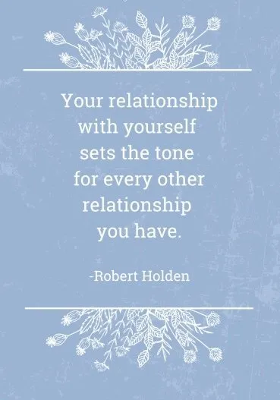

Slide 8

Healthy Relationship with Self
A healthy relationship with yourself means understanding, accepting, and caring for your emotional, mental, and physical well-being.
Why It’s Important:
  Lays the foundation for all other relationships (romantic, familial, social, professional).
  Enhances self-esteem, confidence, and overall happiness.
  Promotes emotional resilience and better decision-making.

Slide 9
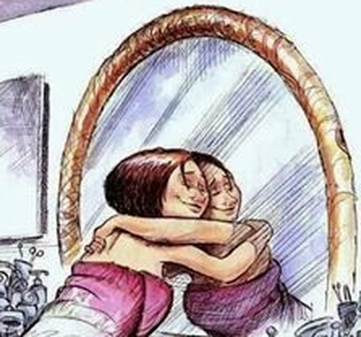
Self-Awareness
  Understanding your thoughts, emotions, and behaviors.
  Recognizing your strengths and areas for growth.
Self-Acceptance
  Embracing your authentic self, including imperfections.
  Being kind to yourself, even in times of failure.
Self-Care
  Prioritizing your physical, emotional, and mental needs.
  Regularly engaging in activities that nurture your well-being (exercise, hobbies, relaxation).
Self-Respect
  Valuing yourself and making decisions that align with your values.
  Cultivating a mindset of self-compassion.
Key Elements of a Healthy Relationship with Yourself

Slide 10
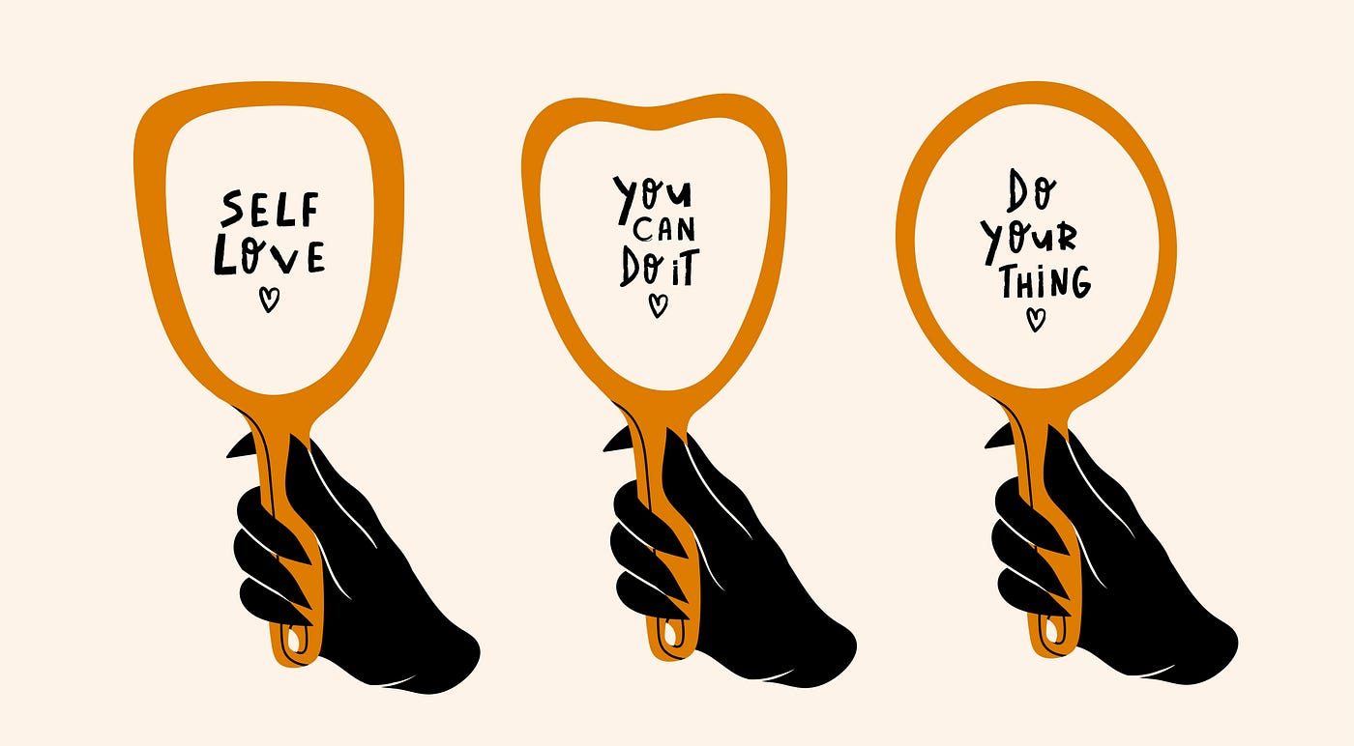
Self Love Reflection
What are three things that I love about myself?
What are three things that I am proud of?
How do I treat myself when I make a mistake? How can I be kinder to myself in these moments?
What self-care rituals make me feel nurtured, and how can I incorporate them into my routine more often?

Slide 11
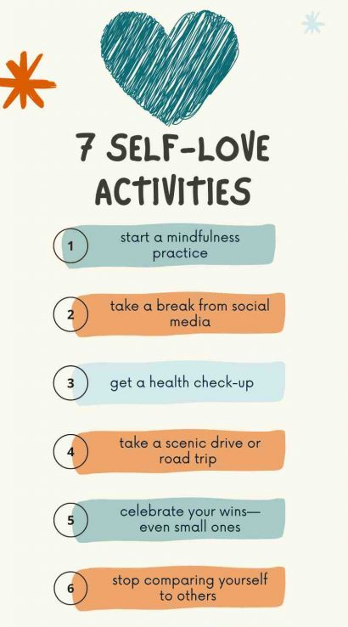
Additional activities to improve relationship with self
Practice Self-Compassion
Journaling
Mindfulness and Meditation
Set Boundaries
Physical Self-Care
Positive Affirmations
Spend Time Alone Doing Things You Enjoy
Forgive Yourself
Explore Your Inner Self
Celebrate Small Wins
Practice Gratitude
Do a Digital Detox

Slide 12

Take Care and Stay Safe!
Thank you for joining us today!
Check-Out Reflection:
  What is one thing you are taking from the group this week?
Please use the same link to return next week

Slide 13


