Slide 1


Presented by Student Health & Counseling Services
Naya Gordon, LCSW and Kathryn Kirkpatrick, LCSW

Slide 2



Let’s Stretch . . .

Slide 3
A Few Group Guidelines
Please mute your audio and type any questions into the chat box
Your video can be off or on, whatever makes you most comfortable
Chat Naya or Kathryn privately for specific needs

Slide 4
Group Agreements Group Values
Confidentiality
Judgement Free Zone
Respect each other
Listen to one another
Participate
Ask clarifying questions/no assumptions
Ask permission before giving advice
Acknowledge what we are bringing into the space
Trigger Warning (Let Folx Know)
· ·
·
Compassion
Empathy
Being open minded
Clear Communication
Uplifting one another
Be your own Boo/Take Care of Your Needs (Restroom, drinks, snacks, etc.) and communicate your needs.

Slide 5

Introductions
Name
Pronouns
Year @ CSUEB
Major
Ice Breaker: What piece of advice would you give your younger self?

Slide 6
Intentions for today’s Group:
Definition of Boundaries
Healthy Vs. Unhealthy boundaries
What boundaries are important in your relationships?

Slide 7

Let’s Talk about Boundaries
Notes:
Let’s talk about boundaries. How do you define boundaries/what comes to mind when we say ‘boundaries’? Why are Boundaries important? Why do boundaries matter?

Slide 8

What Are Boundaries?
Boundaries are the limits and rules we set for ourselves to protect our physical, emotional, and mental health.
Defining boundaries is a process of determining what behaviors you will accept from others and what you will not.
Why Boundaries Matter
They help you maintain your self-worth and protect your energy.
They prevent burnout, stress, and resentment.
They foster healthy communication with others.
Notes:
(Reflecting on what group members say; Reading the slide/have the group members read the slide.) We have defined boundaries and identified why boundaries matter, let’s explore what types of boundaries there are. What types of boundaries can you identify?

Slide 9
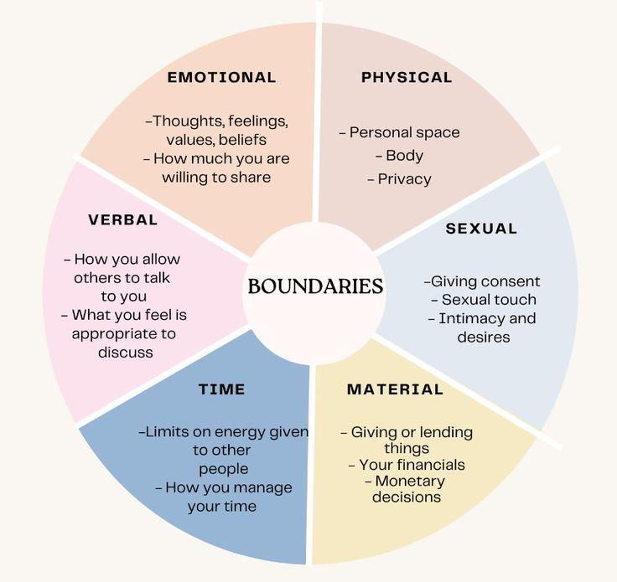
Types of Boundaries
Boundaries include:
Physical boundaries
Emotional boundaries
Sexual boundaries
Digital boundaries
Intellectual boundaries
Financial boundaries
Time/Energy boundaries
Spiritual boundaries
Notes:
Health Boundaries requires self awareness. Clear expectations of ourselves and others. What we are and are not comfortable with. Communication and assertivness.

Slide 10
How to Set Healthy Boundaries
Know Your Limits
Reflect on what feels right and what doesn’t. Recognize when you’re feeling overwhelmed or uncomfortable.
Be Clear and Assertive
Communicate your boundaries clearly and confidently, without guilt or apology.
Example: “I need time to recharge after work, so I can’t commit to anything tonight.”
Respect Others' Boundaries
Just as you set your own, be mindful of and respect other people's boundaries.
Practice Self-Care
Taking time to nurture your physical, emotional, and mental health ensures you’re better able to set and maintain boundaries.

Slide 11
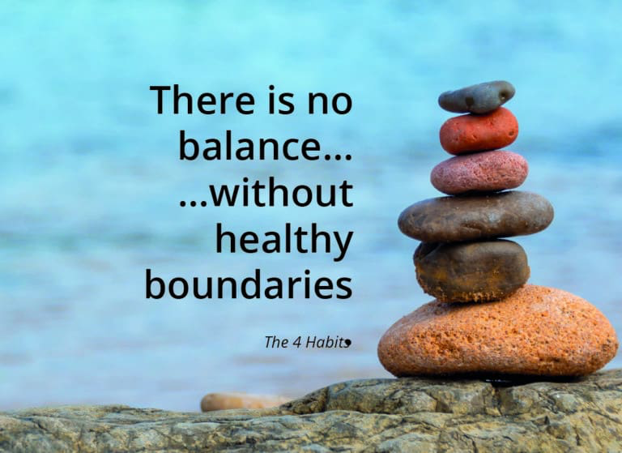
What are signs of healthy boundaries?
Appropriate trust
Revealing a little of yourself at a time, checking to see how the other person responds
Moving step by step into intimacy
Deciding whether a potential relationship will be good for you
Staying focused on your own growth and needs
Weighing the consequence before acting on sexual impulse
Being sexual for yourself, not for partner
Maintaining personal values despite what others want
Noticing when someone else displays inappropriate boundaries
Noticing when someone invades your boundaries
Saying “no” to food, gifts, touch, or sex you don’t want
Asking a person before touching them
Respect for others—not taking advantage of someone’s generosity
Not allowing someone to take advantage of your generosity
Self-respect—not giving too much in hopes that someone will like you
Trusting your own decisions
Knowing who you are and what you want
Recognizing that friends and partners are not mind readers
Clearly communicating your wants and needs (and recognizing that you may be turned down, but you can ask)

Slide 12

What are signs of unhealthy boundaries?
Not trusting anyone
Trusting everyone
No filter for what you share with others
Falling in love with a new acquaintance
Letting your feelings for another person preoccupy you; letting go of everything else
Acting on the first sexual impulse
Being sexual for your partner, not yourself
Going against your personal values or rights
Not noticing when someone invades your boundaries
Accepting food, gifts, touch, or sex that you don’t want
Allowing someone to take as much as they can from you
Invading someone else’s boundaries - not taking “no” for an answer
Touching a person without asking
Believing others can anticipate your needs
Expecting others to fill your needs automatically
Falling apart so someone will take care of you
Taking responsibility for someone else’s problems

Slide 13
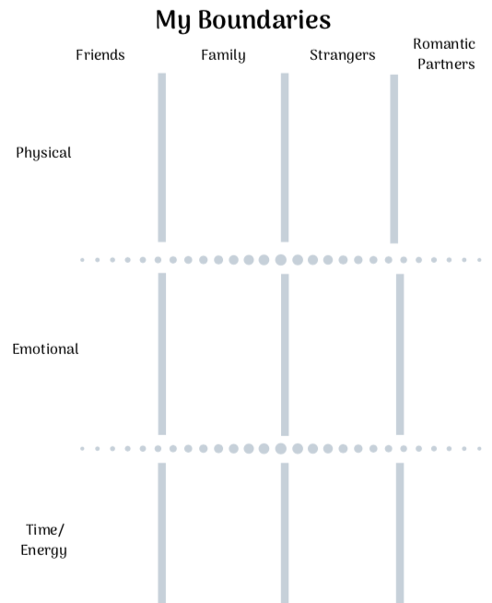
What boundaries are important to you?

Slide 14

Take Care and Stay Safe!
Thank you for joining us today!
Check-Out Reflection:
What is one thing you are taking from the group this week?
Please use the same link to return next week

Slide 15


