Slide 1
Cross-Language Treatment Generalization Systematic Literature Review
Alexandria Tollast
Dr. Eve Higby and Dr. Michelle Gravier
CSUEB Student Research Showcase

Slide 2
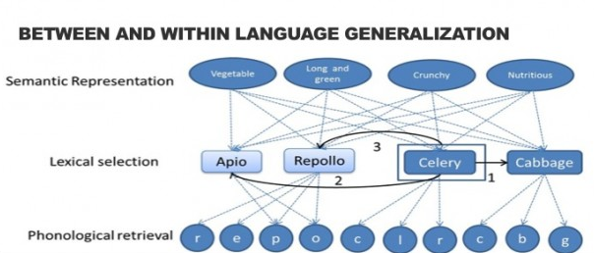
Systematic Literature Review for Cross-Language Treatment Generalization for Individuals with Aphasia
Aphasia: Loss of ability to understand or express language due to brain injury (stroke)
Cross-Language Treatment Generalization (CLTG): Treatment in one language facilitates gains in a non-treated language
Research Question: What factors lead to greater CLTG?
Notes:
Understand or express language
What factors lead to greater CLTG?

Slide 3
Method for Systematic Literature Review
Six databases were used to identify articles meeting the following inclusionary criteria:
Participants included adult bilinguals with aphasia
Study involved treatment/language intervention
Testing was completed in both or all languages
Initial search yielded 4179 articles with an additional 26 records identified through other sources.
After each article was screened for the inclusionary criteria, a total of 59 articles were included in the systematic literature review with a total of 78 participants.
Notes:
Include the PRISMA flow diagram? https://learning.edanz.com/prisma-flow-diagram/

Slide 4
Factors potentially influencing CLTG
Age of second language acquisition
Manner of second language acquisition
Premorbid proficiency
Language of the environment
Type of aphasia
Severity of aphasia
Time since onset of aphasia
Type of treatment
Word characteristics

Slide 5
Analyses
Preliminary Results
How does severity of aphasia affect CLTG?
Participants with mild-moderate or moderate severity of aphasia were more likely to show CLTG compared to those with mild or severe aphasia.
Identify patterns of CLTG for each factor (e.g., CLTG present, absent, or mixed).
This will provide more clarity and better treatment.
Notes:
Results (to date)

Slide 6
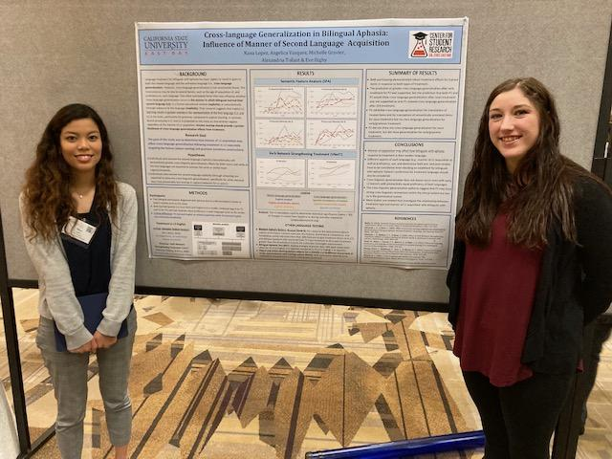
Multilingualism Lab
Knowledge and experience with aphasia
Bilingualism
How bilingualism affects treatment for individuals with aphasia
Supportive mentorship
Better understanding for the field
California Speech language Hearing Association (CSHA) March 2023

Slide 7

Acknowledgments
Dr. Higby
Dr. Gravier
Renad Al-Souqi
Angelica Vasquez
Kana Lopez
Jiana Brandt

Slide 8

Questions?

