Slide 1

Thinking, Reading, and Writing with AI
Preparation for Project 2

Slide 2
Logging on to your CSU ChatGPT Account
Feb 4, 2025, 12:58 PM
“I am delighted to share with you that this week, at the CSU Board of Trustees meeting, the Office of the Chancellor announced a first-of-its kind public-private initiative to establish the CSU as the nation’s first and largest AI-powered public university system to serve its entire community. This initiative will make learning, research, professional development and teaching tools—including ChatGPT—available to all students, faculty and staff across all 23 CSU universities.” - Warmly Mildred García Chancellor
https://chatgpt.com/auth/login

Slide 3

Human-Centered Reading Activity
Let’s read a discussion-board post written by one of my students during the Spring 2025 semester. This post is shared with permission and comes from a discussion activity where I asked students to develop and explain one or two guidelines for using AI in our class.
As you read the post, think about the student’s
Topic, message, and purpose
Audience
Tone
Anything else that strikes you

Slide 4

Student Discussion Board Post
I don’t think we should trust AI and Chat GPT. AI is like my friend who is smart but who also makes a lot of things up and who doesn’t like to admit when he’s wrong. It doesn’t mean I don’t speak with him or haven’t learned anything from him, but it does mean I double check what he says before I pass it along. I think students need to treat AI like that type of person. Maybe you go to it for help and suggestions, but then you always triple check that what it says is accurate. I also want to mention that unfortunately, I don’t think some students feel like they need to check AI for accuracy. Instead, they just accept whatever it tells them. For example, I had a group project in another class where one of my classmates obviously used AI to write his section. I was so frustrated and mad and told him that if I can tell this is AI, don’t you think the professor is going to be able to? It makes me nervous having to work with people who really don’t understand AI and just casually use it without any quality control. Overall, this is why I think one of our class guidelines should be not to trust AI and to always check it for accuracy.

Slide 5

Let’s Discuss
What did you notice about the student’s post?
What was the topic, the message, the purpose?
How did she support her point?
Who was her audience?
How would you describe her tone?

Slide 6

Human vs. AI Summary
Now, let’s each practice writing a 1-2 sentence summary of the post in our own words for a student who missed today’s lesson.
Then, ask ChatGPT to complete the same task. (i.e. Practice writing a 1-2 sentence summary of the post in its own words for a student who missed today’s lesson.)

Slide 7

Think. Pair. Share.
With a partner, compare your summary and ChatGPT’s. Consider the following questions:
How are the summaries similar and different? Do you prefer one over the other? Why?
What did ChatGPT get right?
What might it have missed?
To you, is ChatGPT’s summary clearly AI generated? Explain.
If we had not had the student’s permission to use their discussion-board post, would you have felt comfortable sharing it with Chat GPT? Why or why not?
Did you feel differently reading the student’s post compared to reading the AI summary of it?

Slide 8
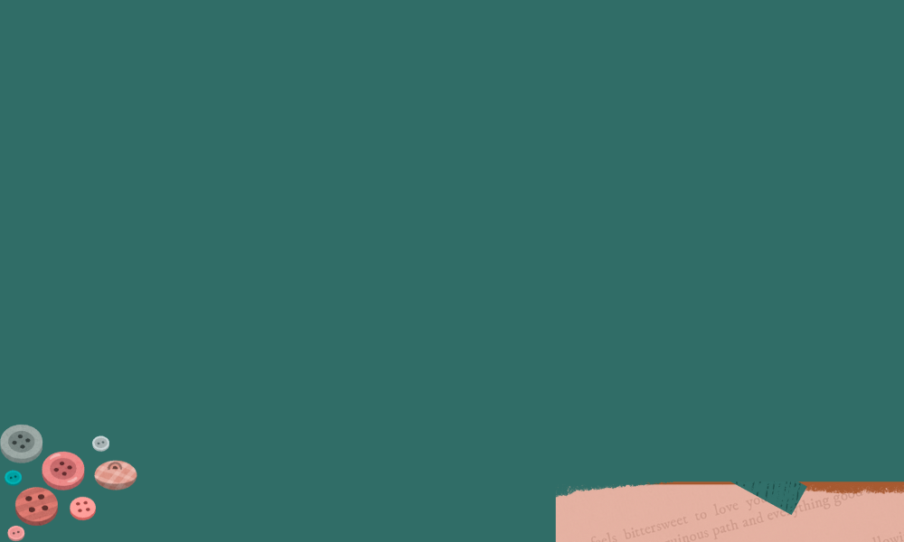
ChatGPT Play Time
Choose 2 to 3 specific things to ask ChatGPT to summarize. Try to choose specific texts/places such as:
A favorite episode of a show (not the whole series)
Your neighborhood
A specific Twitch stream or YouTube video
The interior or vibe of your favorite local restaurant

Slide 9


Make sure that any summary that you complete for our class also has a visual representation of the summary. The image should always have the CSUEB logo on it.
Finally, see how it does summarizing my slides.
Notes:
Show how to download as PDF

Slide 10

Wrap-Up Reflection
What takeaways do you have from this lesson? What is it making you think about?
When is using ChatGPT helpful for summarizing? When is it not helpful or even risky?
What does this mean for how you might (or might not) use AI in our classroom?

